Slide 1

School of Electronics and
Communication Engineering
MINI PROJECT REVIEW 4
Title: Advanced Pothole Detection and Mitigation
Team No: 01
Course: Mini Project
Course Code: 23EECW301
Semester: V
Faculty Mentor: Prof. Ujwala Patil
Sl.No. | Roll No. | Div | SRN | Name
1 | 256 | B | 01FE22BEC087 | Shashank Padavalkar
2 | 306 | C | 01FE22BEC104 | Anirudh Navalgund
3 | 304 | C | 01FE22BEC102 | E Sujaya
4 | 129 | F | 01FE22BEI035 | Royston Vedamuthu

Slide 2
School of Electronics and
Communication Engineering
IMPLEMENTATION
Real-Time RGB Camera Integration:
Integrated an RGB camera for real-time pothole detection.
The system processes camera feed to detect potholes on the road surface.
Based on the pothole's location, the system provides directional instructions:
“Keep Right" if the pothole is on the left side.
“Keep Left" if the pothole is on the right side.
"Pothole in Center" if the pothole is in the center of the road.
Real-Time Processing:
The system continuously processes camera data to provide real-time feedback to the driver.
Algorithms identify the potholes and track their locations dynamically.

Slide 3
School of Electronics and
Communication Engineering
IMPLEMENTATION
RGB Camera:
YOLOv8n model used to detect potholes and provide location-based feedback (left, right, center).
Bounding boxes are drawn over potholes on the camera feed for visual indication.
2D LiDAR:
Real-world calibration and testing completed to detect pothole contours and provide precise distance data.
Measurements validated under controlled conditions.
Integration:
Sensor fusion of RGB camera and LiDAR is done to combine visual and distance data for improved detection.
Feedback system implemented through:
Audio Alerts: Announce pothole locations.
Visual Feedback: On-screen pothole indicators with bounding boxes.
Prototype Details:
System implemented on a personal laptop using tools like VS Code and RoboStudio for testing and development.

Slide 4
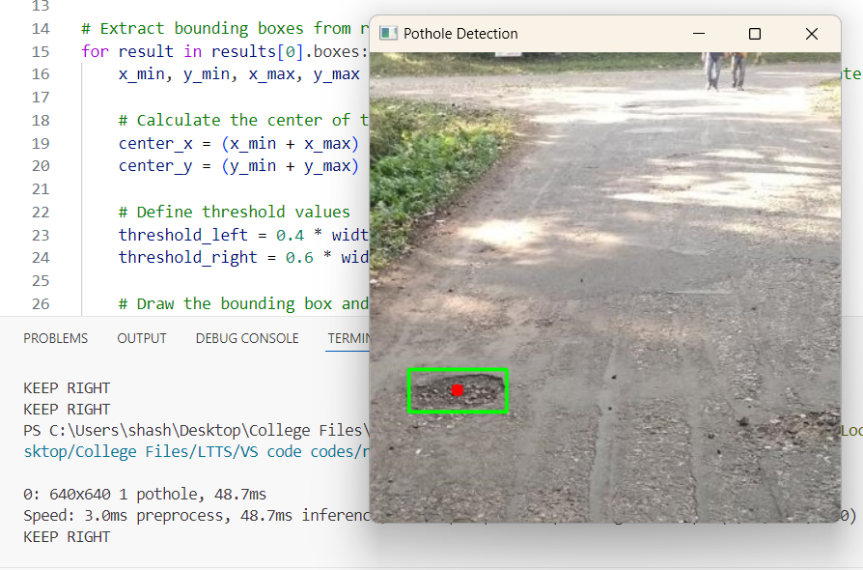
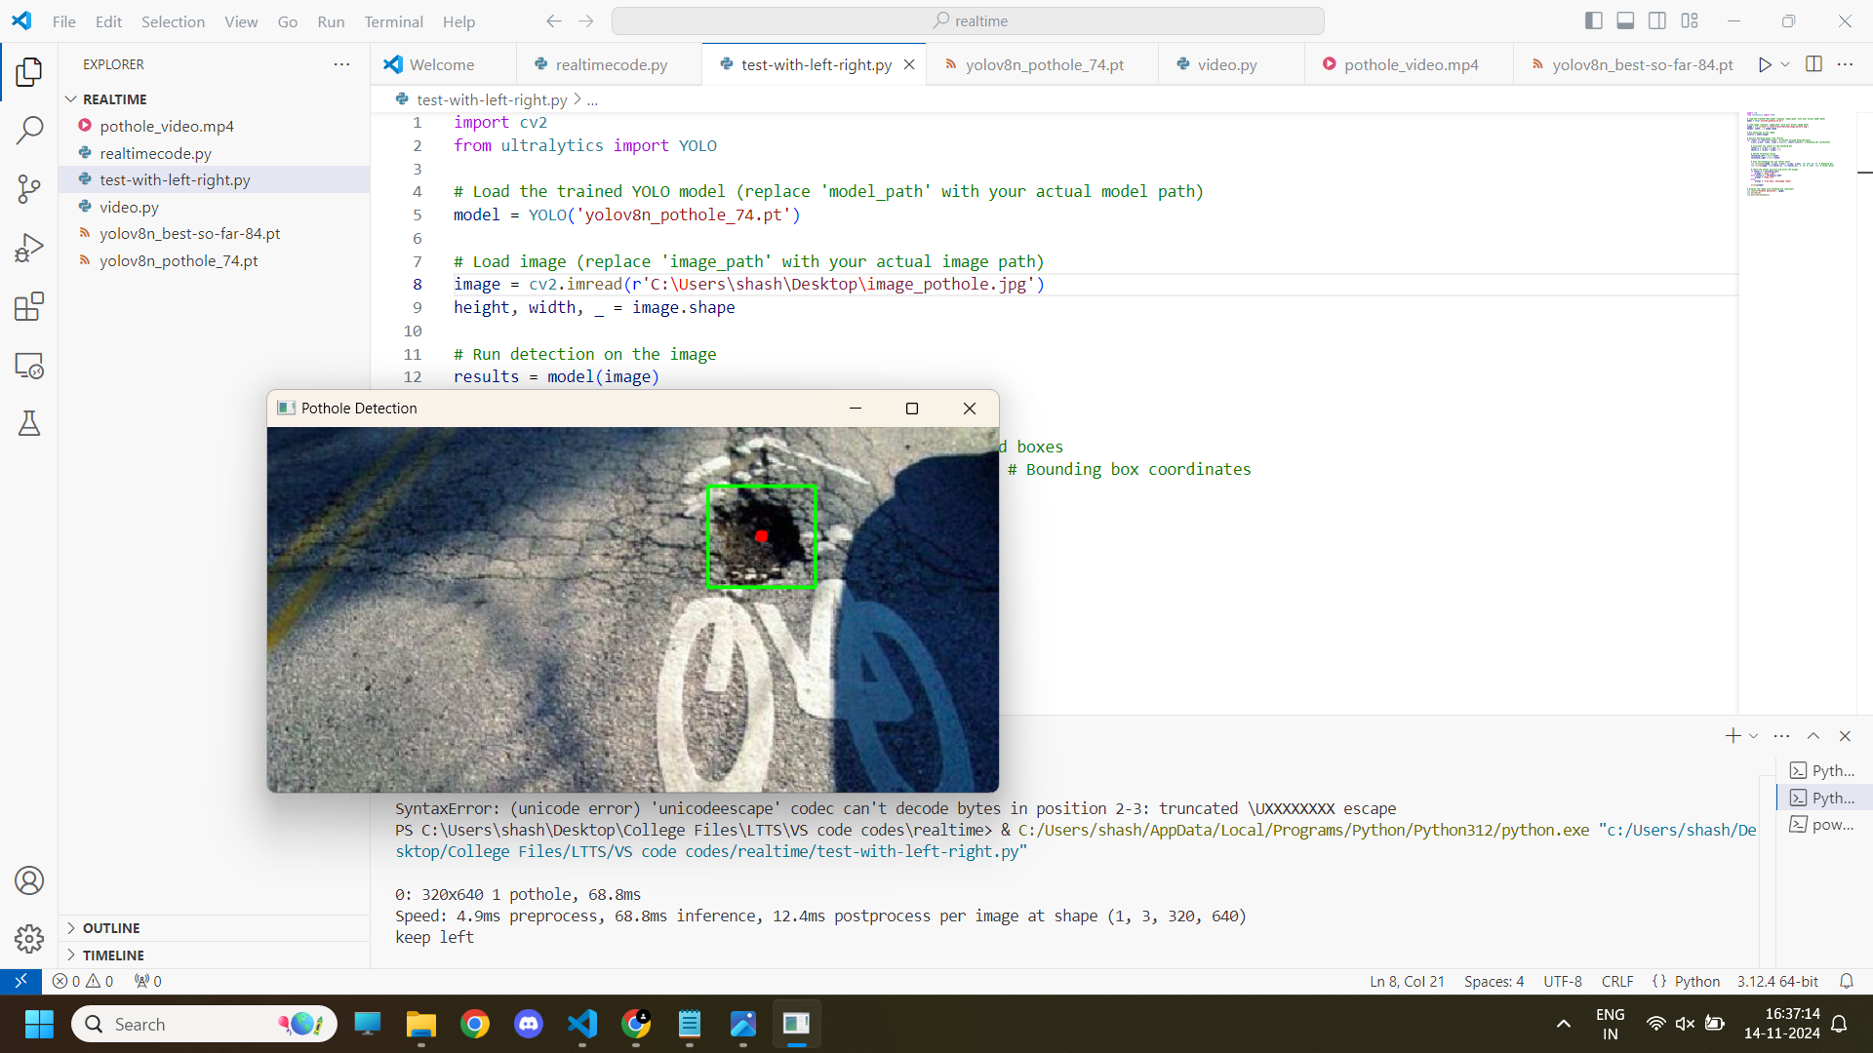
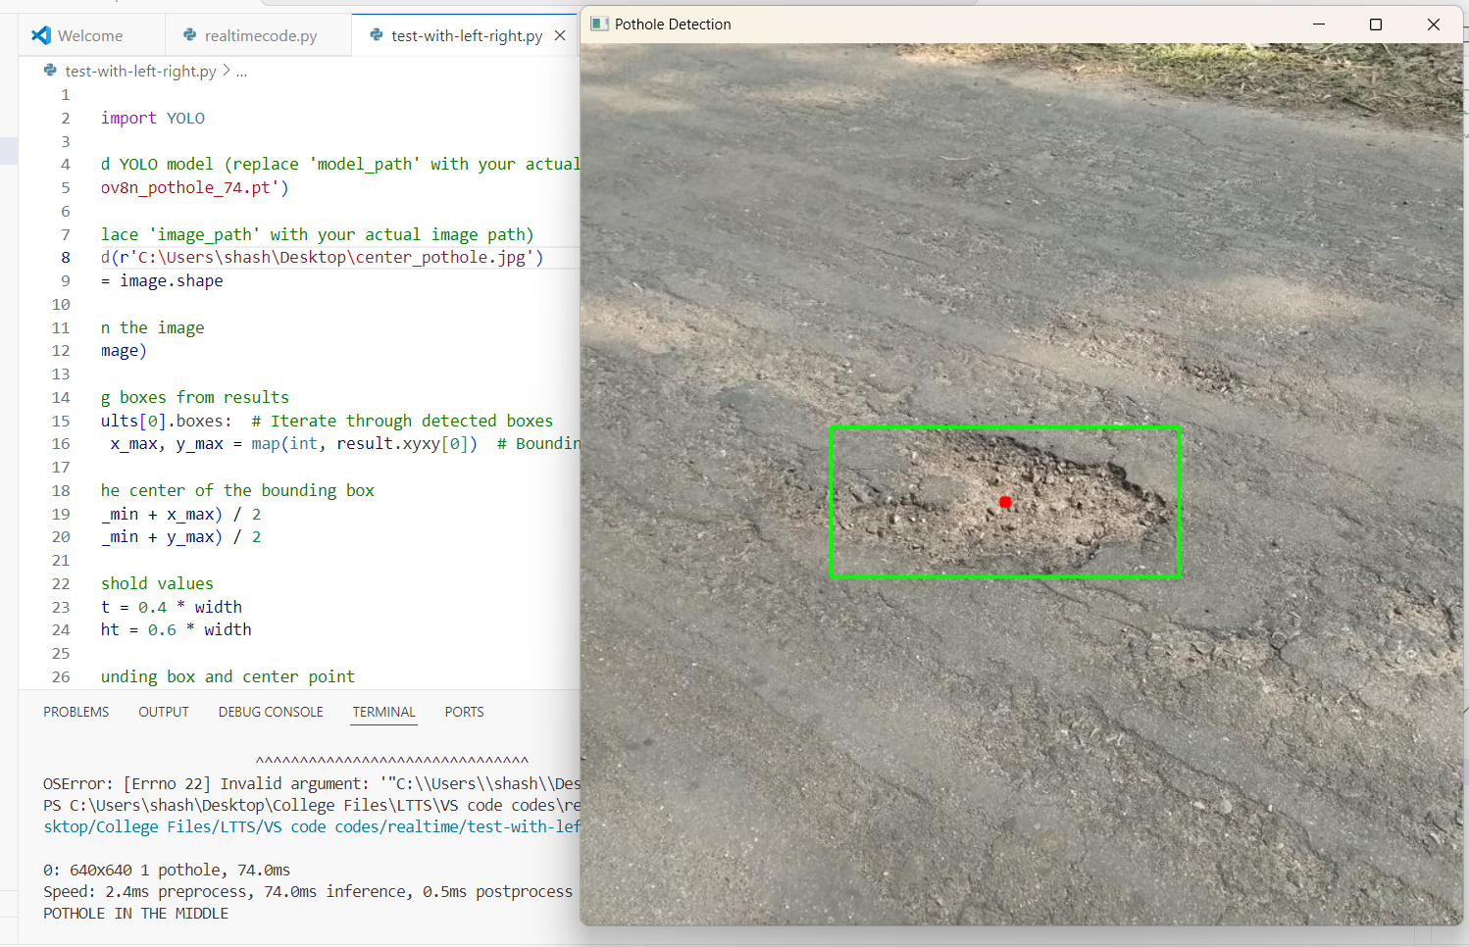
School of Electronics and
Communication Engineering
DEMONSTRATION
(RGB CAMERA)
POTHOLE POSITION: MIDDLE
INSTRUCTION: “SLOW DOWN”
POTHOLE POSITION: LEFT
INSTRUCTION: “KEEP RIGHT”
POTHOLE POSITION: RIGHT
INSTRUCTION: “KEEP LEFT”

Slide 5
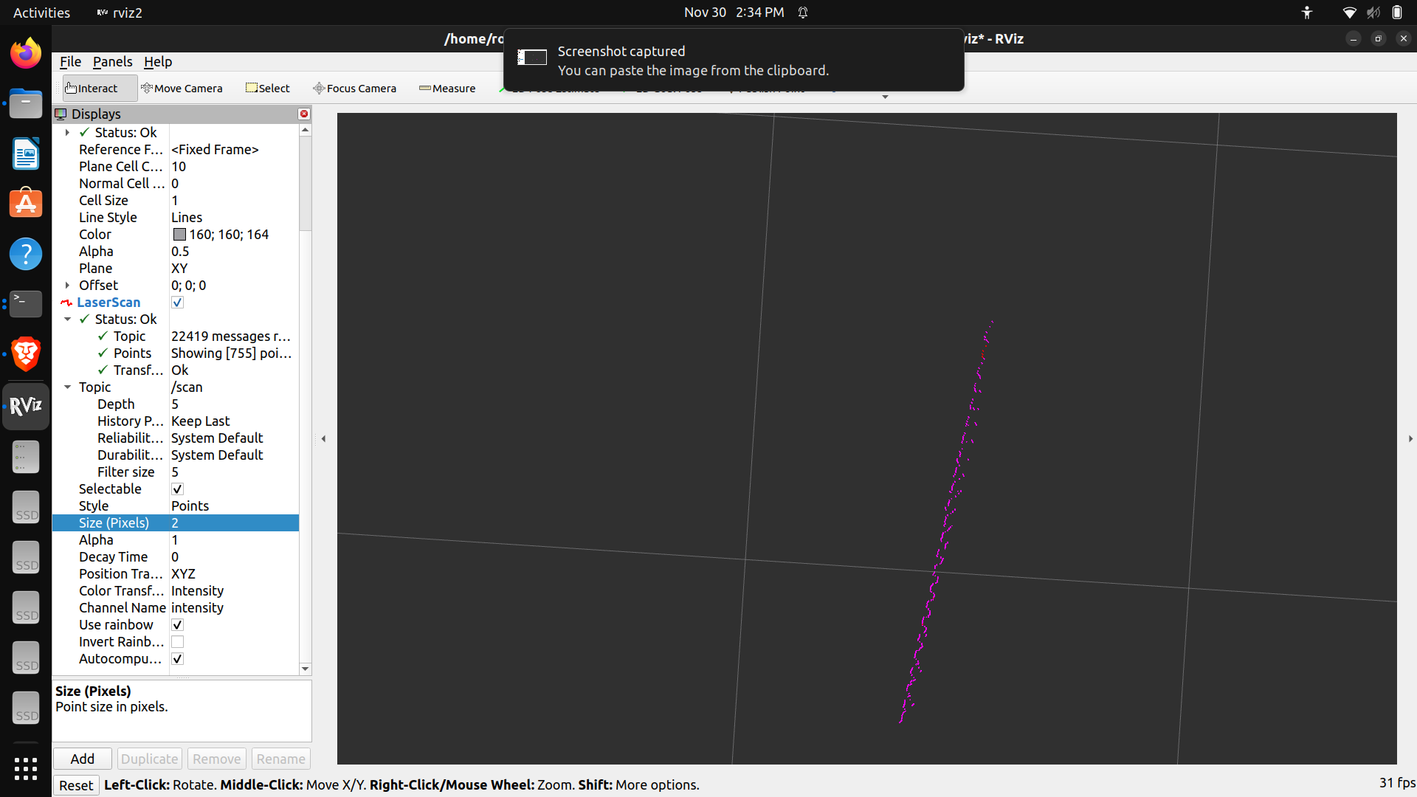
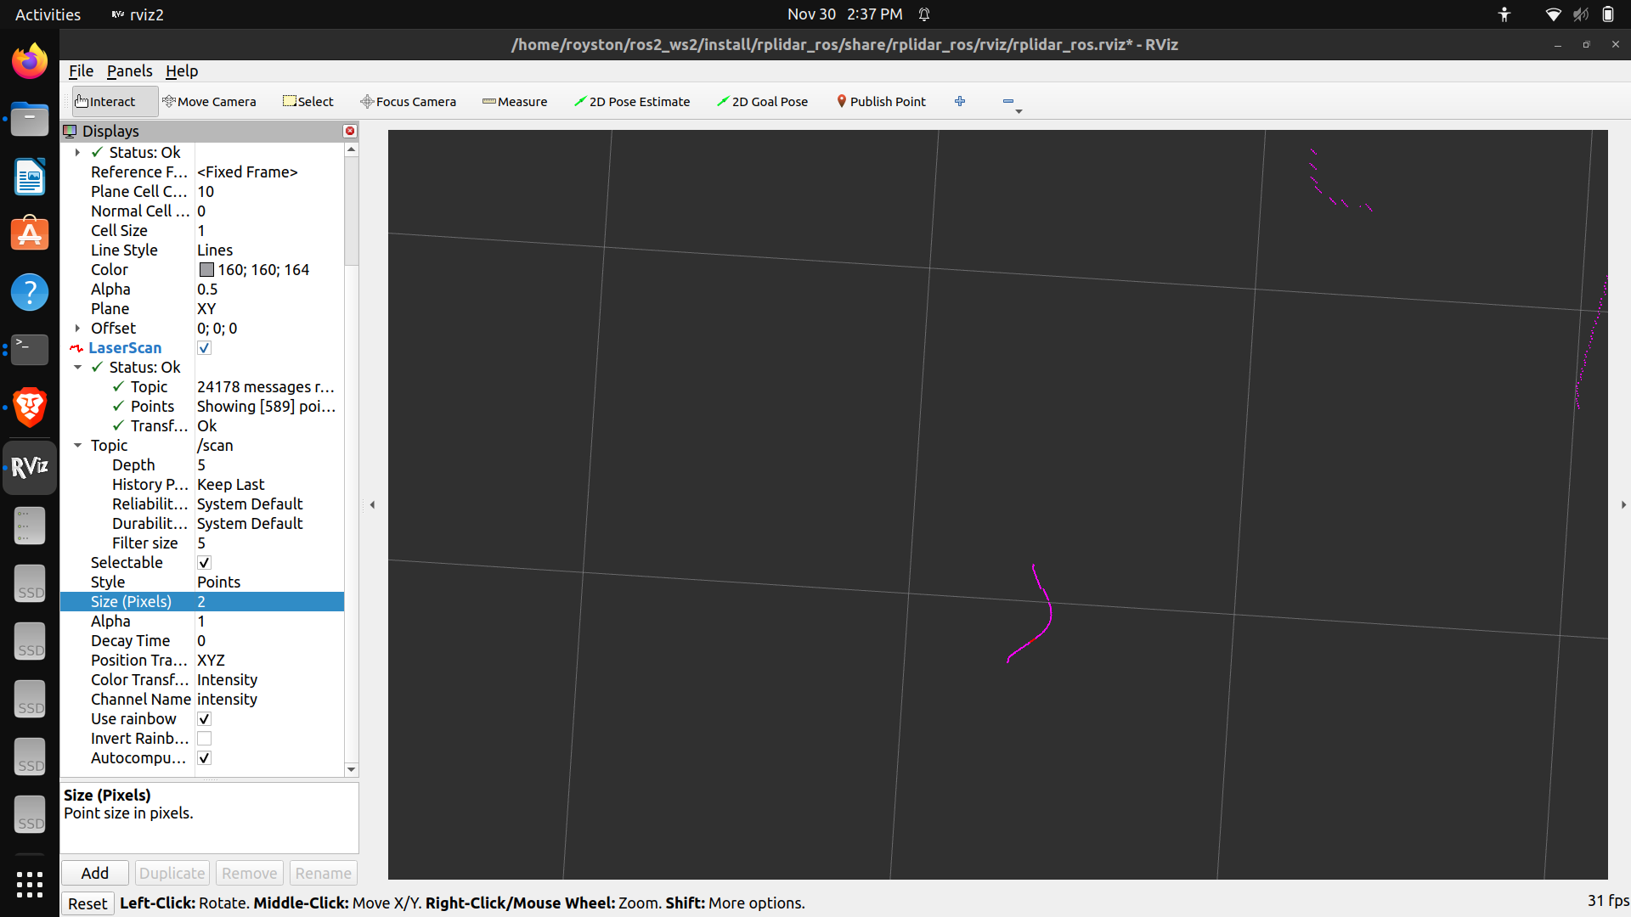
School of Electronics and
Communication Engineering
DEMONSTRATION (In General)
2D LIDAR
DETECTION OF A TEXTURED WALL
DETECTION OF A CURVED SURFACE

Slide 6
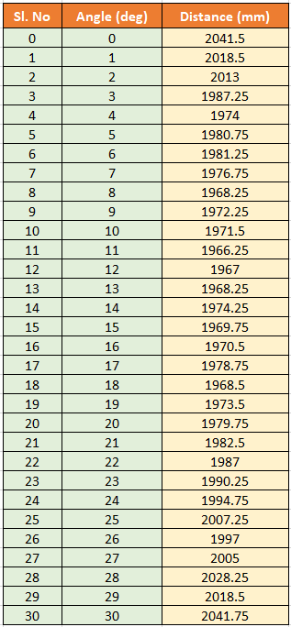
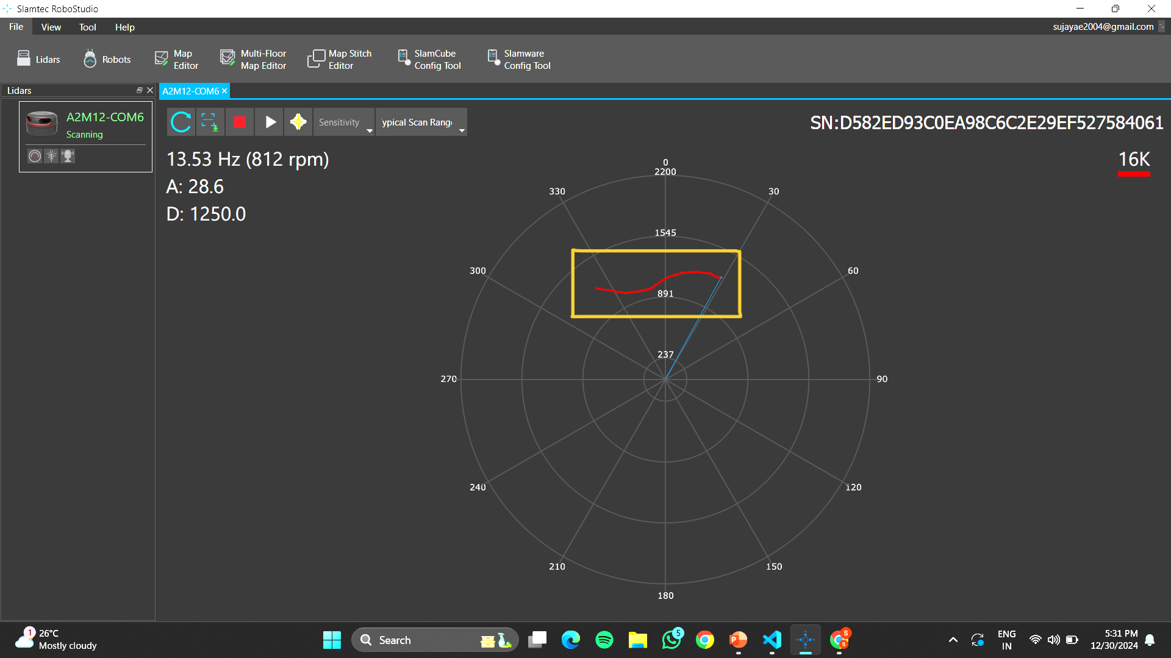
School of Electronics and
Communication Engineering
DEMONSTRATION (With Pothole)
Calibrated Angle & Distance Data
2D LIDAR
Visualization of Contour Formed

Slide 7
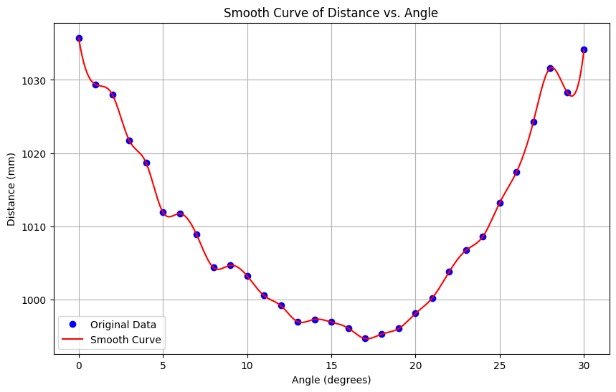
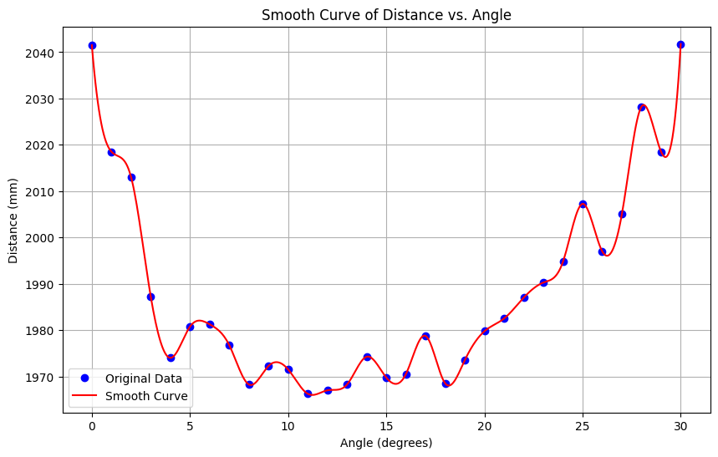
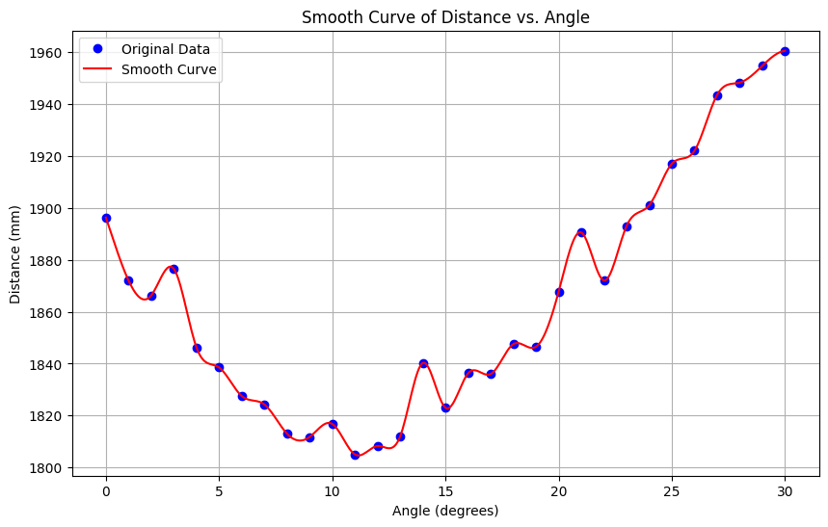
School of Electronics and
Communication Engineering
Distance Variations on Smooth Surface
Distance Variations in Pothole

Slide 8
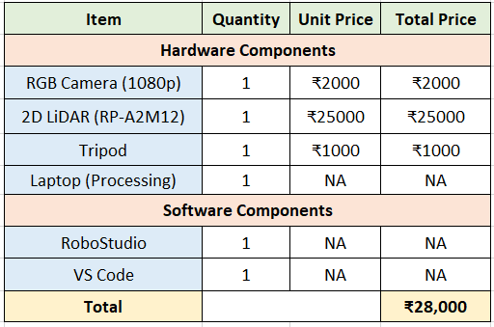
School of Electronics and
Communication Engineering
BUDGET OF THE PROJECT

Slide 9
School of Electronics and
Communication Engineering
ANALYSIS:
RGB Camera:
Strengths: Capable of detecting potholes with precise bounding boxes.
Limitations: Performance depends on camera resolution and lighting conditions.
2D LiDAR:
Strengths: Provides accurate distance measurements and enhances detection in low-visibility scenarios.
Limitations: Works better as a complementary system to the camera rather than standalone detection.
Sensor Fusion (Future Work):
Future work involves integrating LiDAR and RGB data for sensor fusion. This approach is expected to reduce false positives and improve overall accuracy by leveraging the strengths of both modalities..
User Feedback System:
Strengths: Audio alerts and on-screen visuals ensure intuitive navigation assistance.
Overall Evaluation:
The system demonstrates reliable performance in controlled environments and is well-suited for its intended use case. Further testing in diverse conditions will refine its robustness.

Slide 10
School of Electronics and
Communication Engineering
THANK YOU

