Slide 1

Unifying Consensus and Atomic Commitment
Sujaya Maiyya, Faisal Nawab (UCSC),
Divy Agrawal, Amr El Abbadi
DSL
UC Santa Barbara
VLDB 2019
Notes:
Our goal is to develop a unifying framework that encapsulates the fundamental protocols in cloud.

Slide 2

Cloud Data Management
Scalability
Consistency
Fault Tolerance & Availability
Notes:
Over the past decade – many if not all applications use cloud as their backend infrastructure. The applications need to be scalable..

Slide 3










Scalability
Consider Amazon’s data
Too many items to store in a single machine
Data can be too large to be stored in a single server
Notes:
The data produced by the applications can be too large

Slide 4

Scalability
Partition data eg. based on category
Data can be too large to be stored in a single server
Shard or Partition the data
Store smaller chunks in each server

Slide 5





Consistency
Superman wants to transfer $100 to Wonderwoman
Transactions read and write data
Data should be updated in a consistent manner
The database must maintain consistency
$m=
$m-$100
$n=
$n+$100
Notes:
All or nothing

Slide 6
Fault-tolerance and Availability
Commodity servers crash frequently
Data should be replicated for fault-tolerance and high availability
I hope my bank balance info is fault tolerant!

Slide 7


Protocols Supporting the Cloud
Scalability and Consistency
Atomic Commit Protocols
E.g., 2 Phase Commit
Fault-tolerance and Availability
Consensus and Replication Protocols
E.g., Paxos

Slide 8

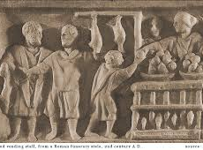
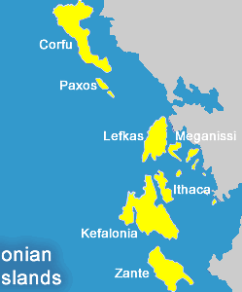
PAXOS

Slide 9
PAXOS: No Failure Case
Each line represents the timeline of a process
Leader Election: Initially, a leader is elected by a majority quorum
Replication: Leader replicates new updates to a majority quorum
Decision: Propagates decision to all asynchronously
Leader
Election
Fault-Tolerant
Agreement
Decision
Leader
Proposer
Asynchronous
Majority

Slide 10
PAXOS: Failure Case
Leader Election: If the leader fails, a new leader is elected
Also, Value Discovery if agreement has been reached
Leader
Election
Fault-Tolerant
Agreement
Decision
Proposer2
Leader2
Majority

Slide 11



Atomic Commitment

Slide 12
Two Phase Commit: No Failure Case
Leader: Initially, a Coordinator is chosen by transaction manager
Value Discovery: Coordinator collects votes from ALL cohorts
Fault-Tolerance: Make Decision persistent on disk
Decision: Send Decision to all cohorts
If all yes, val=Commit, if any (no or failure), val=Abort
Make value Fault-tolerant
Value
Discovery
(Phase 1)
Decision
(Phase 2)
Coordinator
Async
All cohorts
Notes:
When the transaction finishes executing, the coord starts commitment

Slide 13
Three Phase Commit
2PC has possibility of Blocking
Solution: 3 Phase Commit.
Replicate decision to cohorts (similar to Paxos) to avoid site failure blocking
Value
Discovery
(Phase 1)
Fault-Tolerant
Agreement
(Phase 2)
Decision
(Phase 3)
Coordinator
All
Majority
Async
Cohorts

Slide 14
Three Phase Commit: Termination
If leader fails or partitioned → Elect new leader and execute
termination protocol
Leader Election &
Value Discovery
Fault-Tolerant
Agreement
Decision
Leader
Majority
Majority
Cohorts

Slide 15


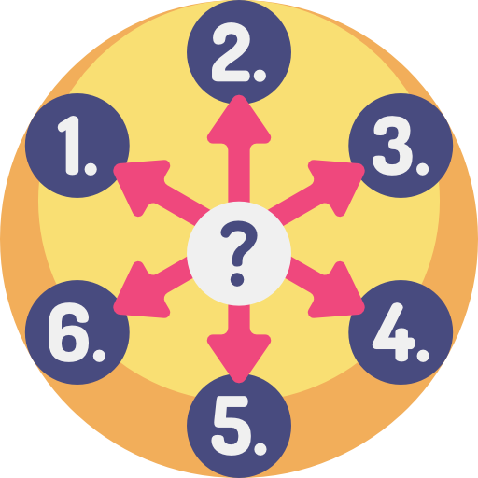
Common phases observed?
Paxos and 2PC/3PC are leader based protocols
Agreement on a single value is the main goal
Both protocols ensure fault tolerance on the decided value
Disseminate the decision, typically asynchronously

Slide 16
A Path for Unification
Notes:
Is there a way to unify this seemingly different paradigms of protocols?

Slide 17
Consensus & Commitment (C&C) Framework
- Consists of four phases
Leader
Election
Value
Discovery
Fault-tolerant
Agreement
Decision

Slide 18
C&C Framework
Two fold benefit:
A pedagogical tool to understand many existing protocols
Three Phase Commit
Leader Election
Value
Discovery
Fault-tolerant
Agreement
Decision
Paxos
Leader Election
Value Discovery
Fault-tolerant
Agreement
Decision
Notes:
It is a useful pedagogical tool.
During failure, we end up doing LE and VD

Slide 19



C&C Framework
Two fold benefit:
Helps understand many existing protocols
Insightful when developing new protocols
A new set of protocols
Paxos Atomic Commit
Sharding only
Replication only
Sharding and
Replication

Slide 20
Paxos Atomic Commit (PAC)
For partitioned and non-replicated data
Any processes can terminate a transaction: leader election
No separate termination case (similar to Paxos)
Fault-tolerance by replicating the value in majority
Leader Election &
Value Discovery
Fault-Tolerant
Agreement
Decision
Leader
All
Majority
Async
Cohorts

Slide 21
2PC/State Machine Replication (SMR)
For sharded and replicated data
Replicate state of each process for persistence
Spanner and Gray and Lamport 2006
Layered architecture: 2PC on top of SMR
2PC among the coordinator and cohorts
Paxos among the replicas
Fault-Tolerant
Persistence
Replicas
Coordinator
Leader
Cohorts
Leader
Fault-Tolerant
Persistence
Replicas
Notes:
Lets observe current way of

Slide 22
2PC/State Machine Replication (SMR)
Layered architecture: 2PC on top of SMR
2PC among leaders of coordinator and cohorts
SMR among shard leader and replicas
Fault-Tolerant
Persistence
Replicas
Majority
Coordinator Leader
Value Discovery
Decision
Cohort
Leader
Majority
Majority
Fault-Tolerant
Persistence
Replicas

Slide 23
2PC/SMR (Google’s Spanner)
Application Access Tier
Transactions Execution Tier
2PC
…
Datacenter A
Datacenter B
Datacenter Z
Replication Layer
PAXOS

Slide 24
Generalized-PAC (G-PAC)
Follows the abstractions of C&C framework
Flattened architecture:
Coordinator → all identical replicas
Reduces one round-trip communication
Related to other consolidating consensus and commitment like TAPIR [Zhang SOSP 2015] and Janus [Mu OSDI 2016]
Restrictive assumptions
Sharding and
Replication

Slide 25
Generalized-PAC (G-PAC)
A majority of replicas from a majority of cohorts
A majority of replicas from ALL cohorts
Coordinator
All
Majority
Async
Cohort 1 Replicas
Cohort 2 Replicas
Cohort 3 Replicas
Leader Election + Value Discovery
Fault-Tolerant
Agreement
Decision

Slide 26
Evaluation Setup
Evaluation on G-PAC against 2PC/SMR Collocated Leaders and Scattered Leaders
All servers hosted on Amazon EC2 across 5 different data centers
Server spec: c4.large machines with 2 vCPUs and 3.75 GiB RAM
Two Phase Locking (2PL) used for concurrency control
Mix of micro and TPC-C benchmarks

Slide 27
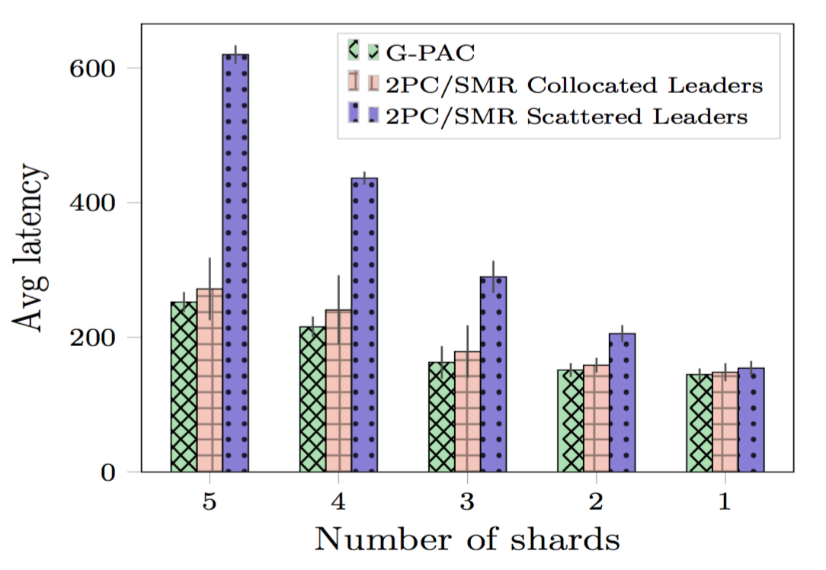
Results
G-PAC has better performance and distributed load
Collocated leaders for 2PC/SMR creates high load on a single datacenter, esp with high number of shards
Notes:
This is a sharded and replicated setting, where each shard is replicated on multiple datacenters.
Micro benchmark

Slide 28
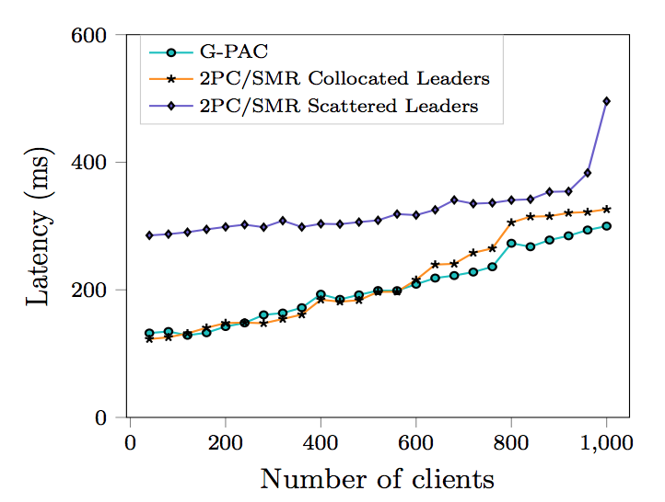
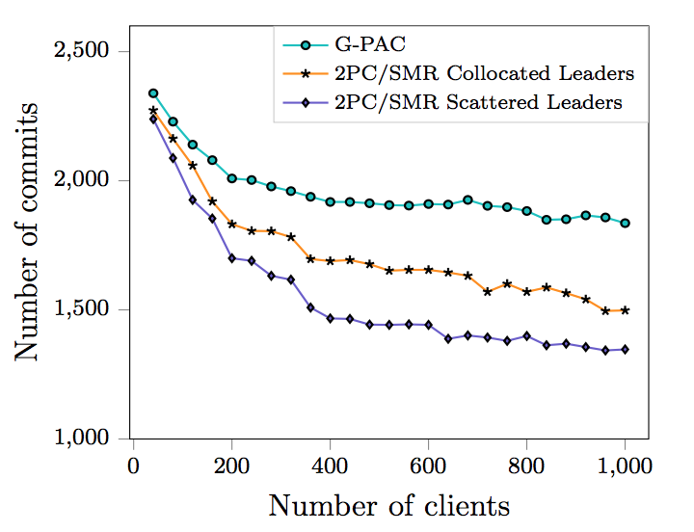
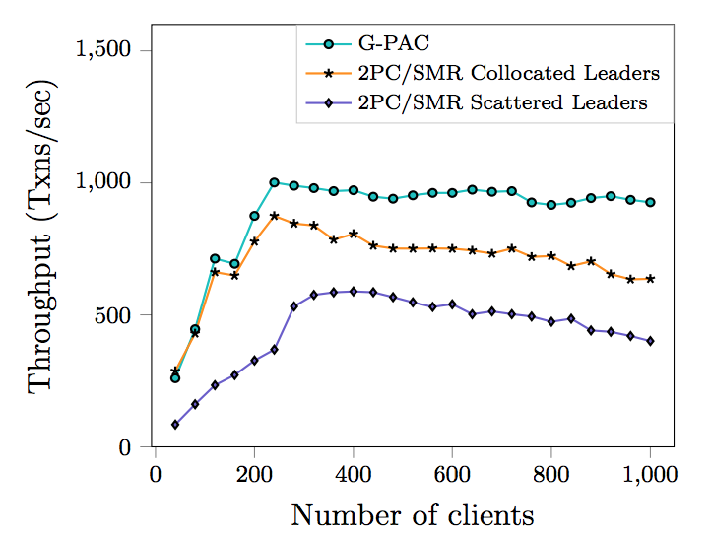
Results
G-PAC has reduced latency, higher number of committed txns, and higher throughout compared to 2PC/SMR
Notes:
TPC-

Slide 29
No. of commits
G-PAC releases lock in 2PL one round-trip lesser than 2PC/SMR, hence committing more transactions

Slide 30
Throughput
Due to increase committed transactions, G-PAC has higher throughput than 2PC/SMR Collocated Leaders.

Slide 31

Thank you!
Questions?
Notes:
Thank you for listening to my talk. I will now take questions

