Slide 1
E-Commerce Sales Data Analytics and Visualization
Framework for Data and Visual Analytics (FDVA) — Mini Project
STUDENT NAME
REGISTER NUMBER
Sujay Kiran NS
241501222
COLLEGE
Rajalakshmi Engineering College
Tools: Python · Pandas · Matplotlib · Power BI · Tableau
Notes:
Introduce the project title, subject and tools used. Replace the bracketed placeholders with your details.

Slide 2
Problem Statement & Objectives
OBJECTIVES
PROBLEM STATEMENT
Raw e-commerce transaction data is difficult to interpret directly. Analytics can reveal useful sales patterns across products, regions, customers and time.
1
Clean and prepare the dataset
2
Perform exploratory data analysis
3
Identify sales trends and patterns
Raw data
Analysis
Insights
Visualize insights using Python, Power BI and Tableau
4
5
Support data-driven business decisions
From records to decisions
Notes:
Explain why raw transaction data needs analysis, then walk through the five objectives.

Slide 3
Dataset & Methodology
≈ 9,800
18
CRISP-DM WORKFLOW
1
Business Understanding
records
original columns
2
Data Understanding
MAIN DIMENSIONS
3
Data Preparation
Category
Region
Segment
4
EDA
Product
Date
5
Visualization
MAIN MEASURE
6
Evaluation
Sales
7
Insights
Notes:
Superstore-style dataset. The only measure available is Sales. Methodology follows CRISP-DM.

Slide 4
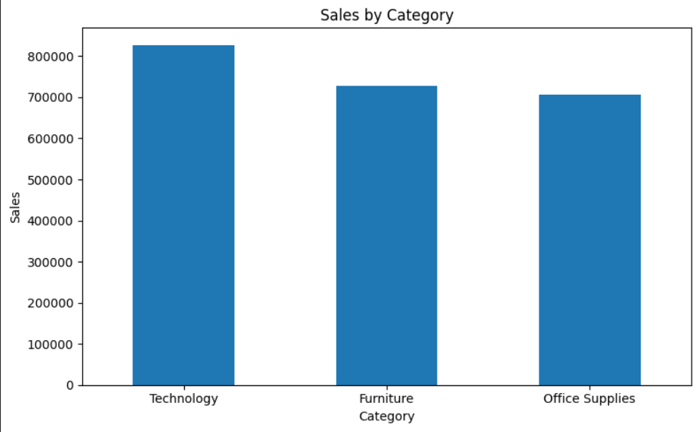
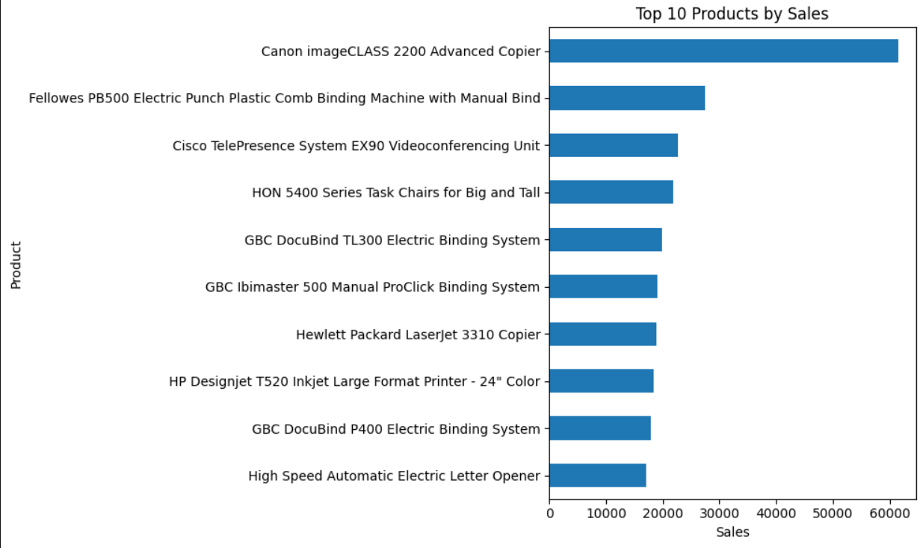
Data Preprocessing & Python EDA
CSV Dataset
Data Inspection
Missing / Duplicate Check
Date Conversion
Feature Creation
Clean Dataset
EDA
DERIVED FIELDS
MATPLOTLIB OUTPUT
Year
Month
Quarter
Shipping_Days
Derived with Pandas
Notes:
Walk through the workflow left to right.

Slide 5
Key Analytical Findings
TOTAL SALES
BEST CATEGORY
BEST REGION
≈ 2.26M
Technology
West
BEST SEGMENT
BEST SALES YEAR
TOP PRODUCT
Consumer
2018
Canon imageCLASS 2200 Advanced Copier
Notes:
Results come from the cleaned dataset analysed in Pandas. Total sales is approximate.

Slide 6
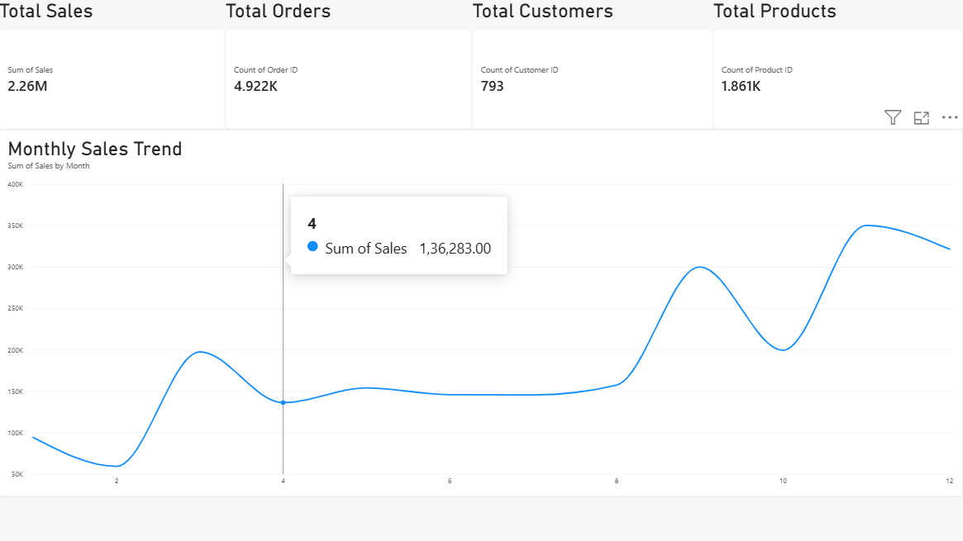
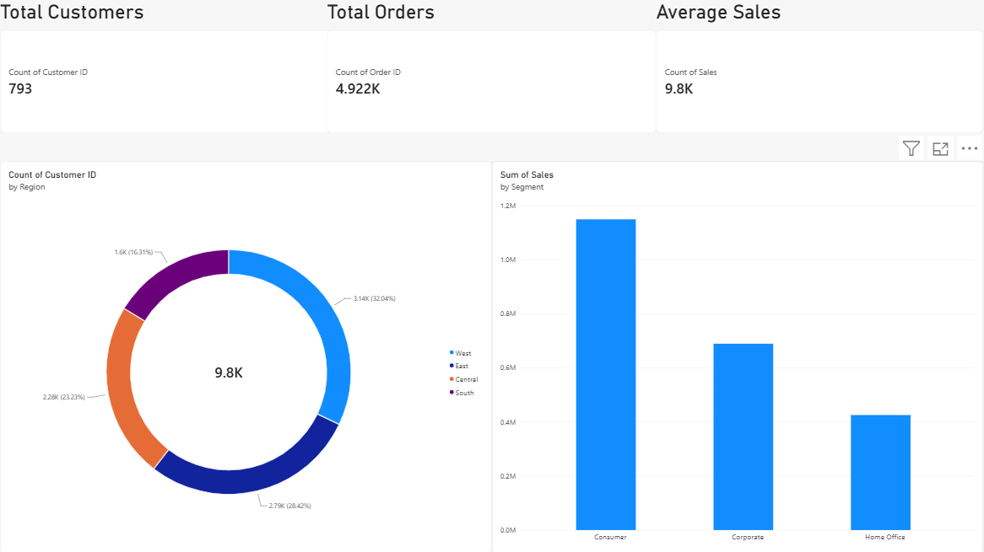
Power BI Dashboard
KPI cards and monthly sales trend
Customers by region and sales by segment
Interactive KPI and sales dashboard with filters, trends and category / region analysis.
Notes:
Two pages of the Power BI dashboard. Demonstrate the filters live if possible.

Slide 7
Insights & Business Recommendations
INSIGHTS
RECOMMENDATIONS
Technology is the strongest category
Focus on high-performing Technology products
West is the strongest region
Investigate factors behind West-region performance
Consumer is the strongest customer segment
Develop strategies to retain and grow Consumer customers
2018 recorded the strongest sales
Monitor sales trends through interactive dashboards
Canon imageCLASS 2200 Advanced Copier is the top product
Identify and promote high-performing products
Notes:
Each recommendation follows directly from the insight on its left.

Slide 8
Conclusion & Future Scope
CONCLUSION
FUTURE SCOPE
The project transformed raw e-commerce transaction data into meaningful insights using Python, Power BI and Tableau.
Not implemented in this project
Add Profit and Quantity data if available
Sales forecasting
Customer segmentation
Predictive analytics
Automated dashboard refresh
Real-time analytics
The project demonstrates:
Data cleaning
Exploratory analysis
Visualization
Dashboard development
Data-driven decision making
Notes:
Make clear that the future scope items were not implemented.

