Slide 1
VOICE CONTROLLED ASSISTANT USING RASPBIAN OS
A Small AI and Smart Assistant

Slide 2
Contents
Introduction
Hardware Requirements
Software
Linux Commands
Programming language
Working
Conclusion and Application
Future scope
References

Slide 3
Introduction
What is Voice Controlled Assistant?
A voice assistant is a digital assistant that uses voice recognition, natural language processing and speech synthesis to provide aid to users through phones and voice recognition applications.
Why Voice controlled Assistant ?
In our Case it is required to control Turn on/off Led using Voice Commands.
Which Voice Api(Application Program Interface) ?
Google Api Since it is open source. It runs on top of Raspbian OS.

Slide 4
Hardware Requirements
Raspberry pi-3 with Raspbian OS installed on SD card-8GB minimum
Power Supply-3-5V is required.
Laptop/PC required to access Command Line of Pi.
USB Mic-To input the Voice command into the Raspberry Pi-3.
LAN Cable-Connecting Pi using SSH connection.
Speakers and Led lights-Input/output devices .
Jumper Wires- To connect I/O devices to GPIO Pins.

Slide 5
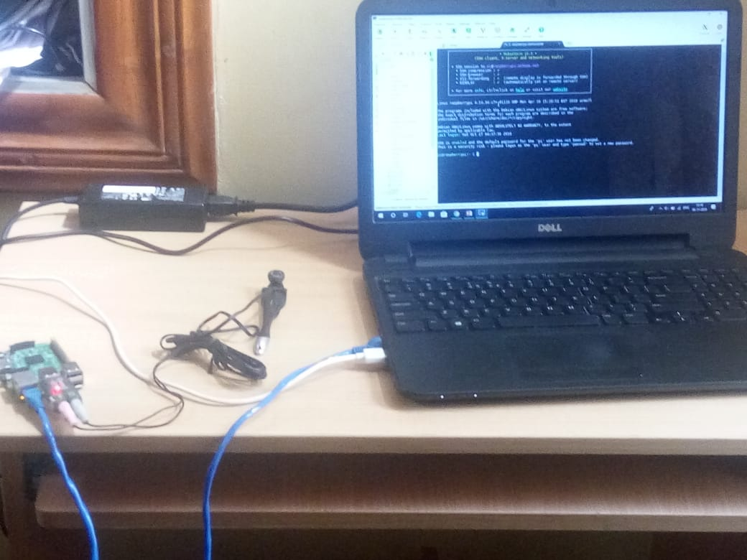
Hardware Arrangement
Connection Flowchart
O/P
I/P
LED
USB Mic
LAN Cable
Raspberry Pi-3B
Power Supply
SSH Connection
Laptop
Command line tool

Slide 6
Raspberry Pi 3B Architecture
Broadcom BCM2835 (CPU & GPU)
1GB SDRAM
4 USB 2.0 Ports
Ethernet Port
HDMI
Audio
SD Card Slot
Micro USB for power
32 bit RISC
SOC-BCM2837

Slide 7
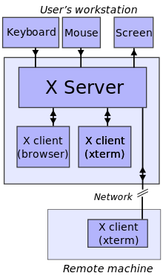
Software
Raspbian OS-is one of the official Operating systems available for free to download and use.
The Raspbian desktop environment is known as the “Lightweight X11 Desktop Environment” or in short LXDE.
Mobaxterm is an ultimate toolbox for remote computing.
X11 Server

Slide 8
Software
SSH, also known as Secure Shell or Secure Socket Shell, is a network protocol that gives users, particularly system administrators, a secure way to access a computer over an unsecured network.
Google Assistant SDK lets us add hotword detection, voice control, natural language understanding and Google’s smarts to our devices.
Json File-Encrypted File containing secret key required to activate Assistant.

Slide 9
Linux Commands
arecord –l : To Locate USB microphone in the list of capture hardware devices.
aplay –l :To locate speaker in the list of playback hardware devices.
.asoundrc file contains the device hardware number .
alsamixer : Used to adjust Speaker and microphone level.
source env/bin/activate: Entering Python Virtual Environment.
Python hotword.py : Running the code file.

Slide 10
Programming Language
Python and IDLE-Integrated Development Learning Environment
Features:
  Multi-window text editor with syntax highlighting, auto completion, smart indent and other.
  Python shell with syntax highlighting.
  Integrated debugger with stepping, persistent breakpoints, and call stack visibility.
Hotword.py :Main python file contains the imported libraries required to process Speech to text and other voice processing.

Slide 11
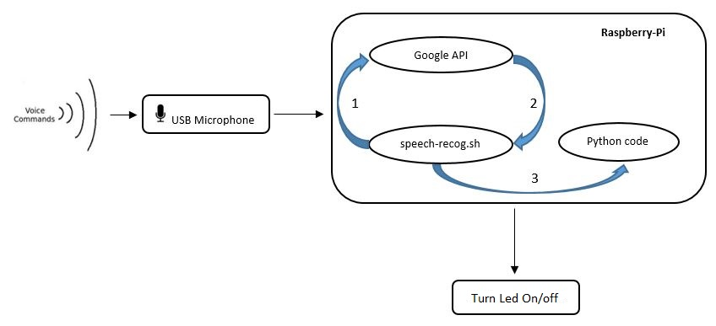
Working
Speech to text api(Google api)

Slide 12
Working
Google Cloud Speech-to-Text enables developers to convert audio to text by applying powerful neural network models in an easy-to-use API.
Natural Language Processing :Current approaches to NLP are based on deep learning, a type of AI that examines and uses patterns in data to improve a program's understanding
GPIO Pins-40: we are using BCM25 i.e. 22pin and Gnd pin 9.
BCM25 is an output pin activated as per Voice commands.

Slide 13
Conclusion and Application
Google Home prototype.
Alexa and AWS .
IOT Based applications.
Smart assistant can answer all our question.

Slide 14
Future Scope
Device actions and Device Traits
Device Traits : The Google Assistant needs to be able to associate a query with a command to send to your device. For this to work, we need to declare what kinds of abilities our device supports. These abilities are known as traits.
Device actions :Device may have special abilities not covered by the current set of traits.
Actions.json : File has to be edited to et desired response.

Slide 15
References
https://developers.google.com/assistant/sdk/guides/library/python/
https://www.codeproject.com/Articles/839230/Introduction-to-Raspberry-Pi-with-Raspbian-OS
https://cloud.google.com/speech-to-text/
https://searchbusinessanalytics.techtarget.com/definition/natural-language-processing-NLP
https://en.wikipedia.org/wiki/IDLE
https://searchsecurity.techtarget.com/definition/Secure-Shell

Slide 16
Queries?

