Slide 1
Predictive Modeling of Customer Bookings
Business Case
Predict customer booking completion using machine learning.
Prepared by: Sujeet Goswami
British Airways Virtual Experience
British Airways Data Science Job Simulation

Slide 2
Problem Statement
• Predict whether a customer will complete a booking.
• Improve marketing efficiency.
• Identify influential booking factors.
British Airways Data Science Job Simulation

Slide 3
Dataset Overview
• 50,000 rows, 14 features
• No missing values
• 719 duplicate rows removed
• Label Encoding applied
British Airways Data Science Job Simulation

Slide 4
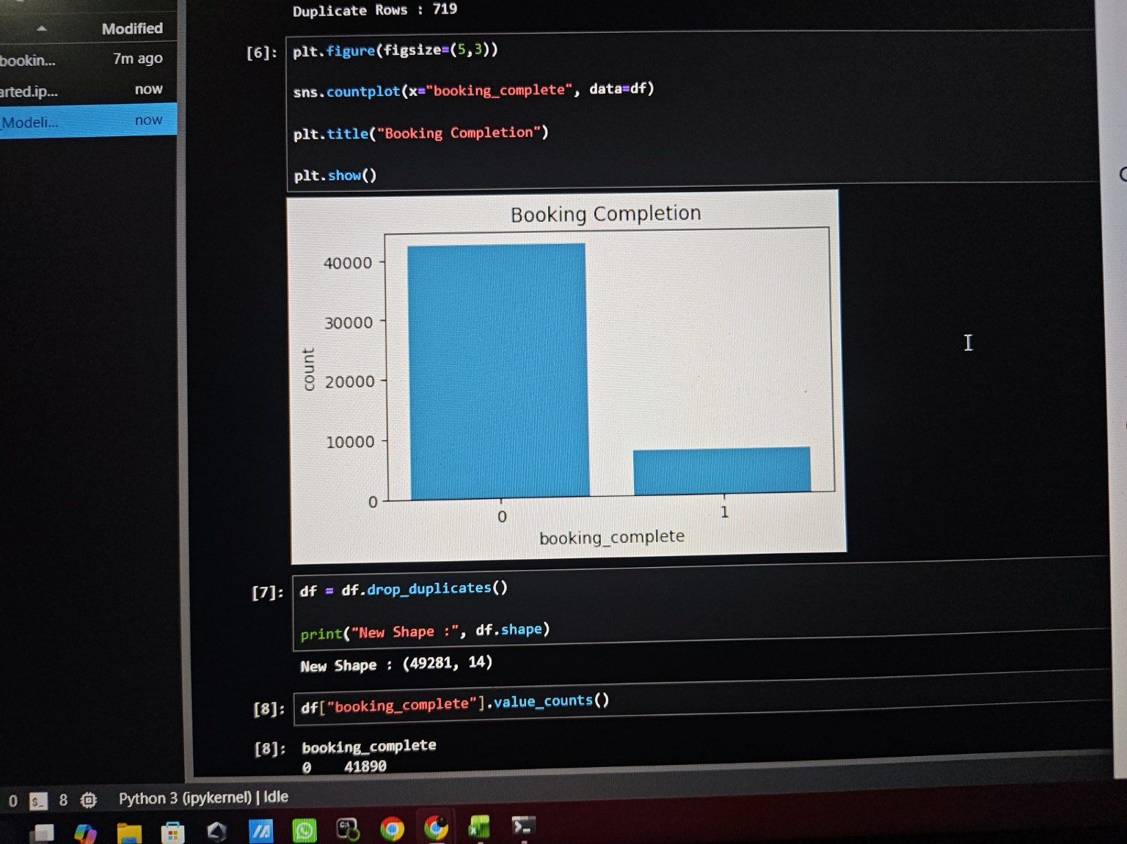
Booking Completion
Most customers did not complete their booking.
British Airways Data Science Job Simulation

Slide 5
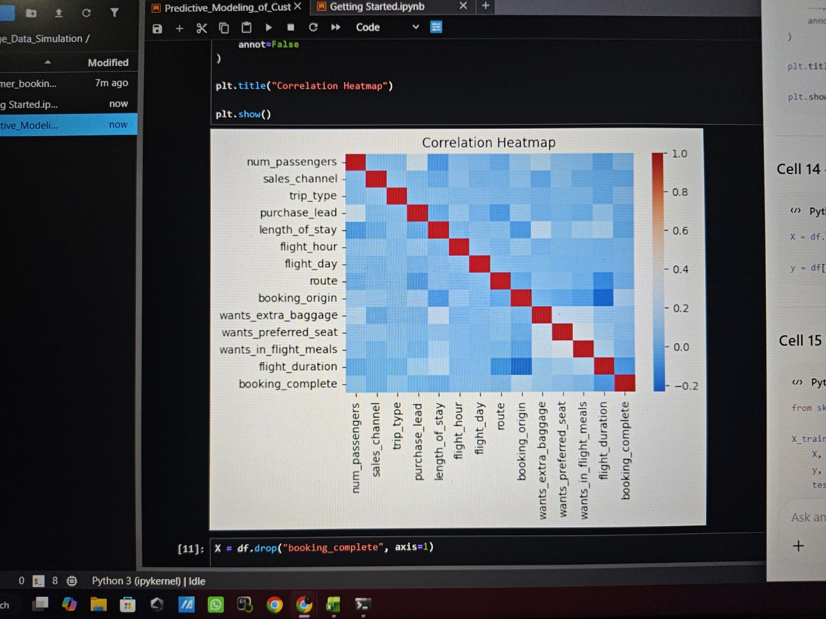
Correlation Heatmap
Weak correlations among most features.
British Airways Data Science Job Simulation

Slide 6
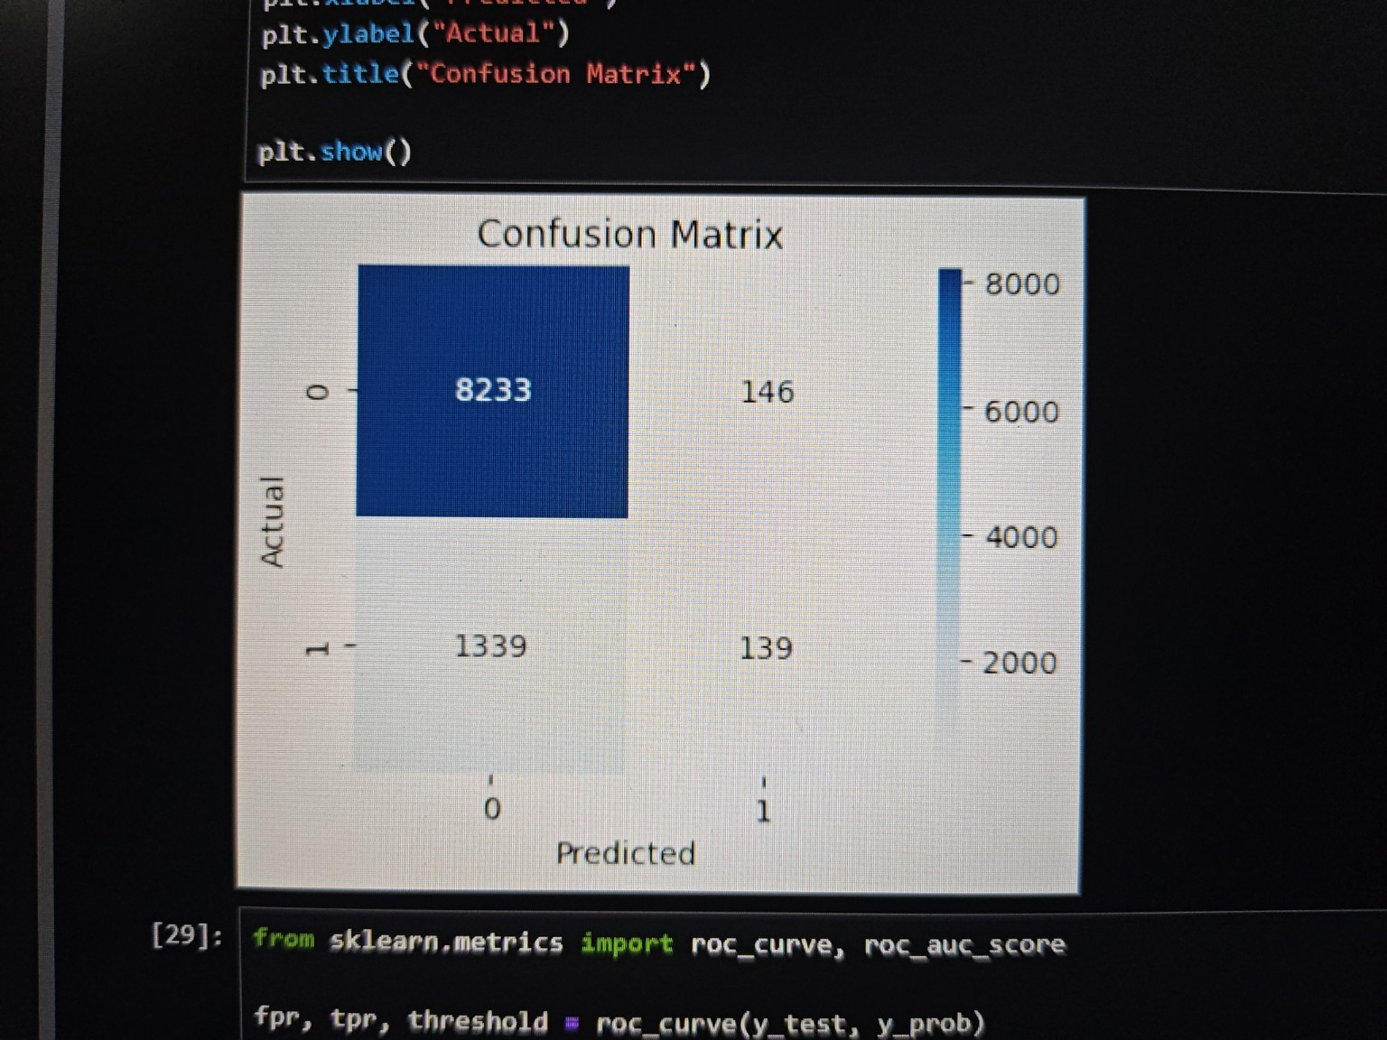
Confusion Matrix
Model predicts majority class well.
British Airways Data Science Job Simulation

Slide 7
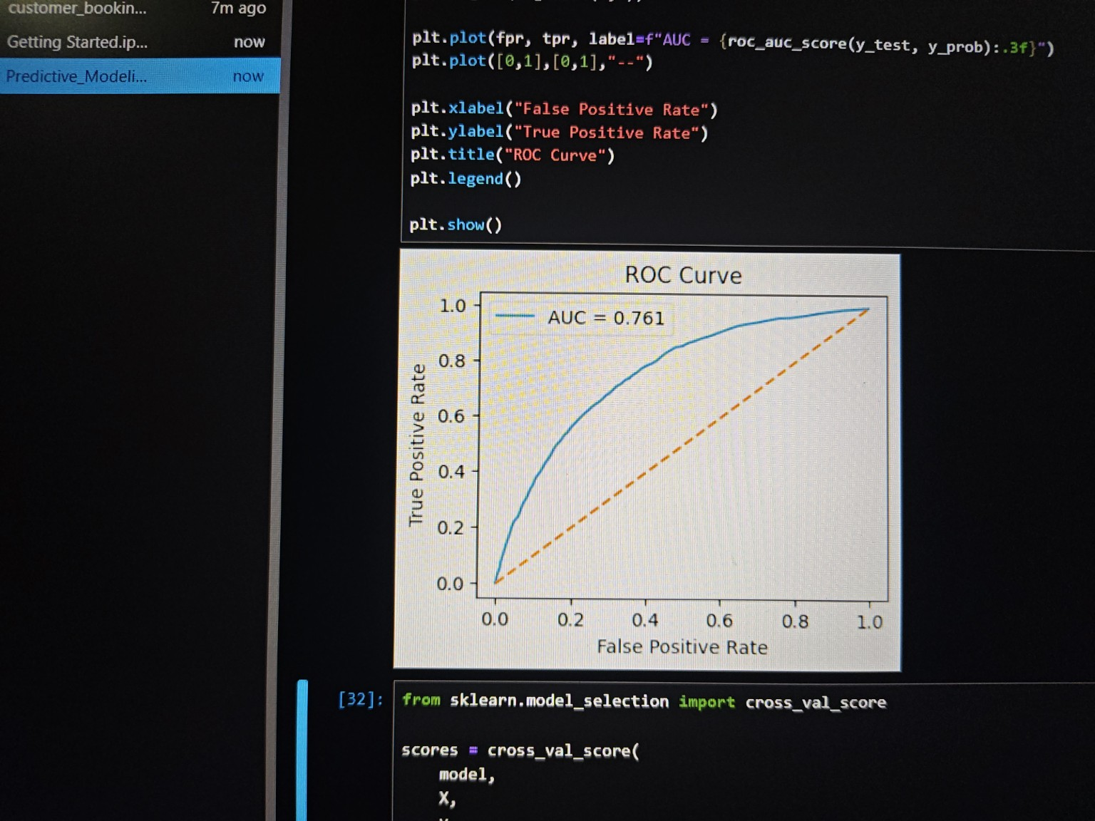
ROC Curve
AUC = 0.761 indicates reasonable discrimination.
British Airways Data Science Job Simulation

Slide 8
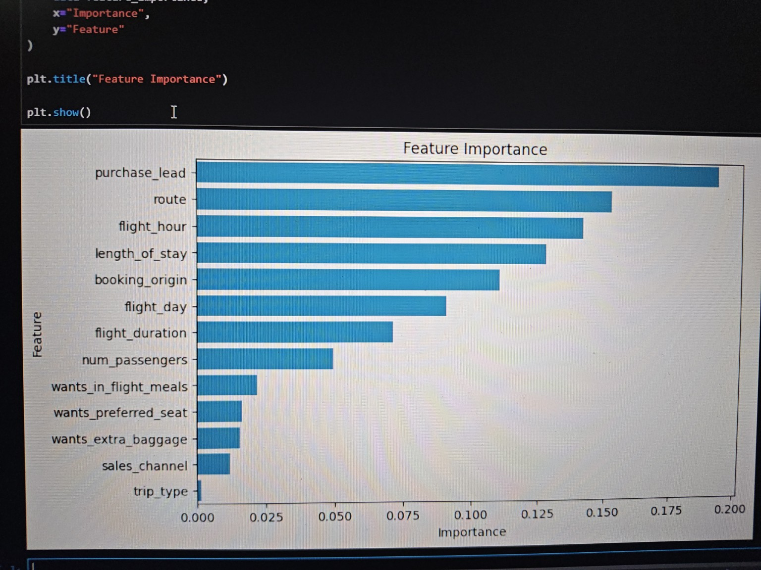
Feature Importance
Purchase Lead, Route and Flight Hour were the most influential.
British Airways Data Science Job Simulation

Slide 9
Model Performance & Conclusion
✔ Random Forest Accuracy: 84.9%
✔ ROC-AUC Score: 0.761
✔ Purchase Lead was the most important feature.
✔ The model can support targeted marketing campaigns.
✔ Future work: Hyperparameter tuning and class imbalance handling.
Prepared by Sujeet Goswami

