Slide 1



SMART INDIA HACKATHON 2026
  Problem Statement ID –SIH26089
  Problem Statement Title-Cooperative Gig Services Platform for Household & Community Services
  Theme-Cooperation & Cooperative Societies
  PS Category- Software
  Team ID- AF-SW-12
  Team Name (TECH NOVA)
@SIH Idea submission- Template

Slide 2

TECH NOVA
SERVIO
🌱 Challenges and Problems
🔷 Innovation and Uniqueness
Workers difficult to find
No trust verification
High platform commissions
No worker welfare
Unorganized local market
🤝 Cooperative Ownership
🗳️ Democratic Governance
💰 Transparent Economics
Workers are not only service providers — they are members and stakeholders of the platform.
Members can participate in collective decision-making and platform policies.
Clear service pricing and earnings information create a fairer and more transparent service.
📍 Local-First Matching
⭐ Digital Reputation
💡 Proposed Solution
Requests are matched using location, skills, availability and service requirements.
Providers build a trusted digital identity through verified profiles, ratings and service history.
Cooperative-Owned Service Marketplace
Verified worker registration
Skill-based service discovery
Secure digital payments
Cooperative administration
Insurance integration
Emergency fund support
🔶 How it Addresses the Problems
Problem | SERVIO Response
Fragmented services | Unified Marketplace
Trust gap | Verified Providers
Unclear pricing | Transparent Pricing
Limited opportunities | Smart Local Matching
Weak worker participation | Cooperative Governance
@SIH Idea submission- Template

Slide 3
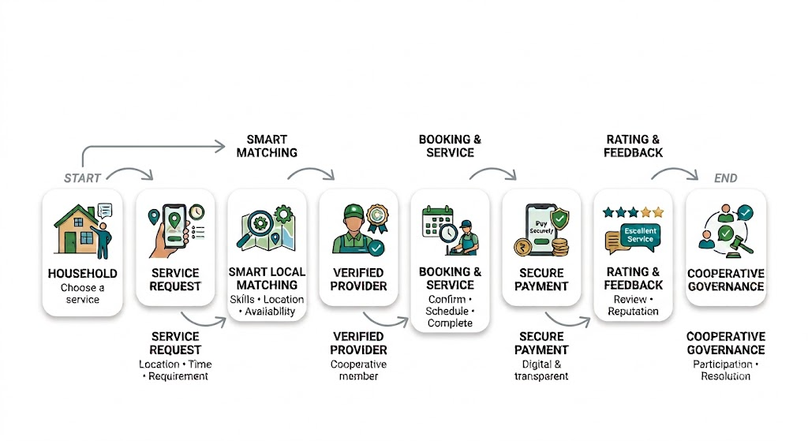
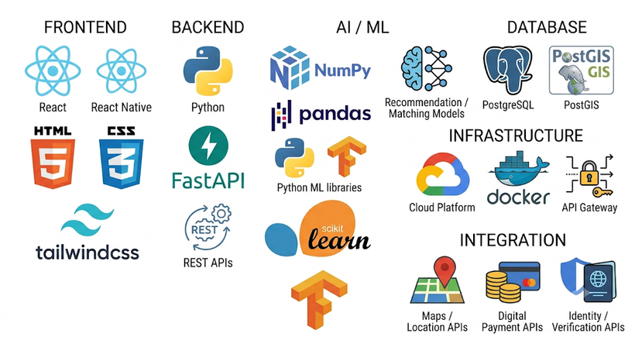
TECH NOVA
TECHNICAL APPROACH
Methodology and Process
SYSTEM FLOW
User & Service Data
Collect profiles, skills, location & availability.
Smart Matching
Match requests using skills, location & availability.
Provider Verification
Verify identity, skills & service history.
Booking & Coordination
Manage requests, schedules & notifications.
Secure Transactions
Enable digital payments & transparent records.
Technology Stack
🎬 SERVIO — DEMO WALKTHROUGH
▶ WATCH DEMO
Prototype
@SIH Idea submission- Template

Slide 4


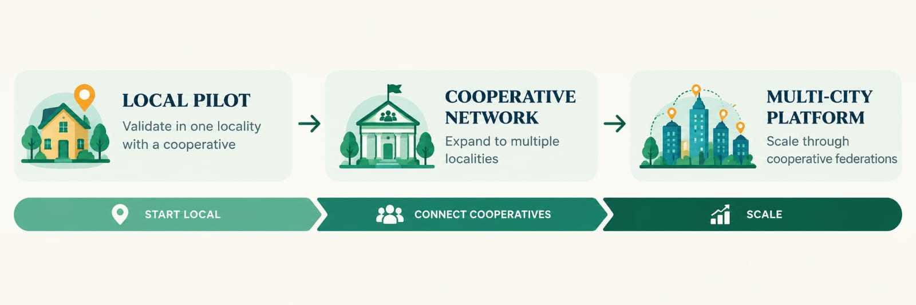
FEASIBILITY AND VIABILITY
TECH NOVA
Technical Feasibility
Financial Feasibility
Operational Feasibility
Low operational cost
Platform service fee
Society partnerships
Sustainable revenue model
.
Aadhaar/KYC verification
Cooperative approval process
OTP-based service completion
Admin monitoring
Cross-platform mobile app
Cloud scalable
Real-time notifications
Secure authentication
SERVIO can start small, validate, locally, and scale through cooperative federations.
@SIH Idea submission- Template
@SIH Idea submission- Template

Slide 5
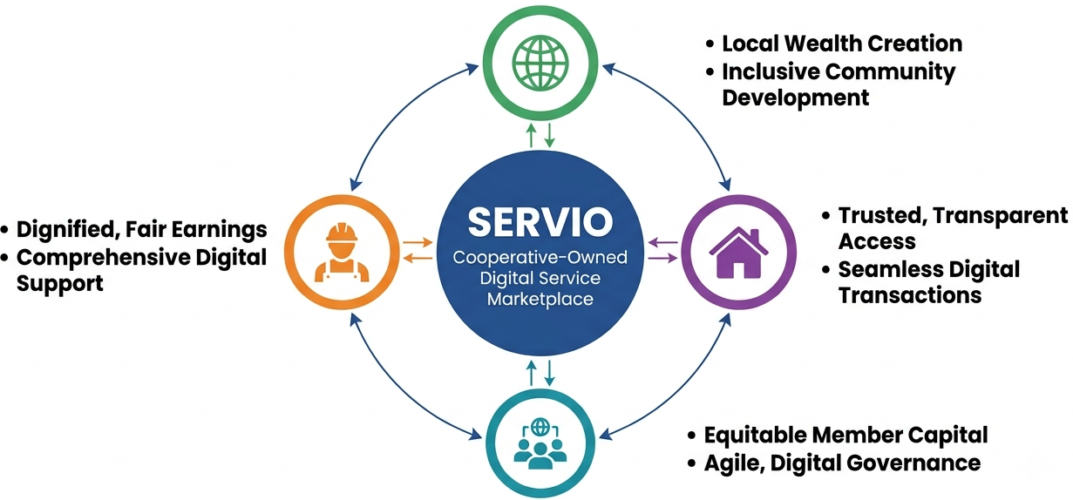
TECH NOVA
IMPACT & BENEFITS
Workers | Customers | Cooperatives | Society
More job opportunities | Verified professionals | Digital transformation | Promotes cooperative economy
Fair & transparent earnings | Faster service booking | Better member engagement | Encourages local employment
Insurance & emergency support | Secure digital payments | Transparent governance | Builds trust in digital services
Digital work history | Transparent pricing | Data-driven management | Inclusive economic growth
Key Beneficiaries
🛡️ Verified Workers
⚡ Faster Booking
💰 Fair Earnings
🤝 Cooperative Growth
@SIH Idea submission- Template

Slide 6


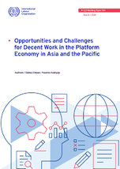
TECH NOVA
RESEARCH AND REFERENCES
REFERENCE PLATFORMS & MODELS
RESEARCH ARTICLES & SOURCES
International Labour Organization (ILO) – Digital Labour Platforms and the Future of Work: Towards Decent Work in the Online World (2018)
International Labour Organization (ILO) – World Employment and Social Outlook 2021: The Role of Digital Labour Platforms in Transforming the World of Work
International Labour Organization (ILO) – Expansion of the Gig and Platform Economy in India: Opportunities for Employer and Business Member Organizations (2024)
NITI Aayog – India's Booming Gig and Platform Economy: Perspectives and Recommendations on the Future of Work (2022)
Government & Policy Sources
Ministry of Cooperation, Government of India – Our Vision
Ministry of Cooperation, Government of India – FAQs / Cooperative Principles
Ministry of Labour & Employment, Government of India – Social Protection for Gig and Platform Workers
Local household service discovery & booking model
Open digital commerce and decentralized marketplace ecosystem
Understanding opportunities and challenges for platform workers
ILO – Digital Labour Platforms and the Future of Work
https://www.ilo.org/publications/digital-labour-platforms-and-future-work-towards-decent-work-online-world
ILO – World Employment and Social Outlook 2021
https://www.ilo.org/publications/flagship-reports/role-digital-labour-platforms-transforming-world-work
ILO – Expansion of the Gig and Platform Economy in India
https://www.ilo.org/publications/expansion-gig-and-platform-economy-india-opportunities-employer-and
NITI Aayog – India's Booming Gig and Platform Economy
https://www.niti.gov.in/node/375
Ministry of Cooperation – Our Vision
https://www.cooperation.gov.in/our-vision
Ministry of Labour & Employment – Social Protection for Gig and Platform Workers
https://labour.gov.in
Our research showed that existing gig platforms mainly focus on customers, while cooperative workers need fair wages, social protection, transparent governance, and digital visibility. SERVIO is designed to address these gaps through a cooperative-owned digital marketplace.
@SIH Idea submission- Template

