Slide 1
IBM University Engagement Project Submission
“Exploring the Power of Agentic AI with IBM Granite and IBM Bob”

Slide 2


Project Tile – [Smart Study Generator Agent ]
Domain of Project – [ Education ]
Student Name | Recent Passport Photo | Email ID | Mobile number [WhatsApp]
sujeet vishwakarma |  | ssujeet6449@gmail.com | 7985885330
Recommended font style and size:
Font Style: Arial
Font Size (Heading): 28
Font Size (Content): 20

Slide 3
Problem Statement -
Problem Statement No.13: Smart Study Generator Agent The Challenge Students today face an overwhelming flood of information—lecture notes, textbooks, research papers, YouTube tutorials, and online resources. This content is scattered, unorganized, and often not personalized to their learning pace or style. As a result, students struggle with finding the right study material, summarizing key concepts, and staying exam-ready. Traditional study tools only provide static notes or flashcards, failing to adapt dynamically to student needs. The challenge is to move beyond static resources toward an intelligent, adaptive study companion.
The Objective :
Build an agentic AI-powered Smart Study Generator that personalizes and streamlines learning for students.
The solution should:
1. Fuse Learning Resources: Aggregate content from class notes, textbooks, research articles, and online tutorials into structured, easy-to-digest study material.
2. Enable Multimodal Input: Allow students to upload notes, voice queries, or images (e.g., textbook pages), and generate concise summaries, flashcards, or concept maps.
3. Create a Predictive & Agentic Layer: Recommend personalized study plans, highlight important topics based on syllabus or past exams, and provide predictive alerts (e.g., “Focus on Topic X—frequently asked in exams”).
4. Visualize Study Progress: Offer a real-time dashboard showing learning milestones, weak areas, practice quizzes, and performance forecasts.

Slide 4
Proposed Solution -
We propose an Agentic AI-powered Smart Study Generator that acts as a personalized study companion for students.
Upload notes, PDFs, textbook images, syllabus and previous-year papers
Generate summaries, study notes, flashcards, quizzes and concept maps
Analyze syllabus and previous-year papers to identify important topics
Create personalized study plans based on exam date, available time and weak areas
Provide AI-powered recommendations and revision alerts
Track progress, quiz performance, milestones and weak topics through a dashboard
Support text, document, image and voice-based learning queries
Developed using IBM Bob + Groq API + Qwen qwen/qwen3.8-27b
Last line:
Our goal is to transform scattered study resources into an intelligent, adaptive and personalized learning experience.

Slide 5
Technology Used
IBM Bob – AI-assisted development
Groq API – LLM integration
Qwen qwen/qwen3.8-27b – Large Language Model
HTML5 & CSS3 – Web interface and responsive design
JavaScript – Frontend functionality
Python & Flask – Backend and Agentic AI logic
PDF/Image Processing – Study material analysis
Chart.js – Study progress visualization
python-dotenv – Secure API key management

Slide 6
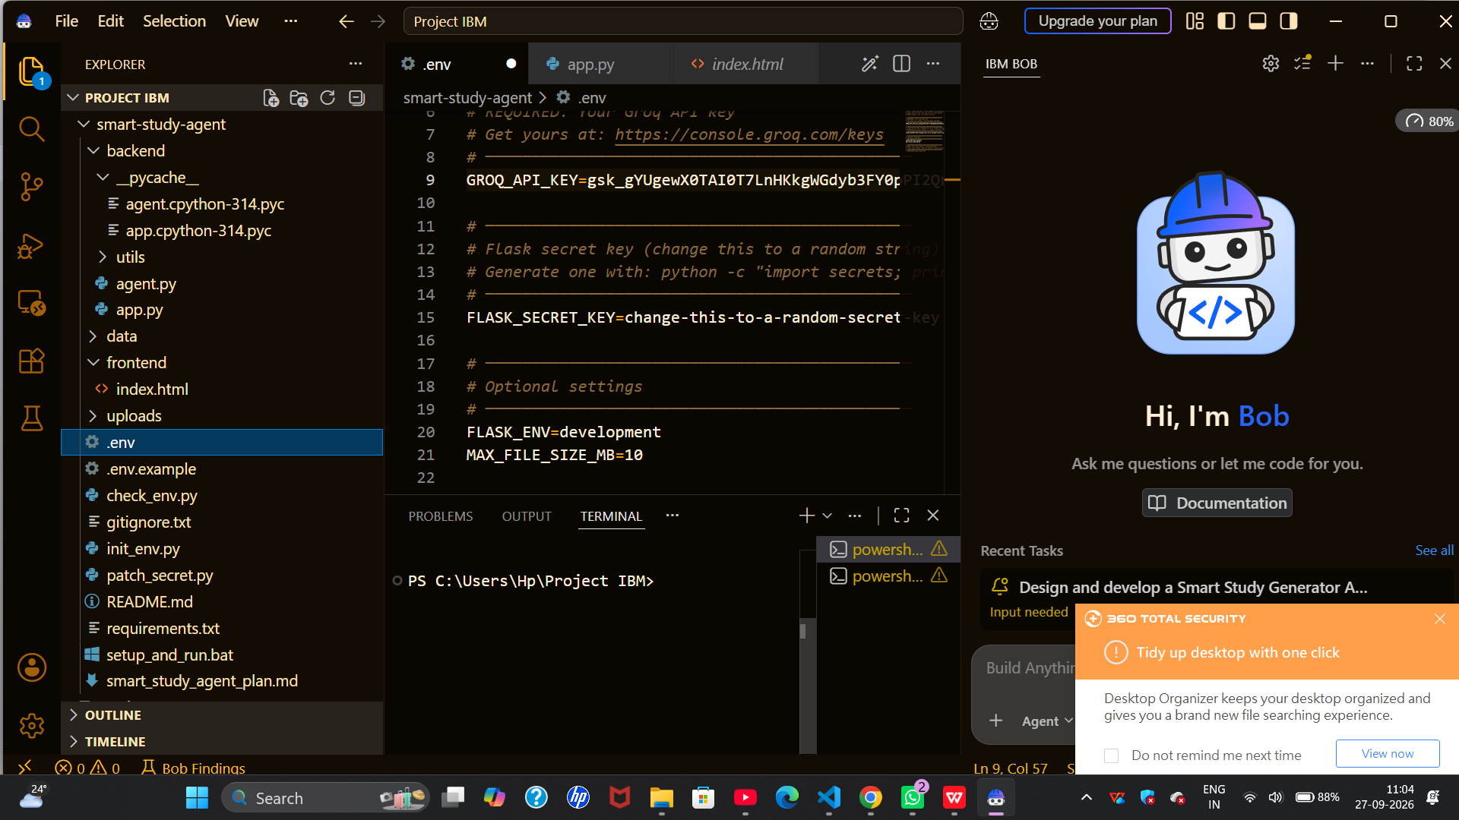
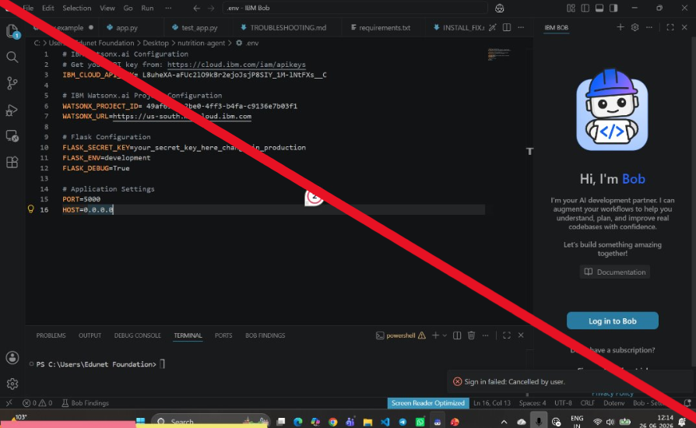
Required Files created using IBM bob -
app.py
agent.py
index.html
style.css
requirements.txt
.env
smart_study_agent_plan.md
setup_and_run.bat

Slide 7
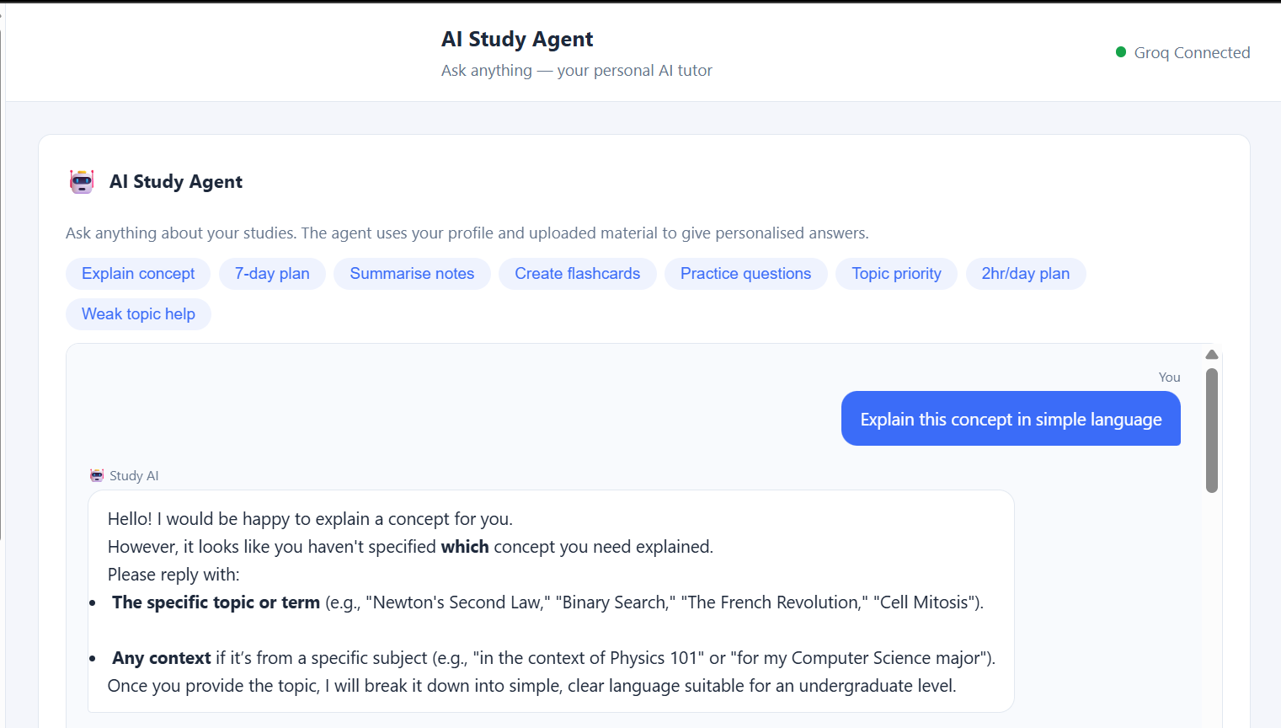
IBM Bob Screenshots:

Slide 8
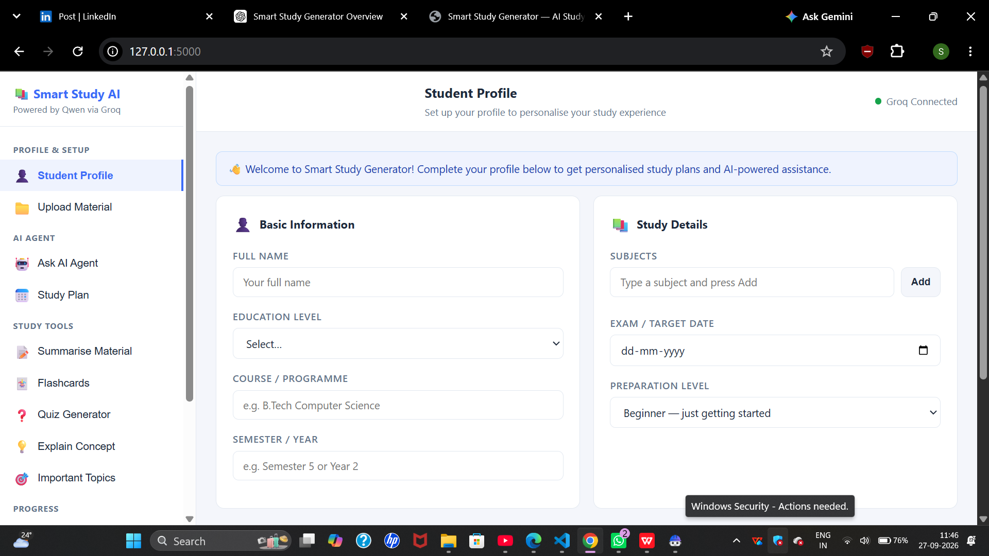

Slide 9
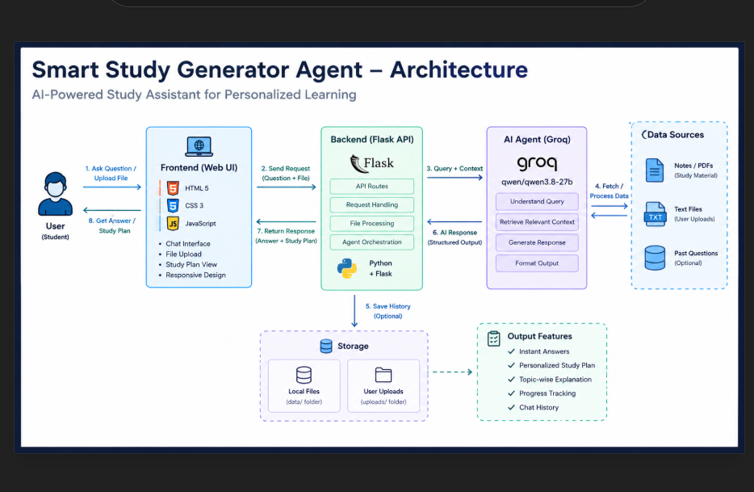
Architecture blueprint for IBM bob:

Slide 10

Role of Agentic AI in the solution
Role of Agentic AI in Smart Study Generator
The Smart Study Generator uses an AI agent to act as a personalized study companion rather than a simple chatbot. The agent processes the student's questions, profile, uploaded study material, progress, and conversation history to generate relevant and personalized responses.
It can analyze uploaded learning materials, explain concepts, answer study-related questions, and generate personalized study plans based on subjects, exam date, available study hours, preparation level, and current progress.
The system also tracks completed topics, quiz scores, weak areas, and milestones to support continuous learning and progress monitoring.
A safety layer checks user queries and uploaded content for prompt-injection attempts before the AI processes them, helping keep the study assistant focused on its intended educational role.
Overall, Agentic AI makes the system personalized, context-aware, adaptive, and focused on improving the student's study workflow.

Slide 11
Project Output Screenshot
Please put IBM Bob output screenshots with 2-3 prompts.
You can take 2-3 more slides for each screenshot
·
·
·

Slide 12
Project Output Screenshot
Please put IBM Bob output screenshots with 2-3 prompts.
You can take 2-3 more slides for each screenshot
·
·
·

Slide 13
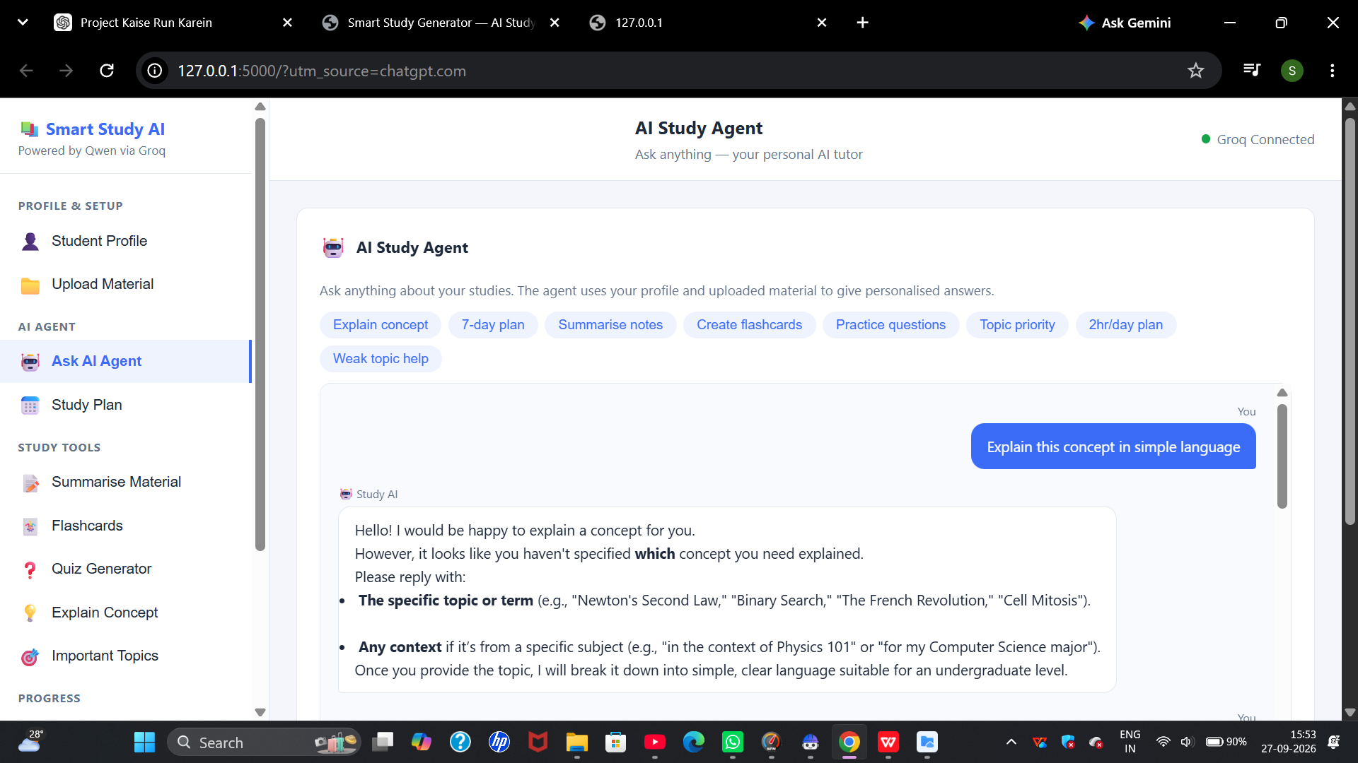
Project Output Screenshot
Please put IBM Bob output screenshots with 2-3 prompts.
You can take 2-3 more slides for each screenshot
·
·
·

Slide 14
Novelty and Uniqueness
Smart Study Generator Agent stands out by combining multiple study-support capabilities into one personalized AI platform:
Personalized Study Planning – Generates study plans based on subjects, exam date, available study hours, preparation level, and progress.
Context-Aware AI Assistance – Uses the student's profile, uploaded study material, previous conversation, and progress to provide relevant responses.
Study Material Analysis – Students can upload PDFs, text files, and images for AI-assisted learning.
Adaptive Progress Tracking – Tracks completed topics, quiz performance, weak areas, and milestones.
Safety-Aware AI – Includes protection against prompt-injection attempts and sanitizes uploaded content.
Continuous Personalization – The system updates the student's study context and plan as their progress changes.

Slide 15
Git Hub Link
· Please create public github repository (Enable Add README button while creating repository) with format –
Please test and Paste the working Github URL –
Make sure you have Uploaded following three files into your github repository
1) All Agent relevant files of IBM Cloud , 2) yourproblemstatement.pdf file 3) your projectpresntation.pptx file 4)any other files
·
·
·

Slide 16
Future Scope
1.Integration with Wearables & Health Devices –
The system can be integrated with smartwatches and fitness trackers to collect real-time data such as steps, calories burned, heart rate, and sleep patterns. This will enable the Nutrition Agent to provide more accurate and dynamic diet recommendations based on actual user activity and health metrics.
2.AI-Powered Voice Assistant & Multilingual Support –
Enhancing the system with a voice-enabled assistant and support for multiple languages will improve accessibility. Users can interact naturally in their preferred language, making the solution more inclusive and suitable for diverse populations, especially in regions with varied linguistic backgrounds.
·
·
·

Slide 17
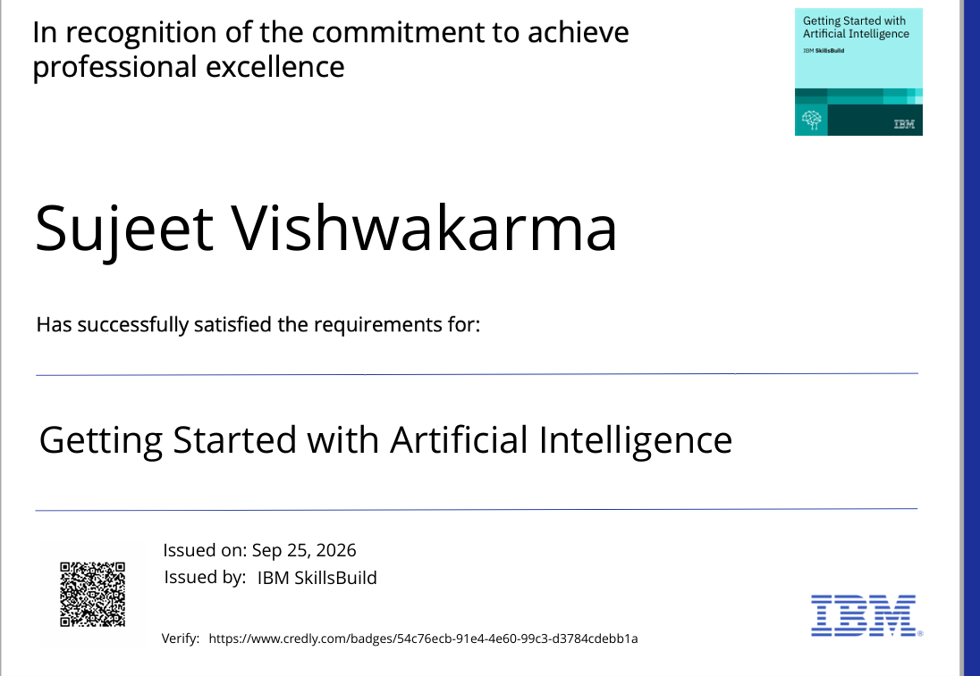
Certificates Earned:
Please add your credly certificate

Slide 18
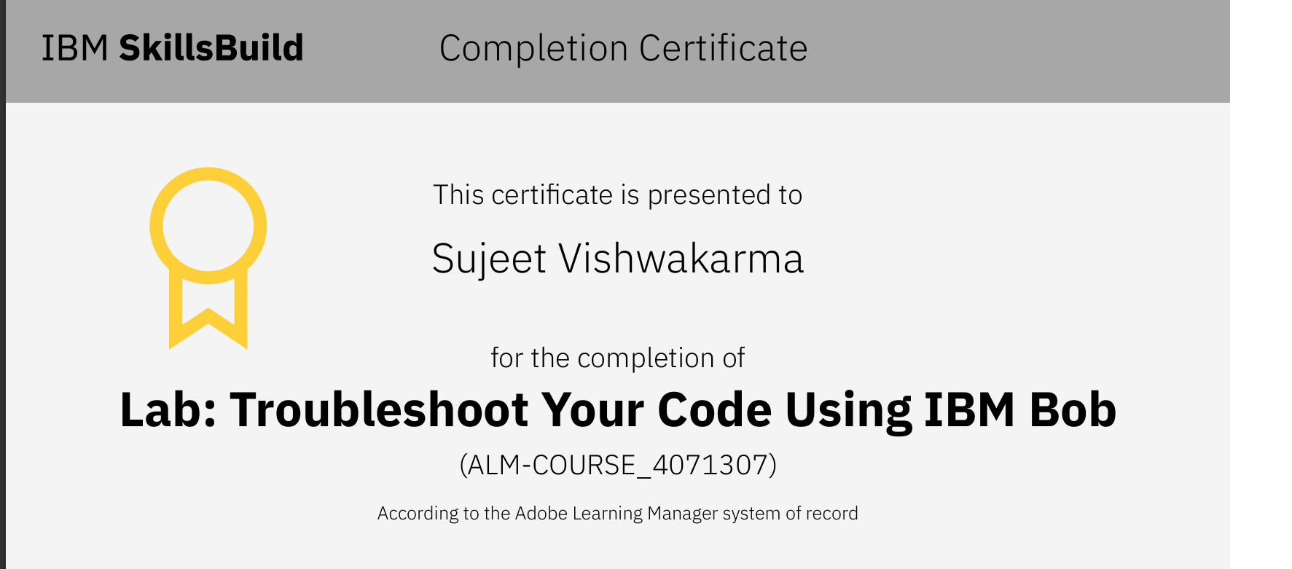
Certificates Earned:​
Add your IBM BOB Certificate

Slide 19


