Slide 1



Deviants
Members: Saurabh Ranjan, Navya Hirebidanur, Sujeeth Shetty

Slide 2
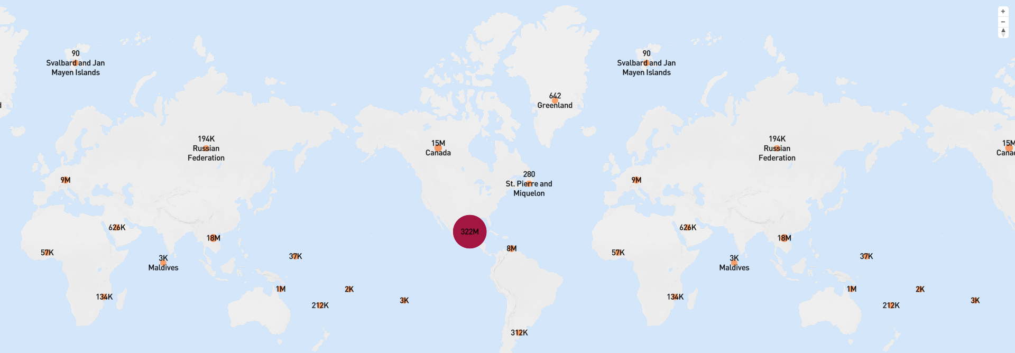
User hits across the globe
Not surprisingly MLB website received highest hits from US and to attract fans from all over the world, website should be made compatible for at least top 10 spoken most spoken languages in the world.

Slide 3
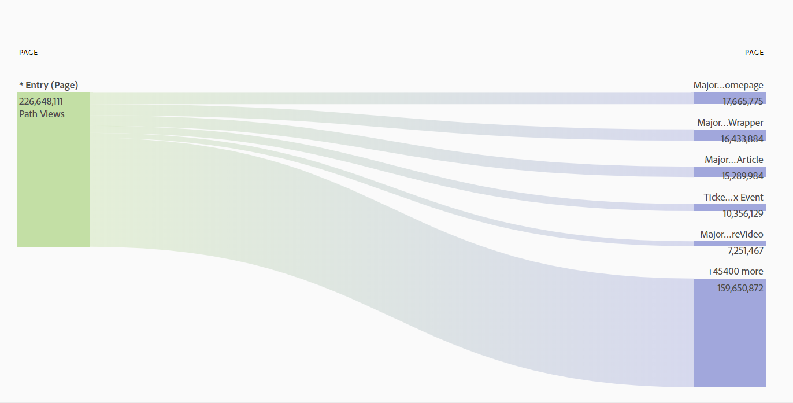
Most visited pages in MLB website
Home page and Scorecard pages are the most visited at MLB website.
Auction page and fantasy page are hard to find as we can see that they have the least number of visitors.
Visitors generally visit website to check game scores, to watch match highlights or to participate in Brackett Challenge which is held in October.

Slide 4
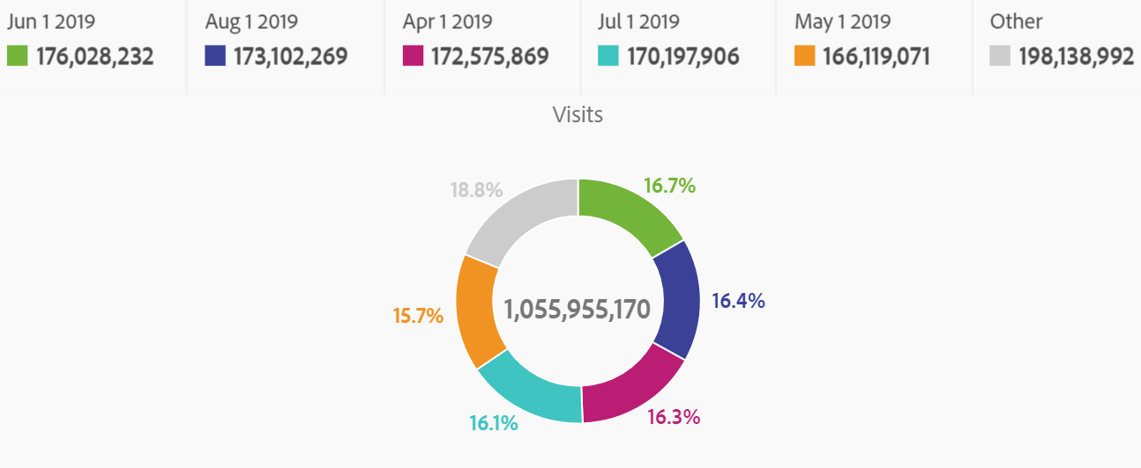
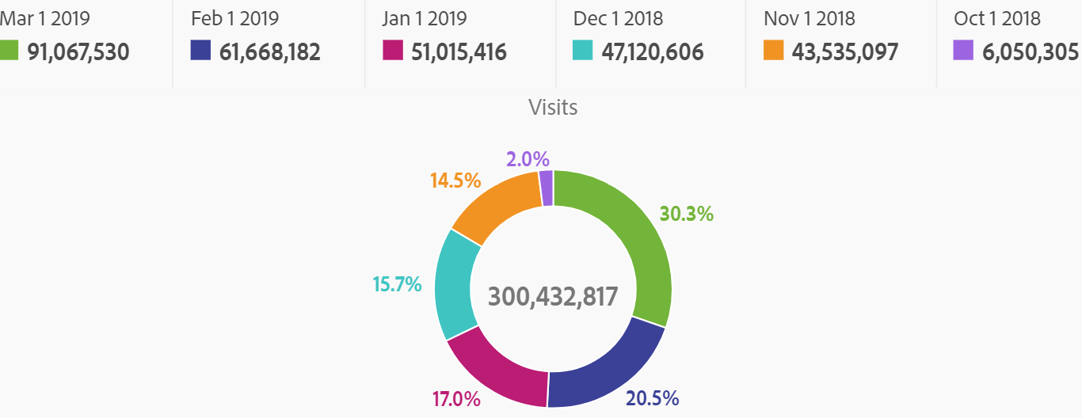
In-Season vs Post-Season
Number of overall visits during post-season is dropped by 78% compared to in-season. To engage users during post-season, Challenges or prediction games should be held to attract more visitors in post season time.
In-Season
Post-Season

