Slide 1
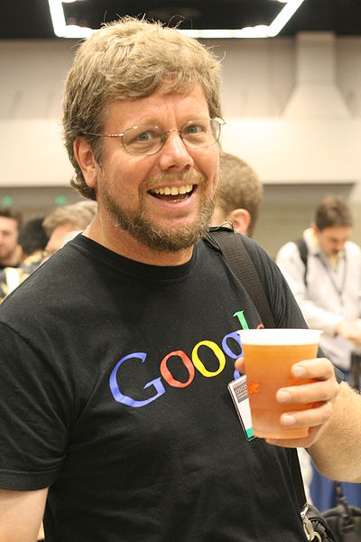
Python’s Benevolent Dictator For Life
“Python is an experiment in how much freedom programmers need. Too much freedom and nobody can read another's code; too little and expressive-ness is endangered.”
- Guido van Rossum
Invented in Late 80s & early 90s .
Really? Java- 1991.

Slide 2
Why Python?
High-level programming language
Open source and community driven- Free Free Free Free
Source can be compiled or run just-in-time: Yes, Can be Orange and Apple both. Interpreter vs Compiler.
Similar to perl, tcl, ruby: Interactive, Scripting and Notebook.
Hybid: OOP, Functional, Procedural.
Dynamic typed – Circle can be rectangle and vice versa.
“Batteries Included”
a standard distribution includes many modules.
Maruti 800 can become Ferrari.

Slide 3
Why Python?
Official language of Google, Yahoo, Facebook.
Machine Language.
Simple syntax: Only syrups(indentation) and no bitter medicines (Comma or semicolon, Braces).
List is endless long

Slide 4
OOPs
1) Class: Blueprint.
2) Object: Anything you and me . Feature and methods.
3) Inheritance: Dynasty is not always bad.
4) Polymorphism: I can play foot ball and cricket both but one at a time please.
5) Abstraction or Encapsulation : Hide and Seek

Slide 5
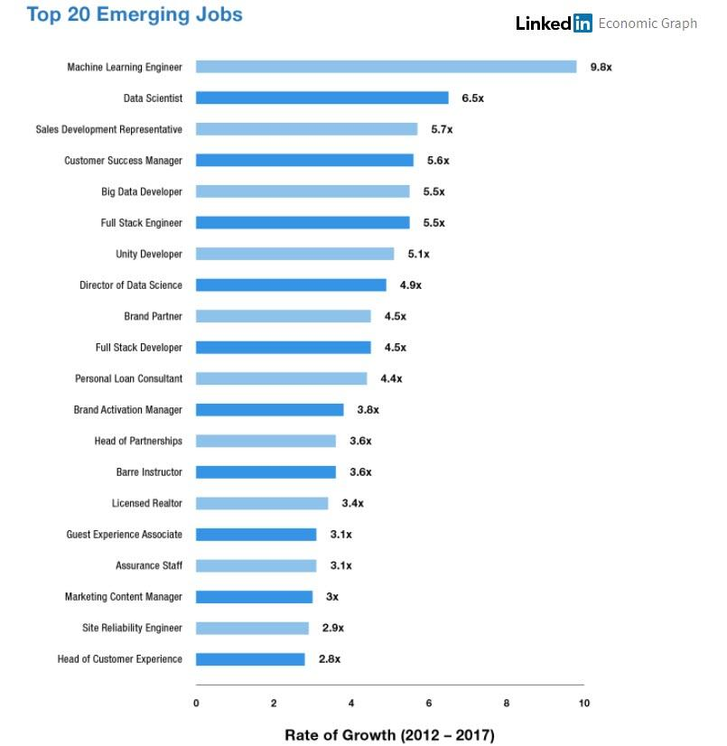
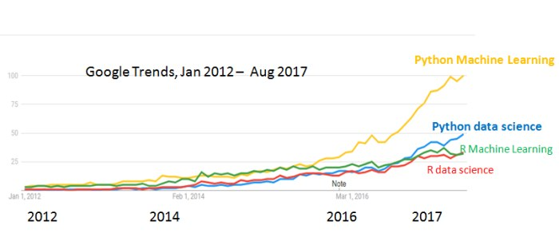
Scope: TCS, Infosys , …..

Slide 6
Thank you. See you on the next class!!!!
Keep Learning

