Slide 1
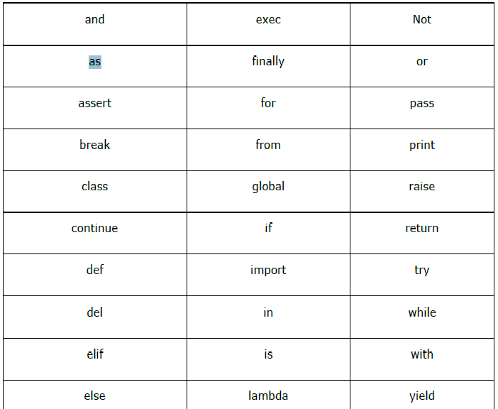
Python Basics
Case sensitive.
Keywords :

Slide 2
Python Basics
Variables and Data Structures
Variables: Numbers (Integer, Float, Complex) , String.
Dynamic Typing, No need to define.
Multiple Assignments: p = q = r = 1 and p,q,r = 1,2,”abc”
Data Structures: List, Dictionary, Tuple and Set
Input and Output
name = input("Enter your name: ")
print("hello", name)
Selection or Condition : If and else/elif
num = 11
if(num>10):
print(“Greater than 10")
elif(num>20):
print(“Num is less than 20..")

Slide 3
Python Basics
Iteration or Looping: For and While loop
for step in range(5):
print(step)
Function :
def hello():
print("hello")
print("hello again")
hello()
Modules: Libraries
import math
num = math.fabs(num)

Slide 4
Python Basics : Structuring
Statements
Single Statements per Line
Multiple Statements per Line – Separated by ‘;’
a = 10; b = 20; c = b + a
print(a); print(b); print(c)
Line Continuation : To avoid scrolling on long sentences
Implicit: statement having ‘(‘, ‘[‘, or ‘{‘ is incomplete without closing match. Array/If –else.
a = [
[1, 2, 3],
[3, 4, 5],
]
print(a)
Explicit : Backslash (\). Must be the last character of line .
x = \
1 + 2 \
+ 10
print(x)

Slide 5
Python Basics : Structuring
Comments:
Hash (#): Single Line
Triple Double Quotation marks(“””) : Multi Lines
White spaces
a = 1-2 : Correct but less readable.
a = 1 – 2 : Correct and more readable.
a = yin x : Incorrect, Whitespace must b/w Keywords.
CHARACTER | ASCII CODE | LITERAL EXPRESSION
Space | 32 (0x20) | ‘ ‘
tab | 9 (0x9) | ‘\t’
newline | 10 (0xA) | ‘\n’

Slide 6
Python Basics : Structuring
Indentation: The Actual Game player.
“Indentation - Whitespaces before a statement”
print(‘hello') # Correct
print(‘hello') # Generate an error
x = 10
while(x != 0):
if(x > 5): # Line 1
print('x > 5') # Line 2
else: # Line 3
print('x < 5') # Line 4
x -= 2 # Line 5
Lines 1, 3, 5 are on same level
Line 2 will only be executed if if condition becomes true.
Line 4 will only be executed if if condition becomes false.

Slide 7
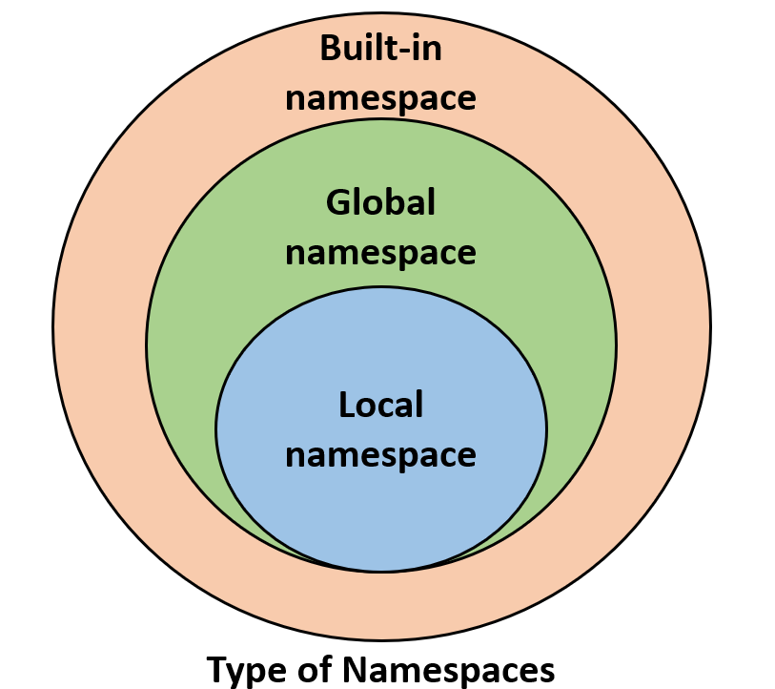
Python Basics : Scope of Object
NameSpace: unique name of each and every Object
Built-in: system Level: print(), id()
Global : Module Level
Local: Local Funcations
Lifetime of a namespace :
Depends on scope of objects
# var1 is in the global namespace
var1 = 5
def some_func():
# var2 is in the local namespace
var2 = 6
def some_inner_func():
# var3 is in the nested local
# namespace
var3 = 7

Slide 8
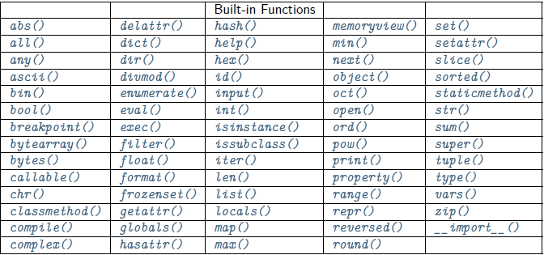
Python Basics : Built in Funcation
Built in Function:

