Slide 1
Keyboard Input
 The input('prompt') function returns one line from standard input
def
print_age_in_days(years):
print 'Your age in
days
is more
than',
365
* int(years)
age
= input('Enter
your
age: ')
print_age_in_days(age)
Line that caused
the exception
Prompt
Enter your age: fifteen
Your age in days is more than
Traceback (most recent call last):
File "<pyshell#192>", line 2, in <print_age_in_days>
print 'Your age in days is more than', 365 * int(years)
ValueError: Invalid literal for int() with base 10 'fifteen'

Slide 2
Exceptions



Are errors generated at runtime
May be raised by Python itself or manually from within a program
Cause a change in the control flow of a program
• Default action is immediate termination
– Includes a stack trace of the calls leading to the exception
It is the programmer’s responsibility to provide code to handle
exceptions
Python’s exception-handling capabilities


•
•
•
Simplify coding
Increase robustness
Provide a uniform approach to handling errors across application code

Slide 3
The try Statement
 General structure of exception-handling code is as follows:
try:
statements ...
Block monitored
for an exception
Block to handle
exceptions of type
exceptionTypeA
except exceptionTypeA:
statements ...
Block to handle
exceptions of type
exceptionTypeB
except exceptionTypeB:
statements
...
except:
statements
Block to handle any other
unnamed exception
...
else:
statements
...
Block to handle
if no exception
was raised
Block to execute
whether an exception
was raised or not
finally:
statements
...

Slide 4
Handling a Single Exception
 Statements within the try block are executed and monitored for an
exception
 On exception, control passes to the appropriate except block
• Associated with the most enclosing try
def print_age_in_days(years):
print
'Your
age
in
days
is
more
than', 365 * int(years)
Raises ValueError
exception
try:
2
age =
raw_input('Enter
your
age:
')
print_age_in_days(age)
except ValueError:
Call function
within try
an integer'
1
print 'You did
not input
the age
as
Branch to except
for that exception
3

Slide 5
Handling Multiple Exception Types


If present, multiple except blocks are checked sequentially
except(exceptionA, exceptionB) defines a single block for multiple exceptions
except: defines a block for any unnamed exception

def print_age_in_days(years):
print 'Your age in days is more than', 365 * int(years)
try:
age = raw_input('Enter your age:
print_age_in_days(age)
except ValueError:
')
print 'You did not
except EOFError:
input the age
as an integer'
print
except:
print
'End
of file
from
standard
input'
For any unnamed
exception type
'Non
Value or EOF
error occurred'

Slide 6
The else and finally Clauses
 else: defines a block that is executed if no exceptions are raised
• Follows all except clauses
– Must have at least one except
 finally: defines a block that is always executed
• Whether an exception was raised or not
def print_age_in_days(years):
print 'Your age in days is more than',
365 * int(years)
try:
age = raw_input('Enter your age: ')
print_age_in_days(age)
except ValueError:
print
else:
print
finally:
print
'You did not input the
age as an
integer'
age, 'was successfully
converted
to integer'
'Input test complete'
Block always
executes
No exception raised

Slide 7
Exception Instances
 Exception instances are assigned by except ExceptionType as name
• name.args references a tuple given to the ExceptionType constructor
def print_age_in_days(years):
print 'Your age in days is more than',
365 * int(years)
try:
age = raw_input('Enter your age: ')
print_age_in_days(age)
except ValueError as ve:
print
print else:
print
finally:
print
'You did not input the
'Value Error handled',
age as an
ve.args
integer'
age, 'was successfully
converted
to integer'
'Input test complete'

Slide 8
The raise Statement
 Initiates the named exception
• Which may be handled or not
import string
def print_age_in_days(years):
for digit in years:
if digit not in string.digits:
raise the
exception
raise ValueError('Cannot convert', digit, years)
print 'Your age in days is more than',
365 * int(years)
try:
age = raw_input('Enter your age: ')
print_age_in_days(age)
except ValueError as ve:
print 'You did not input the age as an
print 'Value Error handled', ve.args
Enter your age: fifteen
You did not input the age as an integer
integer'
Value Error handled, ('Cannot convert', 'f', 'fifteen')

Slide 9
The open and close Statements



Open a file syntax: object = open('pathname'
Returns a file
Specifies an opening mode
[,
'mode'])
Optional
•
'r'—Opened for reading at the beginning
– Default mode
'w'—Opened for writing at the beginning
'a'—Opened for writing at the end
Additional '+' with mode opens for both reading and writing operations
•
•
•

Specifies a file’s content type within the mode
•
•
Text is the default
'b' specifies binary

Close a file syntax: object.close()
• Releases open file reference

Slide 10
Opening Files and Exceptions

An IOError exception is raised when opening to
• Read a file that does not exist
• Read or write a file without appropriate access rights
IOError exception attributes include

•
•
•
errno—Error message number, args[0]
strerror—Error message string, args[1]
filename—Filename used when the exception was raised
try:
infile = open('Incorrectfilename')
except IOError as ioe:
print
print
print
print
'Unable to open the file'
'Error number', ioe.args[0],
'Message', ioe.args[1],
'Filename in error', ioe.filename
If open() failed,
close() is not needed
file object = open(file_name [, access_mode][, buffering])

Slide 11
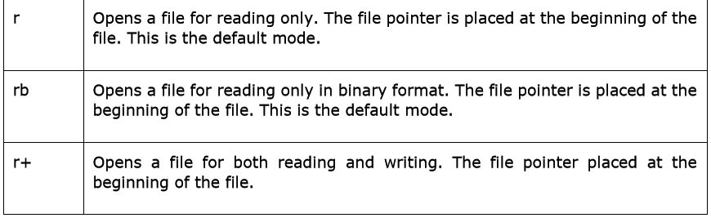
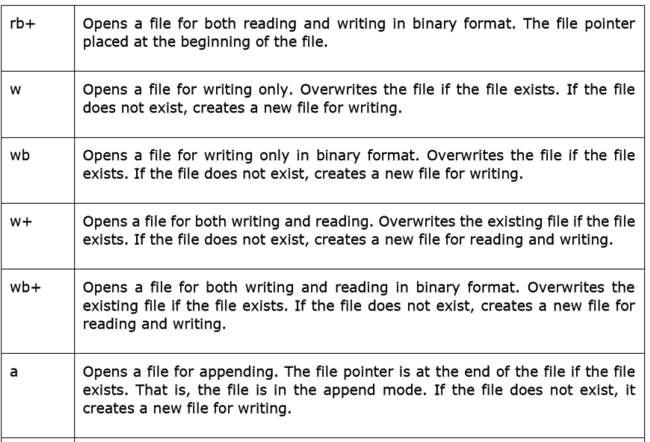
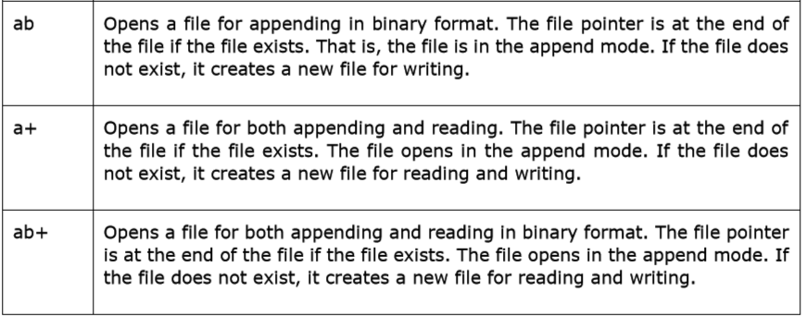
Modes of Files to be Opened:

Slide 12
Reading a Text File

File is a sequence of characters
• '\n' separates lines
simple.txt
line 1
line 2
line 3
line 4
\n
l
i
n
e
1
\n
l
i
n
e
2
\n
...


read(): Returns the entire file contents as a single string
readline(): Returns the next line from the file
• Includes the '\n' line delimiter
• rstrip() string method can remove the '\n'
readlines(): Returns the entire file contents as a list of strings, including the '\n'
IOError exception may be raised



Slide 13
Reading a Text File Example
try:
infile = open('C:/Course/1905/Data/simple.txt',
print infile.readline().rstrip()
print infile.readlines()
infile.close()
except IOError as ioe:
print 'Error number', ioe.args[0],
print 'Message', ioe.args[1]
'r')
line 1
['line
2\n',
'line
3\n',
'line
4\n']

Slide 14
Writing a Text File



write(string_ref): Writes a single string into a file
writelines(list_ref): Writes a list’s contents into a file
On writing, data is cached
• close() writes the cache and releases the file object
• flush() followed by os.fsync() writes the cache and keeps the file open
IOError exception may be raised


Slide 15
Data Handling Exceptions
 Once opened, files should be closed
try:
infile = open('C:/Course/1905/Data/simple.txt',
try:
print infile.readline().rstrip()
'r')
print infile.readlines()
infile.write('line 5\n')
except IOError:
IOError exception
raised writing to the file
print 'Read or
finally:
infile.close()
Write
error
on file'
File must be closed whether
or not exception occurs
except IOError as
ioe:
print
'Failed
to
open
the
file'

Slide 16
Using with to Open and Close Files
 The with statement wraps a block of statements with methods defined
by a context manager
• If the file is opened, it will be closed
– Even if an exception is raised
try:
with open('C:/Course/1905/Data/simple.txt','r') as infile:
print infile.readline().rstrip()
print infile.readlines()
infile.write('line
5\n')
If open() was
successful, close() is guaranteed
except IOError:
print
'Read
or
Write
error
on
file'

Slide 17
Using Loops and Iterators for File Access
 The file object is iterable
try:
with open('C:/Course/1905/Data/simple.txt','r')
for dataline in infile:
print dataline.rstrip()
as
infile:
except IOError:
print
'Read
or
Write
error
on
file'
line
line
line
line
1
2
3
4

Slide 18
The Standard Streams

Standard streams are file objects available from the sys module
• Already opened for reading or writing when the program starts
• Treated as text files
Default to the keyboard and screen when using the Python interpreter
sys.stdin
• Provides standard input file for file methods
sys.stdout
• Provides standard output file for file methods
• Used by print
sys.stderr

1.
2.
3.
•
•
Provides standard error file for file methods
Used for exception messages

Slide 19
Reading and Writing to Standard Streams
>>> import
>>> inline
Honolulu
sys
= sys.stdin.readline()
Keyboard input
>>>
...
...
...
if inline:
sys.stdout.write(inline)
else:
Screen output
sys.stderr.write('No
input
found')
Honolulu

