Slide 1
Operator:
Types of operators in Python-
Arithmetic Operators
Comparison or Relational Operators
Assignment Operators
Bitwise Operators
Logical Operators
Membership Operators
Identity Operators

Slide 2
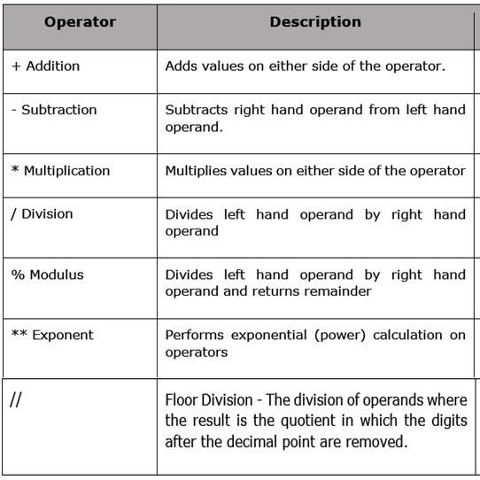
Arithmetic Operators :

Slide 3
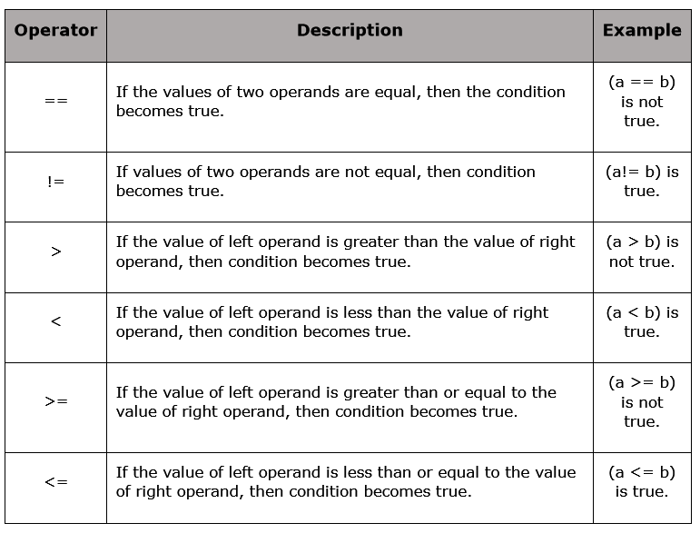
Comparison or Relational Operators :

Slide 4
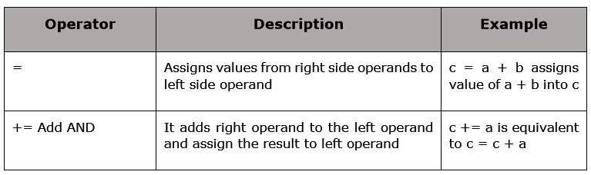
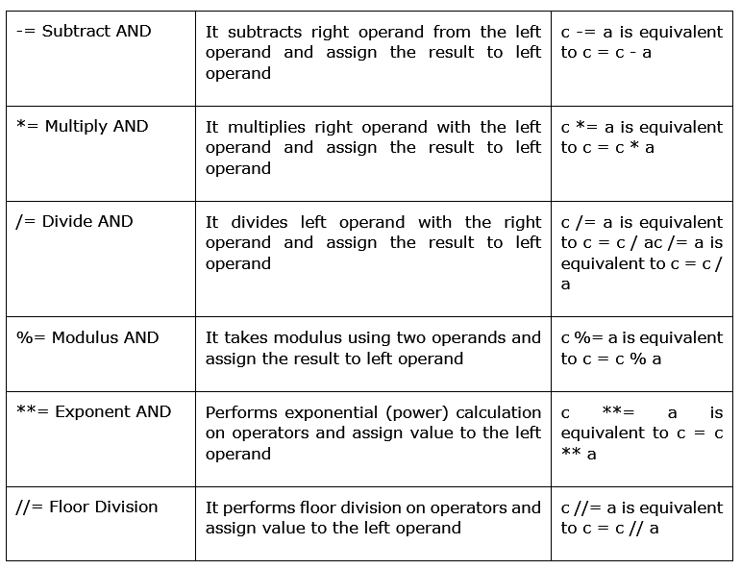
Assignment Operators :

Slide 5
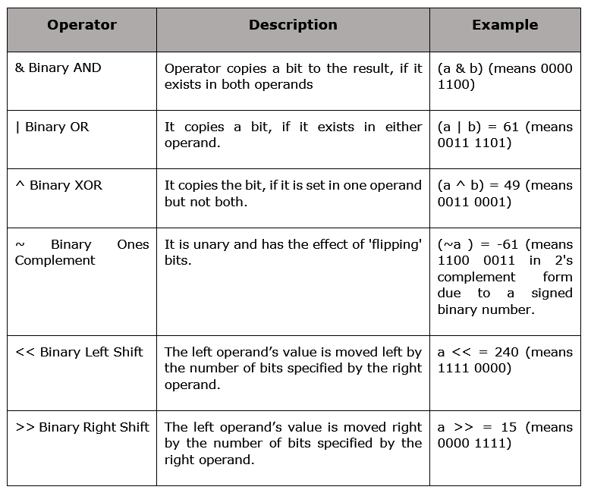
Bitwise Operators: a=60, b=13

Slide 6
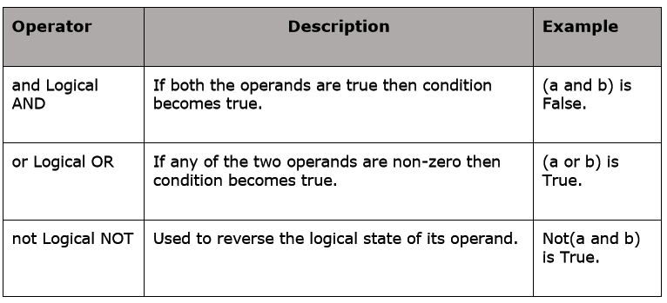
Logical Operators:

Slide 7
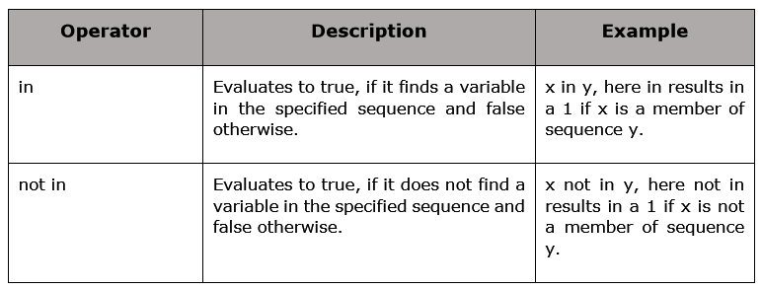
Membership Operators:

Slide 8
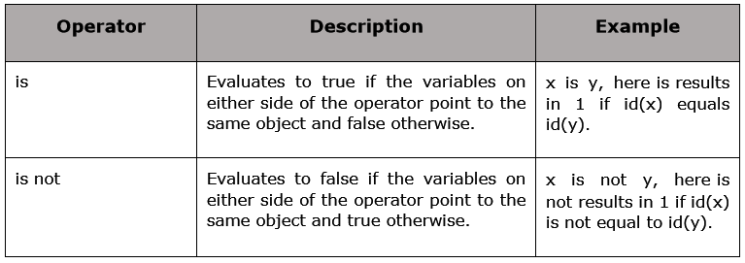
Identity Operators:

