Slide 1

“Food Delivery Website And Application”
Task - 3

Slide 2
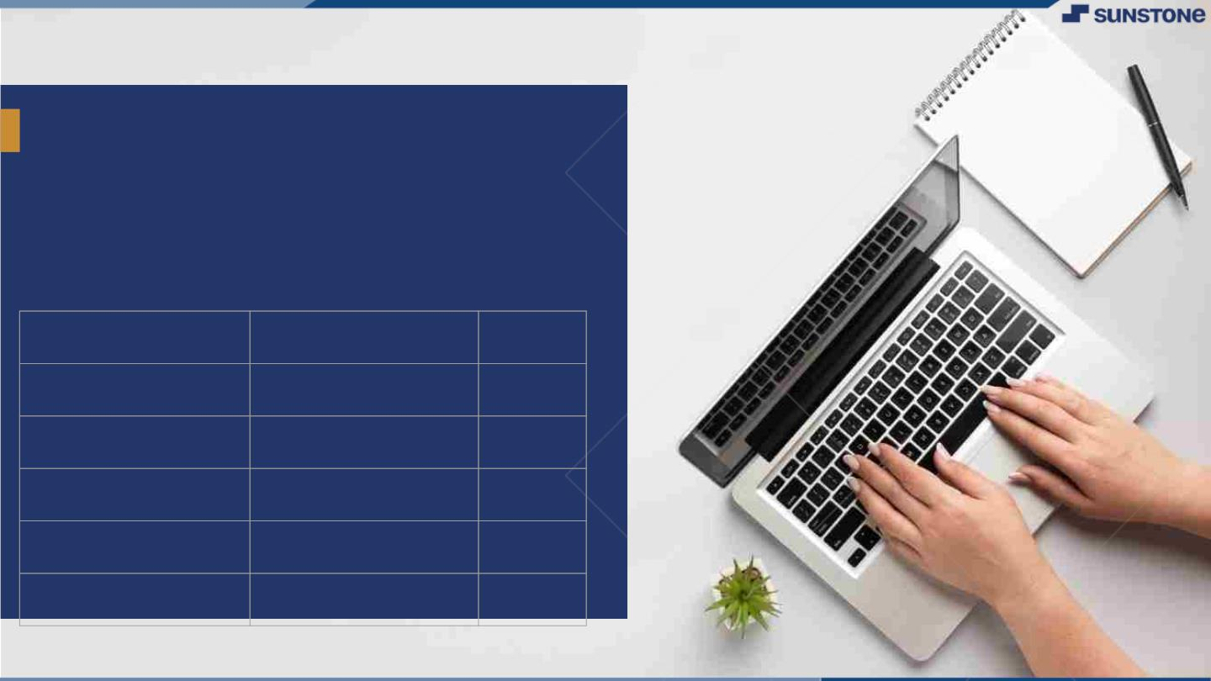
Food Delivery Website And Application
LSM USERNAME | NAME | BATCH
Naazeema Begum A | A.Naazeema Begum | NM_0.2 CC3
S Sujitha | S.Sujitha | NM_0.2 CC3
Udhaya lakshmi V | V.Udhaya Lakshmi | NM_0.2 CC3
Kayalvizhi P | P.Kayalvizhi | NM_0.2 CC3
Swetha M | M.Swetha | NM_0.2 CC3

Slide 3

Task 3 :: Frontend Creation
Create various Front End Programs
Draw and design a uniform front end code for “Your Project”
Draw and design a interactive front end code for “Your Project”
EvaluationꢀMetric:
● 100%ꢀCompletionꢀofꢀtheꢀaboveꢀtasks
Learning Outcome
Developing complicated UI using HTML components
Using props drilling and context to pass variables
Getting familiar with different type of api calls
Handling different input data

Slide 4

Step-WiseꢀDescription
Components creation: Creation of various components for frontend
Develop responsive and user-friendly interfaces for both the website and the mobile application
Creation a database to store user information, menus, orders, and other relevant data.
Optimize the database for efficient data retrieval and storage.
Summaryꢀofꢀyourꢀtask
Design and implement the user interface (UI) of the website or application.

Slide 5
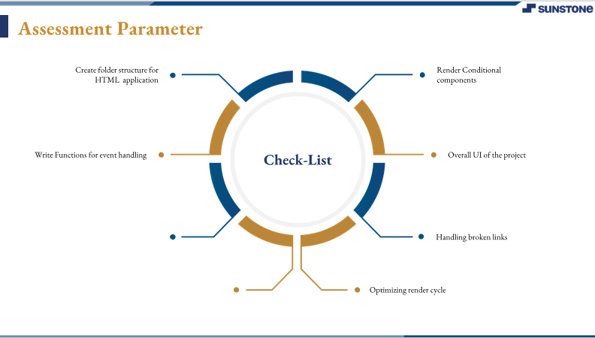

Slide 6
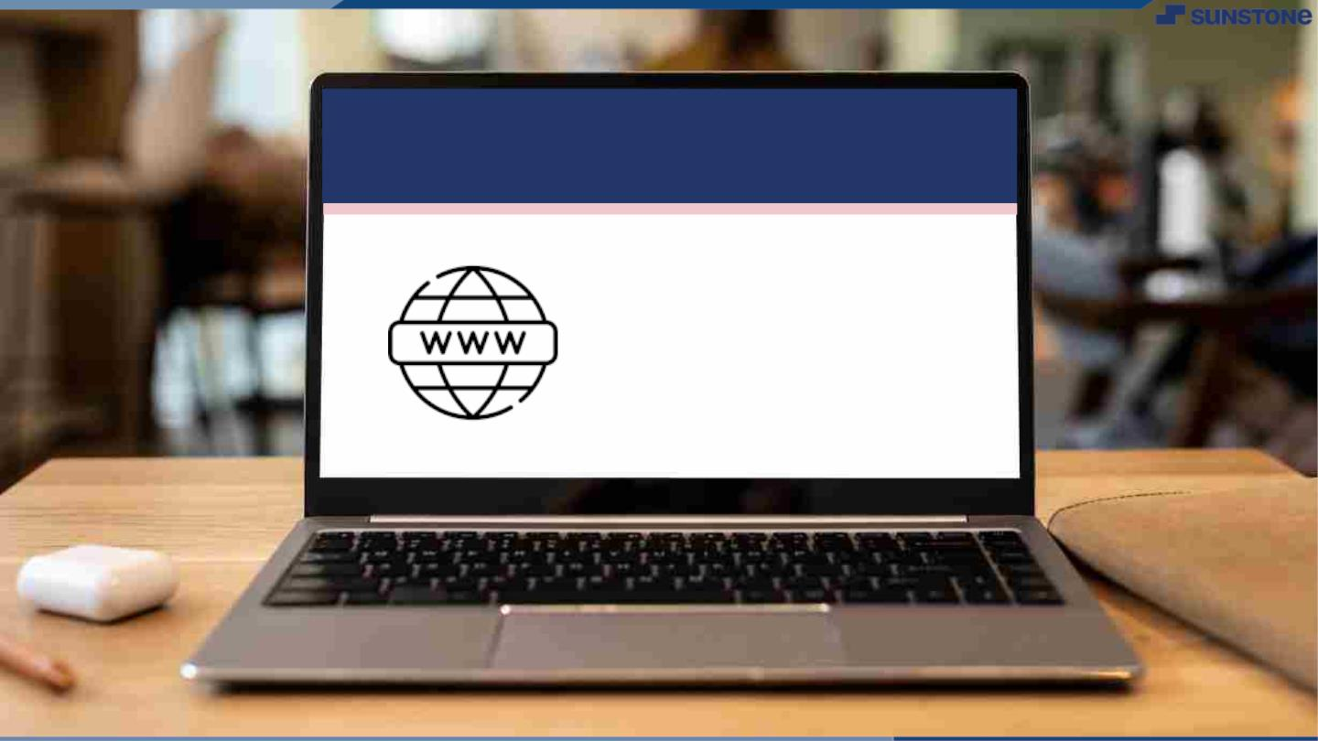
Submission Github
https://github.com/Suji443/NaanMudhalvan

Slide 7


