Slide 1
Project Kindle
Devoja Ganguli
Nazila Shafiei
Suji Yang
May 6, 2019

Slide 2
This project
Sentiment analysis
Does the review says Good or Bad?
Data: Amazon Kindle e-book reviews
http://jmacauley.ucsd.edu/data/amazon/index.html
Techniques: Python library sci-kit learn for supervised machine learning

Slide 3
Procedure
Import all desired packages
Import Amazon Reviews data set using gzip and parse functions
Data Cleaning
Feature Scaling (Binary, Multi-label) of data
Tokenizing and Splitting the data
Word Embedding (Google pretrained word2vec model)
Convert word embedding into sentence embedding
Machine learning
Make predictions on new data with the saved models
Notes:
4. Tokenize and split “str.split()” the Data

Slide 4
Procedure
Import all desired packages
Import Amazon Reviews data set using gzip and parse functions
Data Cleaning
Feature Scaling (Binary, Multi-label) of data
Tokenizing and Splitting the data
Word Embedding (Google pretrained word2vec model)
Convert word embedding into sentence embedding
Machine learning
Make predictions on new data with the saved models
Notes:
4. Tokenize and split “str.split()” the Data

Slide 5
Procedure
Import all desired packages
Import Amazon Reviews data set using gzip and parse functions
Data Cleaning
Feature Scaling (Binary, Multi-label) of data
Tokenizing and Splitting the data
Word Embedding (Google pretrained word2vec model)
Convert word embedding into sentence embedding
Machine learning
Make predictions on new data with the saved models
Notes:
4. Tokenize and split “str.split()” the Data

Slide 6
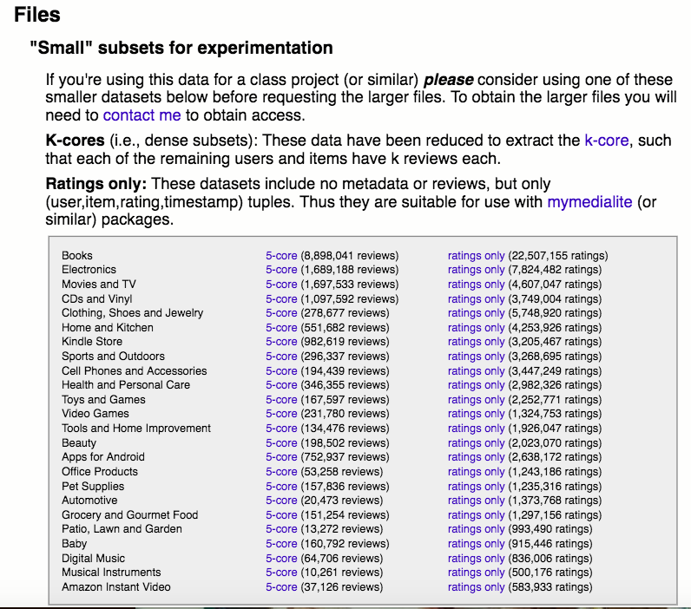
Amazon product data
Julian McAuley, UCSD
http://jmcauley.ucsd.edu/data/amazon/index.html
Notes:
2. Import Amazon Reviews Data set using gzip and parse functions

Slide 7
Procedure
Import all desired packages
Import Amazon Reviews data set using gzip and parse functions
Data Cleaning
Feature Scaling (Binary, Multi-label) of data
Tokenizing and Splitting the data
Word Embedding (Google pretrained word2vec model)
Convert word embedding into sentence embedding
Machine learning
Make predictions on new data with the saved models
Notes:
4. Tokenize and split “str.split()” the Data

Slide 8
Procedure
Import all desired packages
Import Amazon Reviews data set using gzip and parse functions
Data Cleaning
Feature Scaling (Binary, Multi-label) of data
Tokenizing and Splitting the data
Word Embedding (Google pretrained word2vec model)
Convert word embedding into sentence embedding
Machine learning
Make predictions on new data with the saved models
Notes:
4. Tokenize and split “str.split()” the Data

Slide 9
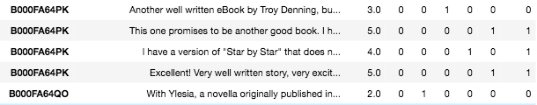
Feature Scaling
Ratings of 1.0 to 5.0
Binary classification {0: negative, 1: positive}
Notes:
ratings 3 and below as negative (bad) and ratings of 4 and 5 as positive (good)

Slide 10
Procedure
Import all desired packages
Import Amazon Reviews data set using gzip and parse functions
Data Cleaning
Feature Scaling (Binary, Multi-label) of data
Tokenizing and Splitting the data
Word Embedding (Google pretrained word2vec model)
Convert word embedding into sentence embedding
Machine learning
Make predictions on new data with the saved models
Notes:
4. Tokenize and split “str.split()” the Data

Slide 11
Procedure
Import all desired packages
Import Amazon Reviews data set using gzip and parse functions
Data Cleaning
Feature Scaling (Binary, Multi-label) of data
Tokenizing and Splitting the data
Word Embedding (Google pretrained word2vec model)
Convert word embedding into sentence embedding
Machine learning
Make predictions on new data with the saved models
Notes:
4. Tokenize and split “str.split()” the Data

Slide 12
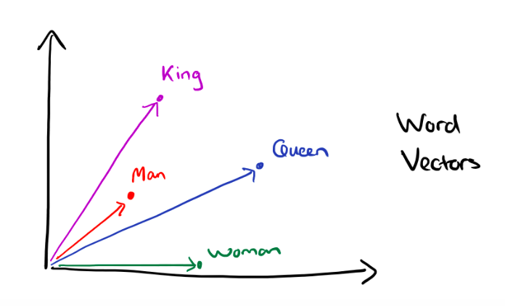
Google Pretrained Word2Vec Model
Word2Vec: array[3.005, -2.9867676, … 10.6] (size: 300)
https://blog.acolver.org/word2vec-king-queen-vectors/

Slide 13
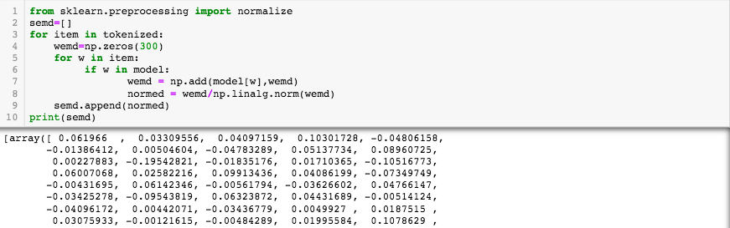
Word to Sentence Embedding

Slide 14
Procedure
Import all desired packages
Import Amazon Reviews data set using gzip and parse functions
Data Cleaning
Feature Scaling (Binary, Multi-label) of data
Tokenizing and Splitting the data
Word Embedding (Google pretrained word2vec model)
Convert word embedding into sentence embedding
Machine learning
Make predictions on new data with the saved models
Notes:
4. Tokenize and split “str.split()” the Data

Slide 15
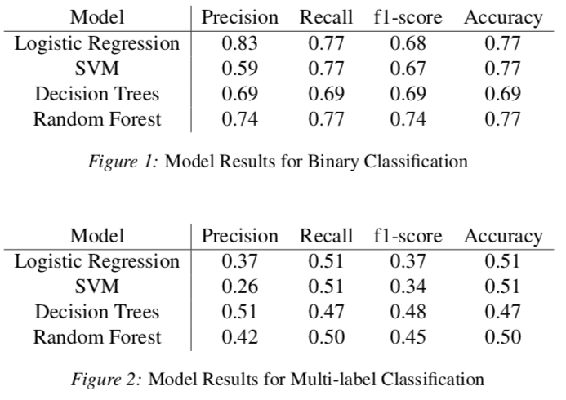
Machine Learning

Slide 16
Procedure
Import all desired packages
Import Amazon Reviews data set using gzip and parse functions
Data Cleaning
Feature Scaling (Binary, Multi-label) of data
Tokenizing and Splitting the data
Word Embedding (Google pretrained word2vec model)
Convert word embedding into sentence embedding
Machine learning
Make predictions on new data with the saved models
Notes:
4. Tokenize and split “str.split()” the Data

Slide 17
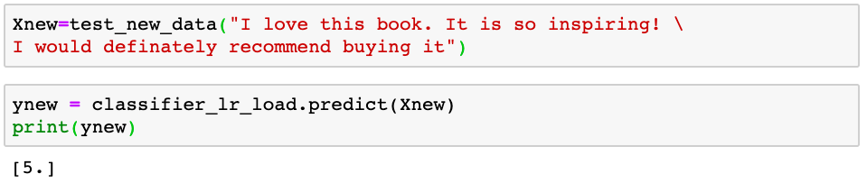
Making Prediction with models

Slide 18
Conclusion
We did not estimate the results multiple times using cross-validation on our data
Having limited computational power prevented us from running the model on the whole dataset
Last but not least, we plotted different training and testing sizes and compared the accuracy of classifiers

Slide 19
References
Bengfort, Benjamin, Rebecca Bilbro, and Tony Ojeda. 2018. Applied Text Analysis with Python: Enabling Language-aware Data Products with Machine Learning. O’Reilly Media, Inc.
He, Ruining, and Julian McAuley. 2016. Ups and downs: Modeling the visual evolution of fashion trends with one-class collaborative filtering. In proceedings of the 25th international conference on world wide web, pp. 507-517. International World Wide Web Conferences Steering Committee
Liu, Bing. 2012. Sentiment analysis and opinion mining. Synthesis lectures on human language technologies 5 (1) : 1-167.
McAuley, Julian. Amazon product data.

