Slide 1
Heterogeneous Graph Attention Network for semi-supervised News Classification
Thesis Mid-Term Presentation Sujil Devkota
074/MSCSKE/013
Supervisor
Dr. Aman Shakya

Slide 2
Introduction
News classification is one of the application of text classification
It helps to categorize news article into certain class, so it is useful when accessing relevant information or recommending news to user
Classification problem deals with both understanding the semantics and grouping the text to its class
Large amount of label data are usually required for classification problem

Slide 3
Problem Statement
Difficult to find labeled data and less labeled data usually doesn’t give high accuracy
Since there is large amount of unlabelled data, getting information from such data will be very beneficial
Extracting information from less amount of data is also challenging

Slide 4
Objectives
To leverage the use of less amount of labelled data as well as large unlabelled data.
To convert raw text data to rich semantic heterogeneous graph network.
To classify the short news data using semi-supervised HGAT method enhancing the embedding approach

Slide 5
Literature Review
Traditional text classification methods such as SVM (Blei et al., 2003)need a feature engineering step for text representation. Similarly, various deep neural network such as RNNs (Liu et al., 2016; Sinha et al., 2018) and CNNs, (Kim, 2014; Shimura et al., 2018) and character-level CNN Zhangetal. (2015) were applied in text classification problem which improve the accuracy Introduction of graph network in the text processing explore more rich semantics with the introduction of GCN (Kipf and Welling, 2017) and also Text GCN (Yao et al., 2019). Later attention layer was added to introduce GAT and HGAT network which perform better in less amount of data.

Slide 6

Why Graph Network?
Natural Representation of Data in graph (preserve higher level semantic levels)
Unlike CNN which has fixed size grid structure (grid graph), it is more flexible
No fixed ordering
Node can have any amount of neighbor

Slide 7
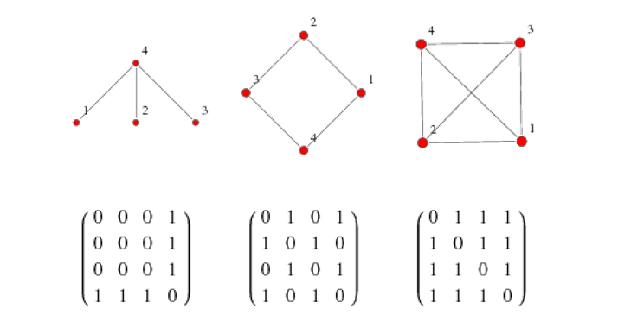
Graph Network
Graph is collection of nodes and edges between them
It can represent a real world objects since every object has property and interactions with some other objects.
Graph (V,E)
Adjacency matrix

Slide 8
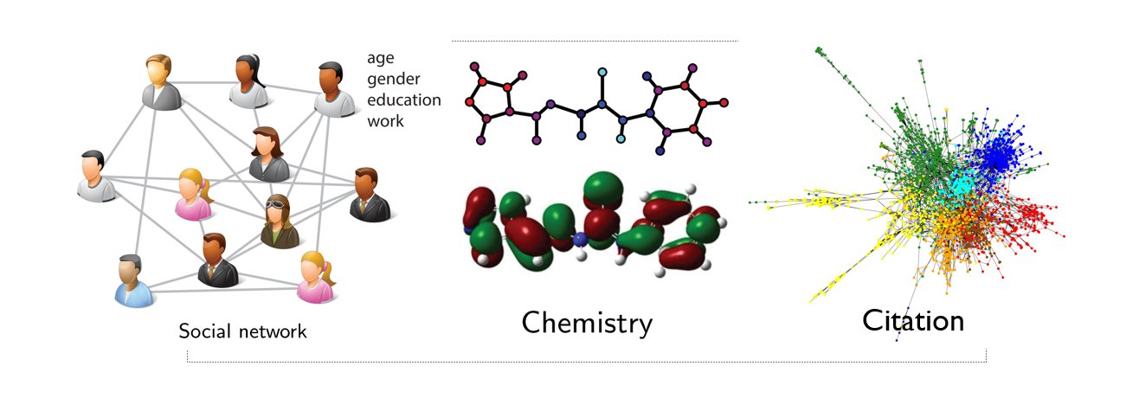
Data representation in Graph

Slide 9


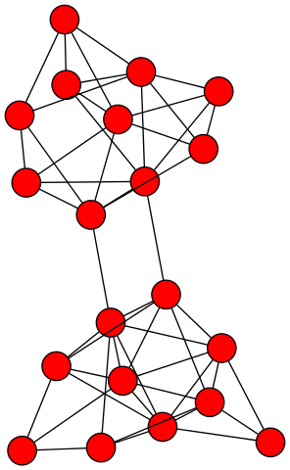
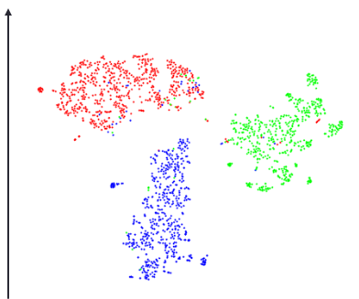

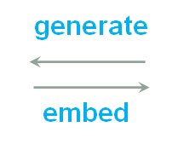
Network Embedding

Slide 10
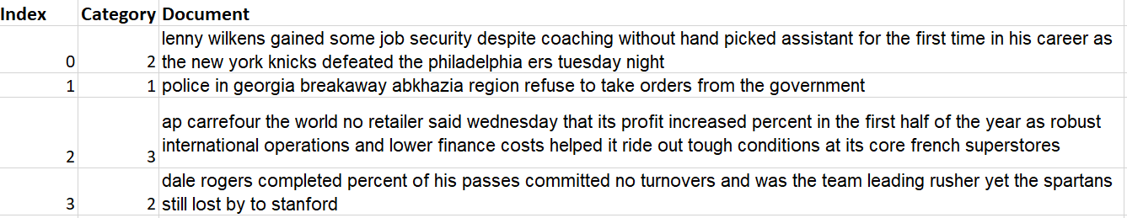
Methodology
Datasets AGNews datasets- 6000 data Derived from base AGNews dataset which contain 4,96,835 categorized news articles from more than 2000 news sources more than 1 year. Updated(09/09/2015) Format: [index] \t [category] \t [news text] \n Category value is: 1-World, 2-Sports, 3-Business, 4-Sci/Tech
Notes:
Document is the text of the news article it is usually very short text average characters in the document is around characters

Slide 11
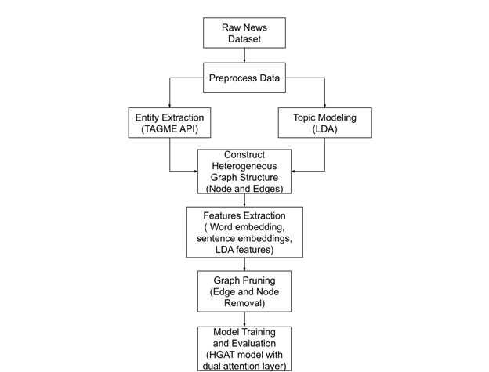
Overall Block Diagram

Slide 12
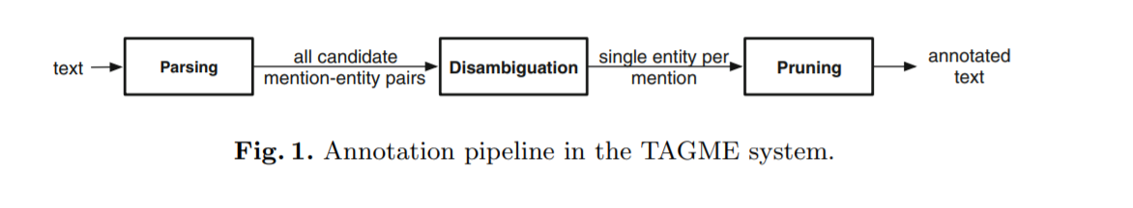
Entity Extraction
Use of TagME API
Input one sentence
Output list of entities in that sentence [{entity 1}, {entity 2},.....]
Format of output: entity 1 = {spot, start, link_probability, rho, end, id, title }

Slide 13
2. Topic Modelling
Represents abstract topic that occur in collection of documents
Latent Dirichlet Allocation (LDA) is used for topic modeling
T_i =(θ_1,θ_2.....,θ_w) where, i is the number of topics θ_w represents keywords and w is the vocabulary size Here each T_i will form a node and each document is assigned with P topics that have the highest probabilities

Slide 14
3. Building Graph
Graph type: Undirected and Heterogeneous Graph
Edge has a label to store link strength
Node type: Document - Ⓓ, Topic - Ⓣ, Entity - Ⓔ
Edge type: Ⓓ↔Ⓣ Ⓓ↔Ⓔ Ⓔ↔Ⓔ
Two documents are linked in following formations with each other Ⓓ↔Ⓣ↔Ⓓ Ⓓ↔Ⓔ↔Ⓓ Ⓓ↔Ⓔ↔Ⓔ↔Ⓓ
Hyperparameters: enitity_similarity : 0.5, min_entity_connection: 10 num_train_text_class: 40-600

Slide 15
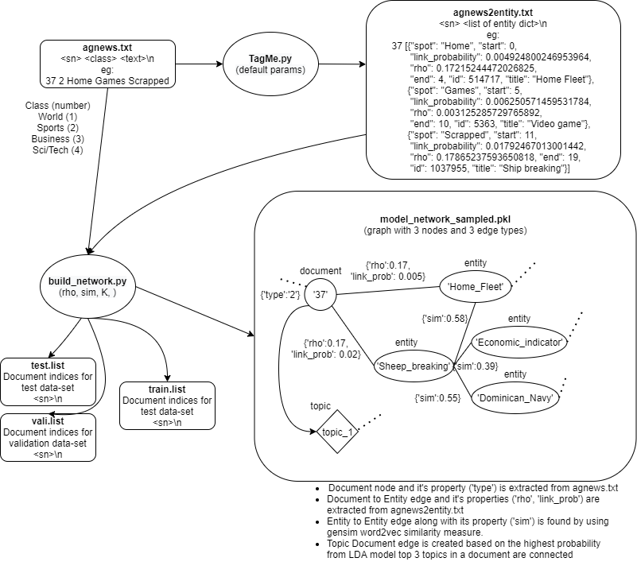
Overall Process of Building Graph

Slide 16
4. Feature Representation
Building the entity node features Pre-trained word2vec model is used to get the word embedding of the entity
Build Text node features Sentence embeddings is generated by averaging the word embedding of each word in the text
Build Topic node features (LDA components), Obtained from topic model
Basic preprocessing used
Tokenize
Lowercase
remove non-alpha characters
remove stop words
word that repeats less than 5 (whole data)

Slide 17
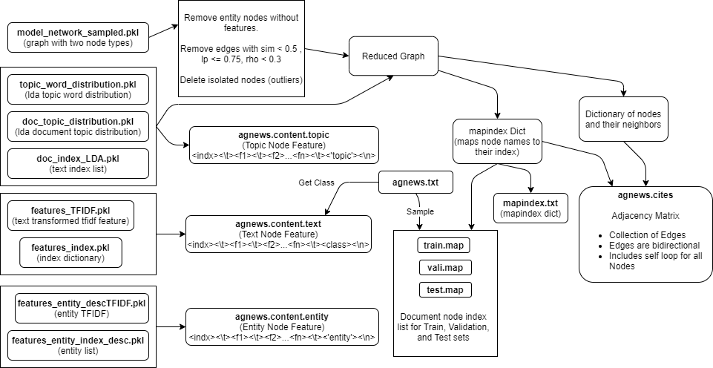
5. Graph Pruning (Overall Diagram)

Slide 18
4. Training
HGAT model HIdden Unit = 512 Class = 4 Dropout Rate (DP) = 0.95 Gamma = 0.1
Adam Optimizer Learning Rate (LR) = 0.005 Weight Decay (WD) = 5e - 8 Epoch = 300 Seed = 42

Slide 19
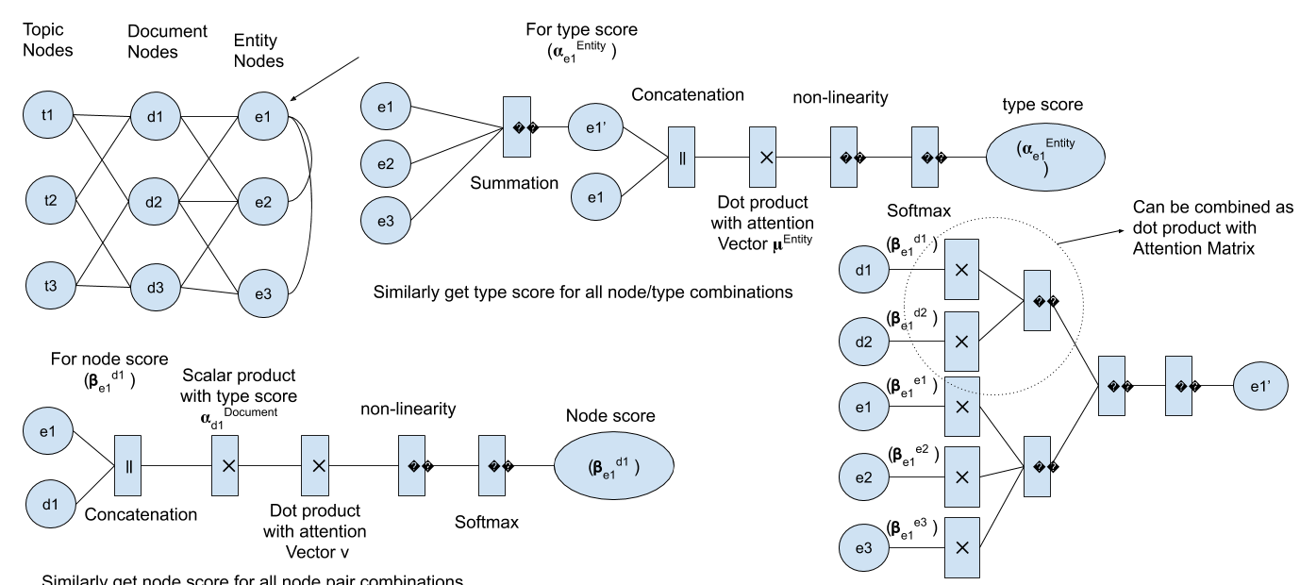
HGAT model

Slide 20
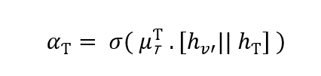
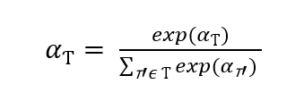
Attention in HGAT
Dual Attention Layer
Type level attention and Node Level attention
Type Level concentrate on which node to give more attention based on its type
Node Level attention is used to focus on attention in individual node 𝜶_{T} is the type level attention which is then passed through softmax layer

Slide 21
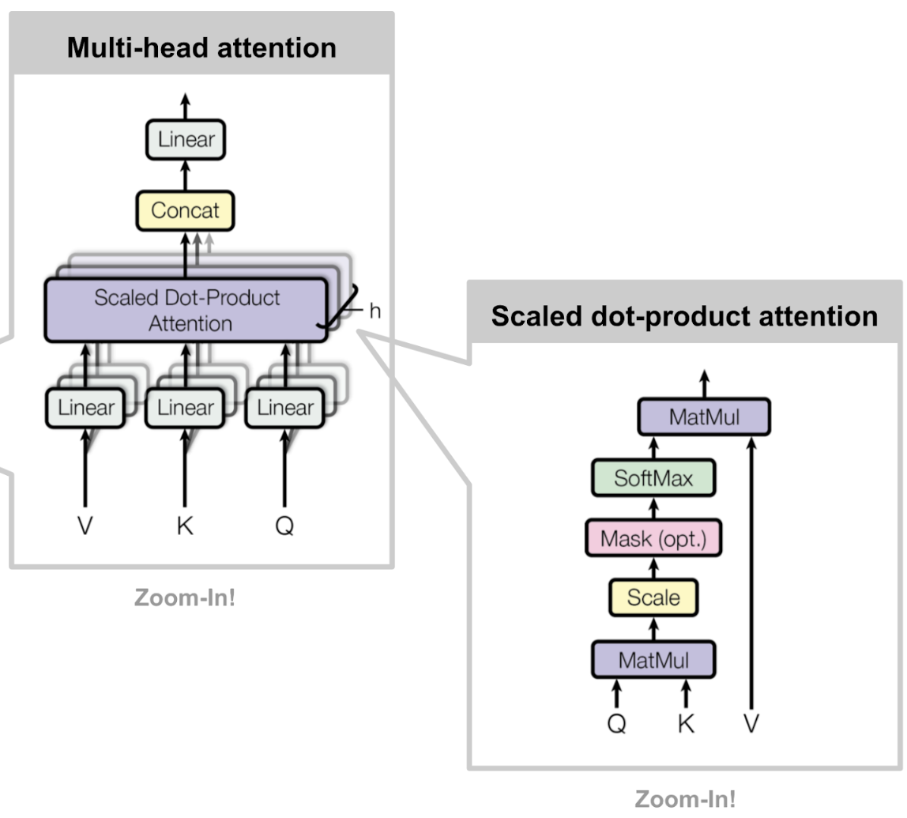

Multi-head Attention Network

Slide 22
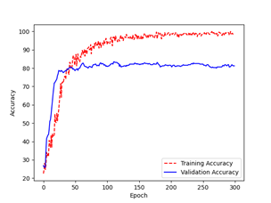
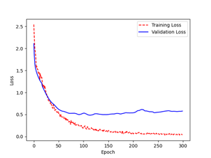
Results
Fig: Accuracy Curve and Loss Curve

Slide 23
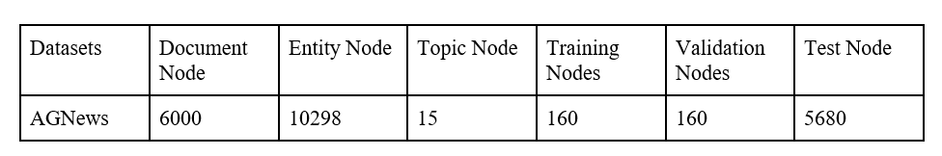
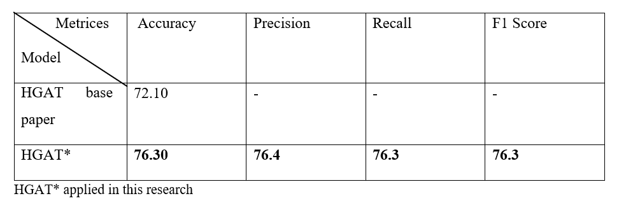
Comparison table

Slide 24
Work Remaining
- Optimization of model by parameter tuning
- Custom Word2vec training with available data to observer the performance
- Testing with other text datasets (another news dataset with more classes)
- Application of Doc2Vec model in text embeddings
- Improvement and update of documentation
- Variational Autoencoders for topic modeling

Slide 25
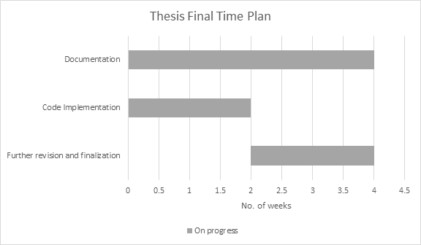
Gantt Chart

Slide 26
References
[1] Petar Velickovi ˇ c, Guillem Cucurull, Arantxa Casanova, Adriana Romero, Pietro ´ Liò, and Yoshua Bengio. 2018. “Graph Attention Networks”. ICLR (2018).
[2] Xiao Wang, Hou Ye Ji, Chuan Shi, Bai Wang, Peng Cui, P. Yu, and Yanfang Ye. 2019. “Heterogeneous graph attention network”. In WWW.
[3] H. Linmei, T. Yang, C. Shi, H. Ji, and X. Li. 2019. “Heterogeneous graph attention networks for semi-supervised short text classification”. EMNLP,
[4] Cao M., Ma X., Xu M., Wang C. 2019. “Heterogeneous Information Network Embedding with Meta-path Based Graph Attention Networks”. ICANN, Lecture Notes in Computer Science, vol 11731. Springer, Cham.
[5] Ashish Vaswani, Noam Shazeer, Niki Parmar, Jakob Uszkoreit, Llion Jones, Aidan N. Gomez, Lukasz Kaiser, and Illia Polosukhin. 2017. “Attention is All you Need”. In NIPS. 5998–6008.
…..

Slide 27
Thank You

