Slide 1
SUPPLY CHAIN MANAGEMENT SYSTEM(SCMS)
SUJIN CHANDRAN
Employee ID : 46009185

Slide 2
Objectives
Supply Chain Management System
Use Case Diagram
Class Diagram
Sequence Diagram
Screenshots
Enhancements

Slide 3
Supply Chain Management System
Supply Chain Management System(SCMS) helps to manage details about customers, dealers, products and orders.
It allows admin to create, display, edit and remove products.
It also helps customers and dealers to register in it and they are asked to login with their username and password.
Also, customers can place a order via login. On the other side admin will accept the order and assigns a dealer to proceed with the product delivery.

Slide 4
Project Method
Phase 1 : Using C# Console Application.
Phase 2 : Using ADO.NET where data stored in SQL Server and UI designed using WPF.
Phase 3 : Using ASP.NET MVC.

Slide 5
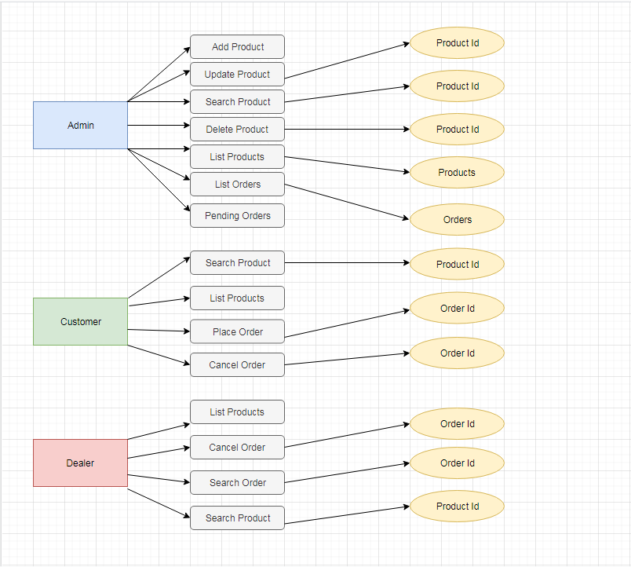
Use Case Diagram

Slide 6
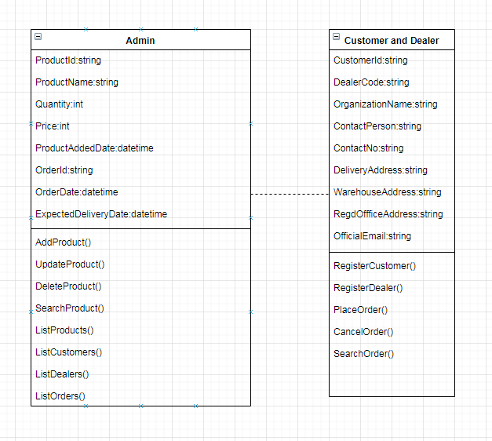
Class Diagram

Slide 7
Sequence/Activity Diagram

Slide 8
Screen shots

Slide 9
Screen shots

Slide 10
Future Enhancements

Slide 11
Thanks

