Slide 1
Cosmo Gas Vision
IGM NeRF:
3D reconstruction of intergalactic gas from 1D quasar absorption spectra
Reconstructing cosmological gas density from sparse 1D absorption signals from ray marching.
Physics-informed NeRF's continuous-field representation and its rendering operator.
Sujin Hwang

Slide 2
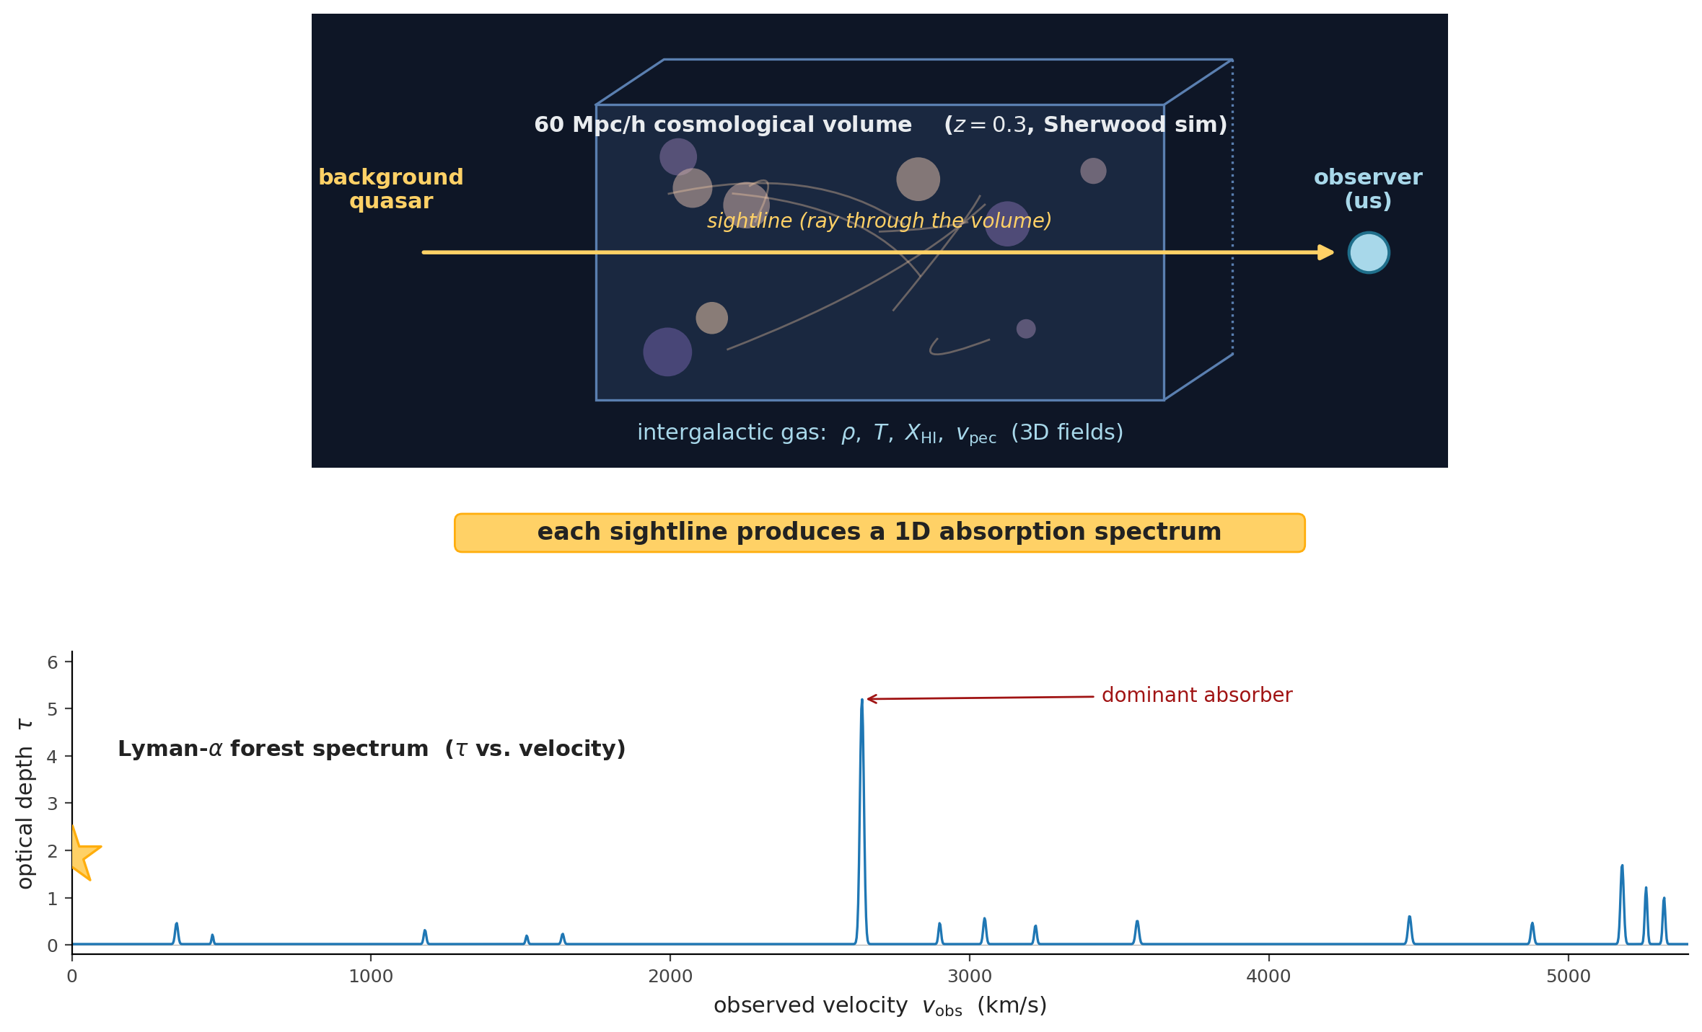
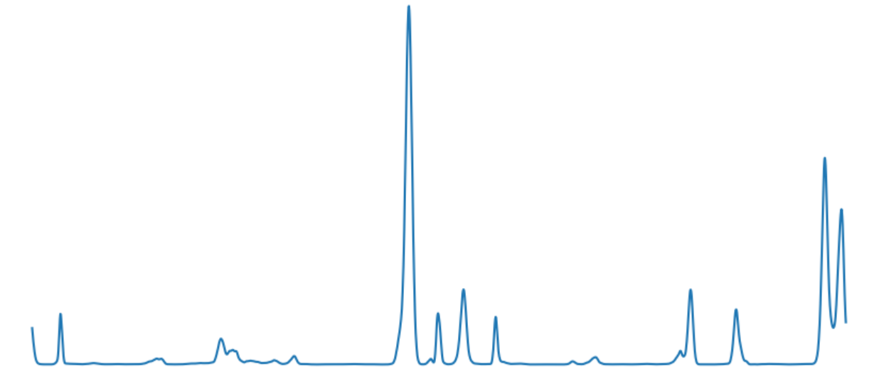
What we are looking at: cosmological gas + quasar spectra
Notes:
"The data comes from the quasar absorption spectra: light from distant quasars passes through intergalactic cosmic gas and gets partially absorbed. Each quasar gives us one long 1D spectrum — a single ray through the 3D volume.
This is a classic sparse-view 3D reconstruction problem, but with three unusual challenges:
Observations are 1D spectra, not 2D images.
2. The forward model is a known nonlinear physics operator (optical depth integral), not learned rendering.
3. The signal is heavily heavy-tailed — most values are small, but rare dense clouds create extremely deep absorption spikes (τ up to 10⁷),
where normal per-pixel Mean Square Error would fail on this."

Slide 3
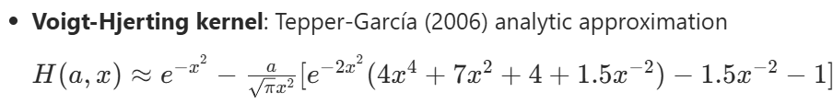
Why this looks like a NeRF problem
NeRF | IGM-NeRF | Notes
Synthetic / real-world scene, ~few m³ | 60 Mpc/h cosmological box
Camera ray through pixel | Spectrum through IGM box
RGB at pixel (u,v) | Optical depth at observed-velocity bin (v_obs)
5D Input, position (x,y,z) + view direction (θ,φ) | Comoving 3D coordinate input in the box | physics is view-independent
Fourier Positional Encoding L_pos=10, L_dir=4 | Fourier Positional Encoding L=10 (no direction encoding) | Captures multi-scale filaments + voids
Volume density σ | Neutral hydrogen density (ρ × X_HI) | Opacity along the ray
View-dependent color c | Voigt absorption kernel H(a,x) | Known physics function, not learned
Volume rendering integral | Differentiable optical depth integral | Line integral along the ray
Notes:
Here is how I mapped the original NeRF to our problem.
As you can see in this table, I kept the core ideas from the original NeRF paper and only changed what needed to be changed for our physics-based setting.
First We still use 3D position as input, just like NeRF — but we don’t need view direction because gas properties are view-independent.
Next The Fourier positional encoding is identical (L=10). This is helpful because the cosmic gas structure has structures across many scales — from large voids to thin filaments.
The MLP backbone is identical to the original NeRF architecture: 8 layers, 256 units, with the same skip connection.
In short: we kept NeRF’s powerful continuous representation and implicit neural field approach, but replaced the rendering engine with real astrophysical physics.
This is what allows us to do sparse-view 3D reconstruction from 1D absorption spectra.”

Slide 4
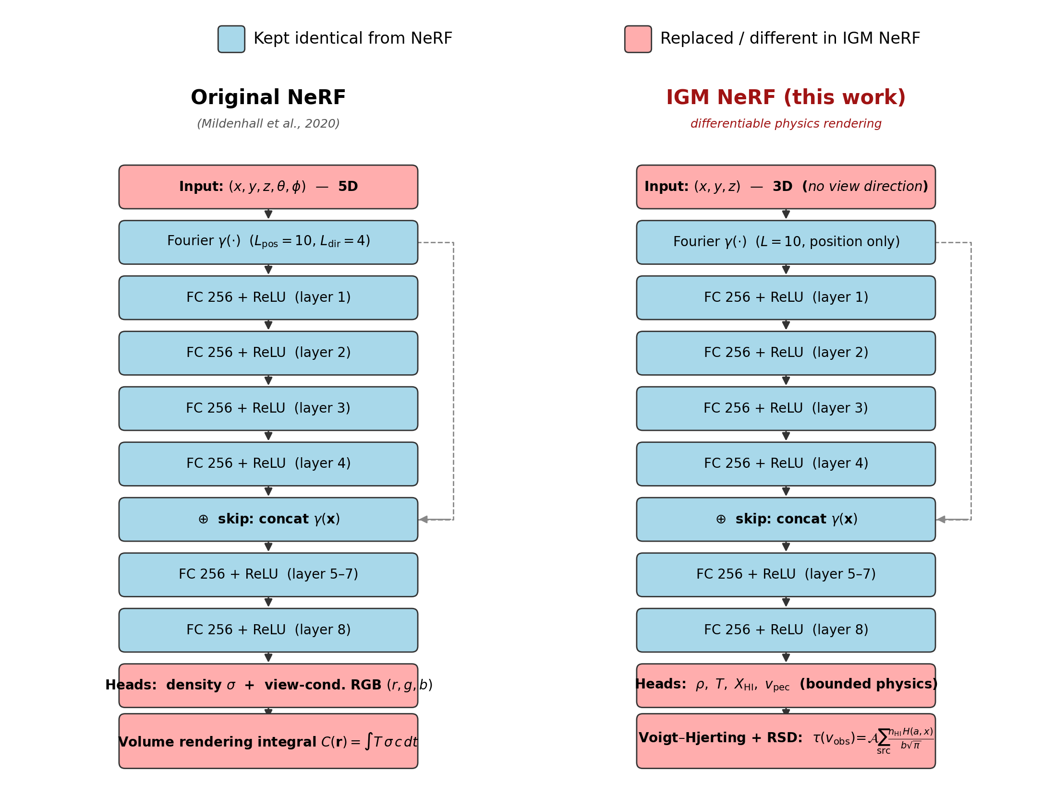
NeRF vs IGM NeRF
Field | Activation | Notes
Density (ρ / ρ̄) | Softplus | Ensures positivity. Filament peaks ~100× mean.
Temperature (T) | Softplus(x) × 10⁴ + 10³ K | Floor at 10³ K (cold gas). Anchored at 10⁴ K. WHIM tail reachable.
HI Fraction (X_HI) | Sigmoid | Constrains to [0, 1].
Peculiar Velocity (v_pec) | Tanh(x) × 500 km/s | Suitable for diffuse IGM at z=0.3 (±200–300 km/s typical). Soft clipping for extremes.
Notes:
"Here’s how we mapped NeRF to this problem:
Using the exact same MLP backbone as original NeRF (8 layers × 256 units, skip connection at layer 4),
The main changes are physics-aware output activations and the custom differentiable renderer.“
Instead of predicting color and density, we predict physical fields: gas density, temperature, neutral hydrogen fraction, and peculiar velocity.
Most importantly, we replaced NeRF’s volume rendering integral with a differentiable optical depth integral that uses the Voigt absorption kernel.

Slide 5
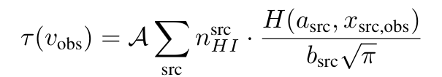

Differentiable physics rendering + loss design
Optical-depth rendering
Loss design
(1) Mask (Saturated-absorber mask) Completely ignore bins where τ is extremely high (saturated cores). These bins contain almost no useful spatial information anyway (the light is fully absorbed).
(2) Cap (at τ_max=10)
For all remaining bins, clip both prediction and ground truth at τ = 10. This prevents strong-but-not-fully-saturated lines from producing huge gradients.
(3) log1p supervision
Instead of MSE(τ_pred, τ_gt), compute
NeRF | IGM-NeRF | Notes
Volume rendering integral | Differentiable optical depth integral | Line integral along the ray
Per-pixel MSE on RGB | log(1+τ) + cap + mask MSE on τ + soft mean-flux anchor
Why log(1+τ)? The IGM opacity distribution is approximately log-normal (Fluctuating Gunn-Peterson Approximation; Bi & Davidsen 1997). Log-space supervision matches this natural noise model, analogous to log-depth supervision in computer vision.
Notes:
"The key technical piece is the differentiable physics rendering:
So the intuition behind the rendering equation is:
Each gas cell contributes a small absorption bump whose shape is given by the Voigt kernel we saw 2 slides ago
(temperature-dependent width + peculiar velocity shift).
We sum all these bumps along the ray to get the predicted 1D spectrum.
For the loss,
1. Mask out completely saturated cores (they carry no useful information)
2. Cap remaining values at τ=10
3. Supervise in log(1 + τ) space (matches the natural log-normal distribution of IGM opacity)

Slide 6
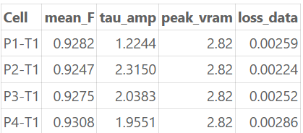
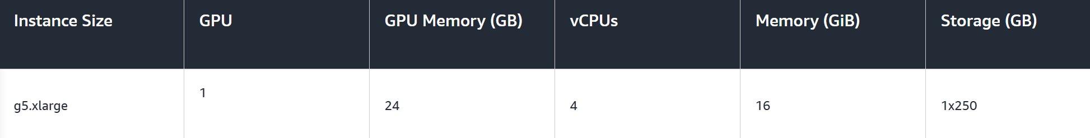
Result: Tier-1 across four feedback variants
Physics | T1 (n=64) | T2 (n=256) | T3 (n=1024) | T4 (n=16,384)
P1 (no fdbk) | 0.9282 / 1.224 | — | — | —
P2 (wind) | 0.9247 / 2.315 | — | — | —
P3 (wind+AGN) | 0.9275 / 2.038 | — | — | —
P4 (strong AGN) | 0.9308 / 1.955 | — | — | —
Same architecture
Same loss
Same hyperparameters
Four different physics priors
Four consistent reconstructions
Calibration constraint holds across all four
Cell: ⟨F⟩_pred / 𝒜 at the production schedule (50,000 steps each).
Mean-flux spread across four physics: 0.9247 → 0.9308 (0.66 %)
Well within the 5 % calibration tolerance vs the observational anchor (Danforth+ 2016, ⟨F⟩_obs = 0.877 ± 15 % at z = 0.3).
T2 / T3 / T4: identical methodology, paused on compute quota
Notes:
“On a sample run with only 64 rays through the entire simulation 60 Mpc box and the model recovers nearly identical mean transmitted flux.
across four very different baryonic physics implementations (0.9247 to 0.9308).
That’s a spread of 0.66%, which is within observational calibration tolerance.

Slide 7
Where this is going
Production sweep — paused on compute
• 12 cells remain (Tiers 2-4 × 4 physics)
• ~820 GPU-hours total
• ~792 GPU-hr in Tier 4 alone (96.5 %)
• 9 calendar days @ 4-way parallel
• ≥ 12 GB VRAM
• Single-GPU per job, parallel
Three downstream gates, ready to run
• 1D flux power spectrum P_F(k_∥)
• Pearson ξ_{ρ̂,ρ}(2 Mpc/h)
• Flux-PDF KS distance
• Implemented and ready
• Awaiting Tier-3 fiducial cell to evaluate against
Notes:
“We still need to finish the training on the full data (Tiers 2–4) and run the final cosmological metrics (flux power spectrum, density correlation, flux PDF).
Final message: The NeRF architecture was the easy part.
The real contribution is showing how to build a differentiable physics-based renderer and design a loss that makes per-sample supervision work reliably on heavy-tailed scientific data.
This suggests implicit neural fields can be a powerful general tool for inverse problems well beyond traditional rendering."
Thank you.

