Slide 1
EXPANDING THE NETWORK
SellSellIt
Jared Speake, Nicholas Anzelotti and Sujin Jeong

Slide 2
WHY?
SellSellIt
ACHIEVE COHESION WITH OUR INTERSTATE BRANCHES

Slide 3
HOW?
SellSellIt
VPN
INTERNET ROUTABLE ADDRESSES
PEER TO PEER NETWORKS

Slide 4
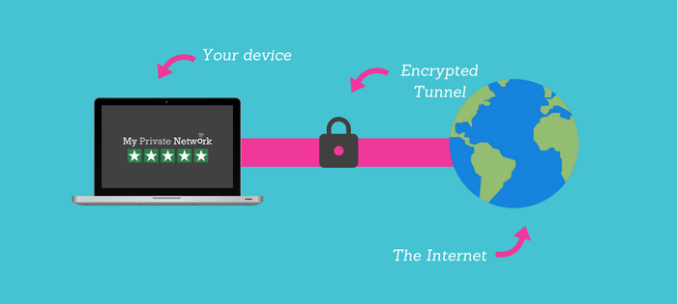
VIRTUAL PRIVATE NETWORK
SellSellIt
IMAGE SOURCE : https://www.my-private-network.co.uk

Slide 5
PROS
SellSellIt
STRONG SECURITY AND PRIVACY SOLUTIONS
PROVIDES CROSS COMPATIBILTY
SPEEDS UP THROTTLED CONNECTIONS THAT ISP LIMITS
ALLOWS EASY FILE SHARING BETWEEN CLIENTS

Slide 6
CONS
SellSellIt
DOES NOT SOLVE REGARDING SERVER SIDE COMPONENTS
SOME IPS REVOKE THE USE OF A VPN
LIMITED SPEED DEPENDING ON TYPE OF VP
INCREASED COMPLEXITY OF THE NETWORK

Slide 7
INTERNET ROUTABLE ADDRESSES
SellSellIt
INSERT IMAGE

Slide 8
PROS
SellSellIt
SIMPLE SET UP
VERSATILE FOR MULTIPLE TYPES OF CLIENT

Slide 9
CONS
SellSellIt
VERY EXPENSIVE
NOT SECURE

Slide 10
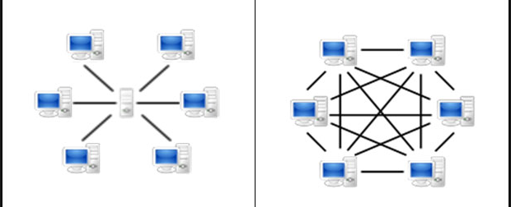
PEER TO PEER
SellSellIt
IMAGE SOURCE: https://en.bitcoinwiki.org

Slide 11
PROS
SellSellIt
EASY FILE SHARING
LOW COST
FAST CONNECTION

Slide 12
CONS
SellSellIt
RELIES ON CLIENT CONTENT
CAN BE INSECURE
POSSIBLE SLOW BROWSING SPEEDS

