Slide 1
Presentation On Workers Hub
Presented By
Anoj Gosai
Sujin Rajak
Susmita Dhital

Slide 2
Contents
INTRODUCTION
OBJECTIVES
FEATURES
SIGNIFICANTS
CONTEXT DIAGRAM
DFD LEVEL 0
DFD LEVEL ONE (For Admin, Workers and Hiring Manager)
USE CASE DIAGRAM FOR WORKERS AND HIRING MANAGER
USE CASE DIAGRAM FOR ADMIN

Slide 3
ER DIAGRAM
TOOLS AND TECHNOLOGIES
TEST CASES
FUTURE ENHANCEMENT
LIMITATIONS
CONCULSION

Slide 4
Introduction
Workers hub System is a web based application, developed to provide a platform for finding jobs and workers for the job
Workers who are looking for work can create an account and build up a resume.
Hiring manager who are looking for workers for their job can create an account and search the workers.

Slide 5
So in order to avoid such issues and inconvenience before the hiring process, we have made the system free to contact each other, hiring managers don't need to pay to register and hire workers. Workers can generate their profile and the system auto-generates their CV according to the information they have entered.
There is a hire button in our system that a hiring manager can click, and once the hiring manager has clicked that button, the worker's email will be notified.

Slide 6
Objectives
To provide platform for workers to showcase their skillset.
To provide the platform for hiring manager to search for the right candidates that suites their job requirement.

Slide 7
Features
Manage the CV of the workers
User can upload their photo.
The system allows users to edit their profile, change password.
Login system to provide user’s data security.
Profiles of the users can be rated.
Account can be deactivated and activated as per user’s will.
Hire workers in one click.

Slide 8
Significant
Hiring managers can easily get the necessary information about the workers.
Hiring manager can select the right candidate from the wide variety of candidates.
Workers can fill in the hire centric information only.
Hiring manager can select the suitable workers according to their profile ratings.

Slide 9
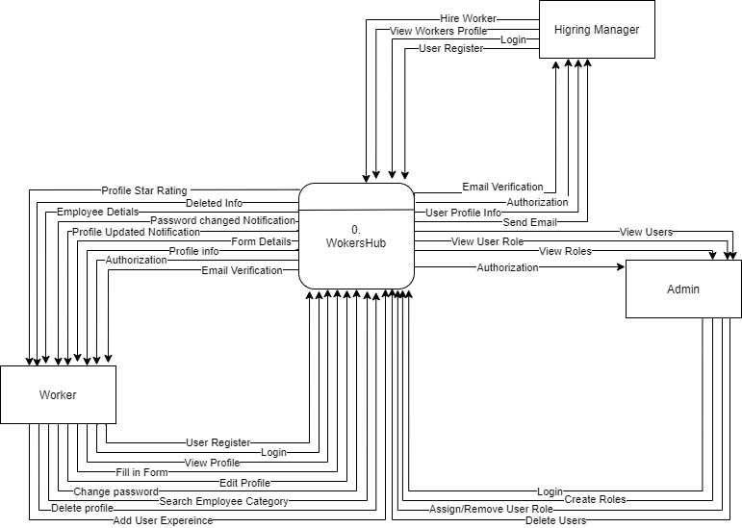
Context Diagram

Slide 10
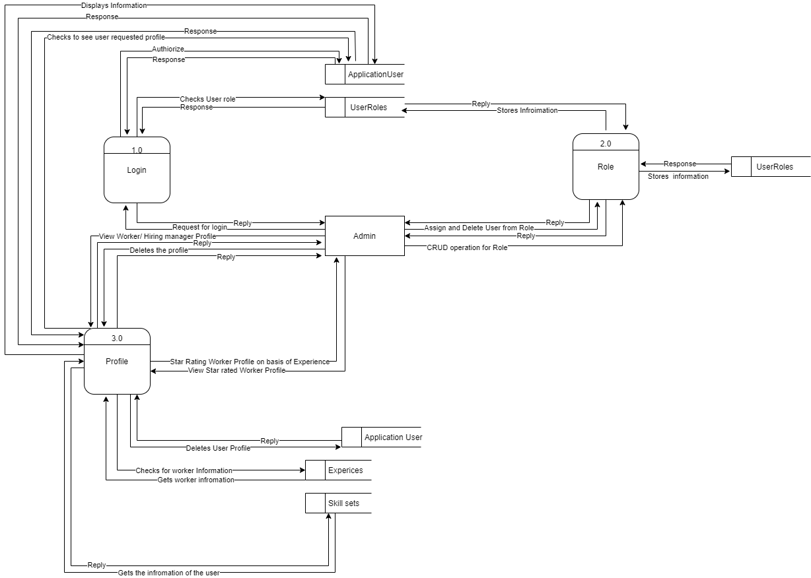
DFD Level One (For Admin)

Slide 11
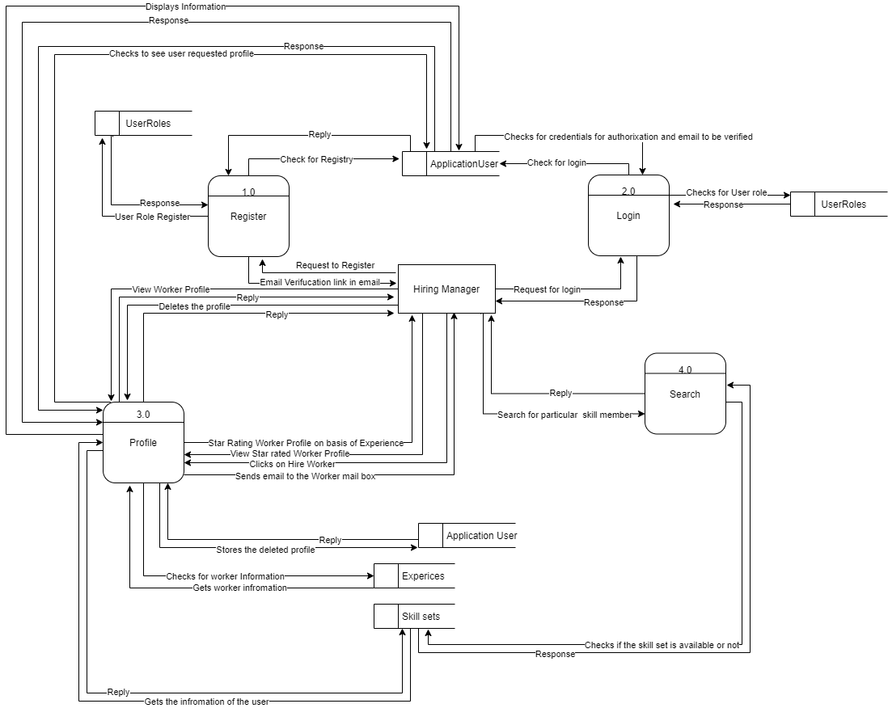
DFD Level One (For Hiring Manager )

Slide 12
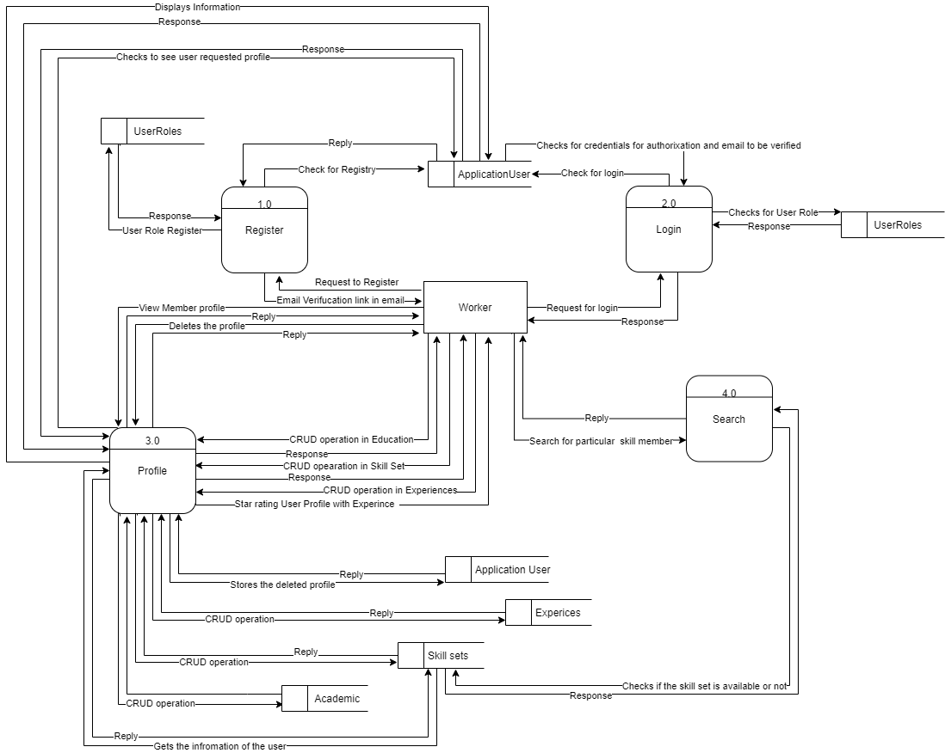
DFD Level One (For Workers)

Slide 13
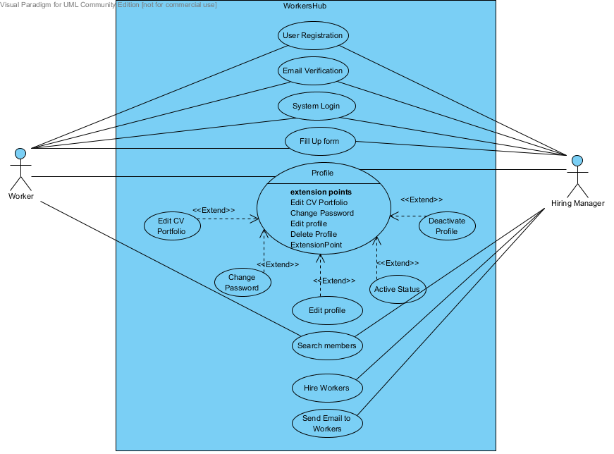
Use Case Diagram of Worker and Hiring manager

Slide 14
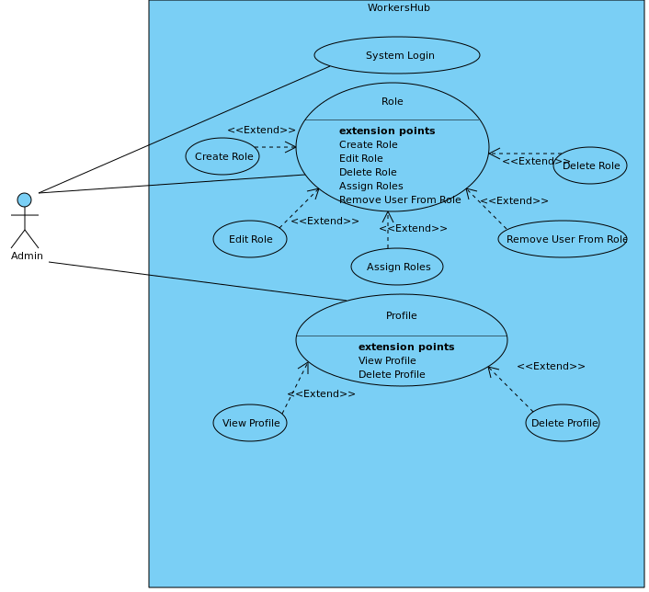
Use Case Diagram For Admin

Slide 15
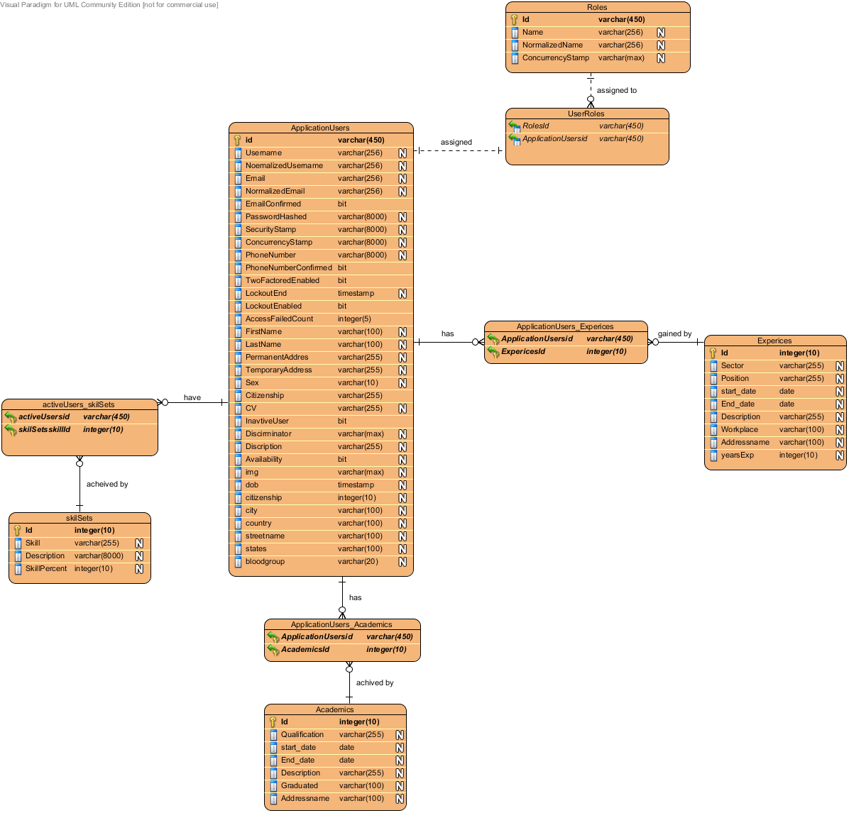
ER Diagram

Slide 16
Tools and Technologies
Front-End WEB DEVELOPMENT
Mark-up Language-HTML
Dynamic Programming Language-JavaScript
jQuery
Bootstrap
Razor Pages
Font awesome
SASS

Slide 17
Framework: ASP.NET Core
Software Architecture: MVC(Model View Controller)
Back-end web development
ASP.NET Web API
Database: SQL Server
Development tools: Visual Studio 2019, SSMS
Interface: Web application
Version control: Github

Slide 18
Test Cases
S.no | Test objectives | Remarks
1 | To check whether the website runs or not | Successful
2 | To check whether the signup button works or not | Successful
3 | To check whether the login button works or not | Successful
4 | To check whether the CURD operation can be performed or not. | Successful
5 | To check whether the profile picture can be uploaded or not | Successful
6 | To check whether the search bar is working or not. | Successful

Slide 19
Future Enhancement
We will implement chat system in the future.
We will work on GPS system for searching skills based on location.

Slide 20
Limitations
There is no chatting system is implemented in this website.
No searching of skills based on location.
No featured hiring manager or workers.

Slide 21
Conclusion
The website “Workers Hub” has been successfully designed and developed as the best and flexible website within the available resources. This website has been developed for the workers to find the suitable job related to their skillset and for the hiring managers to hire the right worker for their project type.

