Slide 1
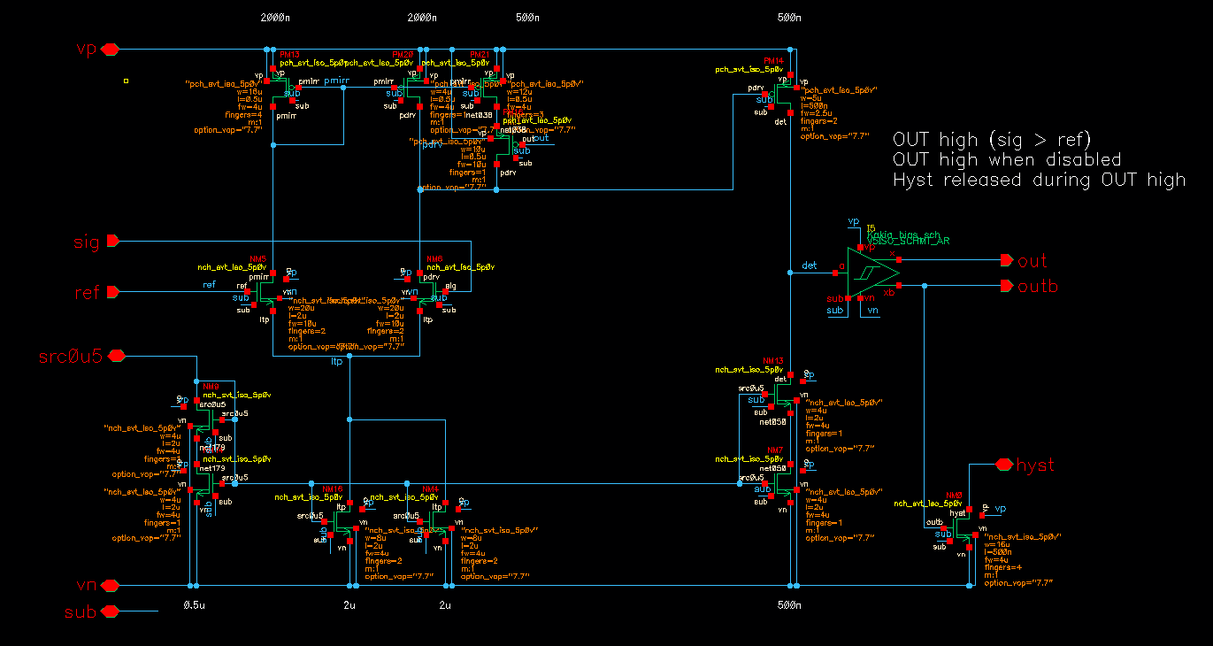
Schematic
Sub circuit

Slide 2
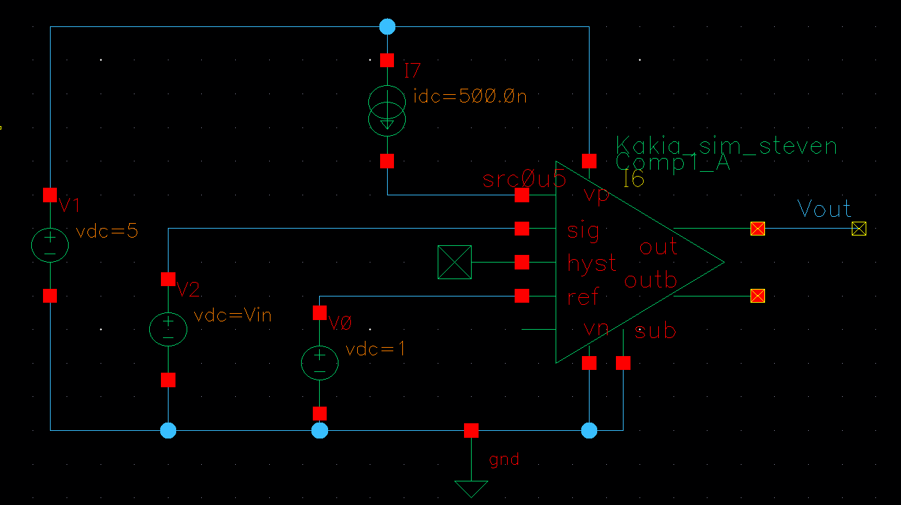
Test bench
Sweep Vin from 0 to 2V
Hysteresis

Slide 3
Netlist
// Library name: Kakia_sim_steven
// Cell name: Comp1_A
// View name: schematic
Main circuit
// Library name: Kakia_bias_sch
// Cell name: V5ISO_SCHMT_AR
// View name: schematic
Sub circuit
// Library name: Kakia_sim_steven
// Cell name: test
// View name: schematic
Test bench

Slide 4
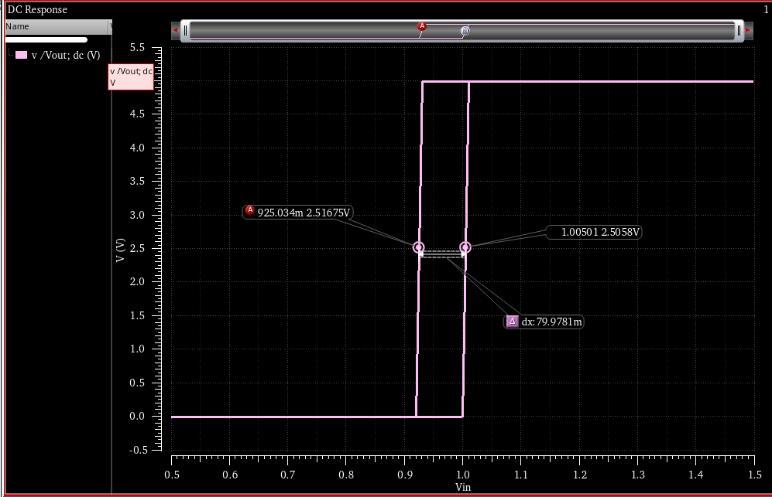
Simulation Result
Trigger point is about 1V with 80mV hysteresis

Slide 5
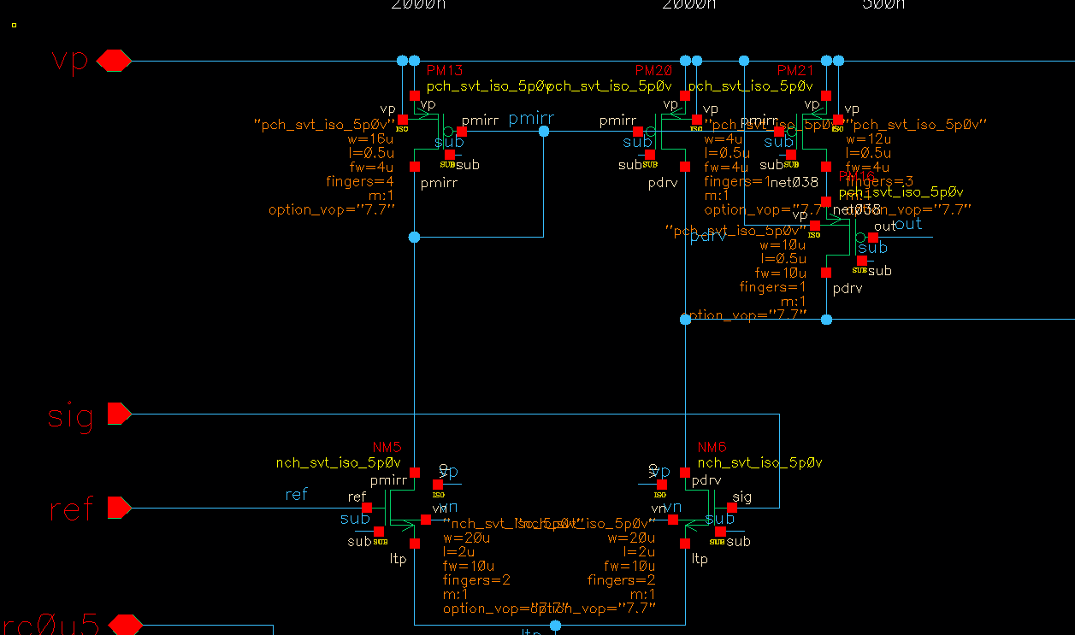
Key devices
PM13, PM20, PM21
NM5, NM6

Slide 6
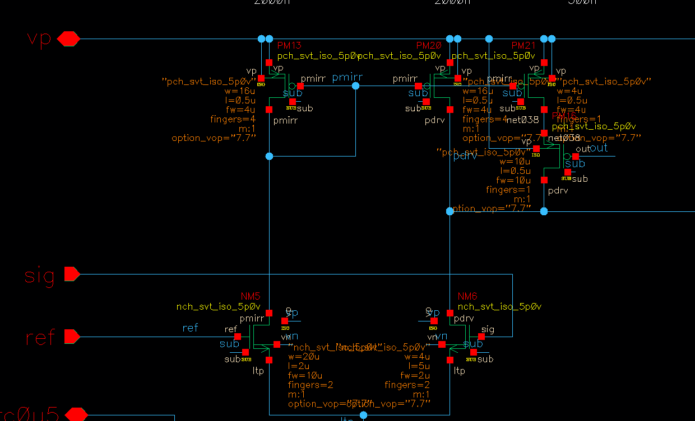
Set “key devices” to incrorrect size
PM20, PM21 and NM6 are set to incorrect size

Slide 7
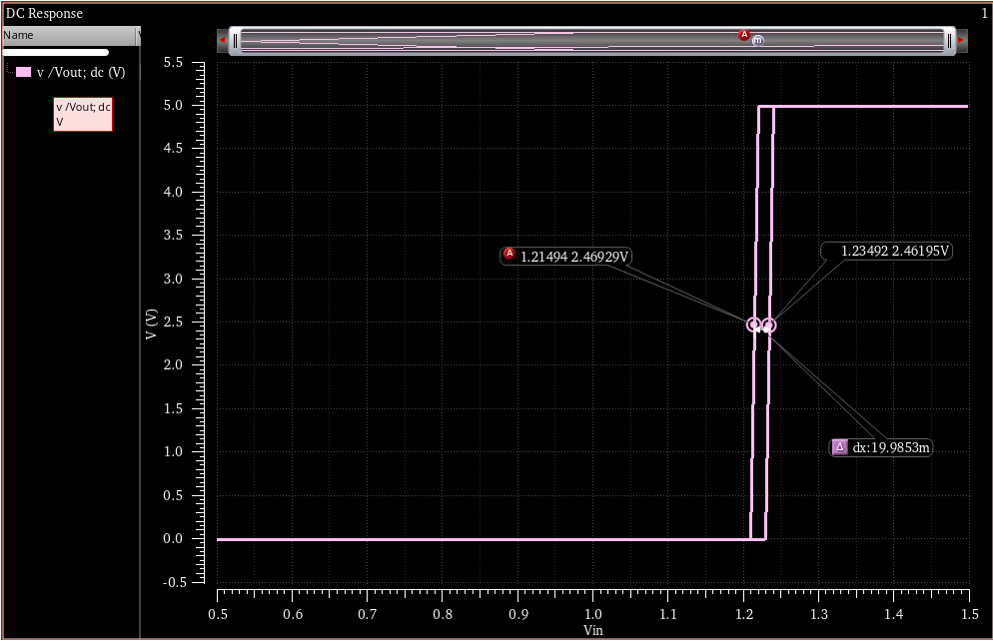
Incorrect simulation Result

