Slide 1
TELECOM AI AGENT
Hybrid SQL & RAG System for Automated Call Drop Analysis
UNIVERSITY OF CALCUTTA
COMPUTER SCIENCE AND ENGINEERING
SUJIT PAL
EXAM ROLL - T91/CSE/234053
REG NO. - D01-1114-0184-23

Slide 2
Problems
What to do ?
Telecom operators continuously monitor network logs and performance metrics to maintain network quality and reduce call drops. Analyzing large volumes of logs manually to identify root causes is a time-consuming and complex task for engineers.
Solution
RAG based AI Agents
Retrieve relevant network logs from a database.
Automate call drop root cause analysis .
Summarize findings in human-readable language.
Recommend possible solutions automatically.

Slide 3
Methodology
01
04
02
05
03
Collection of telcom logs and network performance data
Build an AI Agent to connect with SQL and ChromaDB, validate query relevance, retrieve context, and generate intelligent responses.
Clean & Store telecom logs in a structured database (SQL) for retrieval
Develop a User Interface for seamless interaction between users and the AI agent.
Convert network performance data into embeddings & Store it in a vector database (ChromaDB).

Slide 4
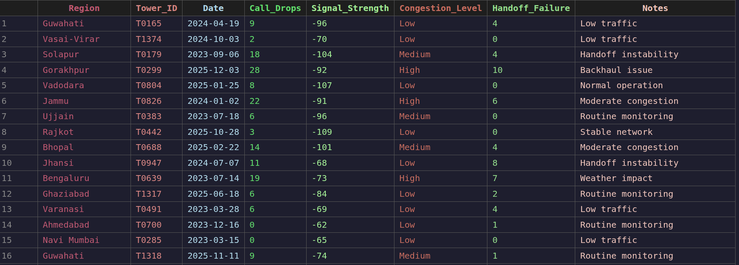
Telecom Logs Dataset

Slide 5
Tools, Libraries, and Models Used
Tools,Libraries and Models | Purpose in Project | Free or Paid
Python | Core programming language used to develop the Project. | Free
Pandas | Used for cleaning, preprocessing raw telecom logs. | Free
MySql Database | Used to store structured telecom logs for efficient querying retrieval. | Free
ChromaDB Database | Vector database used to store and retrieve embeddings. | Free
Sentence Transformers (all-MiniLM-L6-v2) | Used to generate vector embeddings for telecom performance documents and user queries. | Free
Llama-3.3-70B-Versatile | LLM used for advanced reasoning,sql generation, network analysis, root-cause identification, and response generation. | Paid
Llama-3.1-8B-Instant | Lightweight LLM used by agents for query classification. | Paid
Groq API | Provides high-speed inference infrastructure for running Llama models. | Paid
Streamlit | Used to build the web-based user interface. | Free

Slide 6
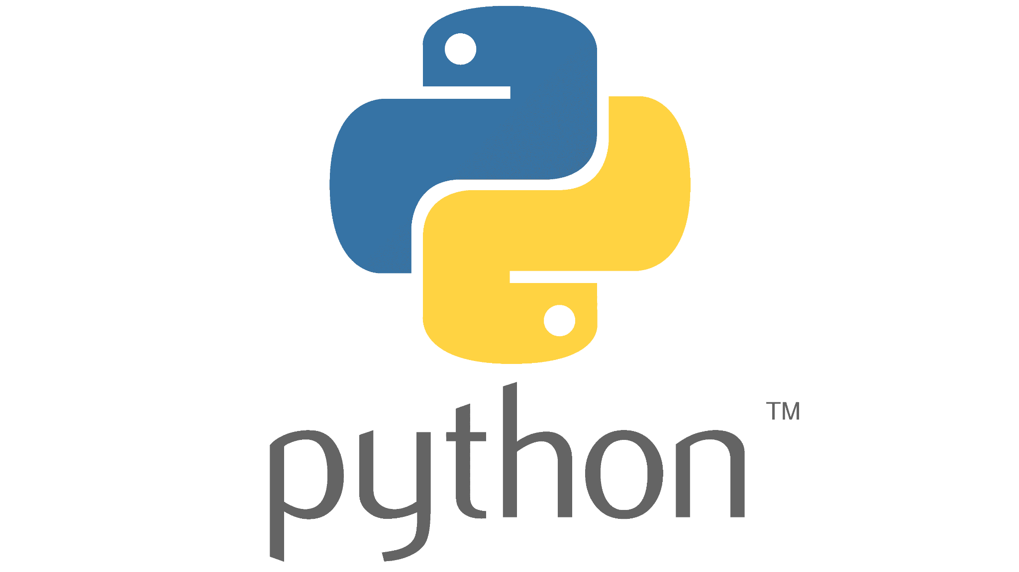


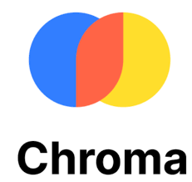
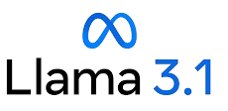
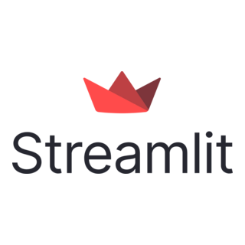
Workflow
Techstack
User Query
Guardrail AI Agent (Llama-3.1-8B-Instant)
Relevant?
Telecom SQL AI Agent (llama-3.3-70b-versatile)
Vector Search in ChromaDB using
sentence-transformers/all-MiniLM-L6-v2
SQL Query
Network Performance data Context
Execute SQL
Telecom Log Context
Lead Analyst AI Agent
(llama-3.3-70b-versatile)
Telecom
Report & Insights

Slide 7
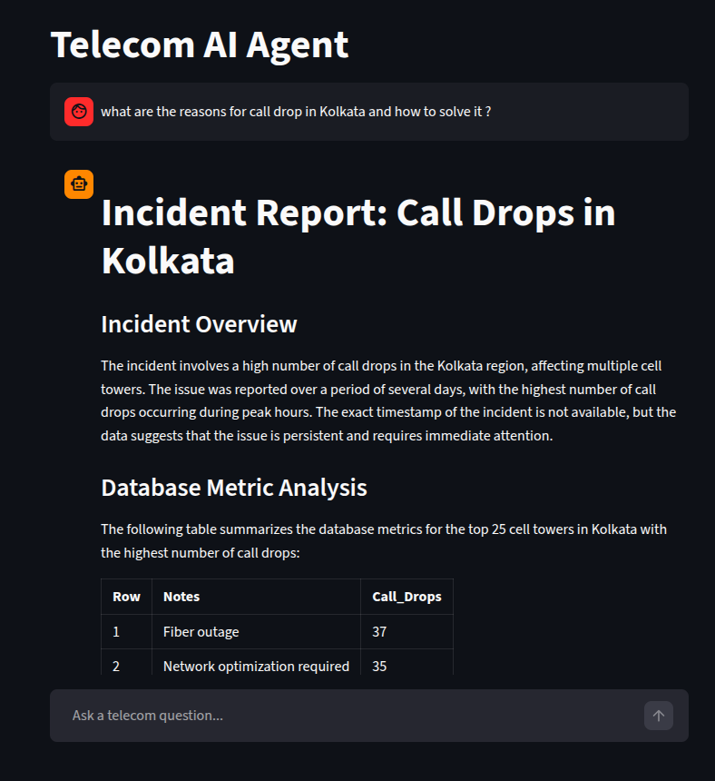
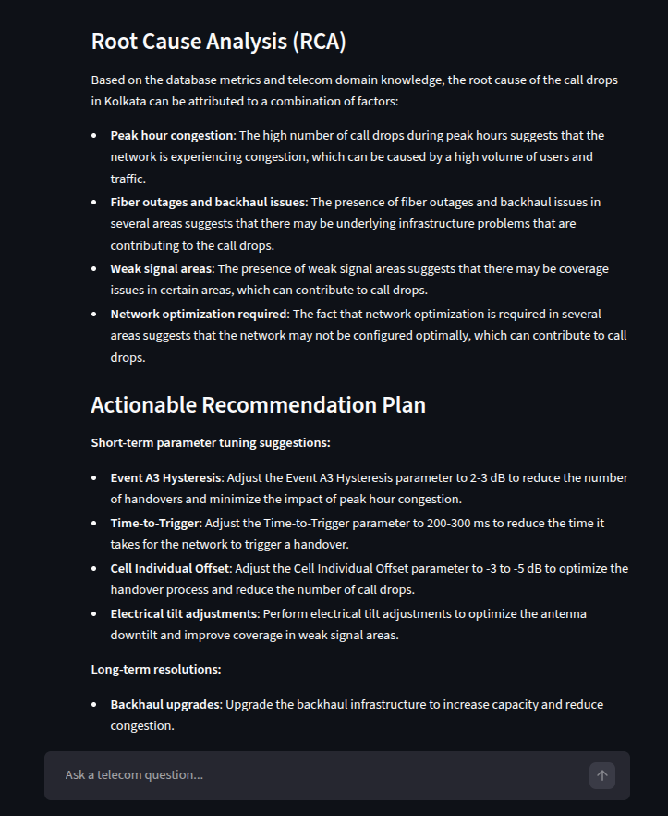
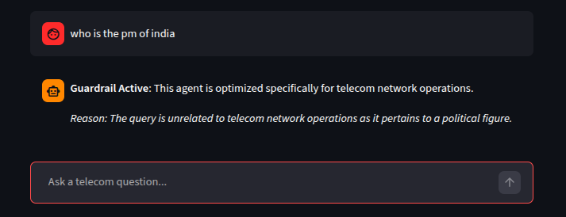

Slide 8
Challenges
Cost
Time Spent
Data Quality Management: Cleaning and preprocessing large volumes of noisy telecom network logs before analysis.
Hybrid Data Retrieval: Integrating SQL database queries with vector-based semantic search to retrieve relevant context efficiently.
Accurate AI Analysis: Ensuring reliable and context-aware responses from LLMs for telecom performance monitoring and troubleshooting.
Development Cost: ₹0 (Used free/open-source tools and free API access during testing)
Running Cost: Based on Groq API pricing
Average Token Usage: ~4,000 tokens per query
Data Collection: 2 Hours
Data Cleaning & Storage (SQL + ChromaDB): 2 Hours
AI Agent & Streamlit Interface Development: 2 Hours
Testing and Validation: 1 Hour
Presentation & Documentation: 2 Hours
Total Project Time: 9 Hours

Slide 9
Environmental & Sustainable Growth Factors
Reduces Manual Monitoring Effort: Automates telecom performance analysis, reducing operational overhead and resource consumption.
Efficient Resource Utilization: Helps identify network inefficiencies, enabling optimized use of telecom infrastructure and energy.
Digital-First Solution: Eliminates the need for paper-based reporting and supports sustainable digital operations.
Learning Objective
Future Scope
Gained experience in building AI agent workflows using LLMs.
Learned to integrate SQL databases, vector databases, and RAG pipelines.
Developed skills in data preprocessing, embedding generation, and Streamlit application development.
Integrate real-time telecom monitoring dashboards .
Support multi-modal inputs such as logs, charts, and network diagrams.
Add predictive analytics and anomaly detection for proactive network issue identification.

Slide 10
CONCLUSION
The Telecom AI Agent integrates SQL-based log analysis and ChromaDB-powered semantic search to provide intelligent insights from telecom network data. By combining structured and unstructured information with Large Language Models, the system enables efficient network issue analysis and automated report generation for NOC operations.
REFERENCE
Groq API Documentation : https://console.groq.com/docs
ChromaDB Documentation : https://docs.trychroma.com
MySQL Documentation : https://dev.mysql.com/doc
OpenAI. ChatGPT : https://chat.openai.com

Slide 11
THANK YOU

