Slide 1
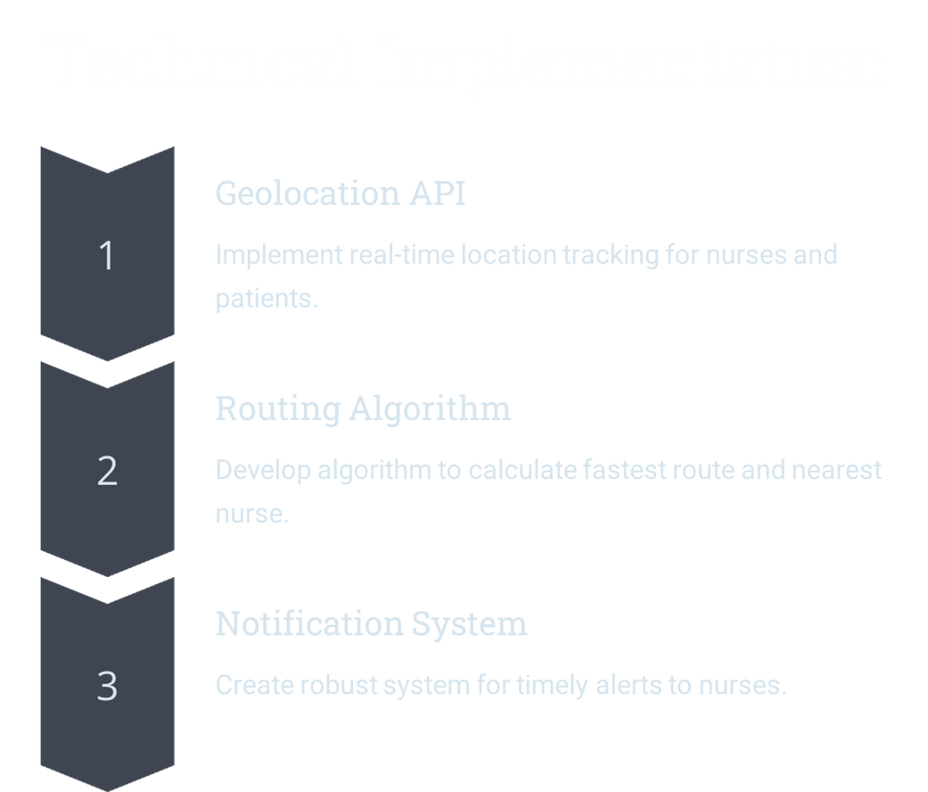
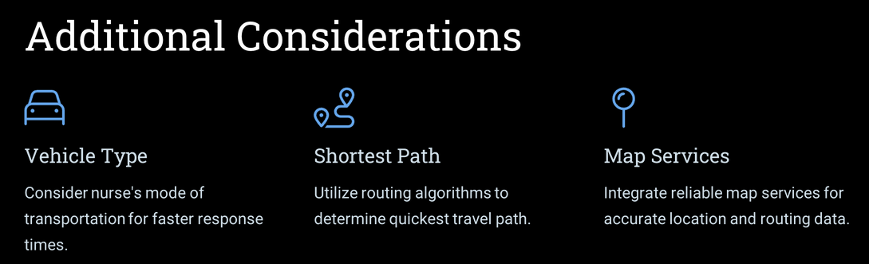
TEAM NAME :
“ Developer Devs ”
RapidAid
Team Members :
TANMAY BHARAT SATALKAR
AKSHAY VINOD JHA
ADITYA SOMNATH VYAVHARE
SUJIT SHANKAR KOLTE
YOUR HEALTH IS OUR RESPONSIBILITY
Problem Statement :
“ A geolocation-aware solution to connect patients in need with the nearest available nurse. “

Slide 2


Slide 3
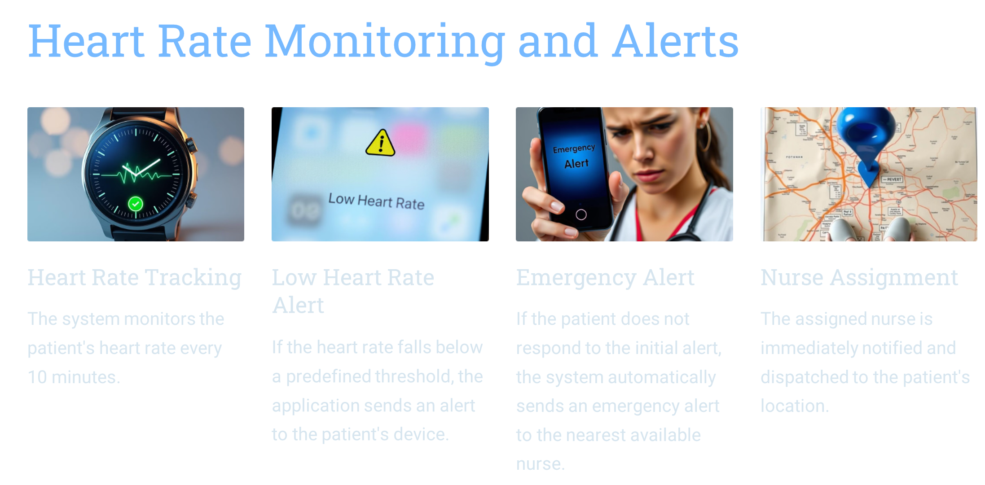

Slide 4
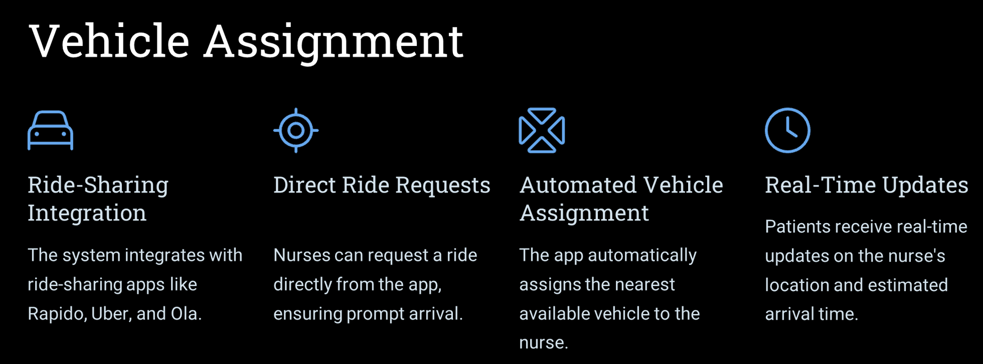
Scope For Future Enhancements :

