Slide 1



The Book Point
Presented by
Nitish : 231FA04F55
Sujit : 231FA04E34
Notes:
1

Slide 2
Project Overview
Online Platform
Book Categories
Dual Functionality
For book lovers
Love Story, Horror, Mystery
Read online and order physical copies
Notes:
2

Slide 3
Project Objectives
1
Easy Access
2
Dual Support
3
Secure Transactions
User-friendly platform
Online and physical
User-friendly navigation
Notes:
3

Slide 4





Website Features
Online Reading
Physical Orders
Multiple Categories
Account Management
Notes:
4

Slide 5





Technology Stack
Razorpay
1
Payment
2
MySQL
Database
3
PHP
Backend
4
JavaScript
Frontend
5
HTML/CSS
Foundation
Notes:
5

Slide 6

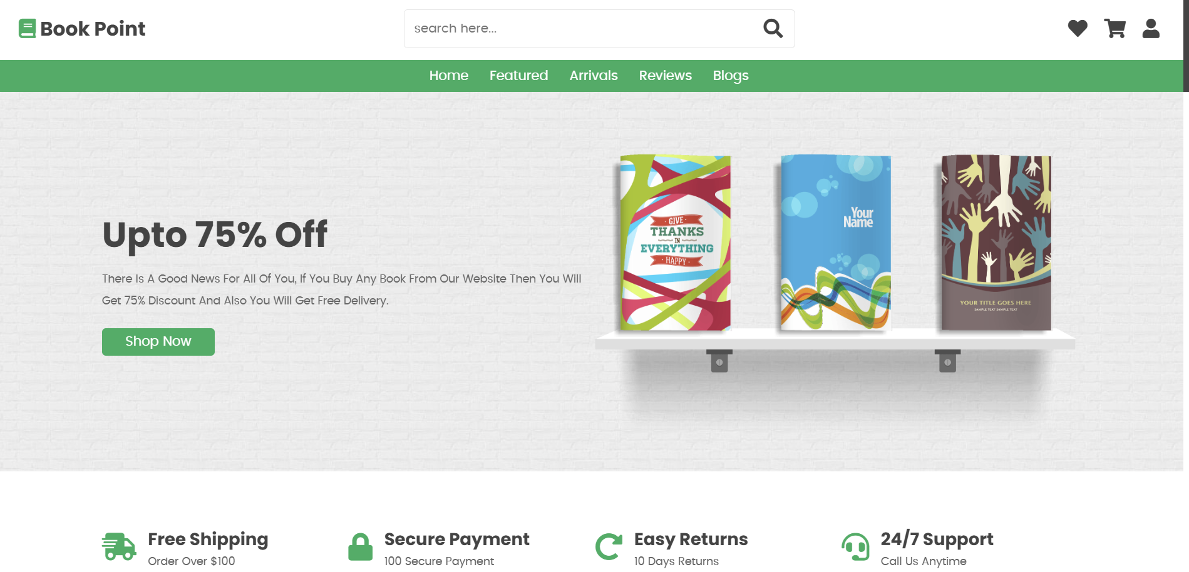



Website Structure
Home Page
Display books, categories, menu
Menu bar
Home, feature, Arrivals, Reviews,
Blogs
Book Details
Description, reading, purchase
Login/Signup
Account management
Notes:
6

Slide 7



User Experience
Easy Navigation
Responsive design
Clean UI
Secure Payments
Simple and effective
Smooth transactions
2
1
3
Notes:
7

Slide 8
Thank you!
Notes:
8

