Slide 1

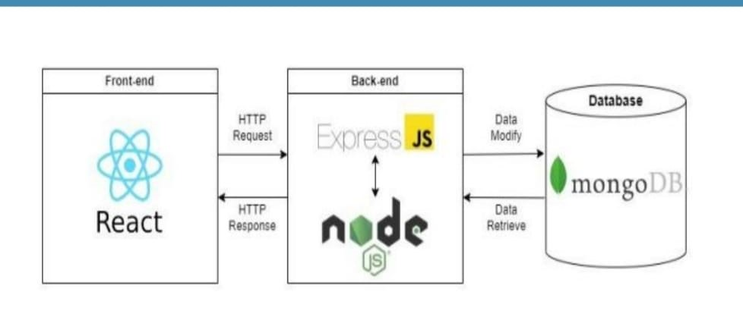
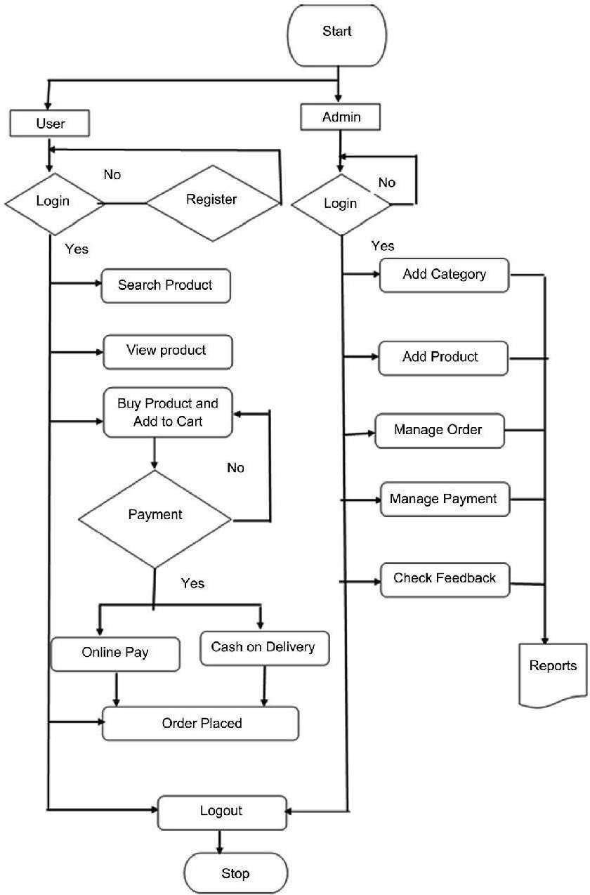
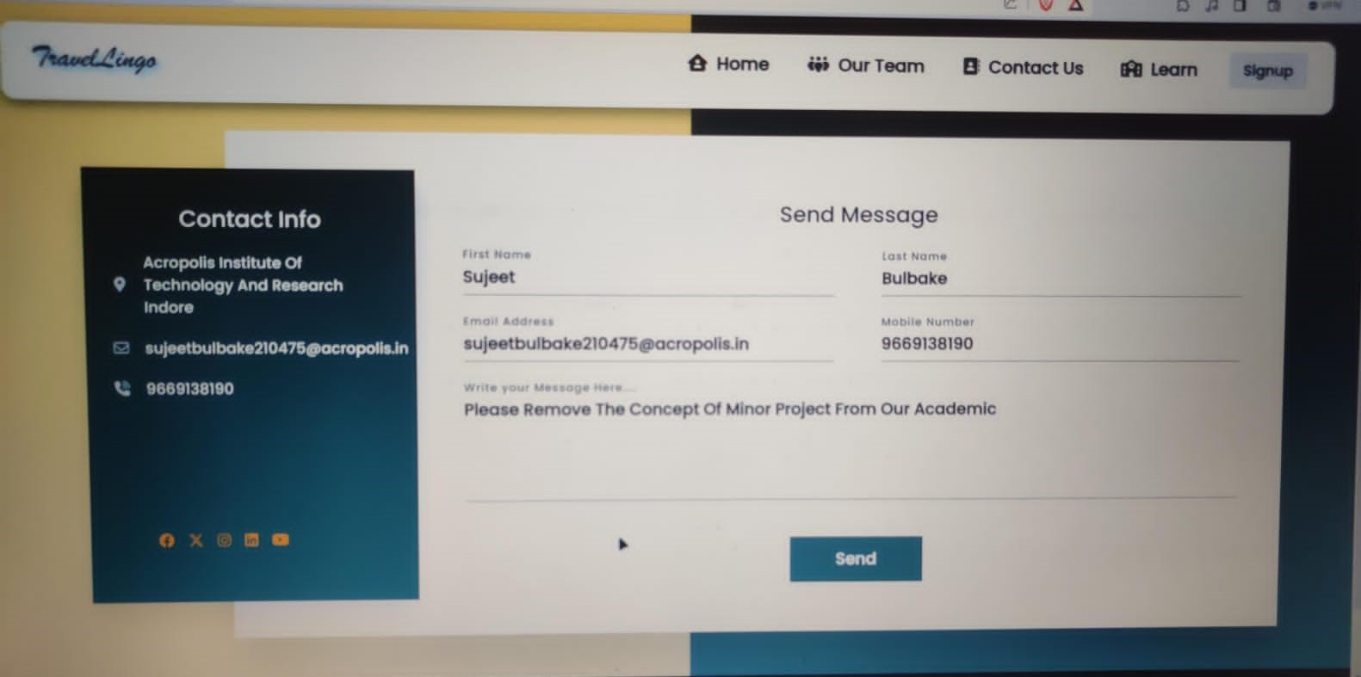
TravelLingo: Your All-In-One Destination for Learning
Shubham Patidar, Sameer Tyagi,Sujeet Bulbake ,Shrikant Mishra
Under the guidance of Ronak Jain
ABSTRACT
Methods Proposed
OBJECTIVE
Travel language and culture learning platforms play a vital role in equipping travelers with the necessary linguistic and cultural competencies. These versatile resources, such as Duolingo, Rosetta Stone, and italki, offer an array of interactive language courses. They not only cover vocabulary and grammar but also provide cultural insights, fostering a deeper understanding of the destination's traditions. Complementing these digital tools are YouTube channels, cultural exchange programs, and online language learning communities. By combining these resources, travelers can cultivate language skills and gain invaluable cultural awareness, enhancing their overall travel experience and fostering more meaningful interactions with local communities.
The objectives of this project is -.
Language Proficiency: Enable travelers to acquire language skills for effective communication.
Cultural Awareness: Promote understanding of local customs and traditions.
Enhanced Travel Experience: Enrich the overall journey by facilitating deeper engagement with local culture and communities.
CONCLUSION
language and culture learning platforms are indispensable tools for the modern traveler. They facilitate effective communication, cultural awareness, and immersive experiences. These resources enhance journeys by breaking down language barriers and fostering respect for diverse traditions. By embracing these platforms, travelers can unlock the full potential of their adventures, forging genuine connections with the people and places they encounter, and savoring the richness of global diversity.
INTRODUCTION
In an increasingly interconnected world, travel has become more accessible and appealing to people of all backgrounds. Language and culture learning platforms play a pivotal role in equipping modern travelers with the tools they need to make the most of their journeys. These platforms, including apps like Duolingo and Rosetta Stone, online communities, and cultural exchange programs, offer a dynamic and interactive approach to language acquisition while providing insights into the customs and traditions of the regions travelers plan to visit. This not only enhances language proficiency but also cultivates cultural sensitivity. By combining these resources, travelers can embark on their adventures well-prepared, ensuring that they can navigate new environments, build meaningful connections with locals, and truly immerse themselves in the diverse cultures they encounter.
Login Page
RESEARCH POSTER PRESENTATION DESIGN © 2022
www.PosterPresentations.com

