Slide 1

Session On Three.Js
Sujit Barnwal
(Solution Analyst)
Akash Kushwaha
(Solution Analyst)

Slide 2
Sample 3D websites
https://bruno-simon.com/
https://lusion.co/
http://oos.moxiecode.com/js_webgl/tree_rays/
https://www.heroforge.com/
https://my-room-in-3d.vercel.app/

Slide 3

What is HTML5 ?
What is HTML ?
Difference Between HTML and HTML5 ?
Which element of HTML5 is used in 3D web development ?

Slide 4

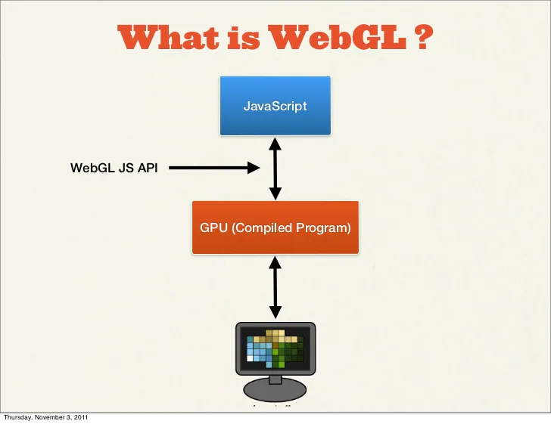
WHAT IS WebGL ?
Derived from OpenGL's ES 2.0 library which is a low-level 3D API
Provides similar functionality of ES 2.0 (Embedded Systems) and performs well on modern 3D graphics hardware.
A JavaScript API for rendering interactive 2D and 3D graphics within any compatible web browser without the use of plug-ins.
Allows GPU-accelerated usage of physics and image processing and effects as part of the web page canvas.
A JavaScript API that can be used with HTML5 canvas.
Notes:
CSOP, Gaming, Micrelec, PPJ, FPJ, Fitpage,

Slide 5
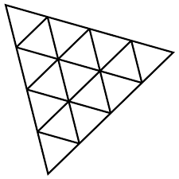

WHAT IS THREE.JS?
A cross-browser JavaScript library and application programming interface (API) used to create and display animated 3D computer graphics in a web browser using WebGL.
Allows the creation of graphical processing unit (GPU)-accelerated 3D animations using the JavaScript language as part of a website without relying on proprietary browser plugins.
Open Source.
Relatively easy to add any 3D Interactivity between 3D Objects and User Interfaces like keyboard and mouse.
CREATE 3D SCENES WITH
CREATE 3D SCENES WITH
CREATE 3D SCENES WITH
Notes:
CSOP, Gaming, Micrelec, PPJ, FPJ, Fitpage,

Slide 6
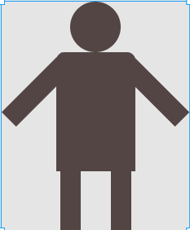
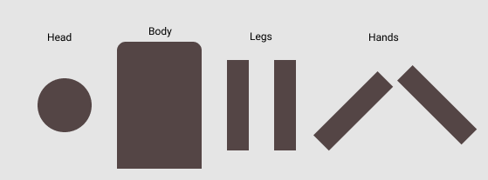
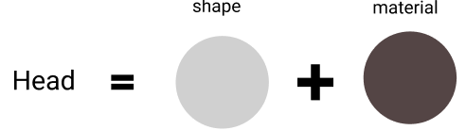
Elements Used in 3D ?
Scene which contains objects and lights.
Camera who watches scene.
Renderer outputs camera on a Canvas
NOTE –
Objects are 3D or 2D Shapes.
Mesh extends objects.
Mesh = Geometry + Materials.

Slide 7
Practical Session
Knowledge becomes wisdom
only after
it has been put to
Practical Use.

Slide 8
THANK YOU!

