Slide 1
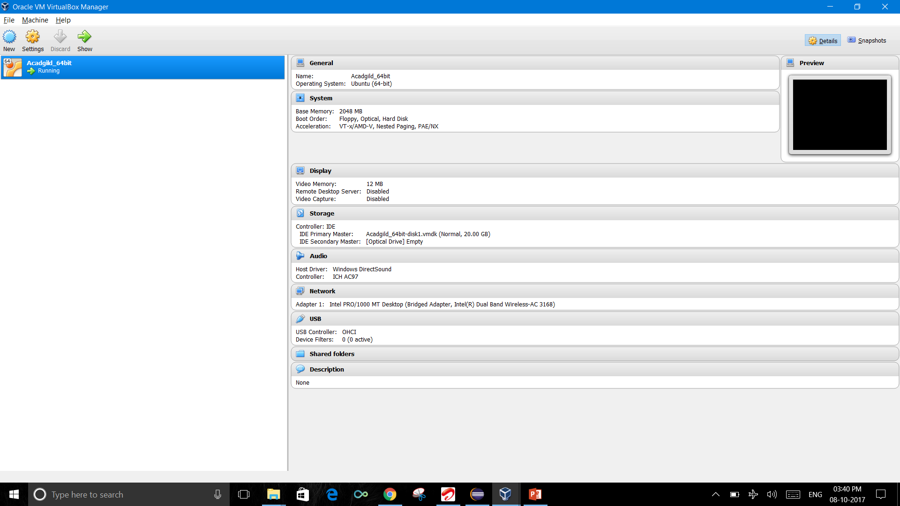
Imported AcadGild VM into Oracle VB

Slide 2
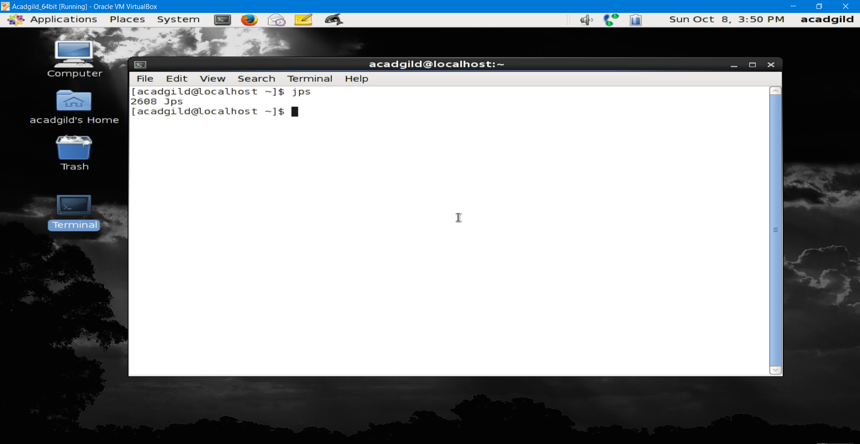
Jps command to check the list of daemons we need to start

Slide 3
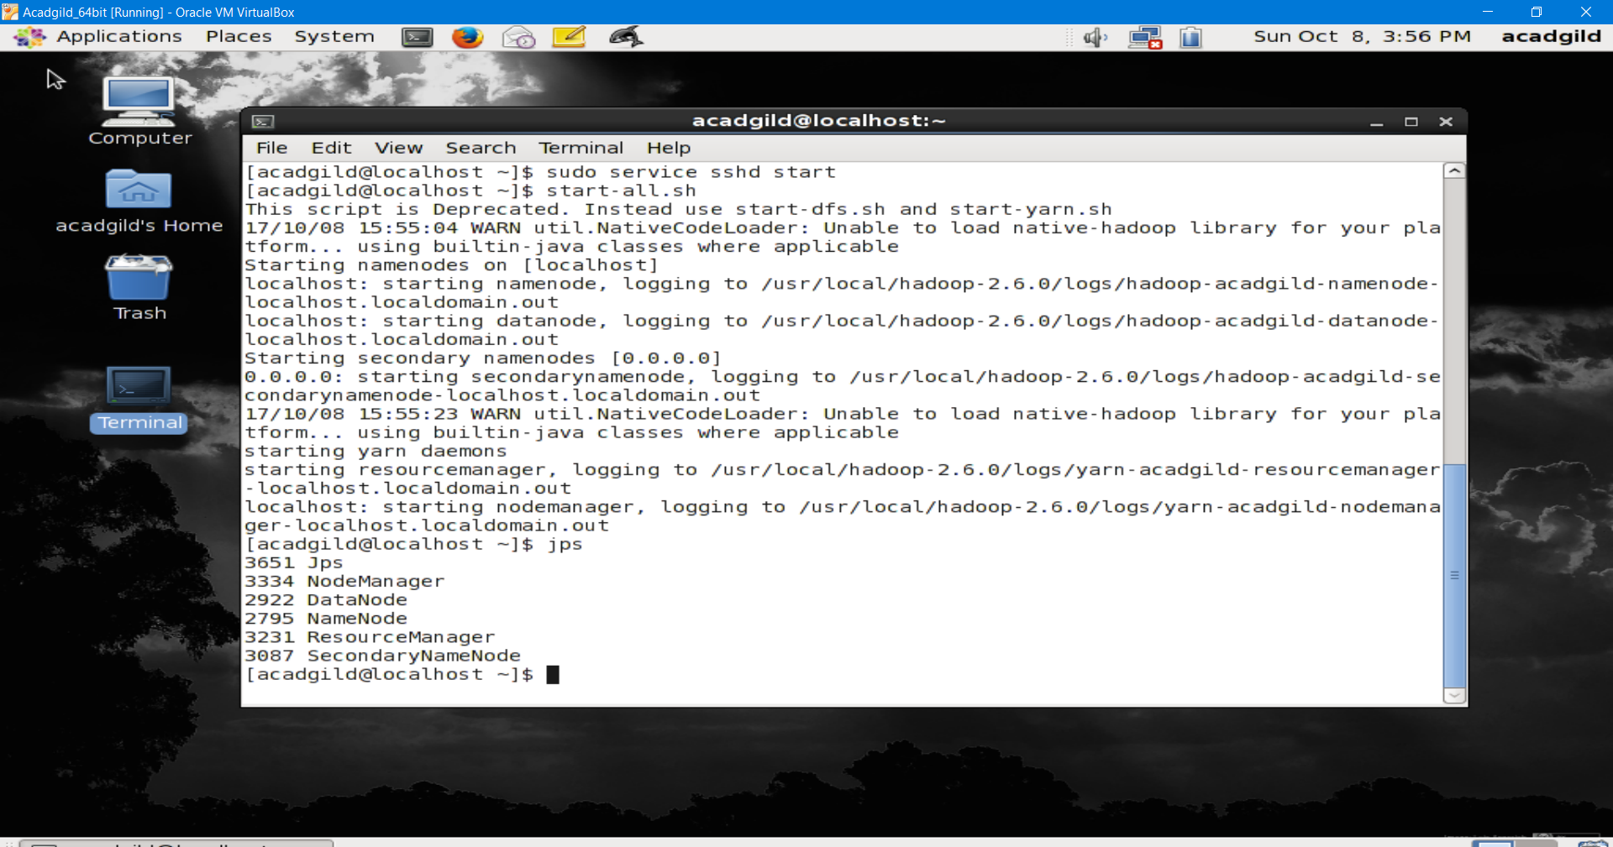
To Start all the daemons.

Slide 4
Started Job history server

Slide 5
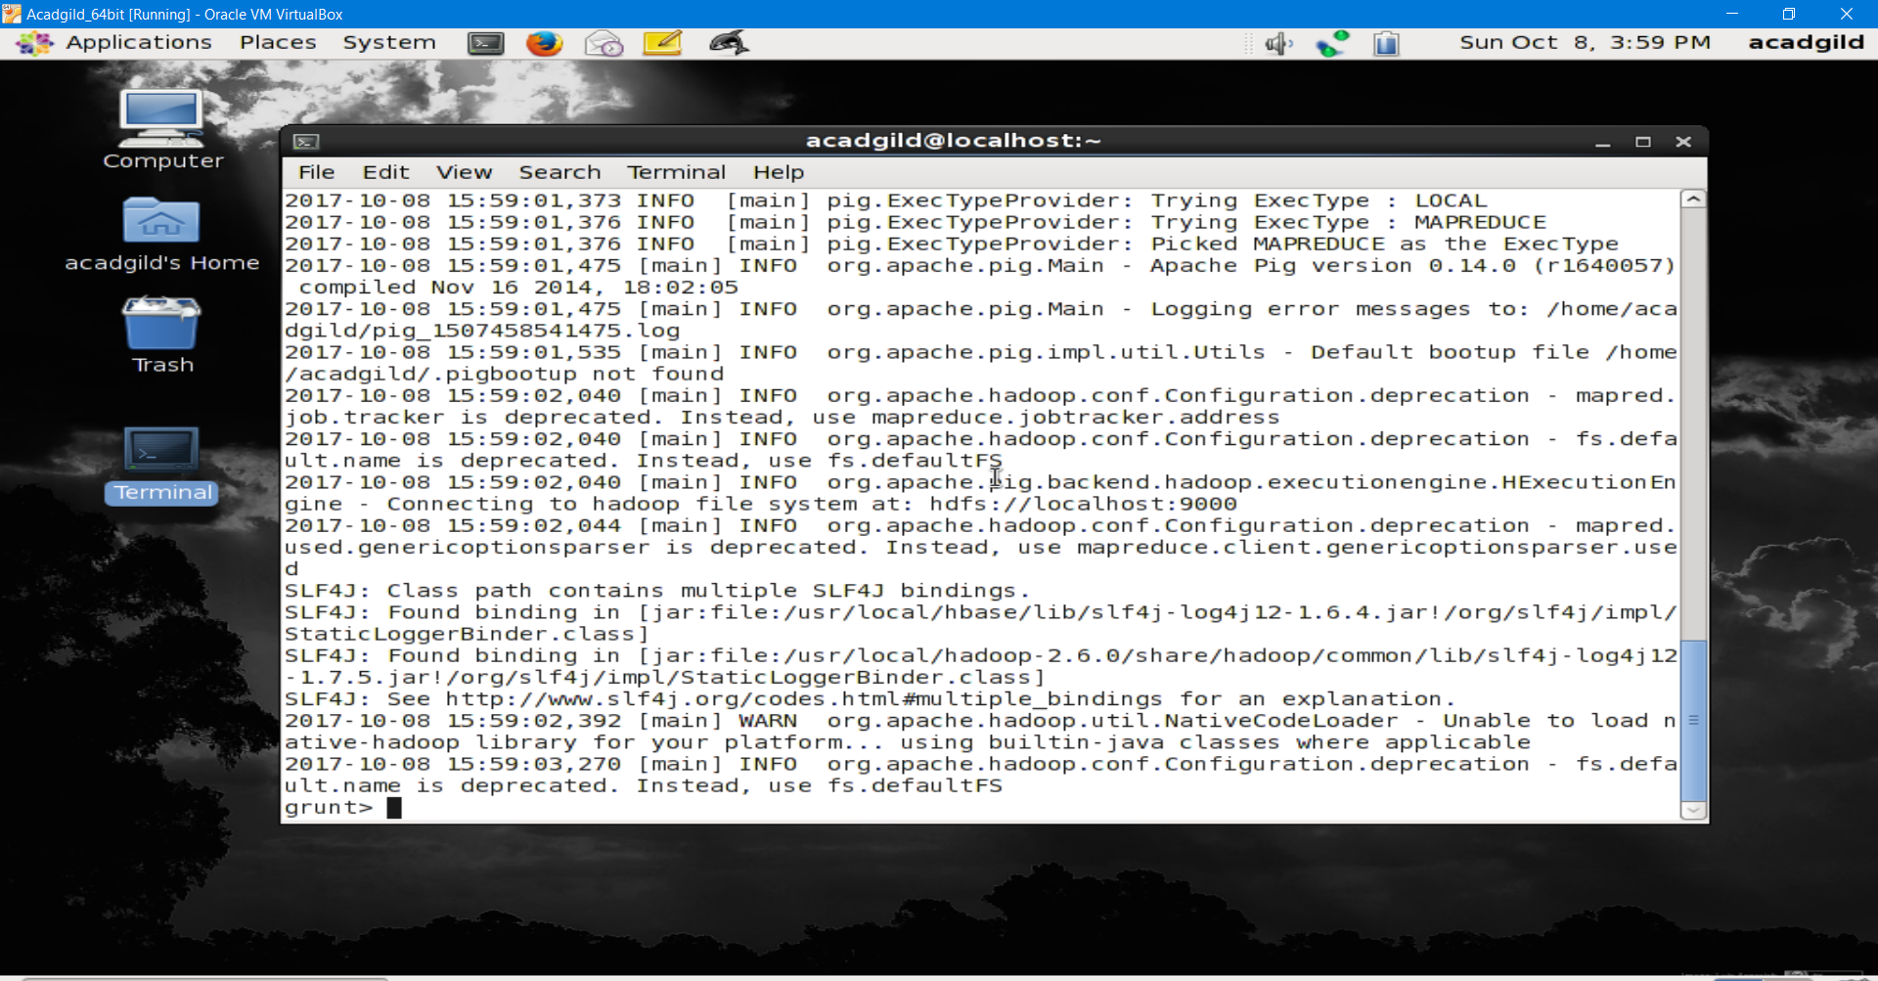
Started Pig.

Slide 6
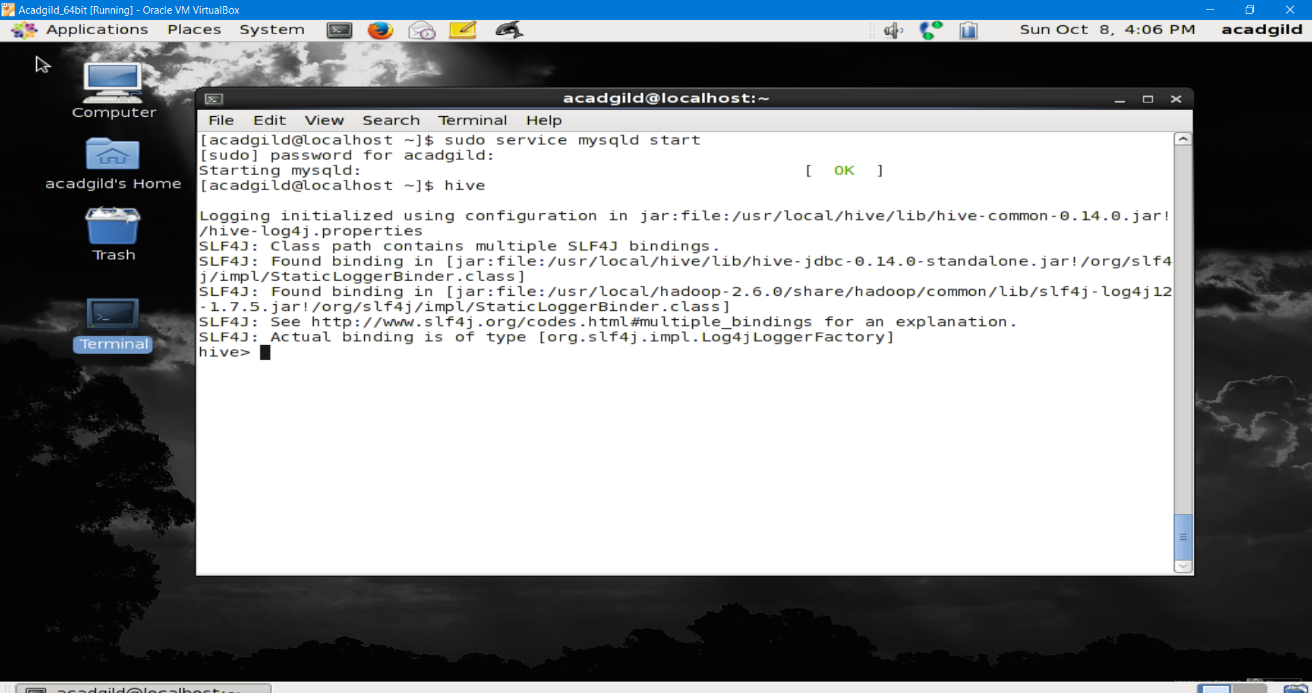
Started Hive.

Slide 7
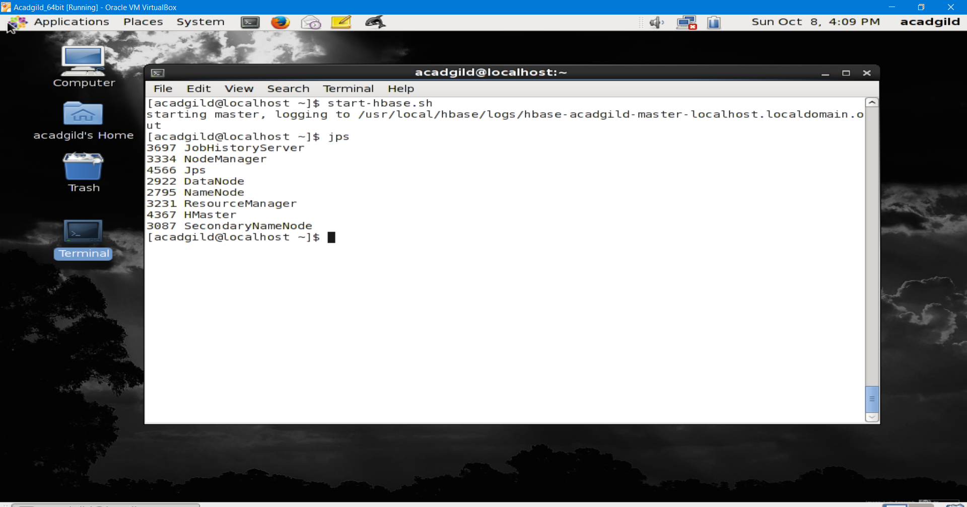
Started HBase.

