Slide 1

Laptop Analysis

Slide 2
Agenda
1
Objective of the Project
2
Dataset Overview & Data Collection
3
Data Cleaning & Preparation
4
Exploratory Data Analysis (Key Use Cases)
5
Key Business Insights
6
Conclusion & Recommendations
7
Challenges Faced
8
Q&A
INNOMATICS RESEARCH LABS
3

Slide 3
Problem Statement:
Customers often struggle to compare laptops because product information is spread across multiple listings with varying prices, specifications, ratings, and discounts. Manually analyzing this large amount of data is time-consuming and inefficient. There is a need for a centralized, interactive solution that collects, analyzes, and visualizes laptop market data to help users make informed purchasing decisions.
Challenge: Manual comparison is slow, difficult, and prone to errors.
Solution: Use Python Web Scraping to collect data, EDA to analyse it, and Power BI to create an interactive dashboard. Outcome: Enables faster, data-driven laptop comparison and purchasing decisions.

Slide 4
Objective of the Project
Project Objectives:
Scrape laptop data from Flipkart using Python.
Clean and preprocess the collected dataset.
Perform Exploratory Data Analysis (EDA) to identify patterns and trends.
Analyse price, ratings, RAM, storage, processor, and brand performance
Laptop listings scraped & analyzed
Approach
•
Extract product data from Flipkart using Requests + BeautifulSoup
10
•
Clean & structure raw text fields into usable numeric/categorical data
Perform univariate, bivariate & multivariate EDA
Brands compared across Budget, Mid-Range & Premium segments
•
•
Answer key business questions and derive actionable insights
INNOMATICS RESEARCH LABS
4

Slide 5
DATA COLLECTION
Dataset Overview
Source
Raw vs. Cleaned Dataset
Flipkart.com search results for "laptops", scraped across 95 result pages using Python (requests + BeautifulSoup)
Metric | Raw Dataset | Cleaned Dataset
Total records | 2,185 | 506
Price format | Text with ₹ and commas (e.g. "₹56,990") | Integer (56990)
RAM format | Text (e.g. "8 GB LPDDR4X RAM") | Standardized (8 GB)
Display format | Text (e.g. "39.62 cm (15.6 Inch)") | Numeric inches (15.6 inch)
Discount | Text ("27% off") | Numeric % + Original Price derived
Shape | (2090,9) | (506,9)
Raw Fields Collected
Product Name
Brand
Processor
RAM
SSD
Display Size
Price
Discount %
Rating
5

Slide 6
Data Cleaning & Preparation
01
02
03
Text → Numeric Extraction
Type Conversion
Duplicate Removal
Used regex to pull clean numeric values out of RAM, Display, Price and Discount text fields.
Converted Price to int and Rating to float for numeric analysis.
Detected and dropped duplicate listings scraped across overlapping search pages.
04
05
06
Missing Value Checks
Feature Engineering
Consistency Checks
Verified null counts across all fields before and after cleaning.
Derived Price_Category (Budget/Mid-Range/Premium), Original_Price and Processor_brand.
Standardized RAM/SSD labels (e.g. "8 GB LPDDR4X RAM" → "8 GB") for reliable grouping.
6

Slide 7
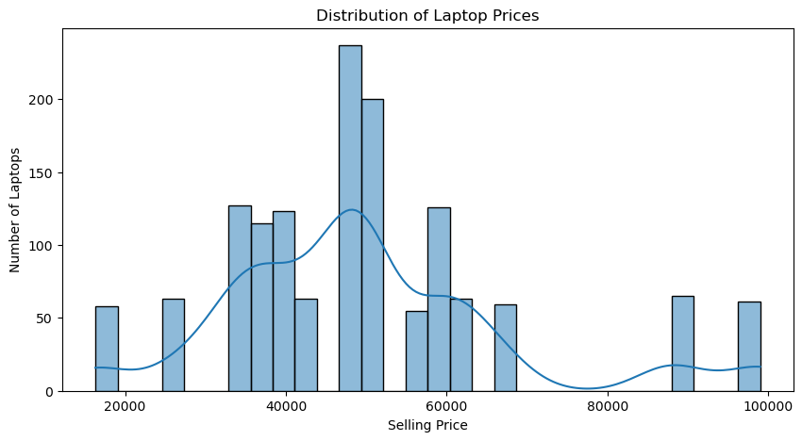
Price Distribution
₹18,000
Minimum Price
₹48,990
Median Price
₹99,990
Maximum Price
INNOMATICS RESEARCH LABS
7

Slide 8
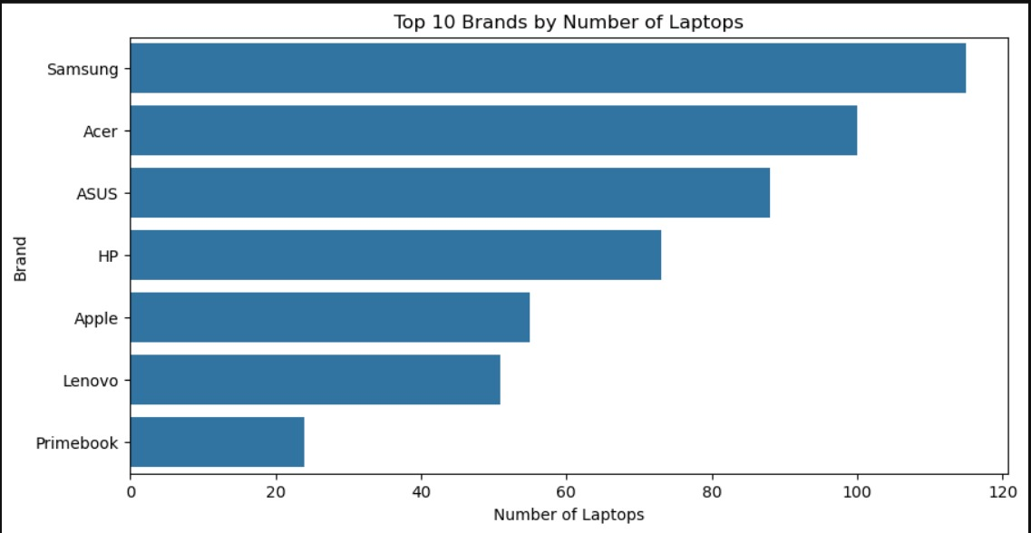
Brand Landscape
SAMSUNG
leads the market with 117 listings
Why it matters
Samsung, Acer and ASUS together account for the vast majority of listings, indicating a market dominated by a handful of high-volume brands rather than an even spread across manufacturers.
INNOMATICS RESEARCH LABS
8

Slide 9
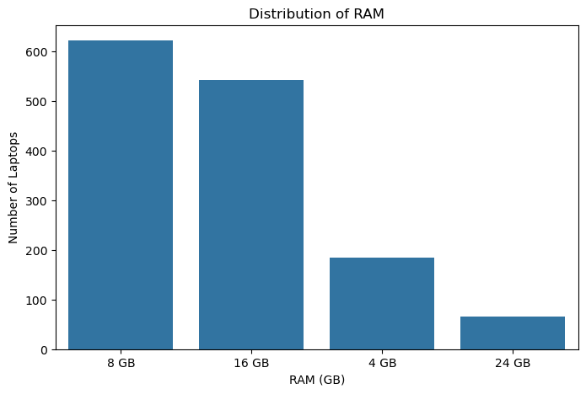
RAM & Rating Distribution
RAM Configuration
Insight: 8 GB RAM is now the single most common configuration.
9

Slide 10
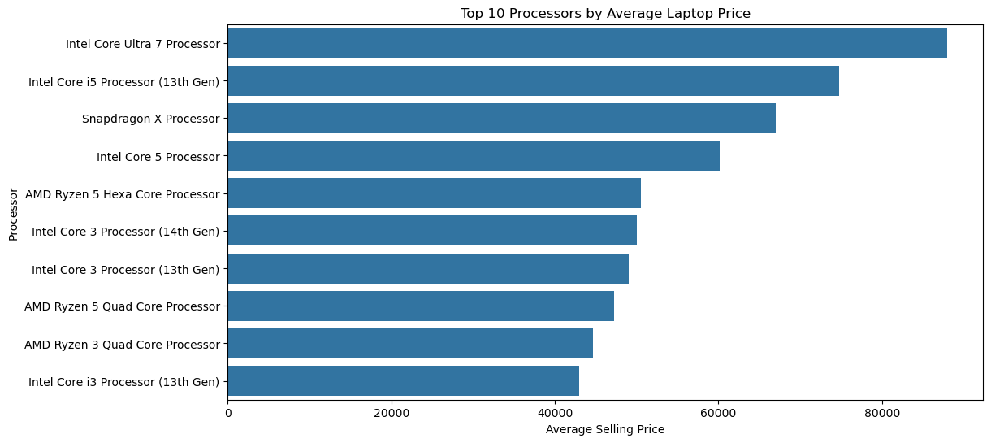
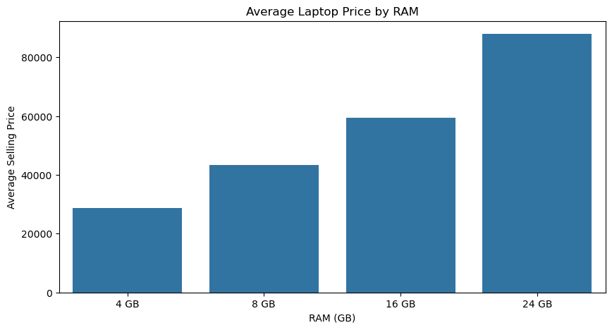
Price by Processor & RAM
Top 10 Processors by Avg. Selling Price
Avg. Price by RAM Size
Insight: Average selling price climbs steadily with RAM size, confirming RAM as one of the strongest price drivers across listings.
10

Slide 11
Price, Discount & Rating — Correlation
 | Price | New_Discount | Rating
Price | 1.00 | 0.01 | 0.00
New_Discount | 0.01 | 1.00 | 0.00
Rating | 0.00 | 0.00 | 1.00
What this tells us
All three correlations are close to zero. Price does not meaningfully predict discount depth or customer rating — shoppers are not simply rating expensive laptops higher, and discounting isn't concentrated at any particular price point.
INNOMATICS RESEARCH LABS
11

Slide 12
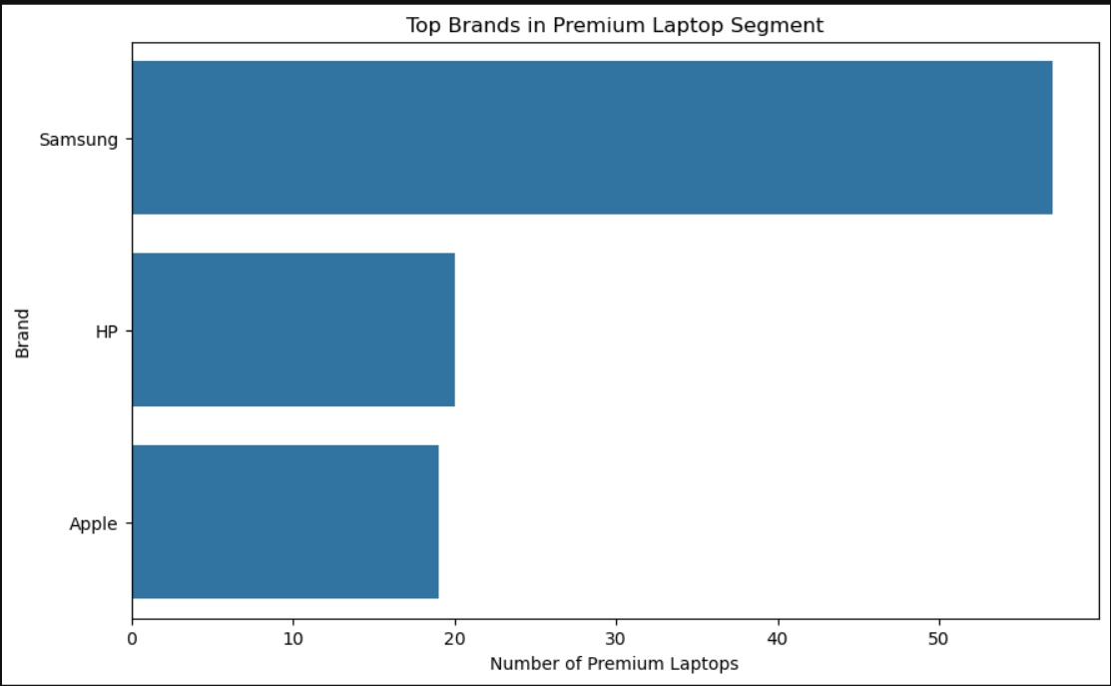
Premium Segment Analysis
Samsung leads the premium laptop segment with the highest number of premium listings, while HP and Apple follow with significantly fewer models. This indicates Samsung has the strongest presence in the premium category among the displayed brands.
12

Slide 13
Key Business Questions
Highest market share?
Highest average price brand?
ASUS (714 listings, ~33%)
ASUS (avg. ₹48,368)
Most common RAM?
Most common SSD?
8 GB (803 listings)
512 GB SSD (1517 listings)
Intel vs AMD pricing?
Do pricier laptops rate better?
AMD-based laptops are priced marginally higher on average than Intel
Only marginally — ratings stay ~4.18–4.19 across all price bands
Highest average discount brand?
Price vs. discount vs. rating link?
WarnerCann (avg. 29.0% off)
Essentially no correlation between the three (all near 0.00)
13

Slide 14
KEY INSIGHTS
What the Data Tells Us
ASUS leads the online laptop market on both volume and premium-segment presence.
The typical listing sits around ₹48,990 — squarely in the mid-to-premium range.
1
2
16 GB RAM and 512 GB SSD are now the mainstream standard configuration.
Processor and RAM size are meaningful price drivers; discount depth and rating are not.
3
4
Customer satisfaction (avg. rating ~4.19/5) is consistently high across every price band.
Nearly half of all listings (48%) already sit in the Premium (≥₹80k) segment.
5
6
14

Slide 15
Recommendations
Expand Mid-Range Availability
Prioritize High-Demand Configs
Compete on Value, Not Just Discounts
Introduce more models in the ₹40,000–₹80,000 band where demand is concentrated.
Focus manufacturing on i5/Ryzen 5, 16 GB RAM, 512 GB SSD builds.
Since discount depth barely moves ratings, invest in build quality and service instead.
Grow the Premium Portfolio
Offer Flexible Storage Tiers
Track Competitor Pricing Continuously
Premium buyers already report strong satisfaction — room to add more high-end models.
Keep 512 GB SSD standard, but expand 1 TB options for power users.
Automate repeat scrapes to monitor price and discount shifts over time.
15

Slide 16
CONCLUSION
Overall Key Finding
The online laptop market is largely concentrated around mid-to-premium configurations — 16 GB RAM, 512 GB SSD and Intel/AMD mainstream processors — with ASUS as the dominant brand across both volume and price leadership. Price, discount and rating operate almost independently of each other, meaning customer satisfaction is driven far more by product quality and experience than by price point or promotional depth.
2141 listings analyzed
ASUS: market & premium leader
16GB / 512GB: mainstream standard
Weak price–discount–rating correlation
16

Slide 17
WORKING THROUGH THE PROJECT
Challenges & Experience
Dynamic & inconsistent HTML
Uneven field counts per page
Messy text fields
Flipkart's listing tags varied across pages, requiring careful, resilient BeautifulSoup selectors.
Some listings were missing specs, so array lengths had to be checked and aligned before building the DataFrame.
Price, RAM, Display and Discount all arrived as free text (₹, commas, units) needing regex-based extraction.
Pagination at scale
Duplicate listings
Deriving meaningful categories
Looping across ~95 pages while respecting request headers and avoiding blocked/empty responses.
The same product often reappeared across search pages and had to be de-duplicated post-scrape.
Defining sensible Budget / Mid-Range / Premium price cutoffs that reflected the real distribution.
INNOMATICS RESEARCH LABS
17

Slide 18
THANK YOU

