Slide 1


Enhancing Higher Education Student Success
Presented by • Haritha Balineni • Ruchitha Paccha
• Sujith Parvathi • Karun Reddy Beeravalli
Data Dragons | University of South Florida

Slide 2


Overview
Page 02
Business Question
Method & Purpose
Dataset
Descriptive Analysis
Exploratory Analysis
Data Prep
Models
Results
Conclusion
Thank You
Data Dragons | University of South Florida

Slide 3
Business Question
Page 03
In today's educational landscape, student retention and success is of utmost importance for educational institutions. Identifying students who are at risk of dropping out and implementing timely interventions can significantly contribute to improving graduation rates and ensuring academic success.
(Both school dropout and educational failure in higher education are an obstacle to economic growth, employment, competitiveness, and productivity, directly impacting the lives of students and their families, higher education institutions, and society as a whole)
What are certain factors that may affect students' retention or drop out in academic institutions?
Data Dragons | University of South Florida

Slide 4
Method & Purpose
Page 04
This project aims to develop a predictive model using machine learning classification algorithms to identify students who are likely to drop out. By leveraging data on student demographics, academic performance, socio-economic factors, and other relevant variables, the aim is to build a robust predictive model that can effectively forecast the likelihood of students dropping out.
Predicting the likelihood of a student dropping out will enable universities to provide support and resources to those students to improve retention rates
Data Dragons | University of South Florida

Slide 5


Dataset
Page 05
It encompasses a wide range of information about students in higher education institutions, such as their demographics, socioeconomic backgrounds, and academic performance information that can be used to analyze the possible predictors of student dropout and academic success.
Data Dragons | University of South Florida

Slide 6

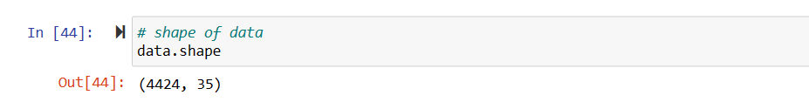
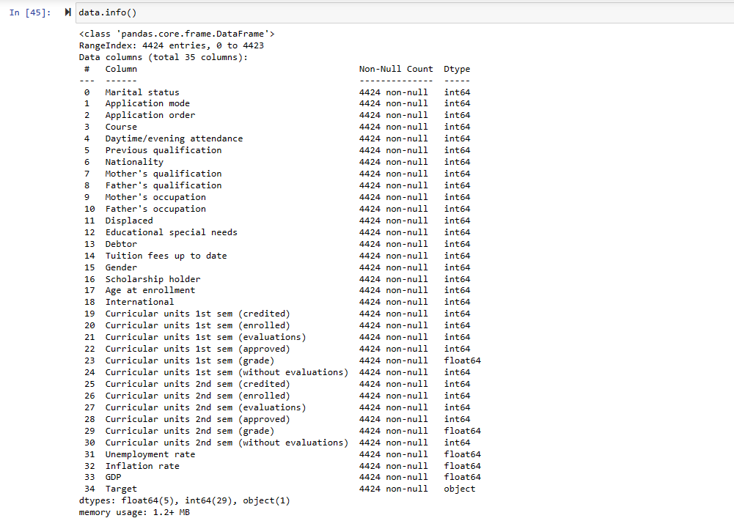
Descriptive Analysis
Page 06
We have 4,424 observations (rows) and 35 features (Columns)
The majority of categorical variables in the downloaded dataset have already been converted to numerical format.
However, for the purpose of exploratory data analysis, we will revert certain columns to their original categorical form.
Data Dragons | University of South Florida

Slide 7

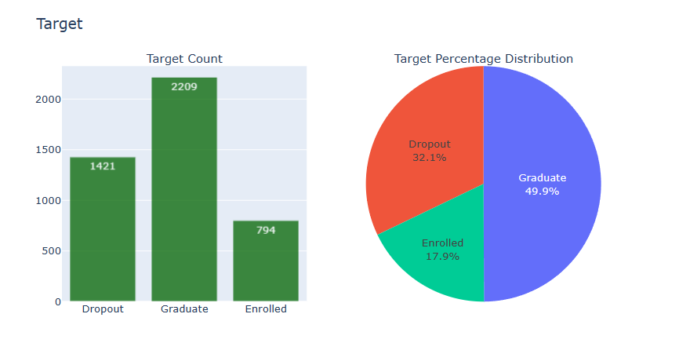
Exploratory Analysis
Page 07
Target Variable
From the target column we can infer the following:
Dropout: This means for that particular observation, the student dropped out
Graduate: The student is a graduate
Enrolled: The student is currently enrolled
Data Dragons | University of South Florida

Slide 8
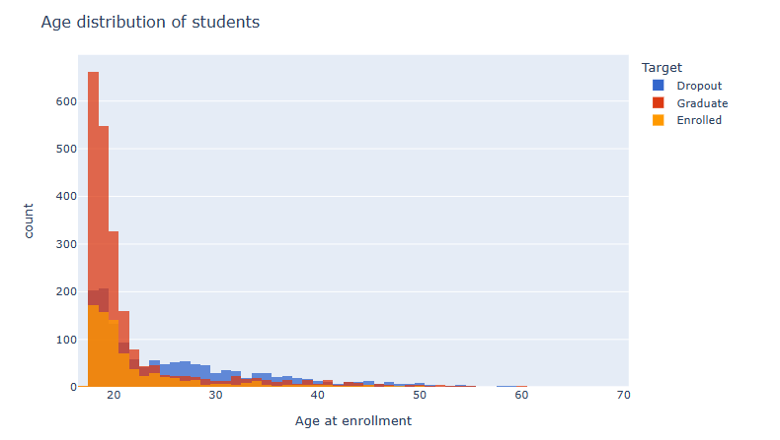

Exploratory Analysis
Page 08
Age
Distribution shows that majority of the students are in their late teen's to early 20's
It is also observed that there was an increase in dropout rate from mid 20's to early 30's
Data Dragons | University of South Florida

Slide 9
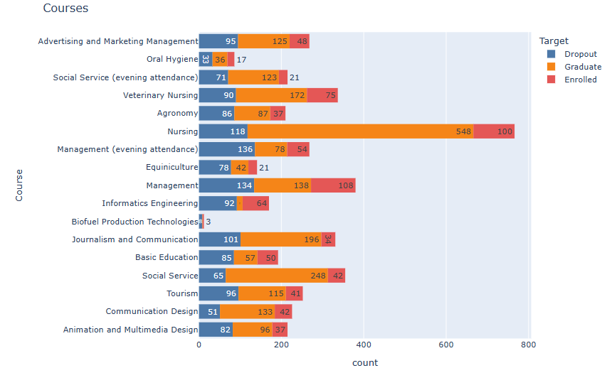
Exploratory Analysis
Page 09
Courses
The course that had the highest number of dropouts was Management with evening attendance (136)
Data Dragons | University of South Florida

Slide 10
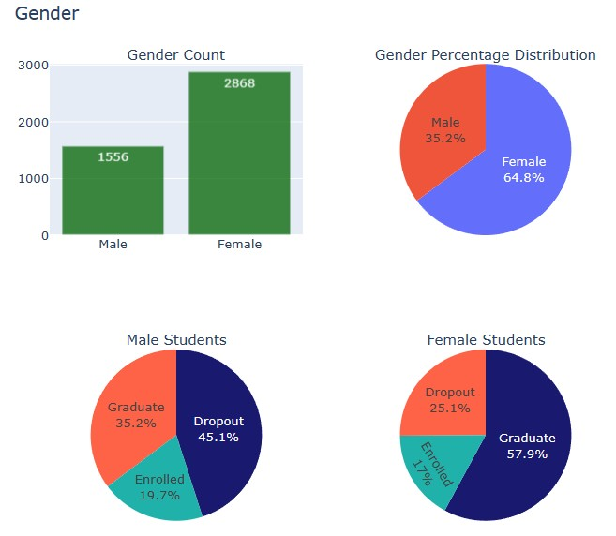
Exploratory Analysis
Page 10
Gender
There was a significant number of female students (64.8%) compared to the males (35.2%).
Also it is observed that there was a higher rate of dropout students that were male (45.1%), compared to the females (25.1%).
Data Dragons | University of South Florida

Slide 11
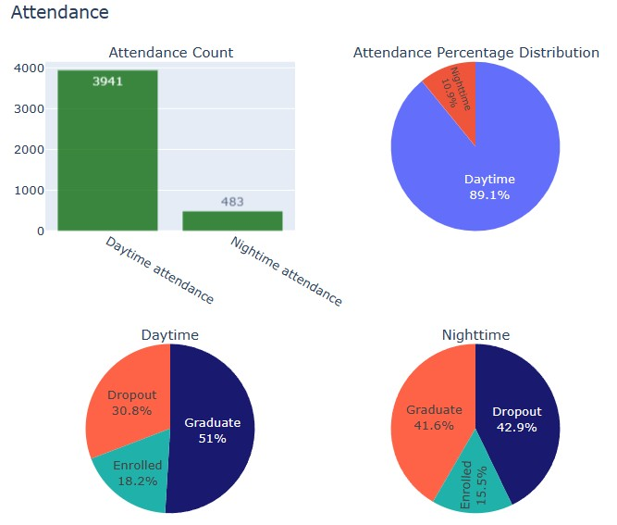
Exploratory Analysis
Page 11
Attendance
Vast Majority (89.1%) of the students attended daytime classes, however, there seems to be about 12.1% increase in the dropout rate for nighttime students compared to the day time students.
Data Dragons | University of South Florida

Slide 12
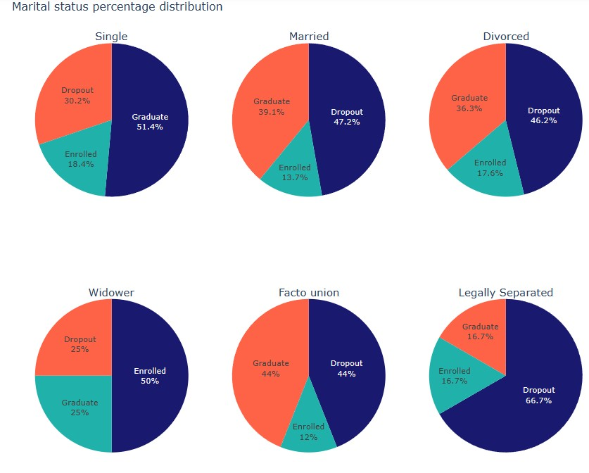
Exploratory Analysis
Page 12
Marital Status
Vast majority of the students are single, however 30.2% of single students dropout.
Another thing to note is that legally separated students (66.7%) had the highest percentage of dropouts followed by Married students (47.2%).
Data Dragons | University of South Florida

Slide 13
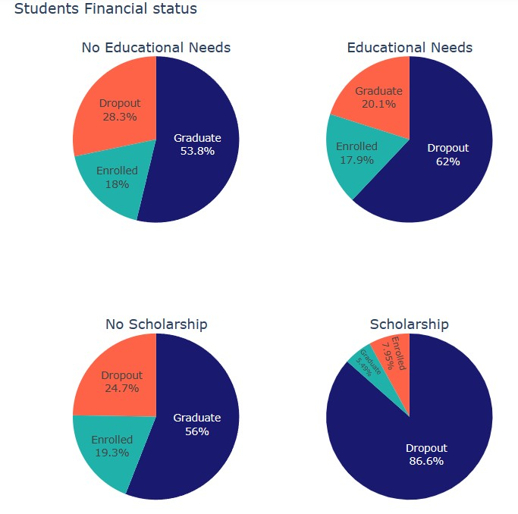
Exploratory Analysis
Page 13
Financial Status
Unsurprisingly, students who were in debt and had not completed payment for tuition had a higher dropout rate of 62% and 86.6% respectively.
Data Dragons | University of South Florida

Slide 14
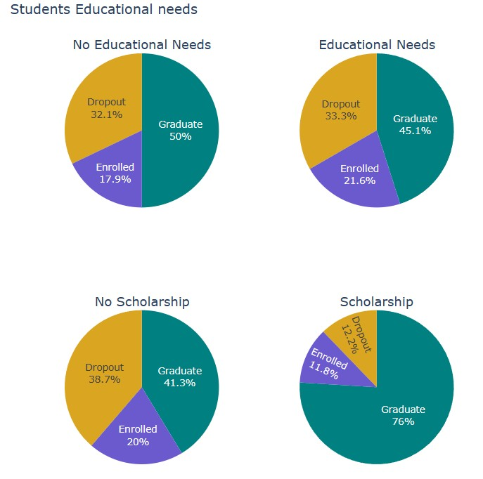
Exploratory Analysis
Page 14
Educational Needs
Similarly, students who were granted scholarships had a low dropout rate of 12.2% compared to those who were not given (38.7%). The educational needs of the students didn't seem to be a significant factor because students with and without educational needs had a 33.3% and 32.1% dropout rate respectively. The column would be dropped before training the model
Data Dragons | University of South Florida

Slide 15
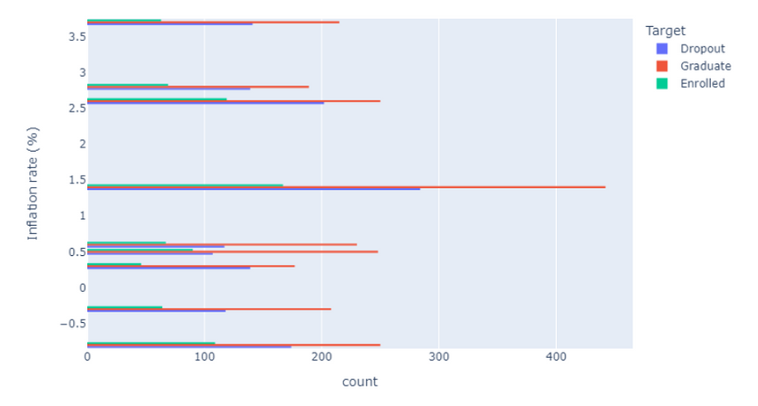
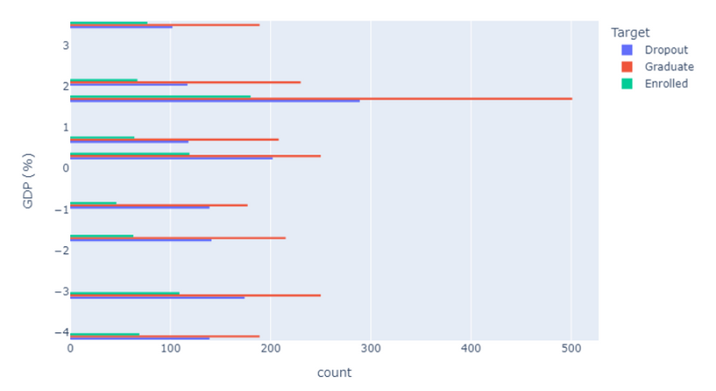
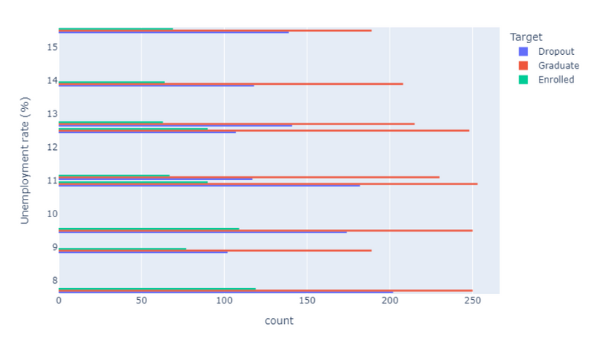
Exploratory Analysis
Page 15
Economic Factors
The economic factors does not seem to have an effect on the dropout rate revealing no pattern or meaningful insight.
Data Dragons | University of South Florida

Slide 16
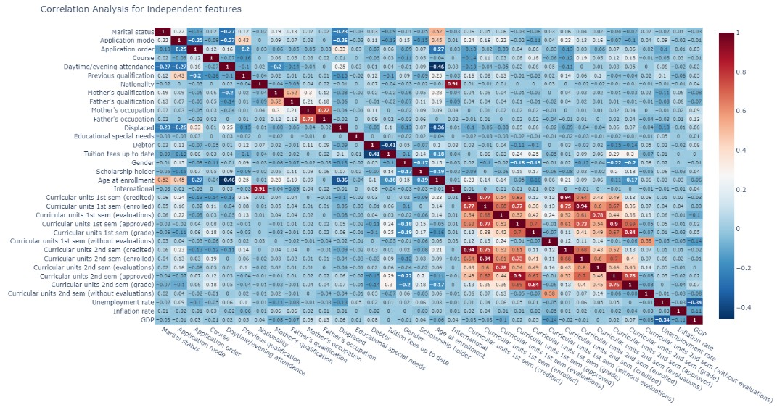
Exploratory Analysis
Page 16
Features Selection
From the results we can see some features have strong correlation with each other:
Nationality and International Mother's qualification and Father's qualification
Mother's occupation and Father's occupation
Curricular Units 1st Sem. and Curricular Units 2nd Sem.
Data Dragons | University of South Florida

Slide 17
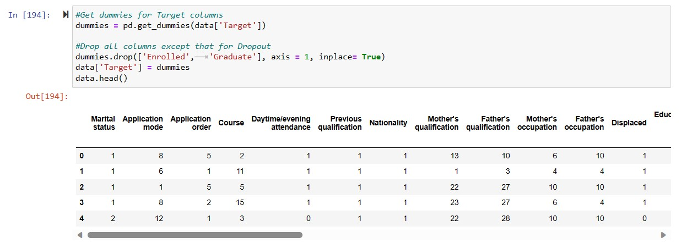
Data Prep
Page 17
Data Processing
Data Dragons | University of South Florida

Slide 18
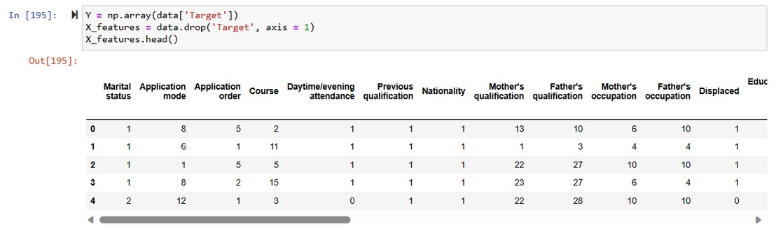
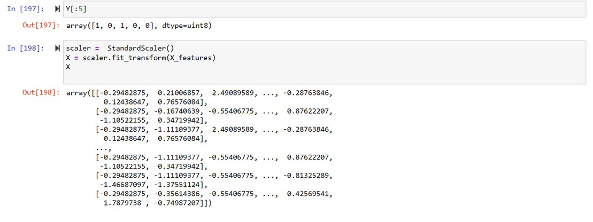
Data Prep
Page 18
Normalizing Data
Data Dragons | University of South Florida

Slide 19
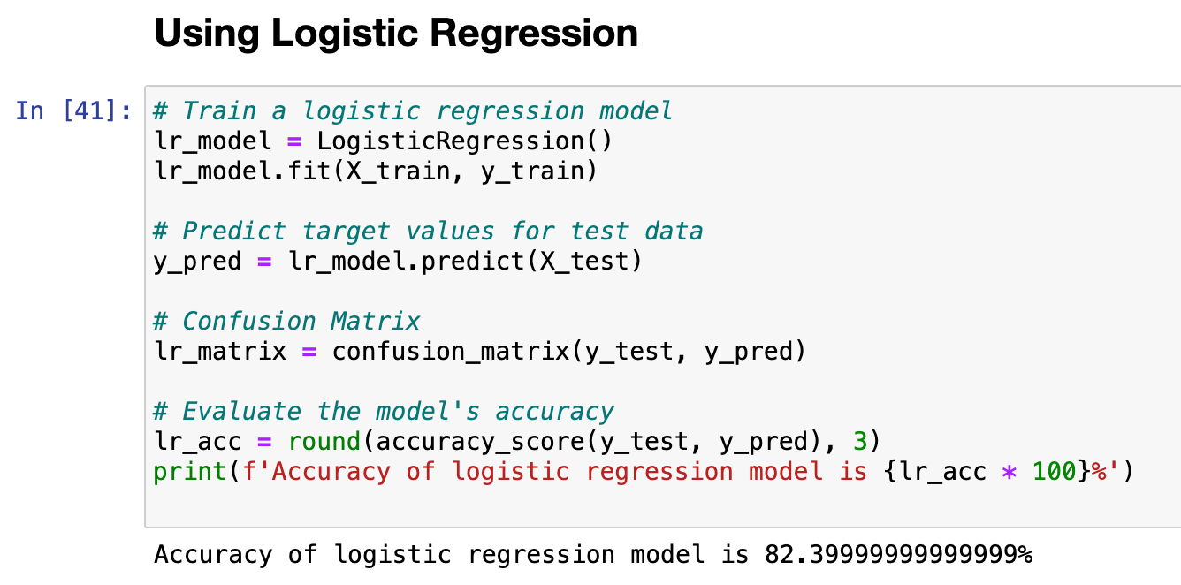
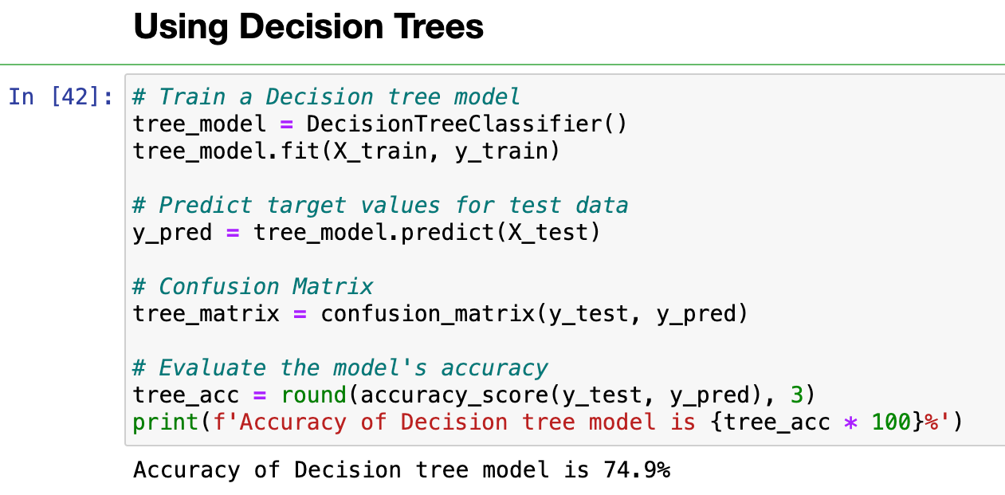
Models
Page 19
Logistic Regression
01
Decision Trees
02
Data Dragons | University of South Florida

Slide 20
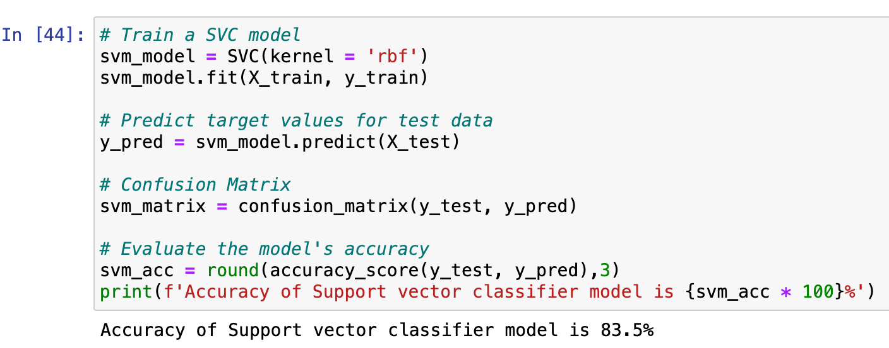
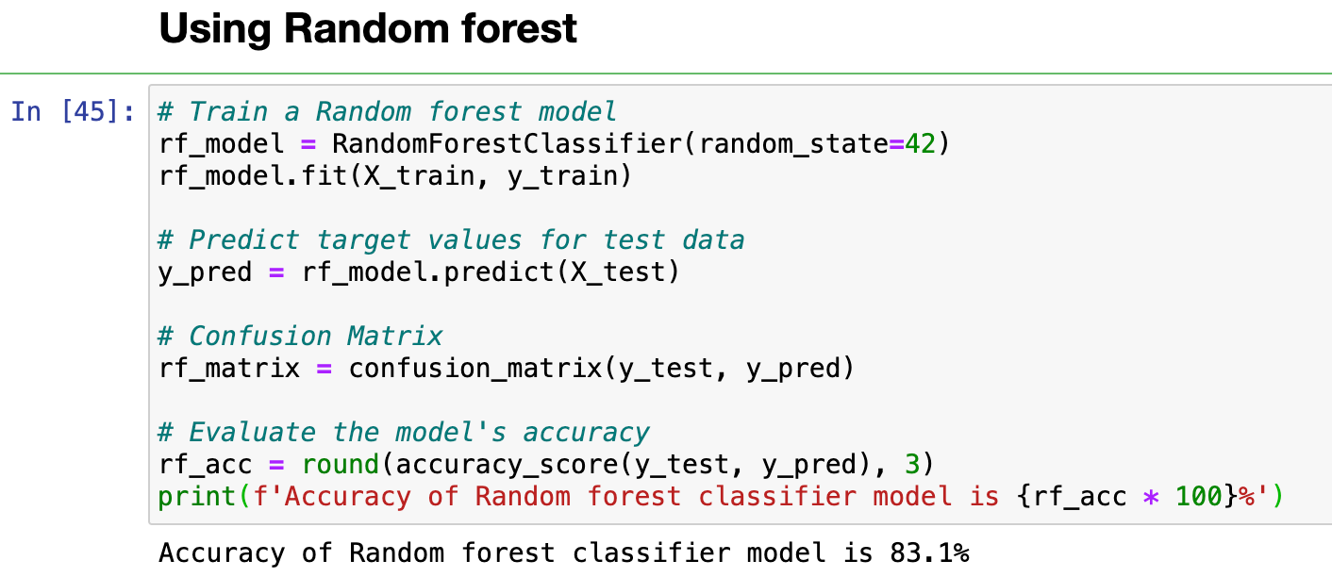
Models
Page 20
Support Vector Machines
03
Random Forest
04
Data Dragons | University of South Florida

Slide 21
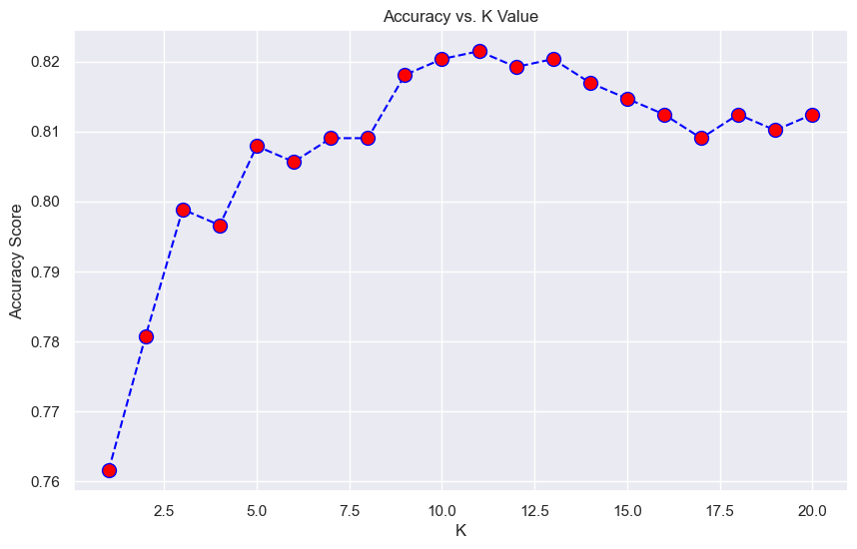
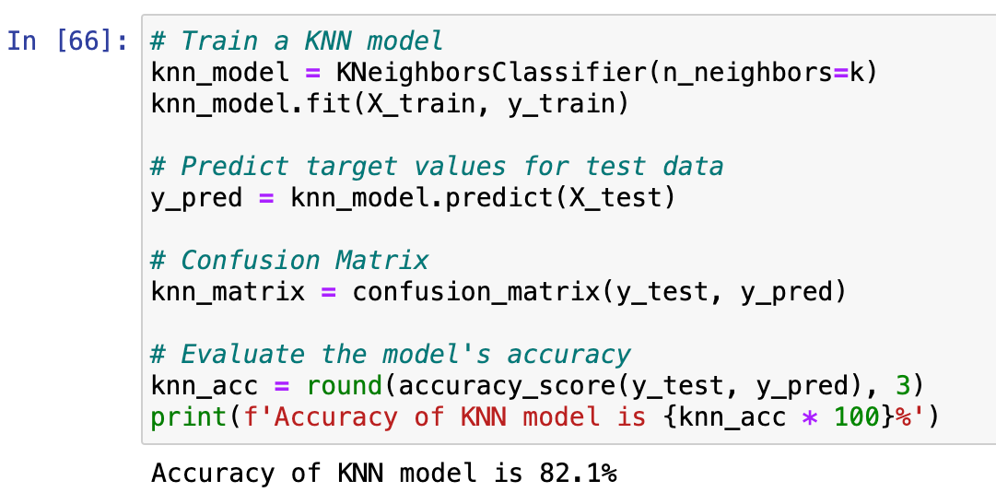
Models
Page 21
K- Nearest Neighbours
05
From the result we can determine that the optimal k- value with the highest score 11
Data Dragons | University of South Florida

Slide 22
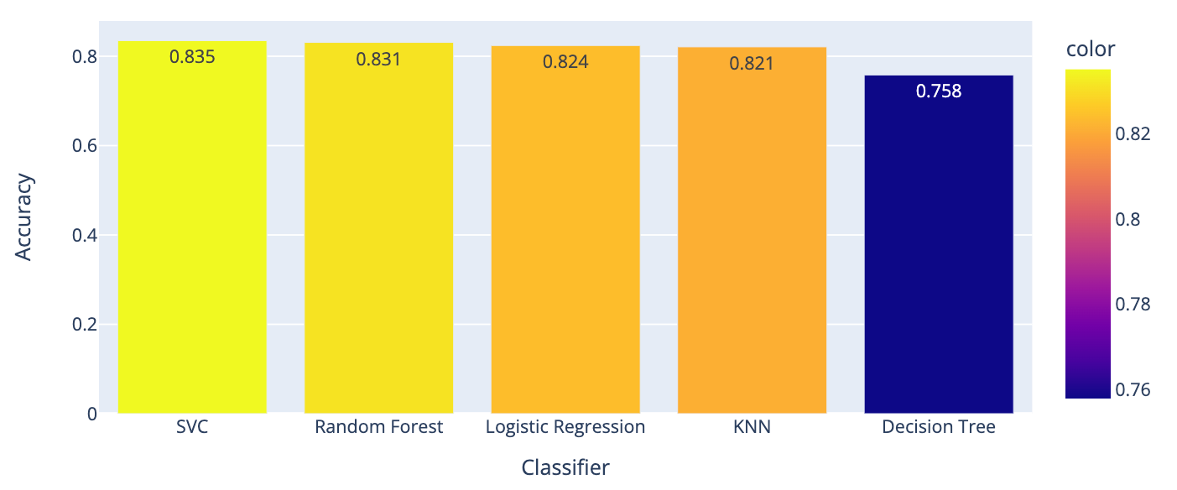
Results
Page 22
Accuracy of Each Classification Model
Data Dragons | University of South Florida

Slide 23
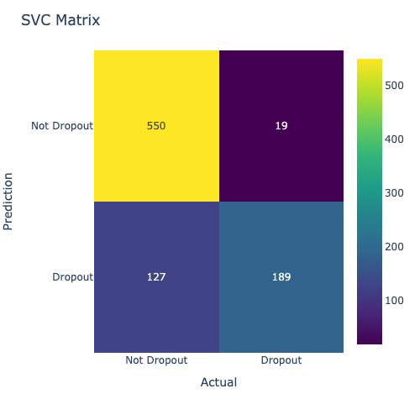
Results
Page 23
Confusion Matrix
Data Dragons | University of South Florida

Slide 24
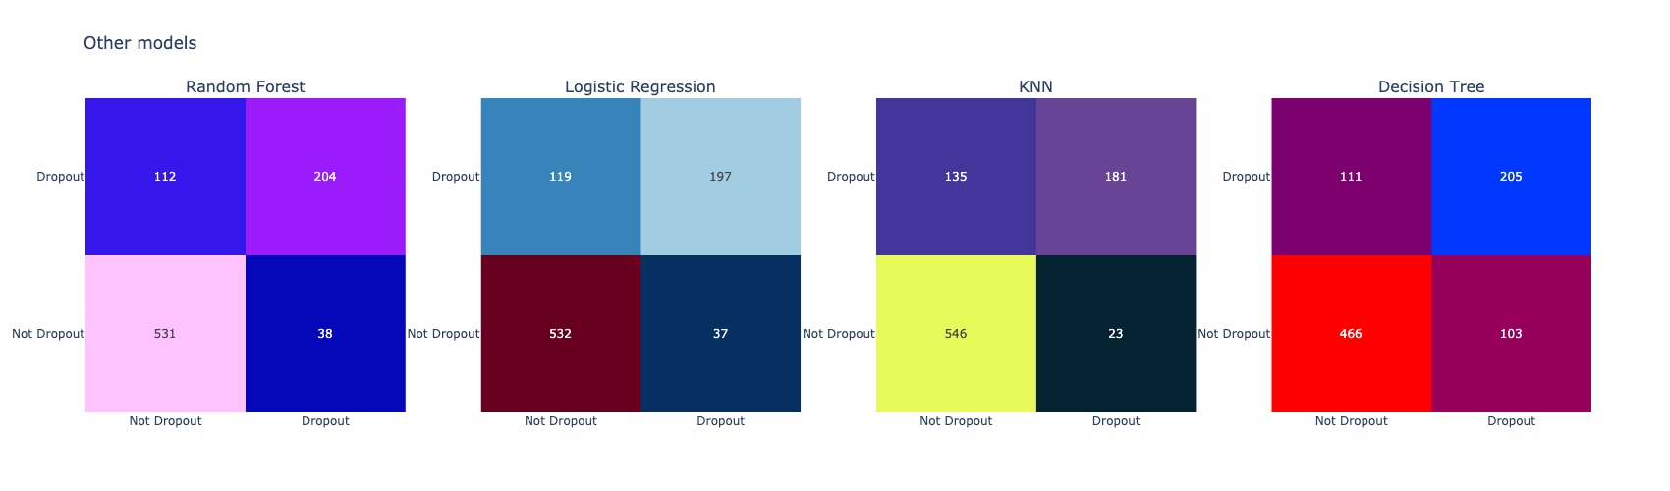
Results
Page 24
Confusion Matrix
Data Dragons | University of South Florida

Slide 25
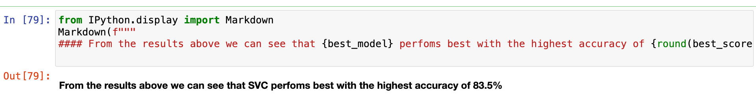
Conclusion
Page 25
The choice of the best model ultimately hinges on the dataset’s unique needs and priorities.
In this context, the models are competitive, with the decision leaning toward the Support Vector Classifier for its adaptability to non-linear data and strong accuracy. However, further assessment, such as cross-validation and considering the implications of false positives and false negatives, would provide a more comprehensive basis for selecting the ideal model for the specific application.
Data Dragons | University of South Florida

Slide 26
THANK
YOU

