Slide 1
CSE 576
TOPICS IN NATURAL LANGUAGE PROCESSING
Optimal Question Generation for Hallucination Detection

Slide 2
Problem Statement
Hallucination in Large Language Models (LLMs) remains a critical challenge, particularly in complex reasoning tasks. This project aims to explore methods for generating optimal questions to detect hallucinations in LLM-generated text, focusing on legal reasoning scenarios. Five advanced reasoning and verification approaches will be applied to various LLMs, including Llama-3.1-8B-Instruct, Llama-3.2-3B-Instruct and Gemini-1.5-Flash. The evaluation will assess models’ ability to correct faulty reasoning, compare question-generation effectiveness, and determine the most robust verification method for minimizing hallucinations and enhancing factual accuracy.

Slide 3
Approach
TREACC (Topic, rule, explanation, analysis, counter arguments, conclusion)
Create several components from original contexts with LLMs
Combine TREACC with human prompt
Advantages
Similar with CoT, but with more details
Disadvantages
Lack of self-verification step
Unable to verify answer by itself
Lower accuracy

Slide 4
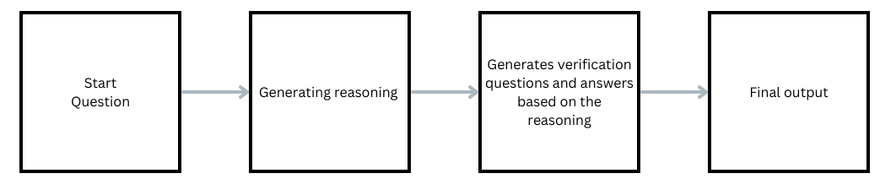
Self-verification
LLM evaluates and corrects their own reasoning outputs. The goal of self-verification is to enhance the reasoning performance of LLMs by enabling them to identify and rectify errors in their logical reasoning processes.
Two-Step Process:

Slide 5
Attention-based Verification with Cross-Step Focus Approach
Three step process:
Stage 1: Initial Reasoning
Model generates a preliminary legal reasoning response.
Uses provided legal context, question, options, and analysis.
Produces a step-by-step explanation ensuring logical consistency.
Stage 2: Verification Question Generation
Identifies critical legal terms for each legal reasoning step.
Forms verification questions targeting critical terms.
Ensures attention is directed to relevant legal terms.
Stage 3: Cross-Step Evaluation and Refinement
Model evaluates its reasoning steps labelling each step as correct or incorrect.
Refines its final response by correcting errors and aligning with the legal context.

Slide 6
Location Based Error Correction in Reasoning
Reasoning Chain
Verification Chain
Reasoning Chain
Legal Context
Questions
Options
Legal Reasoning
Answer Option
Targeted Questions specifying error location
Updated Legal Reasoning
Updated Answer Option

Slide 7
Deductive Verification of CoT Reasoning
Qn-Context Statements #1, #2 ,..
Reasoning Chain:
(Premise#1-Conclusion#1) : RS #1
(Premise#2-Conclusion#2) : RS #2
….
Final Answer
Question, Context, Options
Task : CoT Reasoning
{ step : (premise-Conclusion)}
LLM
…
RS #1
LLM
Is the Reasoning Chain Valid?
Validation
Resample
Final Conclusion

Slide 8
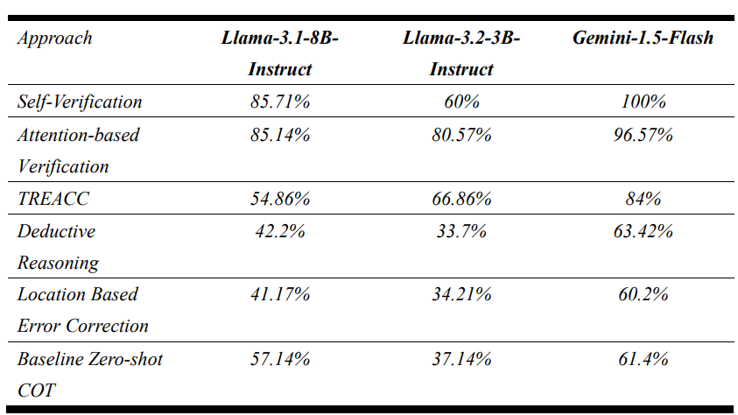
Result

Slide 9
Analysis
Self-Verification: Iterative evaluation excels in models with strong contextual capabilities but performance drops with model limitations.
Attention-based Verification:
Strong adaptability; isolates reasoning faults effectively.
Occasional misclassifications due to revaluation of correct steps.
TREACC: Complexity hinders performance without self-verification.
Deductive Verification:
Suited for complex tasks but struggles with non-monotonic reasoning.
Challenges in identifying error locations reduce accuracy.
Location Based Error Correction: Targeted questions might not be generated on the basis of steps in legal reasoning.

Slide 10
Team members
Chao-Shiang, Chen - 20%
Implemented the TREACC Approach
Ankitha Dongerkerry Pai - 20%
Implemented the Self-Verification Approach
Rakshita Madhavan - 20%
Implemented the Attention-based Verification Approach
Suraj Kumar Manylal - 20%
Implemented the Location based Error correction Approach
Bala Sujith Potineni - 20%
Implemented the Deductive Verification Approach

Slide 11
THANK YOU

