Slide 1

UE19CS204 – Web Technologies Mini Project
Project Title – Dog Adoption Website
(Kuttadopt.com)
Section - E
Nishanth S M – PES2UG19CS266
P P Sujith - PES2UG19CS272
Rajath R Maragiri - PES2UG19CS317
GITHUB Link - https://github.com/Sujith402/Assignment3-Web-Tech

Slide 2
Abstract
We aim to make a functional website with listings for dog adoption in Bangalore.
The basic functionalities are:
Home page with links to dog adoption pages, about us, Contact page.
Bio data and essential information of dog up for adoption (identity verification, etc.)
Listing page (For all available dog, categorized with different filters)-Searching, Sorting, etc.
Functionality for getting in touch with the seller/ buyer.

Slide 3
Technologies Used
Modules/Libraries used,
body-parser: ^1.19.0
express: ^4.17.1
mongodb: ^3.6.3
mongoose: ^5.11.4
nodemon: ^2.0.6
express: ^4.17.1
formik: ^2.2.5
mongodb:^3.6.3
react: ^17.0.1
react-dom: ^17.0.1
react-icons: ^4.1.0
react-router-dom: ^5.2.0
react-scripts:4.0.1
uuid: ^8.3.1
web-vitals: ^0.2.4

Slide 4
Member Contributions
P P Sujith :- Header , Nav Bar(with links), Routing to dog pages, Routing dog breed with back-end.
Nishanth S M :-Contact us form with back-end connectivity, Footer, Post cards for dogs.
Rajath R Maragiri :- Body Template with main contents, Page styling with images, MongoDB connectivity with filtering of dog breeds.

Slide 5
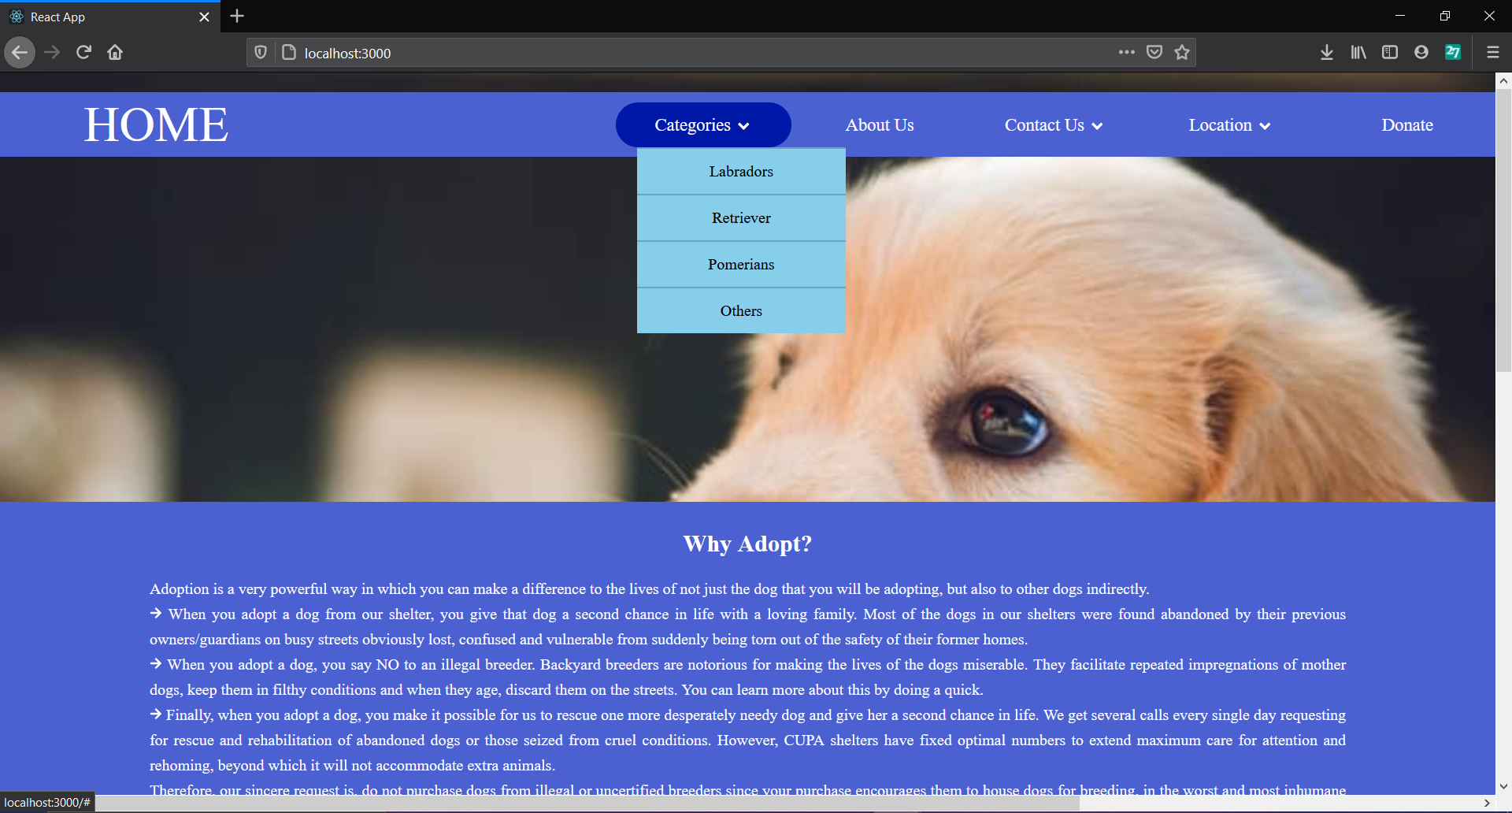
Screen shot

Slide 6
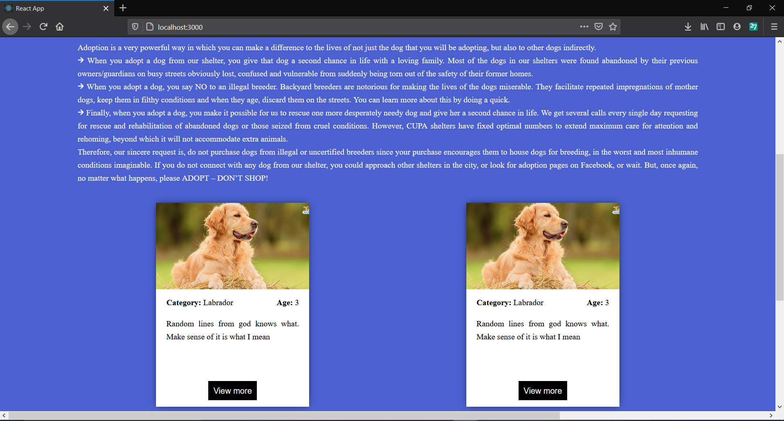

Slide 7
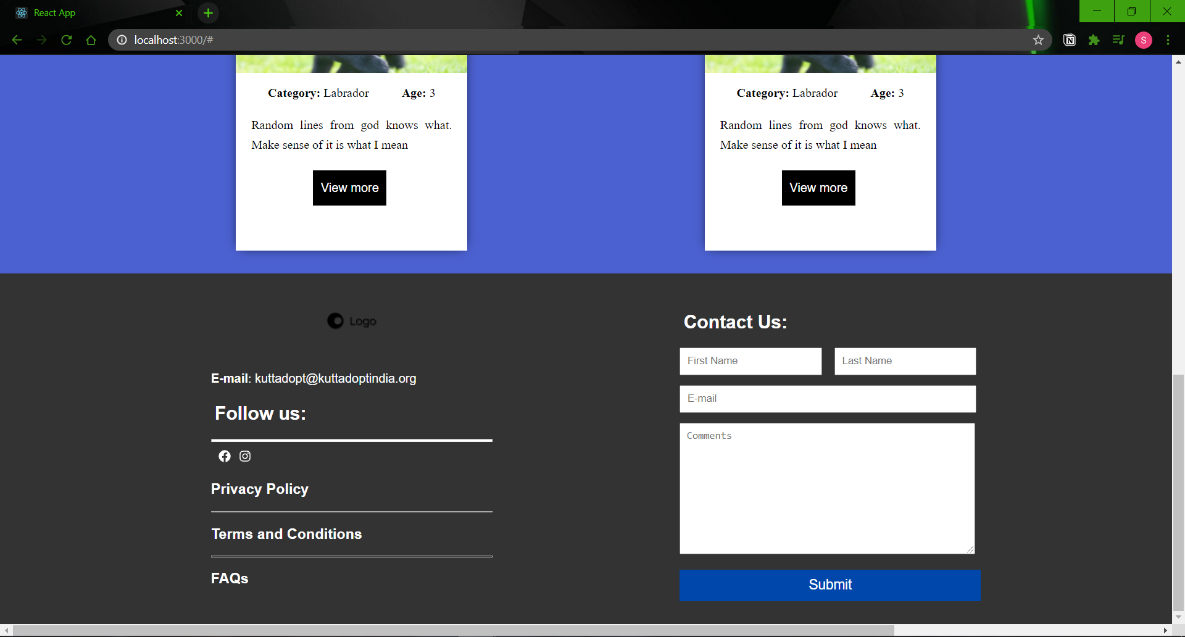

Slide 8
