Slide 1
Diwakar Validation
Dual-camera tag jig vs Motive mocap: how accurate it is, which corner refinement to keep, whether the second camera earns its place, and what error is left

Slide 2
What we measure
Radxa board, two fisheye cameras (stereo pair) looking across the table
Device: 8 AprilTags on one rigid jig {4, 8, 12, 14, 20, 24, 28, 32}; tag 12 is the reference
Truth: Motive mocap rigid body on the device, 100 Hz, GPIO-synced to the cameras
Takes, 3 Oct 2026
  T0: free motion, used only to build the jig
  T1: still holds on a table grid, 2 runs, ~160 usable holds
  T2: circle and figure-eight at 100 / 200 / 300 mm/s pacer speed
  T3: reaching out and back, comfortable and fast
Accuracy
Grip point error per still hold, table plane
mm
Static jitter
Spread of the grip point while the device is still
mm
Coverage
Frames where the tracker returns a pose
%
Error under motion
Grip point error per frame in T2 / T3
mm
Notes:
Every position number is in millimetres; coverage is in percent of frames; the timing offset is in milliseconds. Position errors are in the table plane (mocap X and Z) because the game only uses the table plane.

Slide 3
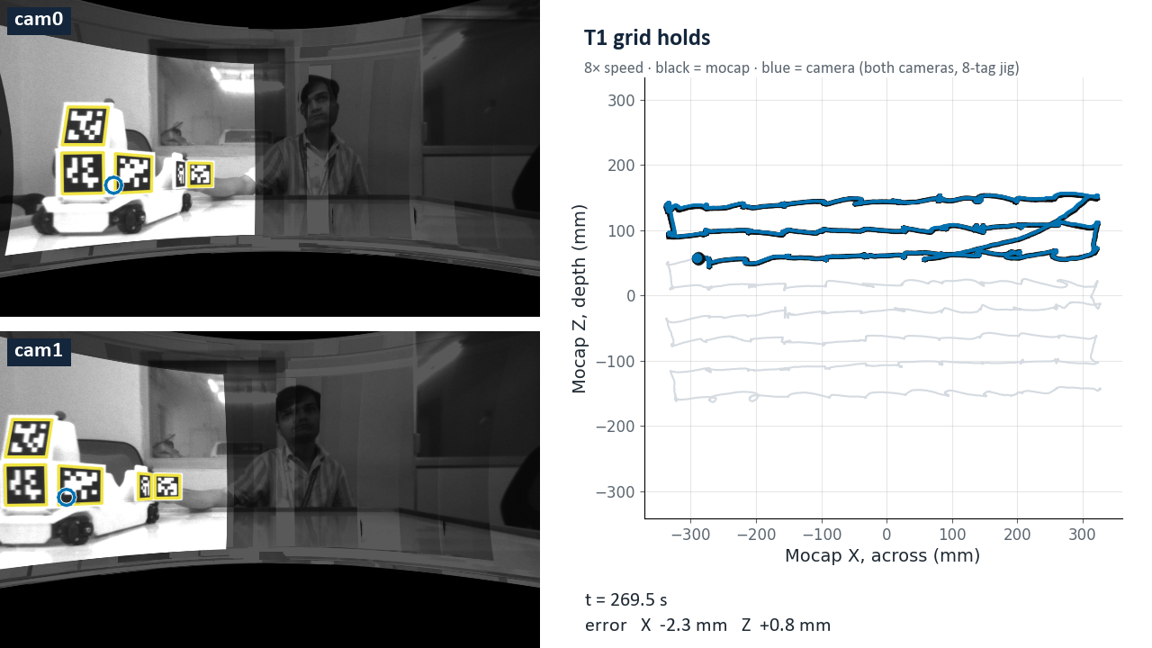
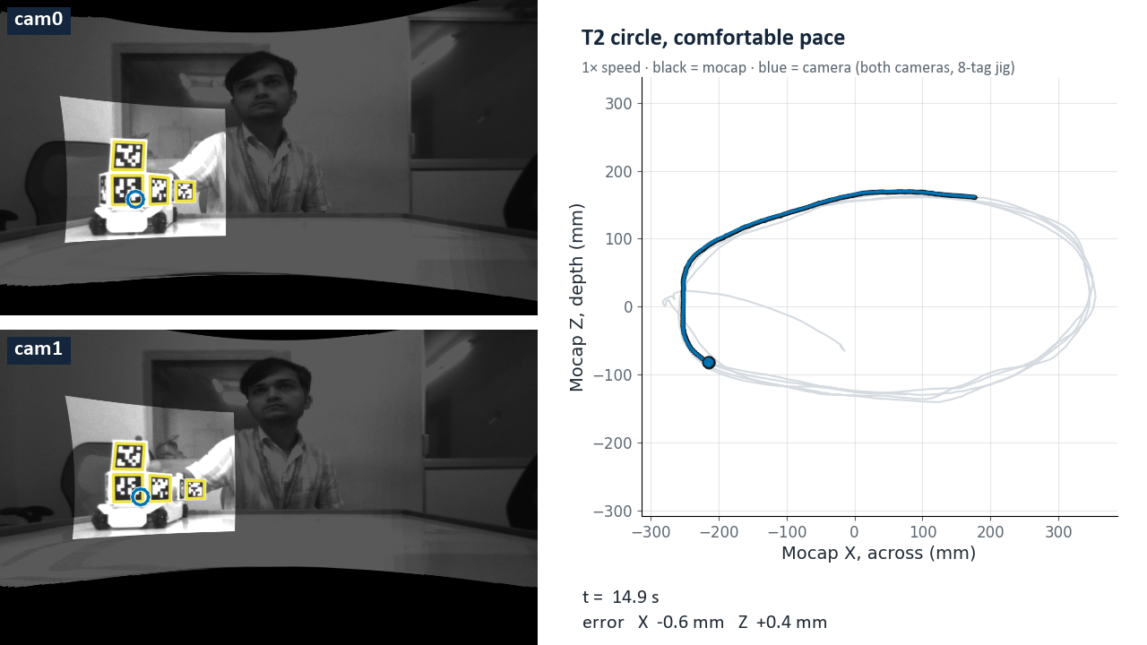
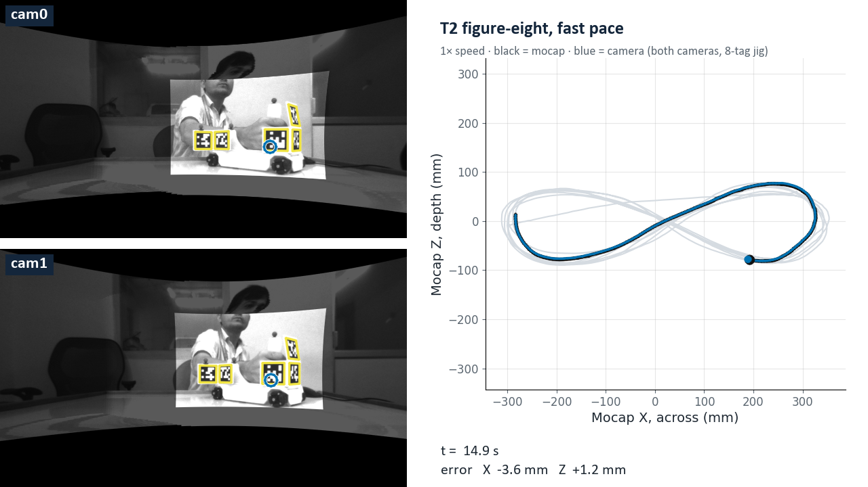
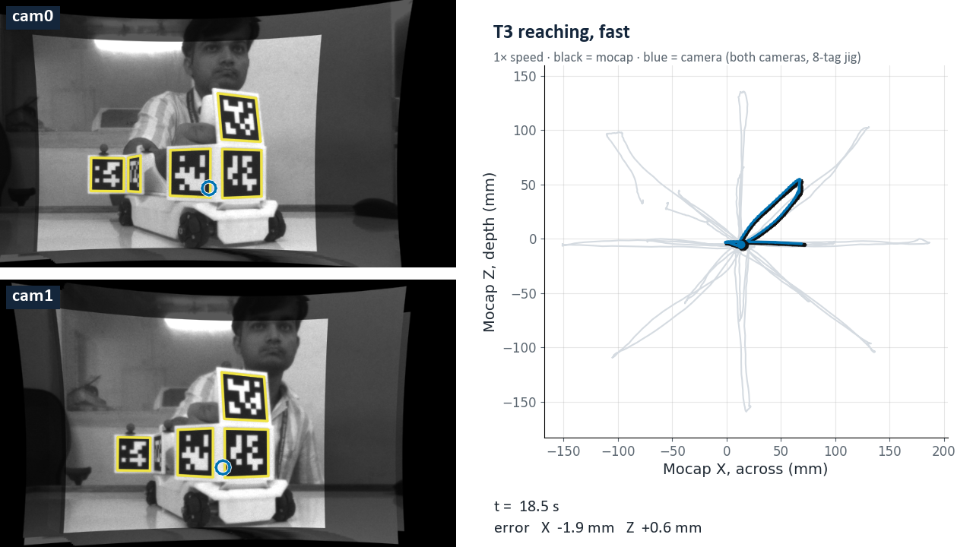
What the takes look like
T1 grid holds 8× speed
T2 circle, comfortable 1×
Left of each video: cam0 and cam1
  yellow: tags the tracker found
  blue ring: solved grip point
  dim: last crop seen there (the recorder keeps only a crop around the device)
Right: table-plane path
  black: mocap; blue: camera, both cameras + jig
Click a video to play
T2 figure-eight, fast 1×
T3 reaching, fast 1×
Notes:
render_vids.py. Left: what each camera recorded (the recorder keeps only a crop around the device; the rest of the view is the last crop seen there, dimmed), undistorted as the tracker sees it, with the tracker's own tag corners (yellow) and the solved grip point (blue ring). Right: table-plane path, mocap black, camera blue (Diwakar edge corners, 8-tag jig, both cameras, registration fitted on the T1 holds). T1 plays at 8x, the others at 1x. Click a video to play it.

Slide 4
Definition: grip point, axes and registration
Positions and axes
Registration
Time sync
Grip point: the point on the jig handle the game uses, from the solved jig pose
Mocap: Motive rigid body on the device, its grip point from the same offset
Mocap axes (Motive, Y up): X across the table, Z depth, Y height
Cameras sit at mocap Z ≈ 600 mm; larger Z is closer to them
Scored in the table plane (X, Z); height is left out because the game uses the table plane
Camera and mocap use different axes: a fixed rotation + translation maps camera to mocap
Plus the grip offset inside the mocap body: 9 parameters, no scale
Fitted on the T1 hold averages of one run, scored on the other run (held-out)
T2 / T3: fitted on both T1 runs, then frozen
Diwakar's own 13-parameter fit (with a free scale) is compared separately
The camera board logs every rising edge of Motive's sync pin; edge k = mocap frame k (100 Hz)
Each camera frame reads the mocap pose interpolated at its own timestamp
Mocap jumps > 20 mm in one frame (rigid-body swaps) count as gaps
The two cameras' frame timestamps agree within 0.1 ms
Notes:
analyze_T1.fit / apply: p_mocap_grip = R_wc g_cam + t_wc, with the grip offset g_body expressed in the mocap rigid body (9 parameters: rotation, translation, offset; no scale). T1 accuracy is held-out: fit on run 1, score run 2, and the reverse. T2 / T3 use the fit on both T1 runs, frozen. Mocap frames whose position jumps more than 20 mm in 10 ms are treated as gaps.

Slide 5
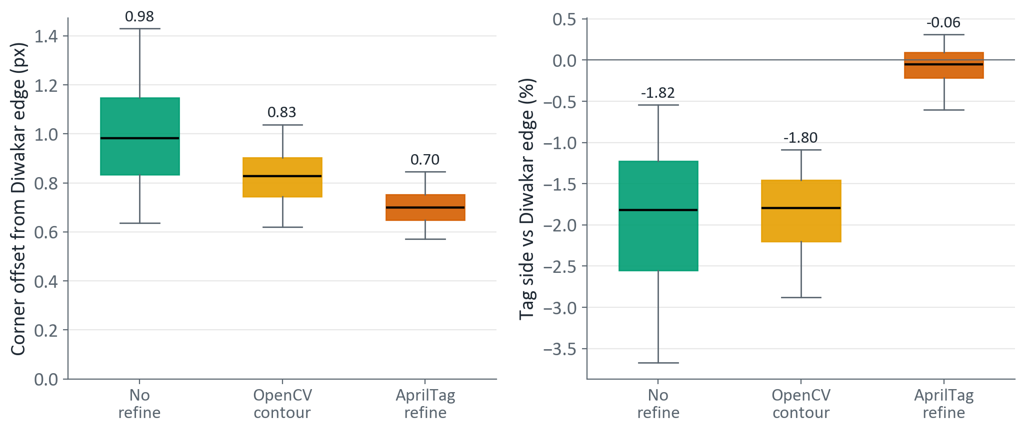
Definition: four corner refinements
No refine
OpenCV contour
Diwakar edge
AprilTag refine
OpenCV adaptive-threshold quad corners, no sub-pixel step
CORNER_REFINE_CONTOUR: line fit along the quad contour
Contour + gradient line fit on the tag edges (the shipped tracker)
rapidtag CORNER_REFINE_APRILTAG (AprilTag library edge fit)
Every refinement moves corners 0.7–1.0 px from Diwakar edge (median)
No refine and contour shrink tags by 1.8 %: a scale bias, since tag size sets distance
AprilTag refine matches Diwakar edge's tag size within 0.06 %
Same tag, same frame, against Diwakar edge corners · box = middle 50 % · whiskers = 5th–95th percentile
Notes:
All four run the tracker's own detector settings on the undistorted image (detect_paths.py, path 'ud'). Diwakar edge = OpenCV CORNER_REFINE_CONTOUR + edge_refine.py from his tracker repo; re-running it reproduces the logged corners to 0.004 px median. AprilTag refine = rapidtag 0.1.12 CORNER_REFINE_APRILTAG. Each refinement gets its own jig, bundle-adjusted from its own T0 corners, so no refinement is scored against another's geometry. Corner offsets: T1 run 1, 489,636 tag detections.

Slide 6
Definition: solvers, rigid body and scoring
Solvers and rigid body
Scoring
cam0 only / cam1 only: one camera's corners, PnP
Both cameras: one pose fitted to both cameras' corners at once (stereo)
Jig: every visible tag of the 8, with tag positions bundle-adjusted from the T0 take
Tag 12 only: the reference tag alone, the same frames
Hold: from the operator's hold start to hold end, 0.5 s trimmed at each end
Per hold: median camera grip point vs mean mocap grip point
Error per hold = camera − mocap (mm); its size = √(X² + Z²) in the table plane
Jitter per hold: SD of the grip point in 50-frame windows (0.5 s), median over the hold; 3D = √(SDx² + SDy² + SDz²) in mm
Mocap noise floor: the same jitter measure on the mocap grip point
Under motion (T2 / T3): error per camera frame, same √(X² + Z²)
Coverage: frames with a pose ÷ recorded frames (%)
Statistics
Box = middle 50 %, line = median (printed), whiskers = 5th–95th percentile
RMSE for the same data is in the speaker notes
Neighbouring frames are correlated, so no significance tests
Notes:
Solvers in common.py: single camera = SOLVEPNP_IPPE for one tag, SQPNP + LM refinement for several; both cameras = Gauss-Newton over both cameras' corners through the stereo extrinsics (p_cam0 = Rx p_cam1 + tx). Jitter: static_jitter_T1.py, 50-frame windows (0.5 s at 100 Hz), SD with ddof 1, in mocap axes. Holds whose mocap SD exceeds 0.2 mm are dropped as moved. Every condition is scored on the same frames per solver.

Slide 7
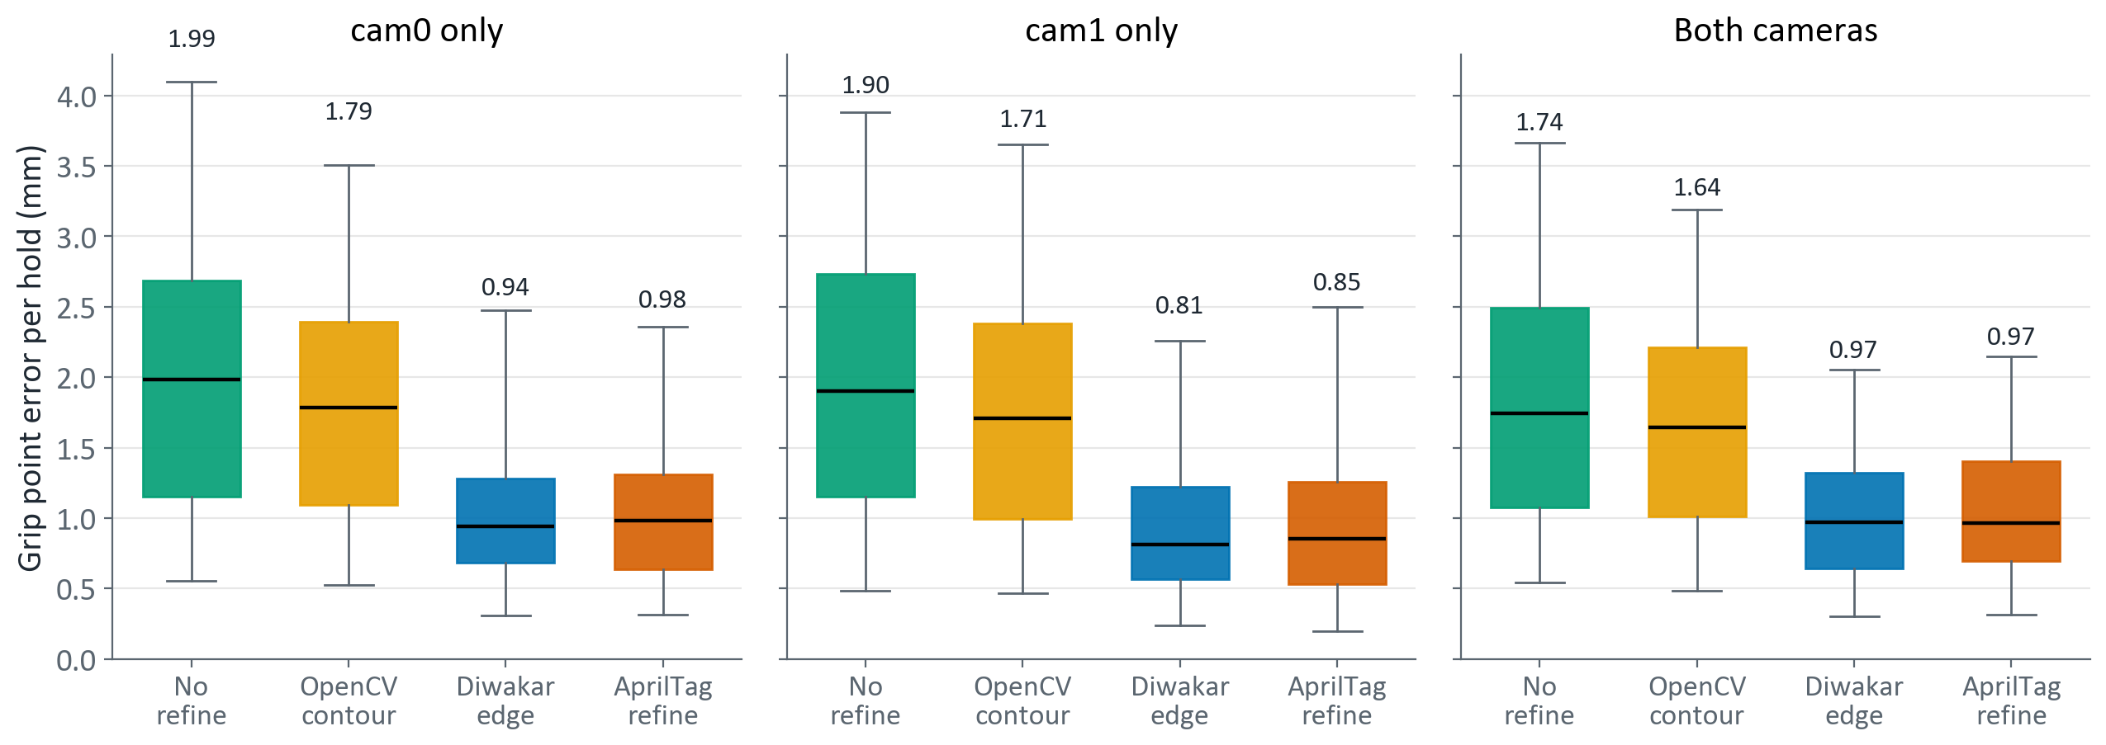
Edge or AprilTag refinement halves the error
Box = middle 50 % of holds · line = median (printed) · whiskers = 5th–95th percentile · 8-tag jig · registration fitted on the other run
Diwakar edge and AprilTag refine: median 0.8–1.0 mm per hold
No refine and OpenCV contour: 1.6–2.0 mm, about twice as large
Same ranking for cam0, cam1 and both cameras
With the jig, two cameras do not beat one: 0.97 vs 0.94 / 0.81 mm
Notes:
T1, held-out registration, 8-tag jig. Holds per solver: cam0 143, cam1 153, both 159. RMSE (mm) cam0 / cam1 / both: no refine 2.37 / 2.34 / 2.13; contour 2.08 / 2.10 / 1.93; Diwakar edge 1.22 / 1.14 / 1.21; AprilTag 1.29 / 1.21 / 1.25.

Slide 8
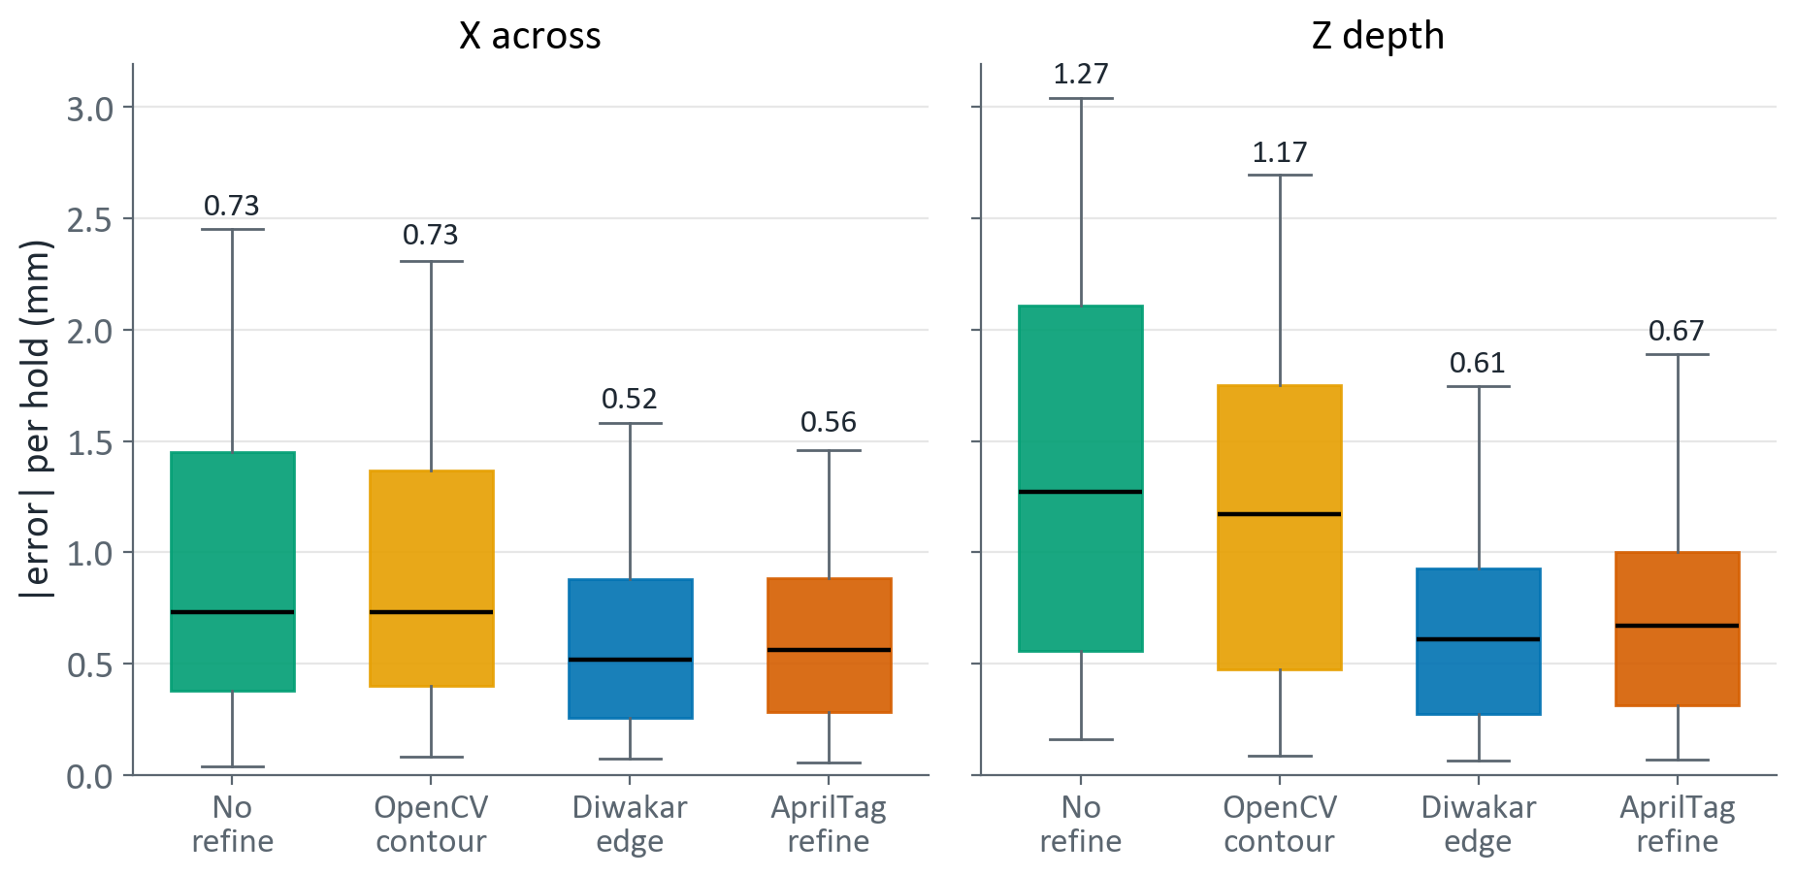
The error left is mostly depth
Both cameras + jig, |error| per hold
Z (depth) is larger than X (across) for every refinement
  No refine: Z 1.27 vs X 0.73 mm
  Diwakar edge: Z 0.61 vs X 0.52 mm
Good refinement removes most of the depth error: 1.27 → 0.61 mm
Depth is a camera's weak direction: it rests on how big the tags look and on the short stereo baseline
Box = middle 50 % of holds · line = median (printed) · whiskers = 5th–95th percentile · both cameras, jig
Notes:
T1, both cameras, 8-tag jig, held-out. RMSE X / Z (mm): no refine 1.28 / 1.70; contour 1.27 / 1.45; Diwakar edge 0.83 / 0.88; AprilTag 0.82 / 0.95.

Slide 9
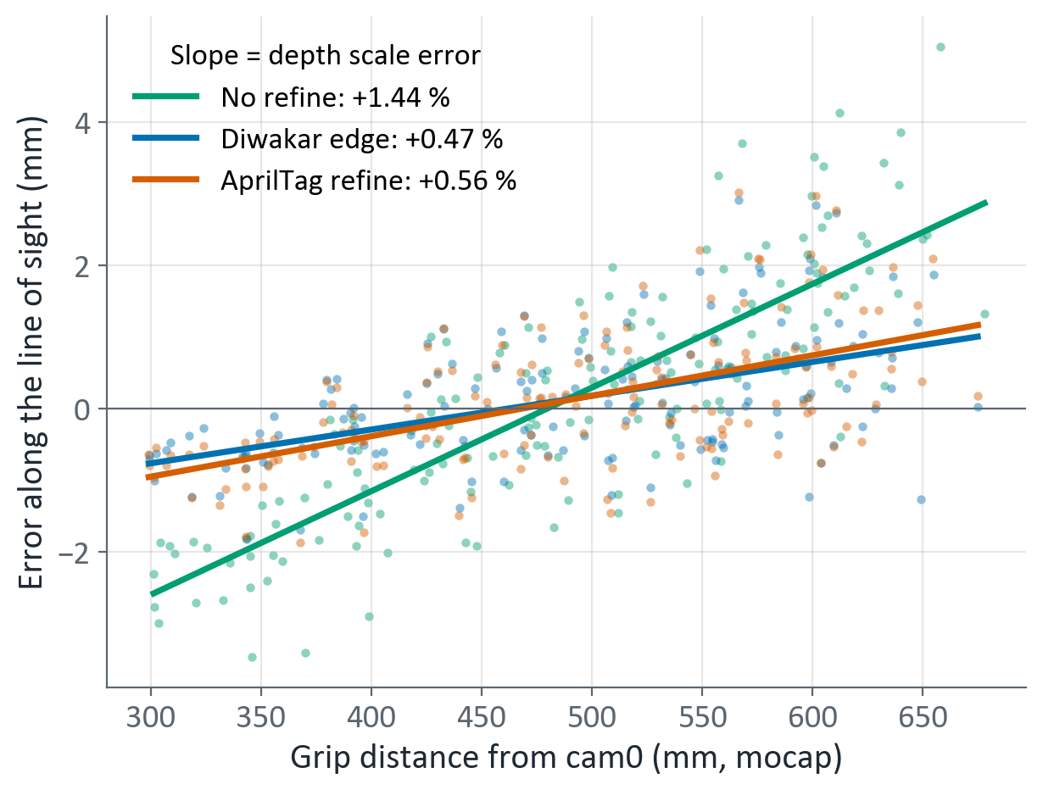
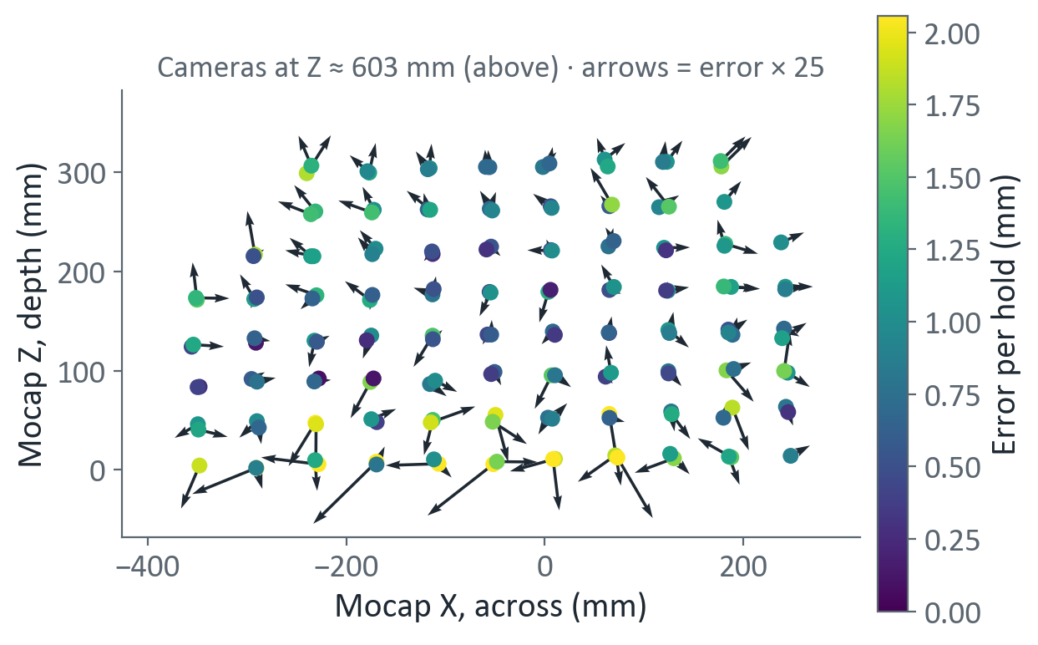
Depth error is a scale error: distances read 0.5 % long
Each dot one hold · both cameras, jig · slope in % = mm per 100 mm
Diwakar edge, both cameras, jig · each dot one hold · arrows ×25
Distances read long: Diwakar edge 0.47 %, AprilTag 0.56 %, no refine 1.45 %
Largest hold errors sit in the far row, ~650 mm from the cameras
No refine shrinks tags 1.8 % and reads farther: corners set the scale
Edge and AprilTag agree on tag size yet read 0.5 % long: check the printed tag size (0.5 % of 50 mm = 0.25 mm) and the focal length
Notes:
Error along the line of sight = (camera − mocap) projected on the direction from cam0's centre to the grip point, mocap axes; distance from the same registration. Slopes (least squares): no refine 1.45 %, Diwakar edge 0.47 %, AprilTag 0.56 %. Tags are printed at a nominal 50 mm side. Diwakar's own fit finds a camera scale of 0.992 (run 1) and 0.994 (run 2): the same effect.

Slide 10
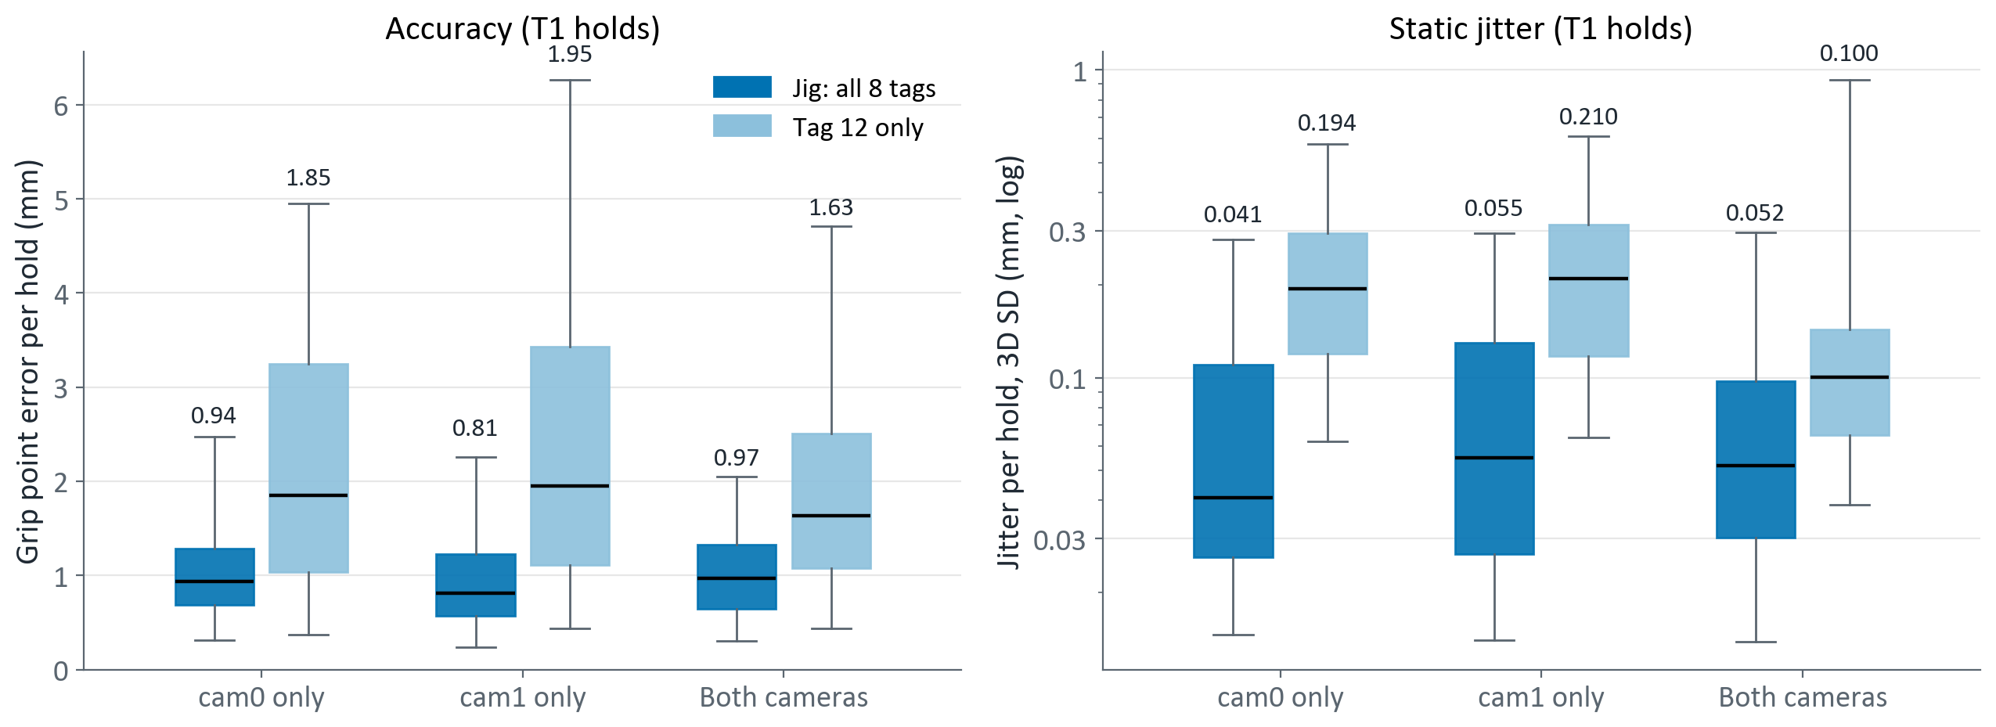
The 8-tag jig matters more than the second camera
Box = middle 50 % of holds · line = median (printed) · whiskers = 5th–95th percentile · Diwakar edge · jitter on a log axis
Tag 12 alone: error 1.6–2.0 mm vs 0.8–1.0 mm with the jig
Jitter with tag 12 alone: 0.10–0.21 mm vs 0.041–0.055 mm with the jig
With the jig, one camera is as good as two
With tag 12 alone, two cameras halve jitter (0.10 vs 0.19 mm) and trim error 12 %
Notes:
Diwakar edge, T1, held-out. Jig vs tag 12 RMSE (mm) cam0 / cam1 / both: jig 1.22 / 1.14 / 1.21; tag 12 2.77 / 3.06 / 2.41. Jitter is the 50-frame window SD per hold (3D, mm), on the same frames.

Slide 11
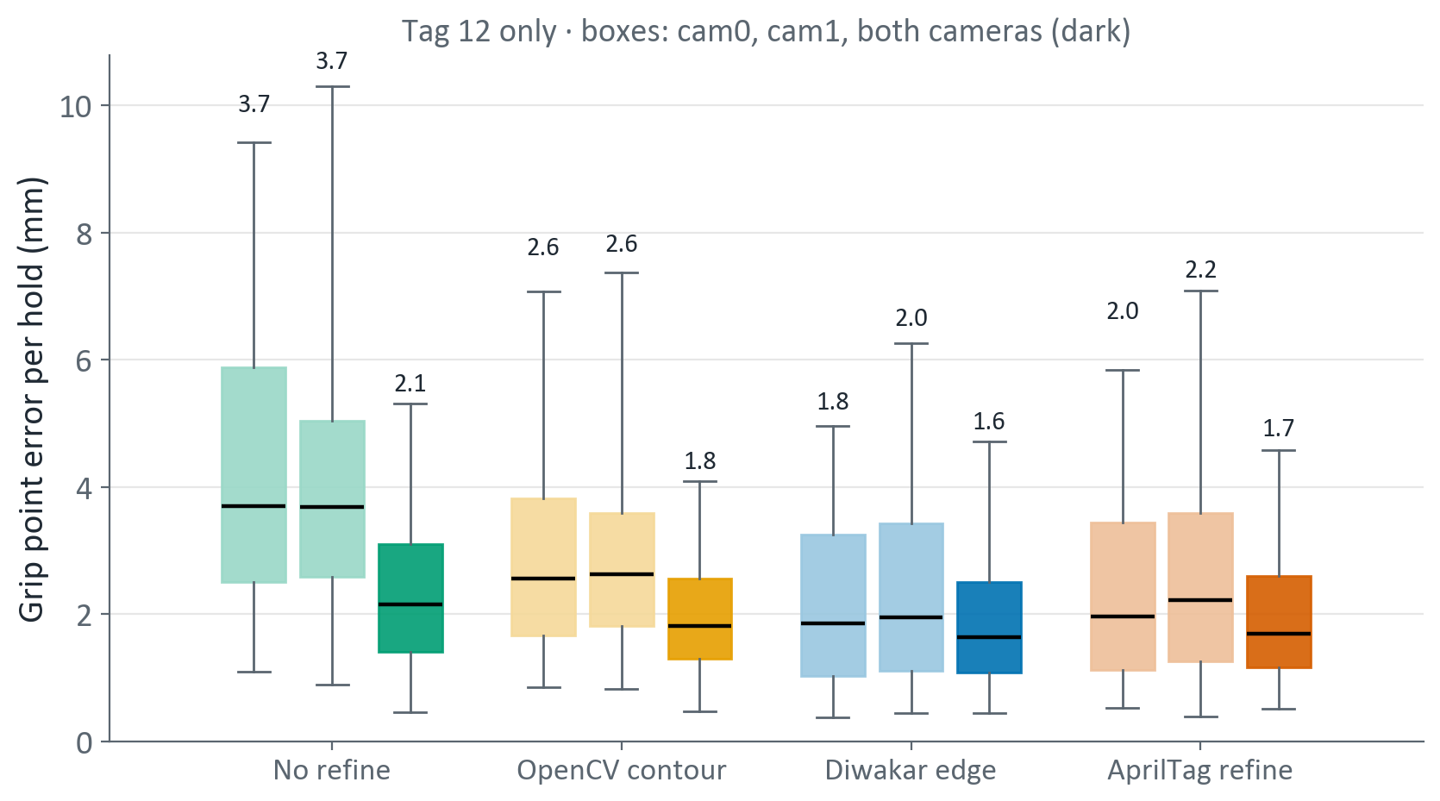
Two cameras rescue weak setups, not strong ones
Tag 12 alone, one camera
  no refine 3.7 mm, contour 2.6, edge 1.8, AprilTag 2.0 (cam0)
Both cameras pull every refinement to 1.6–2.1 mm
Biggest gain where corners are worst: no refine 3.7 → 2.1 mm
The jig with one camera (0.8–1.0 mm) beats any refinement with two cameras and one tag
Box = middle 50 % of holds · line = median (printed) · whiskers = 5th–95th percentile · tag 12 only
Notes:
Tag 12 only, T1, held-out. RMSE (mm) cam0 / cam1 / both: no refine 5.42 / 5.19 / 2.86; contour 3.89 / 3.74 / 2.31; Diwakar edge 2.77 / 3.06 / 2.41; AprilTag 3.54 / 3.55 / 2.41.

Slide 12
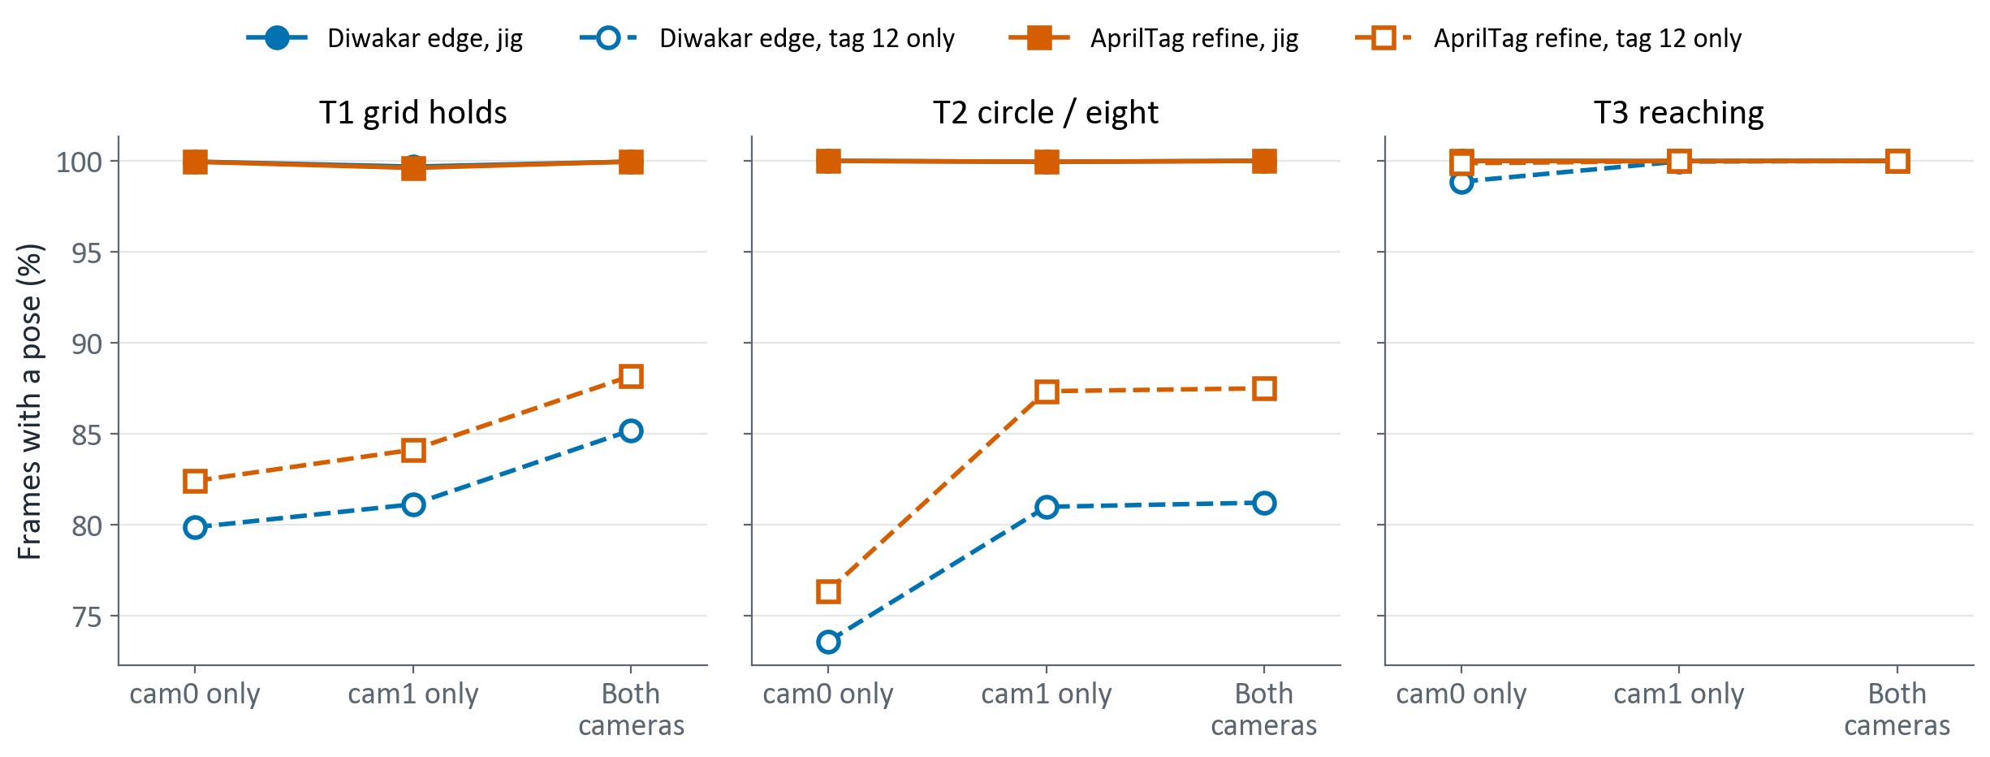
Coverage: with the jig, a pose in every frame
Filled = 8-tag jig · open, dashed = tag 12 only
Jig: a pose in ≥ 99.9 % of frames, every solver, every take
Tag 12 alone, Diwakar edge: 74–85 % in T1 and T2
Two cameras see tag 12 more often than one: T1 80 → 85 %
The jig never needs that: some tag is always in view
Notes:
coverage.png: frames with a pose / frames with recorded images, mean over takes. T2 and T3 record images every second frame, so only those frames are counted for every refinement. Tag 12 coverage in T3 is near 100 % because reaching keeps the device facing the cameras. AprilTag refine uses its own detector (rapidtag), which finds tag 12 more often than the tracker's.

Slide 13
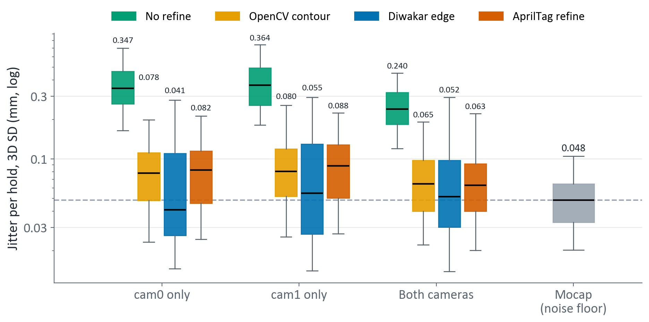
Edge refinement jitters at the mocap noise floor
Mocap noise floor: 0.048 mm
Diwakar edge: 0.041–0.055 mm, at the floor
AprilTag and contour: 0.063–0.088 mm
No refine: 0.24–0.36 mm, 5–7× Diwakar edge
Rotation jitter, Diwakar edge: 0.011–0.012°
Box = middle 50 % of holds · line = median (printed) · whiskers = 5th–95th percentile · 8-tag jig · log axis · dashed = mocap median
Notes:
Median jitter per hold (mm, 3D) cam0 / cam1 / both, jig: no refine 0.347 / 0.364 / 0.240; contour 0.078 / 0.080 / 0.065; Diwakar edge 0.041 / 0.055 / 0.052; AprilTag 0.082 / 0.088 / 0.063. Rotation jitter (degrees, RMS angle about the window mean): edge 0.011 / 0.012 / 0.013; no refine 0.113 / 0.120 / 0.085.

Slide 14
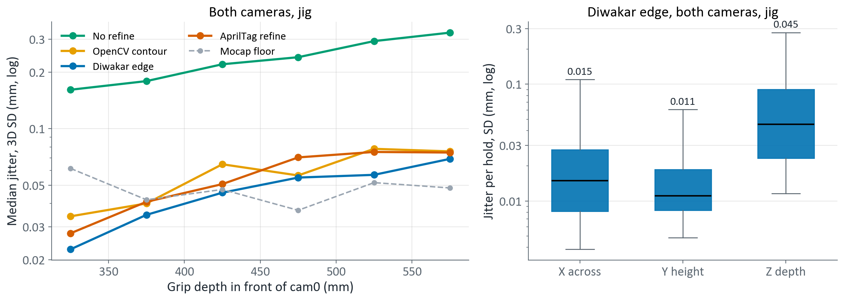
Jitter grows with distance and sits in depth
Left: median per 50 mm bin · right: box = middle 50 % of holds · line = median (printed) · whiskers = 5th–95th percentile · log axes
Every refinement jitters more farther from the cameras
  Diwakar edge: 0.023 mm at 300–350 mm → 0.069 mm at 550–600 mm
Below ~400 mm the camera is steadier than the mocap
Most jitter is along Z depth: 0.045 mm vs X 0.015 and Y 0.011 mm
Same direction as the accuracy error: depth is the weak axis
Notes:
Left: holds binned by the grip's depth in front of cam0 (50 mm bins, bins with at least 8 holds). Right: per-axis SD in mocap axes for Diwakar edge, both cameras, jig. Below about 400 mm the camera jitters less than the mocap reference, so there mocap noise, not the tracker, limits what this test can resolve.

Slide 15
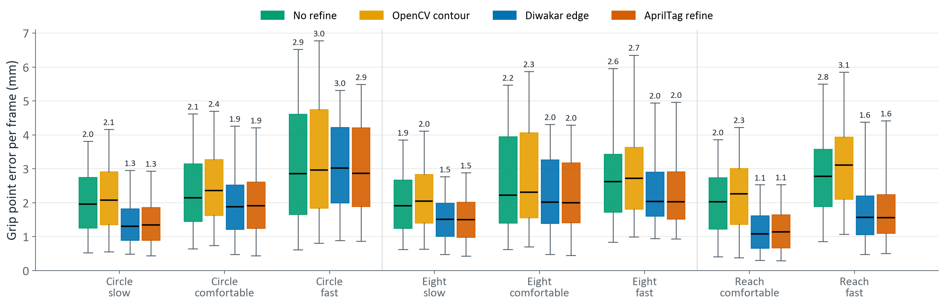
Under motion: same ranking, error grows with pace
Box = middle 50 % of frames · line = median (printed) · whiskers = 5th–95th percentile · both cameras, jig
Edge ≈ AprilTag < no refine ≈ contour, as on still holds
Circle, Diwakar edge: 1.3 → 1.9 → 3.0 mm (slow → fast)
Reaching: 1.1–1.6 mm, close to still holds; it pauses at each target
Circle at fast pace: all four tie (2.9–3.0 mm), so something other than corners dominates
Notes:
T2 / T3, both cameras, 8-tag jig, registration fitted on both T1 runs and frozen. Frames common to all four refinements; images (and so re-detected corners) exist for every second frame. Pacer speeds: slow 100, comfortable 200, fast 300 mm/s. Reaching (T3) includes the pauses at the centre and the targets, so its median speed is low. RMSE (mm), Diwakar edge: 1.65 / 2.31 / 3.43 / 1.76 / 2.56 / 2.67 / 1.39 / 2.21.

Slide 16
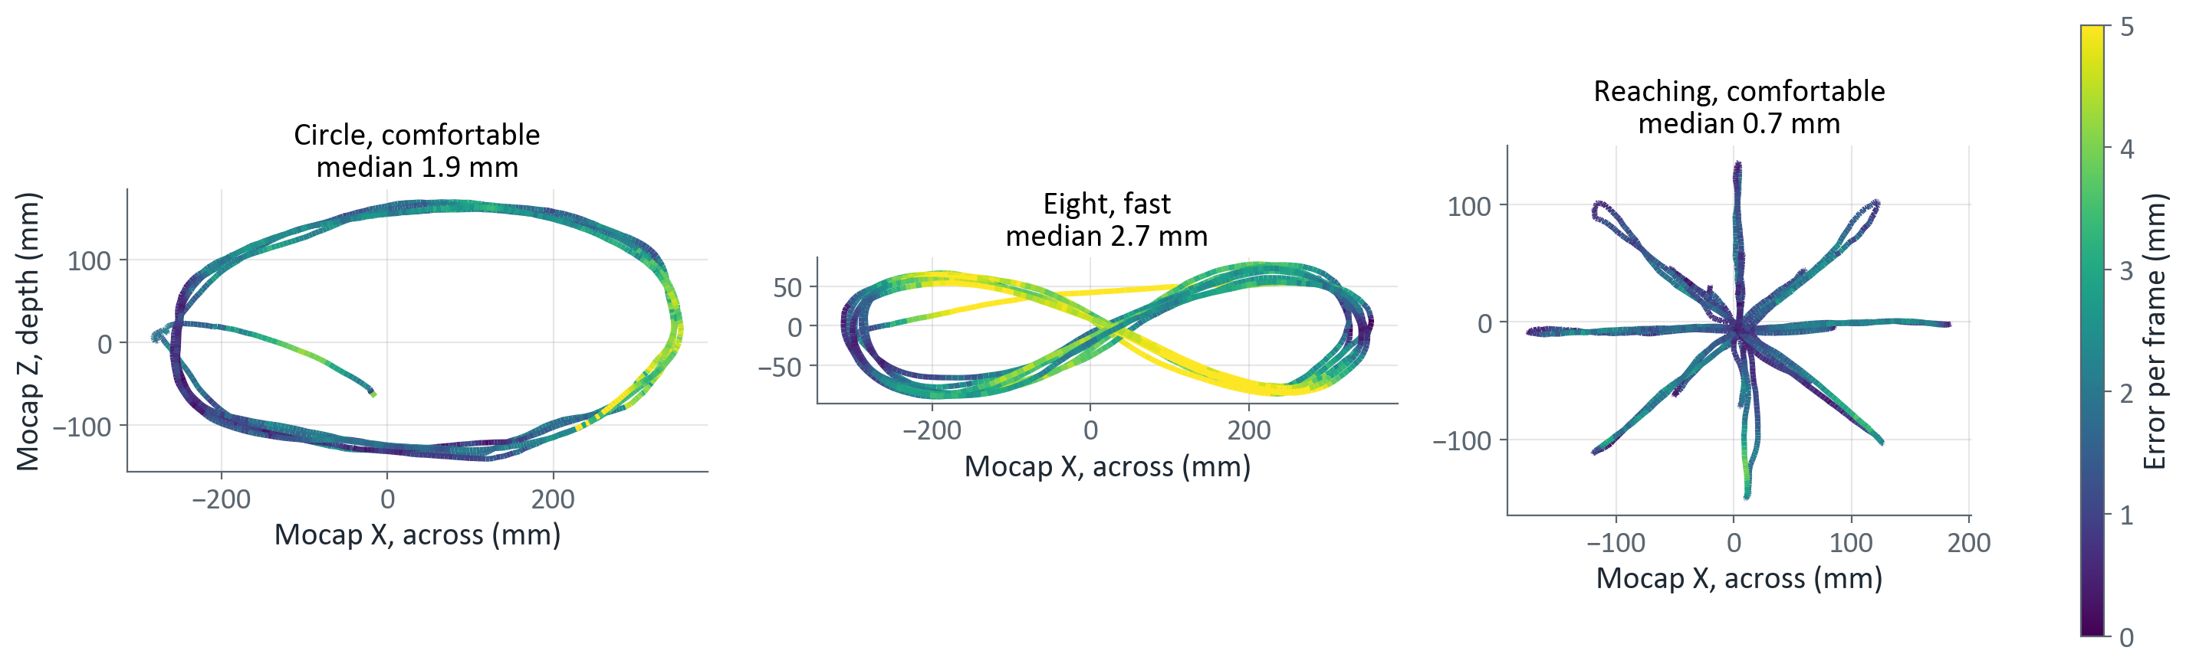
Error peaks where the device moves fastest
Mocap path, coloured by per-frame error · Diwakar edge, both cameras, jig
Figure-eight, fast: the straight crossings, the fastest part, exceed 5 mm
Circle: the error rises on the right-hand turn
Reaching: median 0.7 mm, higher on some strokes
Error follows speed, which points to timing (next slide)
Notes:
Each mocap path coloured by that frame's error (Diwakar edge, both cameras, jig). Colour scale clipped at 5 mm.

Slide 17
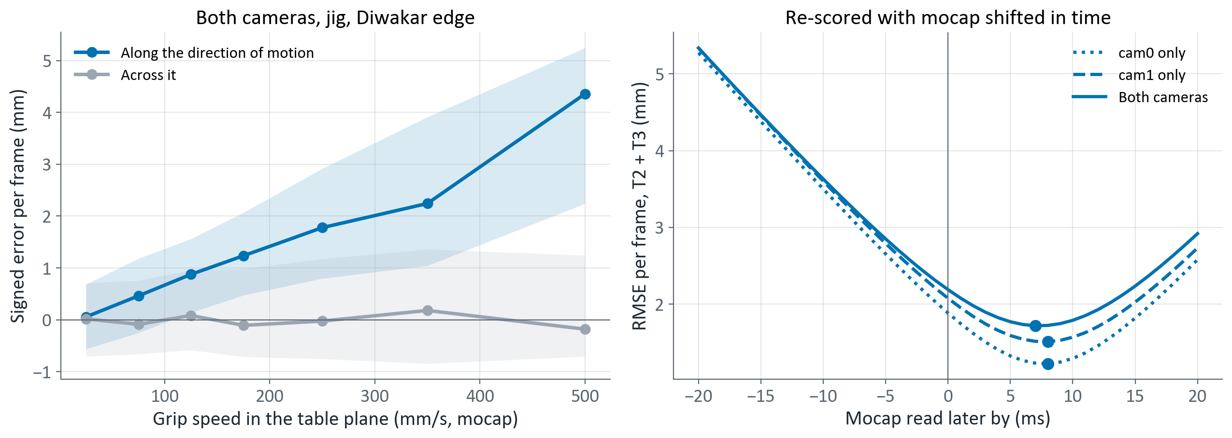
Most of the extra motion error is an 8 ms timing offset
Error points along the travel: 7.6 ms × speed; across it ≈ 0
The camera reports where mocap is ~8 ms later: a clock offset
Mocap read 7–8 ms later: RMSE 2.2 → 1.7 mm (both cameras), 1.9 → 1.2 mm (cam0)
Circle, fast: median 3.0 → 2.1 mm
The cameras agree within 0.1 ms: the offset is camera vs mocap
Open: after the shift, one camera beats two under motion
Notes:
Left: error split into the component along the direction of motion and across it (mocap velocity, table plane); median per speed bin, band = middle 50 %. Fitted along-track error = 7.6 ms × speed. Right: every T2 / T3 frame re-scored with mocap read later by the shown amount. Best shift: cam0 8 ms (RMSE 1.89 → 1.23 mm), cam1 8 ms (2.08 → 1.51), both 7 ms (2.19 → 1.72). The earlier lag scan used 20 ms steps, too coarse to see this. The data cannot tell which clock is late; one LED flash seen by both systems would.

Slide 18
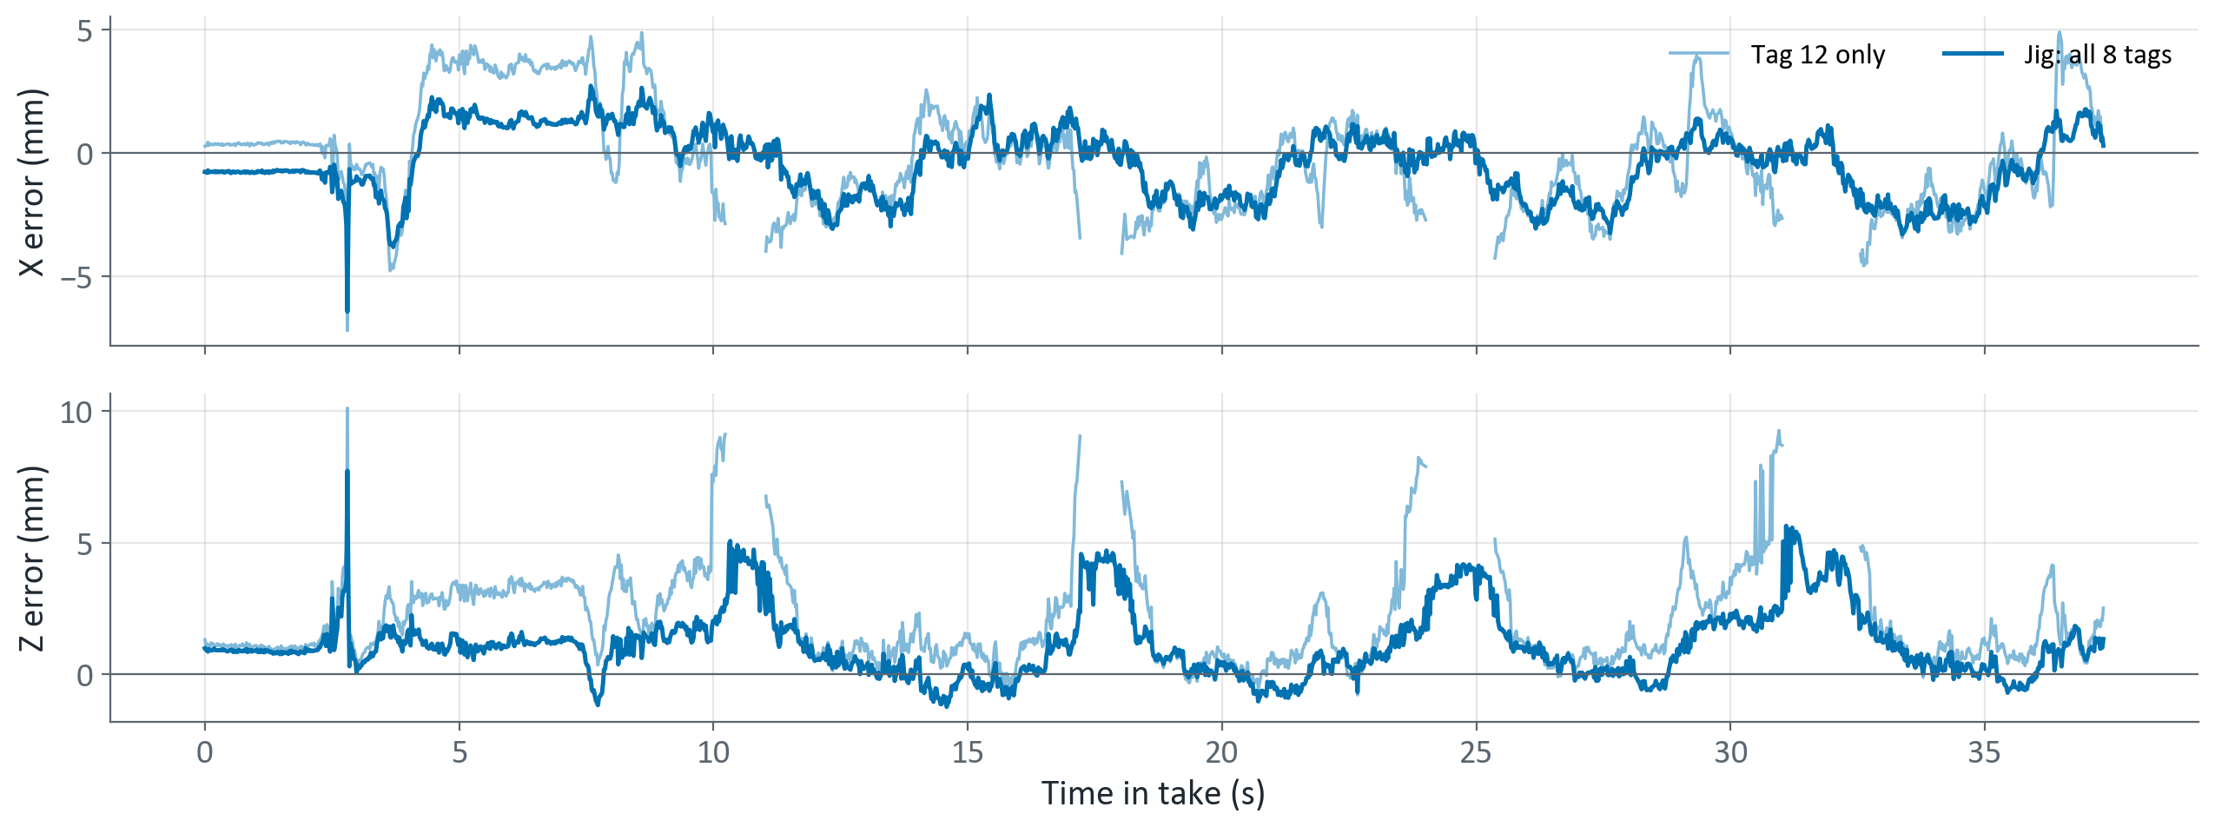
Jig vs tag 12 while moving
T2 circle, comfortable · both cameras, Diwakar edge · gaps = no pose
Tag 12 alone drops out and errs more: median |X| 1.5 vs 1.0 mm, |Z| 1.3 vs 0.9 mm
All T2 / T3: 2.1 vs 1.6 mm median
Z spikes come at the same moments for both: the fast part of each lap
That is the timing offset, not detection
Notes:
T2 circle, comfortable, run 1, both cameras, Diwakar edge. Gaps in the tag 12 line are frames where tag 12 alone gave no pose. Median per-frame error over all T2 / T3 frames, both cameras: Diwakar edge jig 1.60 vs tag 12 2.06 mm; AprilTag jig 1.59 vs tag 12 2.15 mm.

Slide 19
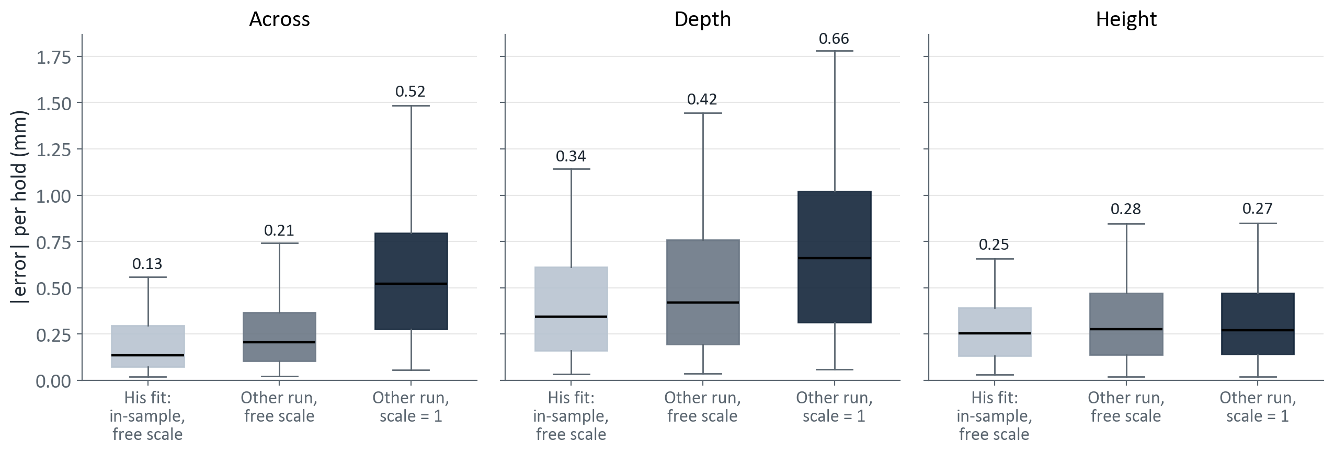
Diwakar's 13-parameter fit: reproduced, but optimistic
Box = middle 50 % of holds · line = median (printed) · whiskers = 5th–95th percentile · his device pose (samples.csv) and fit
His published run-1 RMSE reproduced exactly: 0.31 / 0.63 / 0.33 mm (across / depth / height)
Scored on the other run: 0.36 / 0.70 / 0.42 mm
Scale fixed at 1: 0.76 / 0.92 / 0.42 mm, close to our 9-parameter numbers
His fitted scale, 0.992 and 0.994, is the 0.5–0.8 % depth scale error
Notes:
reproduce_diwakar.py: camera-to-mocap rotation and translation, board-to-body rotation, body origin in the board, and a free scale on the camera translation (13 parameters); rotation residuals weighted 200 mm per rad. Device = mean over the whole hold, mocap = mean over the hold trimmed 0.5 s, errors in his table frame (across, depth, height). RMSE (mm) across / depth / height: in-sample free scale 0.27 / 0.57 / 0.34 (his run 1 alone: 0.31 / 0.63 / 0.33, reproduced exactly); other run, free scale 0.36 / 0.70 / 0.42; other run, scale 1 0.76 / 0.92 / 0.42.

Slide 20
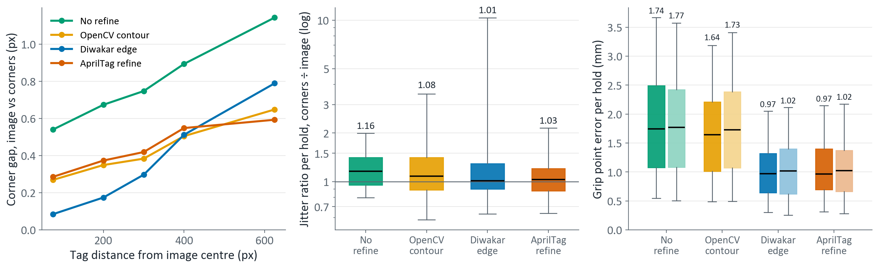
Undistort the image or the corners: a tie
Left: median per radius bin · middle, right: box = middle 50 % of holds · line = median (printed) · whiskers = 5th–95th percentile · right: dark = image, light = corners
Corners differ more toward the image edge: Diwakar edge 0.09 → 0.79 px
Accuracy ties: Diwakar edge 0.97 vs 1.02 mm, AprilTag 0.97 vs 1.02 mm (image vs corners)
Undistorting the image jitters less for threshold refinements: 16 % (no refine), 8 % (contour)
Edge and AprilTag: 1–3 %, no reason to change the tracker
Notes:
detect_paths.py / compare_paths.py: same detector settings both ways. 'Image' = remap the fisheye crop to the pinhole image, then detect (the tracker). 'Corners' = detect on the fisheye crop, then cv2.fisheye.undistortPoints. Each path and refinement has its own T0 jig. Jitter ratio = corners ÷ image per hold (both cameras, jig); medians: no refine 1.16, contour 1.08, edge 1.01, AprilTag 1.03.

Slide 21
Summary
0.8–1.0 mm
0.05 mm
+0.5 %
8 ms
Still-hold error, Diwakar edge or AprilTag refine, jig, any solver
Static jitter with Diwakar edge: at the mocap noise floor
Distances read too long: the main still-hold error
Camera–mocap timing offset: most of the extra error under motion
Keep Diwakar edge refinement; AprilTag refine is an equal drop-in. Drop no refine and OpenCV contour
Keep the 8-tag jig. With it, a second camera adds little; without it, the second camera matters
Measure the printed tag size and recheck the focal length to remove the 0.5 % depth scale
Pin the camera–mocap timing (one LED seen by both) before quoting accuracy under motion
Quote held-out, scale-1 numbers rather than the in-sample 13-parameter fit
Notes:
Still-hold numbers are held-out medians per hold with the 8-tag jig. The timing offset is from re-scoring T2 / T3 with mocap shifted in time.

