Slide 1
Trunk Tracking on NOARK
Stereo ICP vs SAM 3D Body vs a distilled student: why ICP fails in the game, why the student overfit, and why we render synthetic humans

Slide 2
What we measure
One stereo camera (Radxa, 2 × fisheye) on the table, facing the seated person
Truth: Motive rigid body on the sternum, GPIO-synced to the camera
Takes per person
  woc: instructed trunk sweeps, no compensation
  wc: reaching with trunk compensation
  game: RandomReach with the robot cube
8 people: 5 used for training, 3 never seen (Arjun, Jerome, Lee)
Target: Radxa Dragon Q6A, ≥ 10–15 frames/s, no extra setup
Flexion
Lean forward / back
F
Lateral bend
Lean to the side
L
Axial rotation
Twist about the spine
A
Total rotation
Angle of the single rotation from the start pose; needs no camera-to-mocap axis fit
T
Notes:
Every number in this deck is an angle in degrees, compared against Motive mocap of a sternum rigid body. Total rotation needs no axis alignment, so it is the cleanest single number.

Slide 3
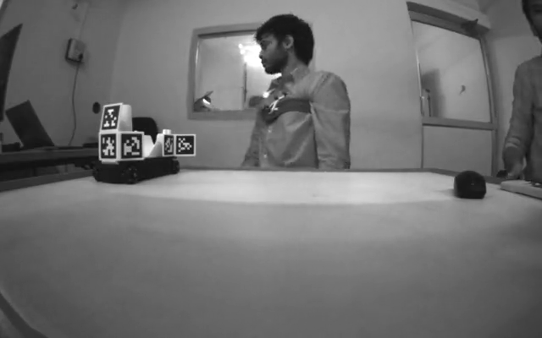
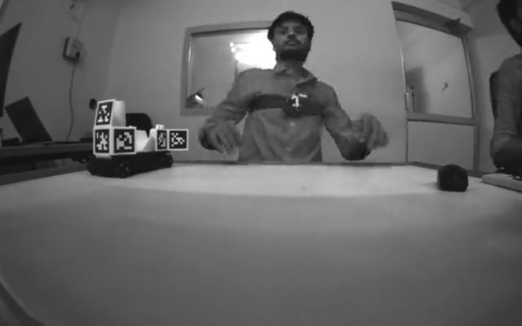
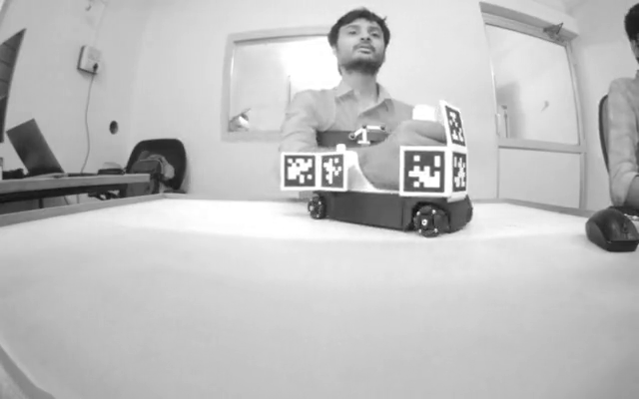
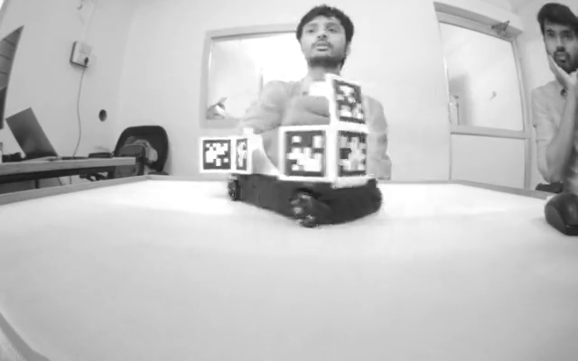
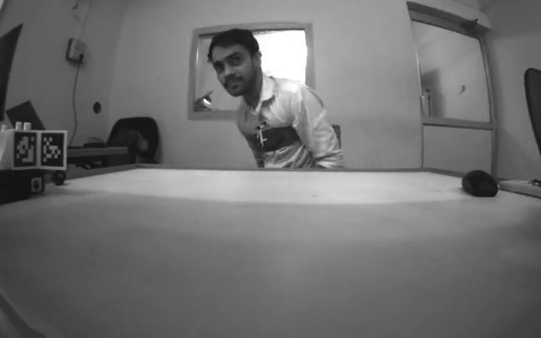
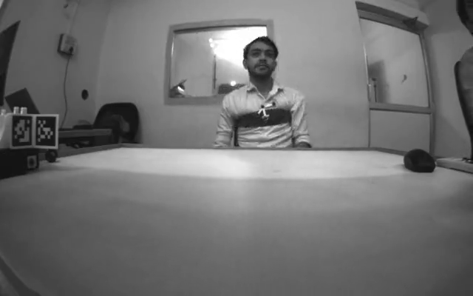
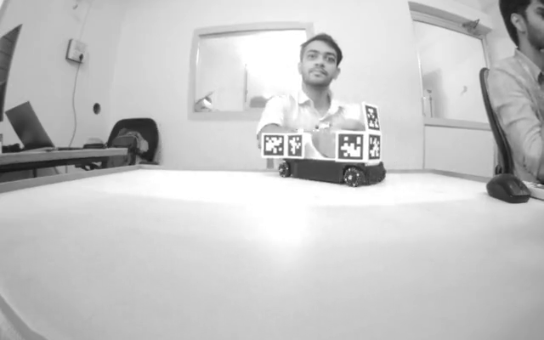
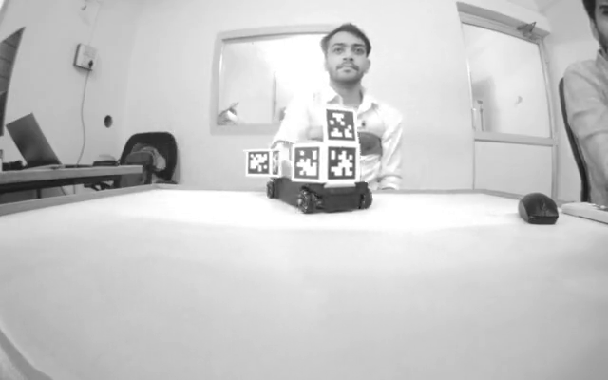
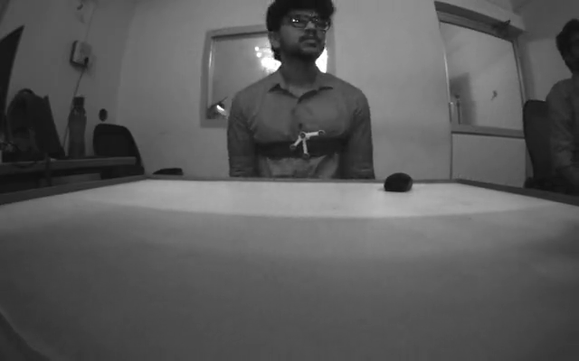
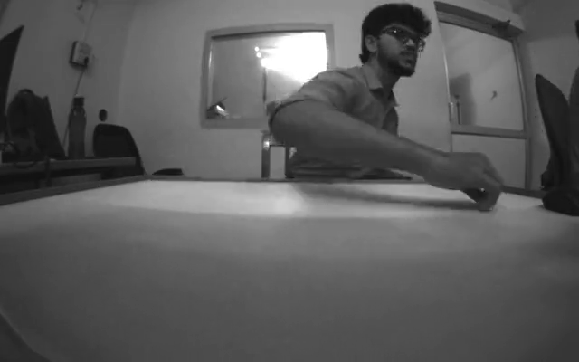
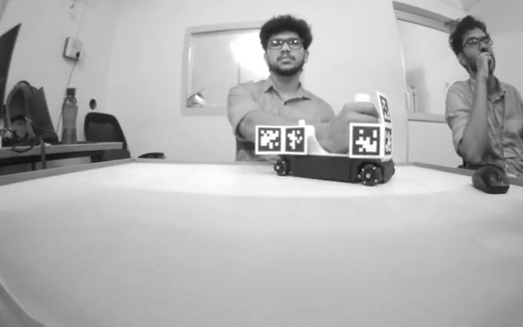
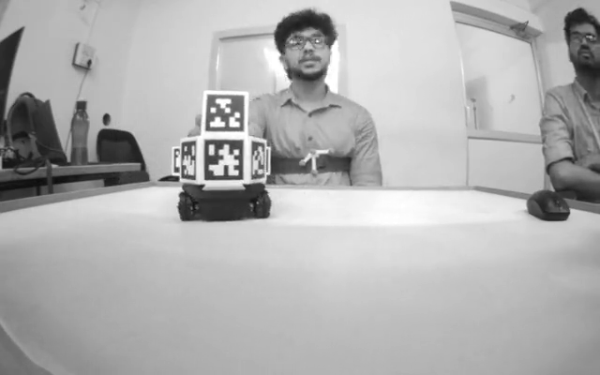
What the takes look like
woc trunk sweeps
wc reaching, compensating
game no compensation
game_wtc with compensation
Arjun
Jerome
Lee
New people · 3× speed · click to play
Notes:
Reference camera, rotated upright, 3x speed, no tracking overlay (28_take_video.py). Protocol takes are about 1 min, game takes about 5 min (about 100 s at 3x). The oct game recording holds two takes: game (pulse 1, no trunk compensation) and game_wtc (pulse 2, with trunk compensation). Click a video to play it.

Slide 4
Three ways to get the trunk angle
Stereo ICP
SAM 3D Body (teacher)
Student (ours)
Stereo depth → YOLO torso mask → chest surface → ICP against the neutral chest
Meta human-mesh model: one image → full 3D body mesh; trunk = upper-spine joint
ResNet18 trained to copy the teacher: grey 256 × 256 crop → keypoints + trunk rotation
Parameters
3.3 M (seg model) + geometry
Parameters
631 M
Parameters
12.2 M
Speed
Seg 50 ms on Q6A NPU
Speed
200 ms on RTX 4060 laptop GPU
Speed
4.1 ms on Q6A NPU (W8A16)
Frames covered
Only frames with enough visible chest
Frames covered
Every frame
Frames covered
Every frame
Notes:
Units are kept apart: parameters in millions, speed in milliseconds per frame on named hardware, coverage in percent of frames.

Slide 5
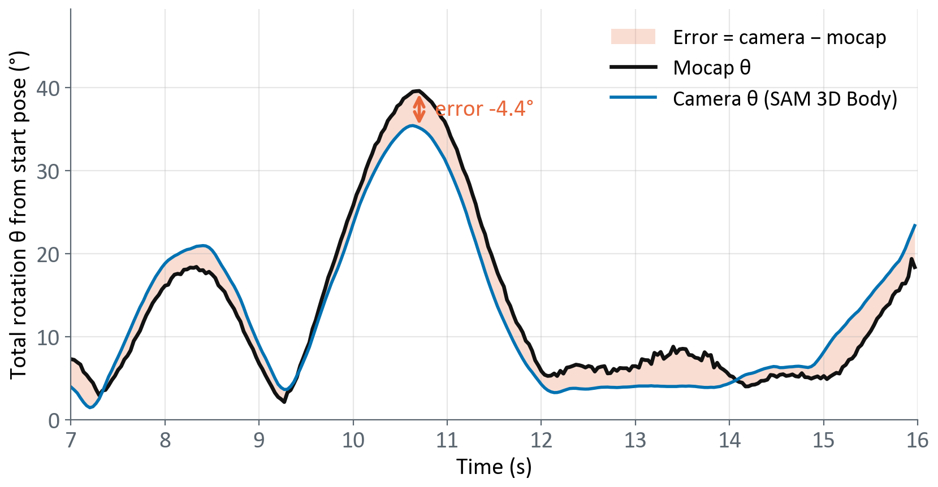
Definition: total rotation and its error
Start pose: mean trunk orientation over the first 15 frames that camera and mocap both have
  protocol takes: start of the take; game takes: from the GPIO rise
θ(t): angle of the single rotation that takes the trunk from the start pose to its pose at time t
  θ = arccos((trace(R(t) R₀ᵀ) − 1) / 2), 0–180°, never negative
Total rotation error = θ_camera(t) − θ_mocap(t), in degrees; box plots show its absolute value
Needs no camera-to-mocap orientation: a rotation's angle is the same in any axes
Limit: compares sizes only. The right size about the wrong axis scores 0, so the three angles check direction
Notes:
Example: Lee (never-seen person), woc take, SAM 3D Body vs mocap. theta is the axis-angle size of the rotation from the start pose: theta = arccos((trace(R(t) R0^T) - 1) / 2). Code: 07_icp_trunk.compare_mocap (mag_i, mag_m).

Slide 6
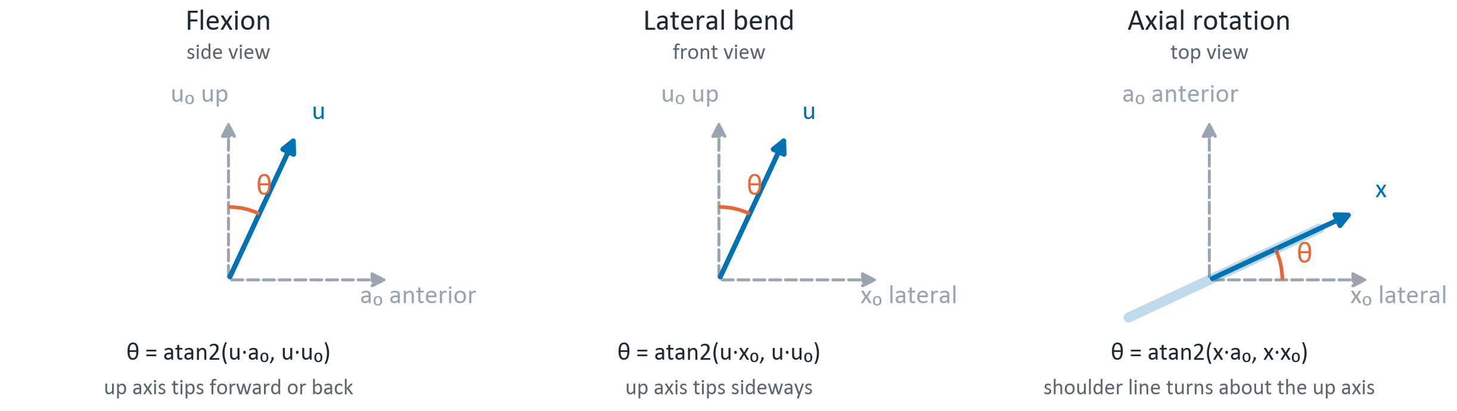
Definition: flexion, lateral bend, axial rotation
Trunk axes
Mocap in camera axes
Camera: lateral x = left minus right shoulder (3D); anterior a = chest-surface normal; up u = a × x
Mocap: sternum rigid body; origin → lateral marker = x, origin → anterior marker = a, u = a × x
x₀, u₀, a₀: the start pose (mean of the first 15 frames), from the camera geometry
u and x: the same axes after the trunk rotation measured at time t
Camera and mocap axes differ by a fixed rotation S (marker mounting, calibration)
S is fitted per method by Kabsch: mocap rotation vectors onto the method's rotation vectors, frames > 5° from the start pose
Fitted on the person's woc take, reused for their wc and game takes; game takes move too little to fit S
Total rotation does not use S
Notes:
06_trunk_axis.trunk_angles. Planar projection angles in the neutral trunk axes, not an Euler sequence. The neutral axes come from the stereo geometry and are the same for every method; what differs is the rotation being split: ICP's chest registration, or the c_spine3 joint for SAM 3D Body and the student.

Slide 7
Definition: how errors are scored
Pairing camera and mocap frames
Statistics
Sync: the camera's GPIO pin is high while Motive records; its rising edge is mocap t = 0, and each camera frame takes the nearest mocap sample
Mocap is split where the rigid body re-locks (jump > 10 cm); the longest clean stretch is scored
Frames scored: protocol takes every frame (30 Hz); Sep 23 game every 3rd (10 Hz); Oct game every 6th (5 Hz)
Camera angles smoothed (Savitzky–Golay, 11 frames, order 3); mocap left raw
Frames a method did not solve are dropped, never interpolated
Frames solved (%) = frames in the mocap window where the method returned an angle
Error per frame = camera − mocap (°); boxes and medians use its size |error|
Box = middle 50 % of frames, line = median, whiskers = 5th–95th percentile
Protocol takes: every method on the frames ICP solved; game takes: each method on its own frames
Frames are pooled across takes; neighbouring frames are correlated, so no significance tests
Mean of per-take medians (student versions): median per take, averaged over the 6 unseen takes
Slope = least-squares line of reading vs mocap; gain (synthetic check) = slope through zero
Seen = in the student's training set; unseen = never trained on · Speed = network time, median of 100 runs
Notes:
Sync and teleport split: 07_icp_trunk.compare_mocap. Smoothing: 06_trunk_axis.smooth_series (SAVGOL_WINDOW 11, SAVGOL_POLY 3). Statistics: deck_figs.py in the deck generator.

Slide 8
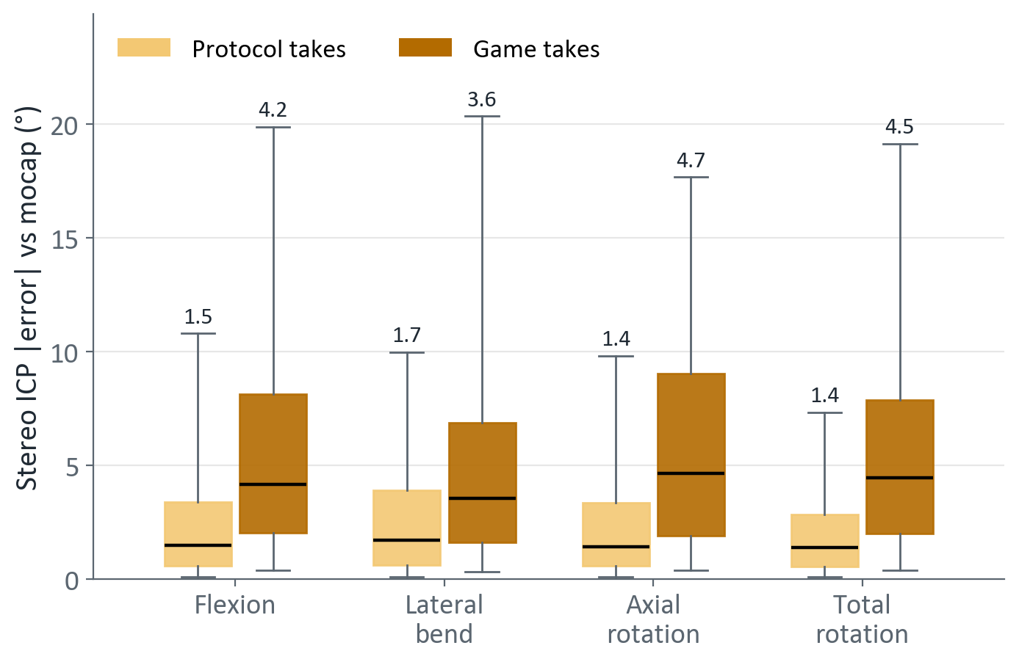
ICP is accurate when it sees the chest, not in the game
Same 7 people, same day (Oct)
Protocol takes: median 1.4–1.7° on every axis
Game takes: median 3.6–4.7°, about 3× worse
In the game the arms reach across the chest and the robot cube sits in front of it
Scored only on frames ICP solved: the frames it lost are not in these boxes
Box = middle 50 % of frames · line = median (printed) · whiskers = 5th–95th percentile
Flexion / lateral / axial: each method's camera-to-mocap orientation fitted on the person's woc take
Notes:
Same seven people recorded on the same day. Protocol = woc + wc takes. Game = the game take with trunk compensation. ICP is scored only on frames it solved, so the game boxes flatter it.

Slide 9
In the game, ICP loses up to half the frames
Protocol takes: ICP solves 85–100 % of frames
Game takes: 48–88 % (Lee 48 %, Diwakar 49 %)
SAM 3D Body: 99–100 % in every take
Lost frames: the visible chest is too small to register, not a stereo failure
  Only 194 of 1312 lost frames (Gokul, Sep) were stereo holes
Notes:
Frames solved = in-window frames where ICP returned a pose. SAM 3D Body returns a pose on 99-100 % of frames in every take.

Slide 10
ICP error is set by how much chest it can see
31 % of game frames have < 200 chest points: ICP cannot run there
≥ 800 points: ICP 1.2–1.7°, as good as the protocol takes, but only 17 % of frames get there
200–800 points: ICP 3.6–7.6°; SAM 3D Body 1.0–2.9° at every size
Notes:
Sep 23 game takes, 5 people. Chest points = size of the visible torso surface after removing arms. Both methods scored on the same frames in each bin. ICP cannot run below 200 points.

Slide 11
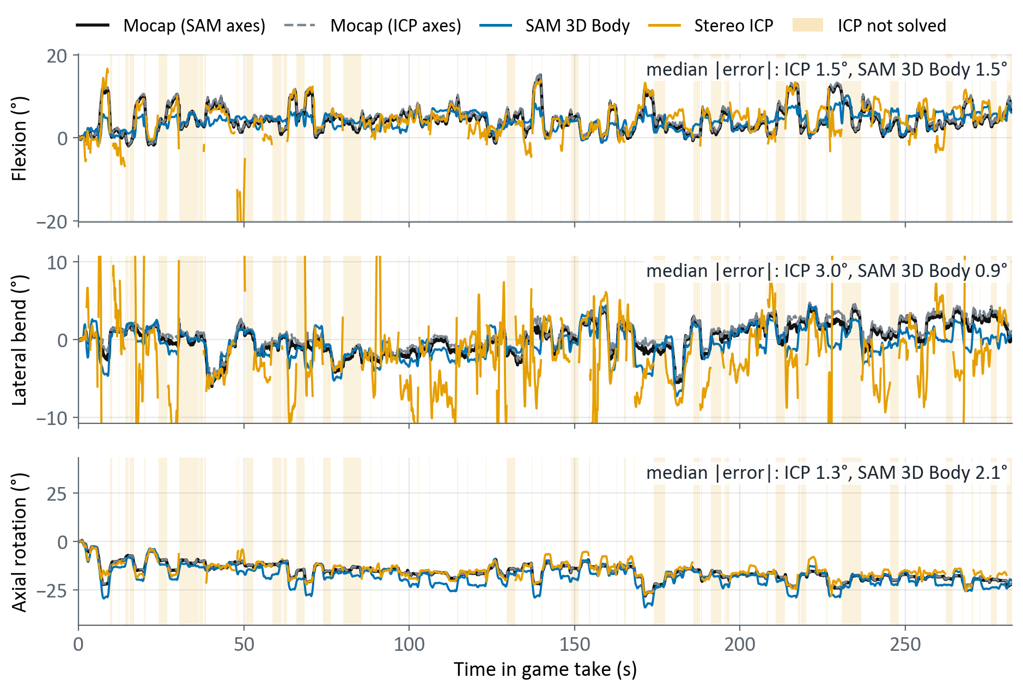
Best ICP person in the game: Gokul
ICP solves 72 % of frames
Median |error|, flexion / lateral / axial
  ICP 1.5 / 3.0 / 1.3°
  SAM 3D Body 1.5 / 0.9 / 2.1°
ICP's weak axis is lateral bend: frequent ±10° spikes
SAM 3D Body reads 3–5° more axial twist between 50 and 150 s, and misses several flexion peaks
Each angle from the start pose · each method vs mocap in its own orientation, set on the woc take · ICP spikes clipped
Notes:
Whole Sep 23 game take. Each method is compared with mocap split into the three angles using that method's own camera-to-mocap orientation, fitted on the person's woc protocol take and applied to the game take. Fitted on the game take itself (what 21/15 do) it is poorly constrained: the two halves of the take give fits 13-14 degrees apart, and the teacher's game fit for Gokul is 32 degrees from its woc fit.

Slide 12
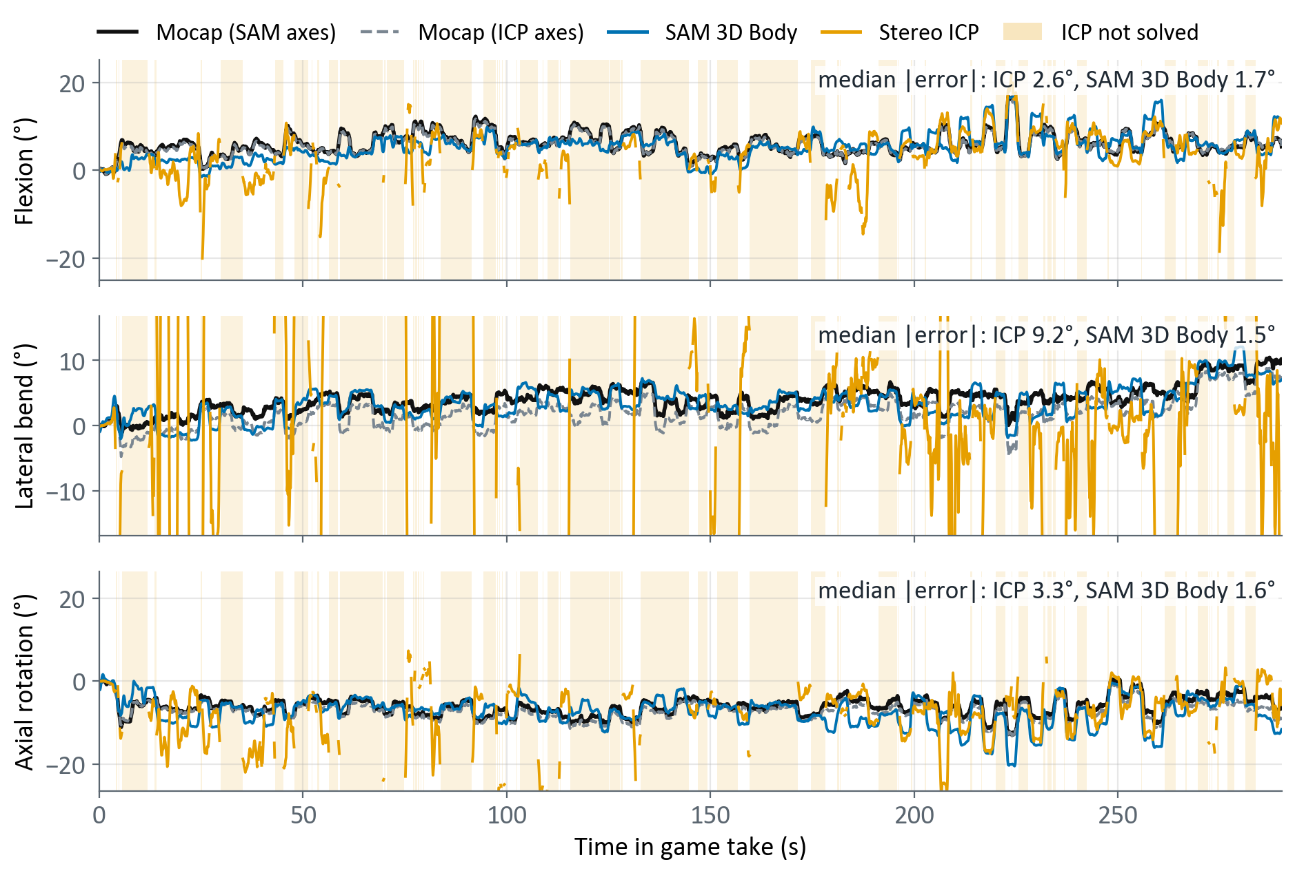
Worst ICP person in the game: Kabil
ICP solves 50 % of frames
Median |error|, flexion / lateral / axial
  ICP, first 170 s: 3.6 / 27.1 / 5.4°
  ICP, after 170 s: 2.3 / 5.2 / 2.7°
  SAM 3D Body, whole take: 1.7 / 1.5 / 1.6°
ICP fails mostly in lateral bend
Why: next slide
Each angle from the start pose · each method vs mocap in its own orientation, set on the woc take · ICP spikes clipped
Notes:
Whole Sep 23 game take. Each method is compared with mocap split into the three angles using that method's own camera-to-mocap orientation, fitted on the person's woc protocol take and applied to the game take. Fitted on the game take itself (what 21/15 do) it is poorly constrained: the two halves of the take give fits 13-14 degrees apart, and the teacher's game fit for Gokul is 32 degrees from its woc fit.

Slide 13
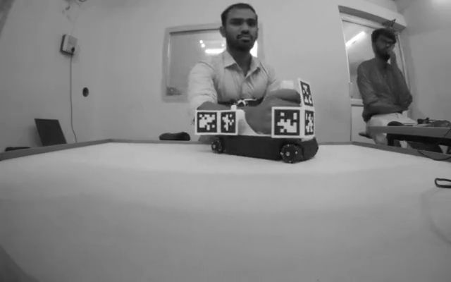
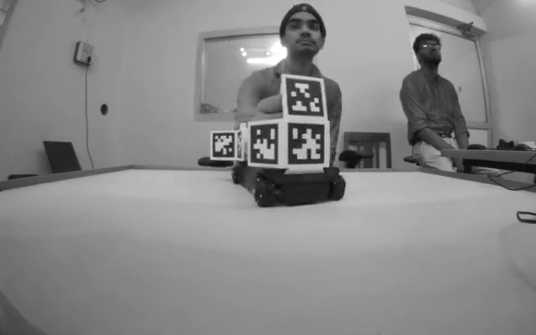
Best and worst ICP person in the game: the videos
Gokul best: ICP solves 72 % of frames
Kabil worst: ICP solves 50 % of frames
Kabil: the robot cube sits in front of his chest, so ICP sees only a strip of it. Its median lateral bend error is 27.1° in the first 170 s and 5.2° after
SAM 3D Body sees the whole body: on Kabil its median error stays at or under 2.8° for every angle, before and after 170 s
Both at 3× speed; click a video to play
Notes:
Sep 23 game takes, reference camera rotated upright, cut to the mocap window (GPIO pulse), 3x speed (render_sep23_game.py). Same takes as the two trace slides before. Click a video to play it.

Slide 14
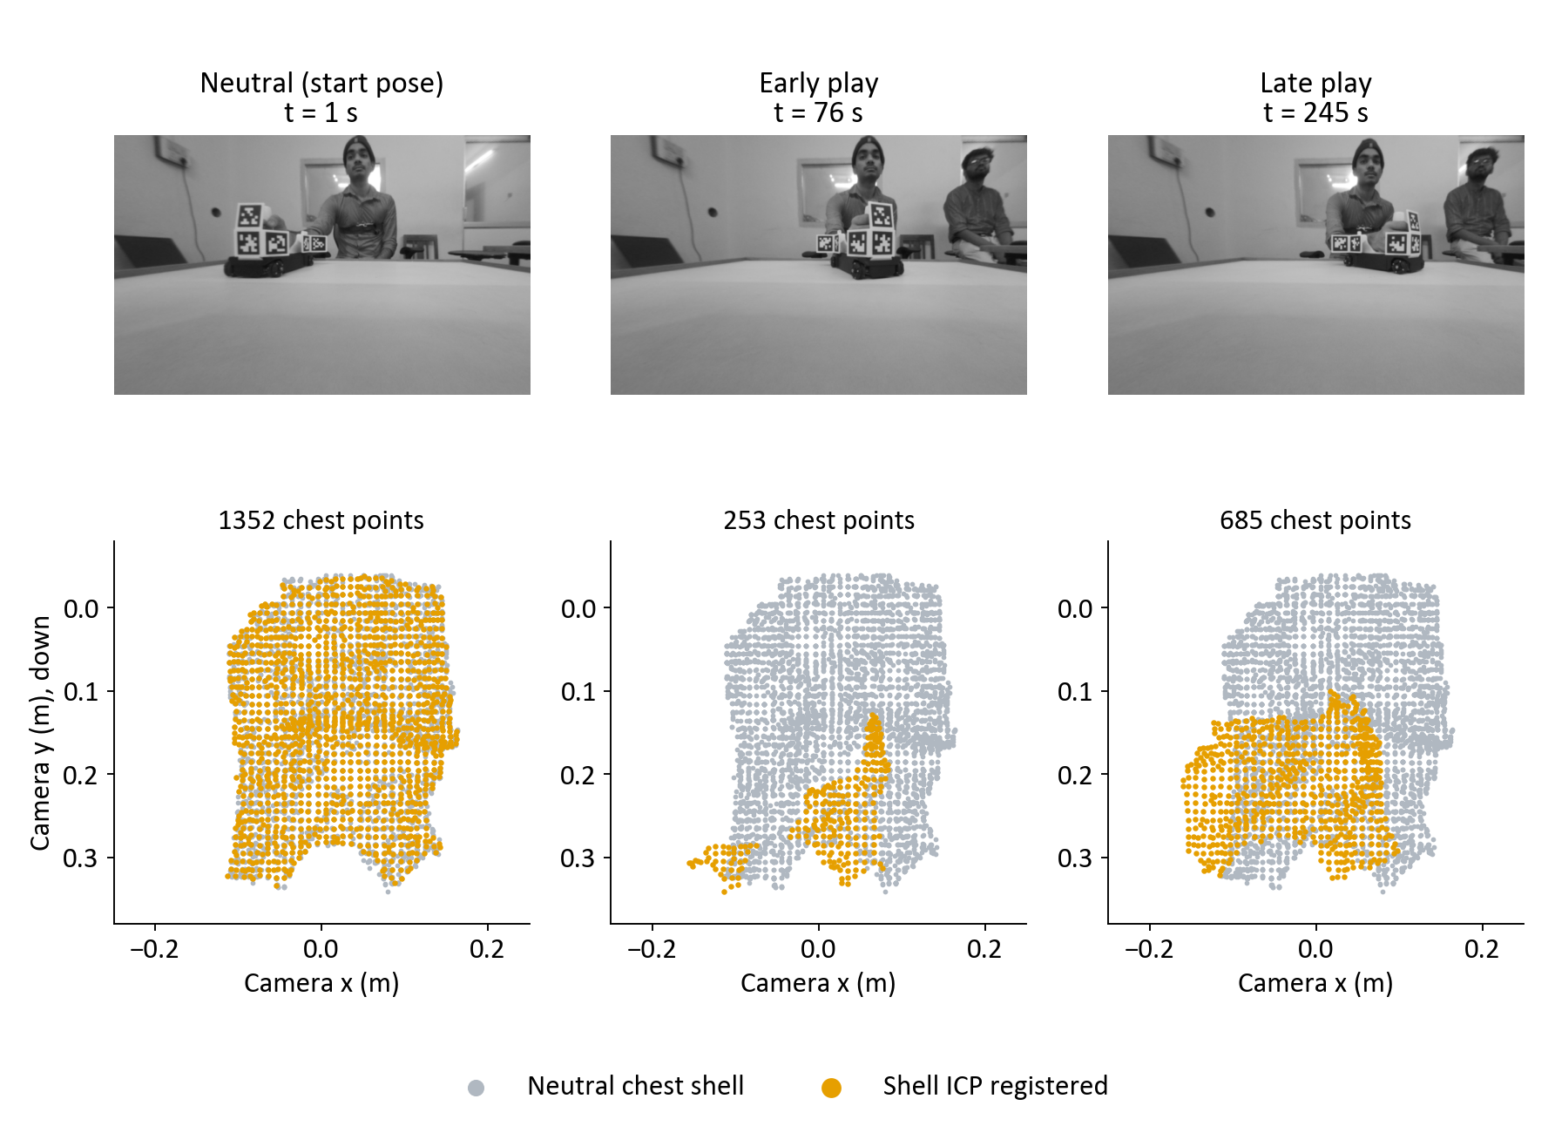
Why Kabil's ICP is wrong: the robot cube covers his chest
Flexion / lateral / axial, degrees from the start pose
Start (t = 1 s): whole chest visible, 1,352 points; every method within 1° of 0
Early play (t = 76 s): the cube covers the chest, a 253-point strip is left
  ICP 15 / -39 / 7 vs mocap 7 / 1 / -7: lateral 40° off
  SAM 3D Body 4 / 2 / -8 vs mocap 7 / 4 / -6
Late play (t = 245 s): cube aside, 685 points
  ICP 8 / 4 / -11 vs mocap 6 / 4 / -8
  SAM 3D Body 10 / 3 / -13 vs mocap 6 / 7 / -7
Notes:
Top: undistorted camera frames. Bottom: front view of the chest surface ICP registered (orange) over the neutral chest (grey), camera coordinates in metres. Angles are total rotation from the start pose.

Slide 15
Fixes tried for ICP: none closed the gap
Fix | Frames solved (%) | Error (°) | Outcome
Mode shell: keep the dominant depth layer | 17–62 → 50–72 | New frames poor: 7–12 median | Kept as default; needs a size gate
Crop to top 20–40 % of the shell | About unchanged | Spikes trimmed (Diwakar p95 27 → 11); protocol worse (2.7 → 4.6) | Dropped
Blend with MediaPipe landmarks | Higher | 13–20 median, r 0.1–0.2 | Dropped: fails on the same frames
Mono depth (YOLO26n-depth) + stereo | 53 → 55; mono only 77 | Mono only: 7.8 median | Dropped
Gate: ≥ 800 chest points only | 1–31 | 0.1–2.4 median, p95 ≤ 5.5 | Accurate but too few frames
Every fix trades frames for accuracy; no geometric variant gets both in the game
The failure is partial-overlap registration of a small chest patch, not depth noise or brightness
Notes:
Coverage and accuracy kept in separate columns. Numbers from the Sep 23 game takes unless noted.

Slide 16
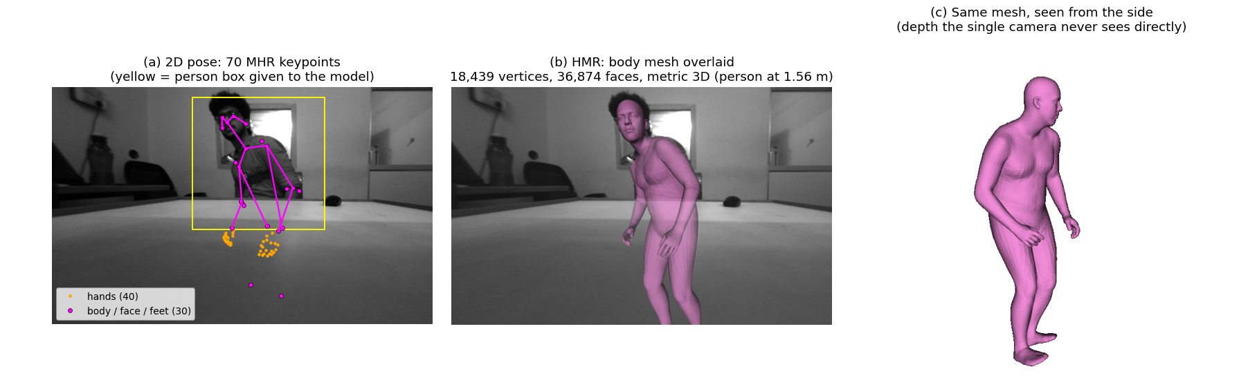
SAM 3D Body: a full body from one image
Explains the arms instead of masking them → an answer on every frame
Trunk = upper-thoracic spine joint (c_spine3), where the sternum marker sits
Input: one camera, grey, undistorted 640 × 400, one fixed person box per take
631 M parameters · 200 ms per frame on an RTX 4060 laptop GPU
Notes:
Shown on Lee (never-seen person), woc take. The model explains the arms rather than masking them out, so it answers on every frame.

Slide 17
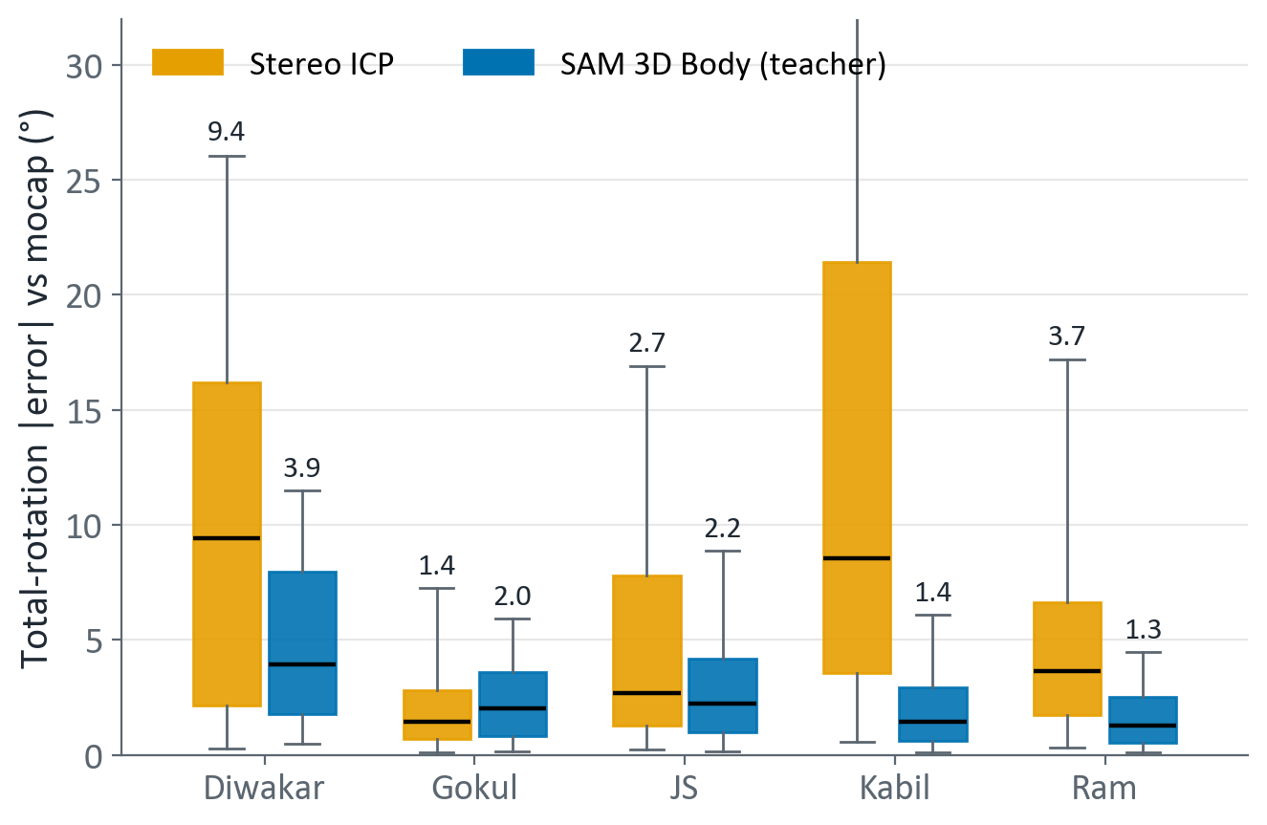
In the game, SAM 3D Body beats ICP for 4 of 5 people
SAM 3D Body: median 1.3–3.9° on 100 % of frames
ICP: median 1.4–9.4° on only 50–72 % of frames
ICP wins only for Gokul, who keeps the most chest visible
Teacher limits
  Second camera adds nothing: errors of the two views correlate r 0.96–0.98
  Over-reads large lateral bends by about 20 %
  In the game it reads 1.7–3.9° high for 3 of 5 people; for Diwakar and Gokul more so when the elbows are bent
Box = middle 50 % of frames · line = median (printed) · whiskers = 5th–95th percentile
Notes:
Sep 23 game takes. Total rotation needs no axis fit. ICP scored on the frames it solved (50-72 %), SAM 3D Body on all frames.

Slide 18
The teacher cannot run on the board, so we distil a student
Teacher: 631 M parameters, 200 ms per frame on a laptop GPU; too big for the Q6A
Student labels = teacher output on the training people's recordings + COCO people
Student: 12.2 M parameters (52× smaller)
  4.1 ms on the Q6A NPU, 105 ms on its CPU
Same output on every frame, no depth, no chest visibility needed
Notes:
Log scale. Hardware differs per point and is named in the label. The 66.7 ms line is the per-frame budget for 15 frames/s.

Slide 19
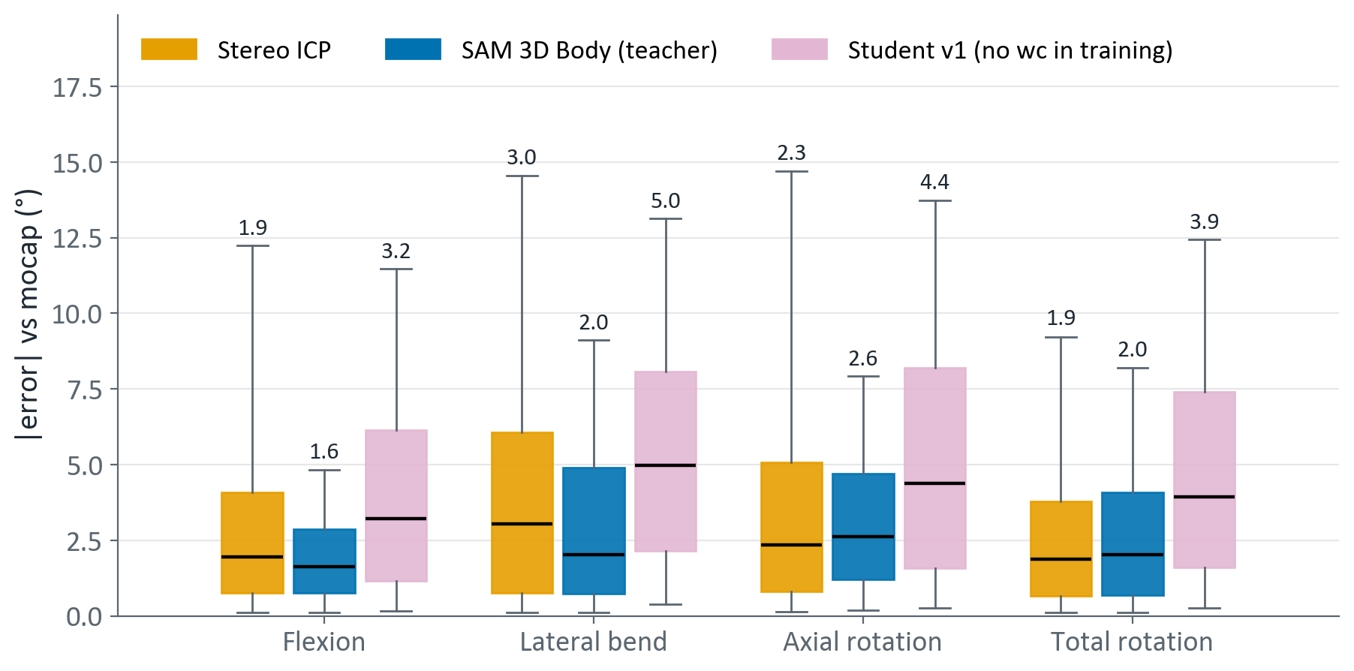
Student problem 1: postures it never saw in training
v1 trained on 5 people, woc + game takes only
New people, wc takes: lateral 5.0° vs teacher 2.0°
Jerome wc: student 5.0° total vs teacher 1.5°, ICP 1.1°: the error is the student's own
Fix (v2): add wc takes and the Oct sessions of the 4 returning people
Box = middle 50 % of frames · line = median (printed) · whiskers = 5th–95th percentile
Flexion / lateral / axial: each method's camera-to-mocap orientation fitted on the person's woc take
Notes:
Student v1 was trained on the Sep 23 woc and game takes only. Scored here on the wc takes of the three never-seen people, on frames ICP solved.

Slide 20
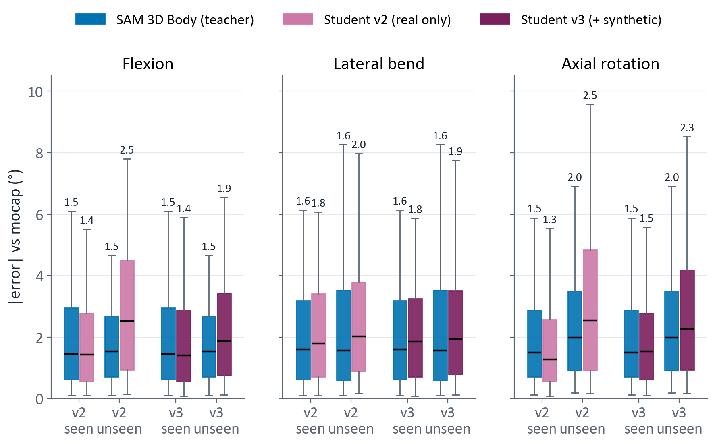
Student problem 2: it learns the people, not the trunk
People it trained on: student ≈ teacher (flexion 1.4 vs 1.5°, axial 1.3 vs 1.5°)
New people: v2 falls behind (flexion 2.5 vs 1.5°, axial 2.5 vs 2.0°)
Same network, same task: it learned the 5 people, not trunk pose
With synthetic people (v3), new-people flexion 2.5 → 1.9°
v3 is still 0.3–0.4° behind the teacher on new people
Box = middle 50 % of frames · line = median (printed) · whiskers = 5th–95th percentile
Flexion / lateral / axial: each method's camera-to-mocap orientation fitted on the person's woc take
Notes:
Seen = the four people in the training set (their Oct protocol takes were training data). Unseen = the three test people. Teacher shown on the same frames for reference.

Slide 21
Student problem 3: it shrinks large flexion on new people
Teacher and ICP follow the diagonal (slope 0.92, 0.91)
Student v2: slope 0.81; at 12.5° true flexion it reads 7.6°
Flexion = leaning toward the camera, the weakest cue in one image
Training poses are mostly upright (71–85 % within ±5°), so an unsure student falls back to upright
v3 (+ synthetic): slope 0.85, reads 9.0°: partly fixed
Notes:
Unseen people, protocol takes, frames ICP solved. Frames grouped in 5 degree bins of mocap flexion; each line is the median reading in the bin. The dashed grey line is a perfect reading.

Slide 22
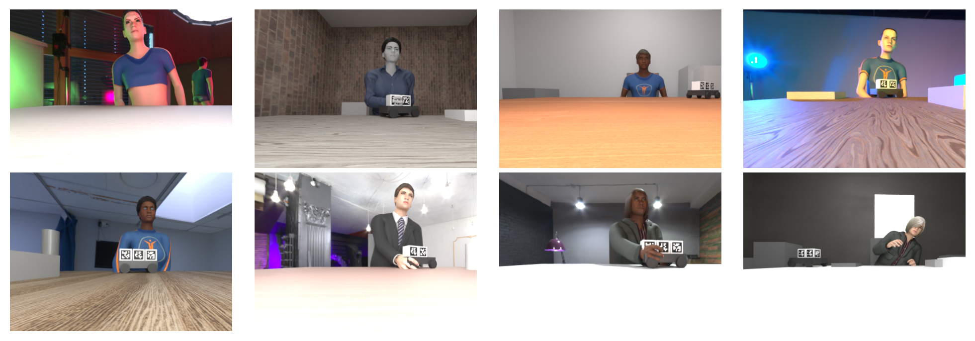
Why render synthetic humans
The bottleneck is identities: only 5 real training people
1,500 random adults, 15,000 frames, 1.6 h on the laptop GPU
Real seated poses: teacher fits of the training people only (52k-pose pool)
Varied rooms, tables, lighting, robot cube, bystanders; camera placed like the rig
Converted to the camera's grey look before labelling
Weak spot: about 10 outfits, so clothing variety is low
Notes:
Blender + MPFB2 (MakeHuman, CC0 assets). Poses come only from the training people, so no test-person pose leaks into training.

Slide 23
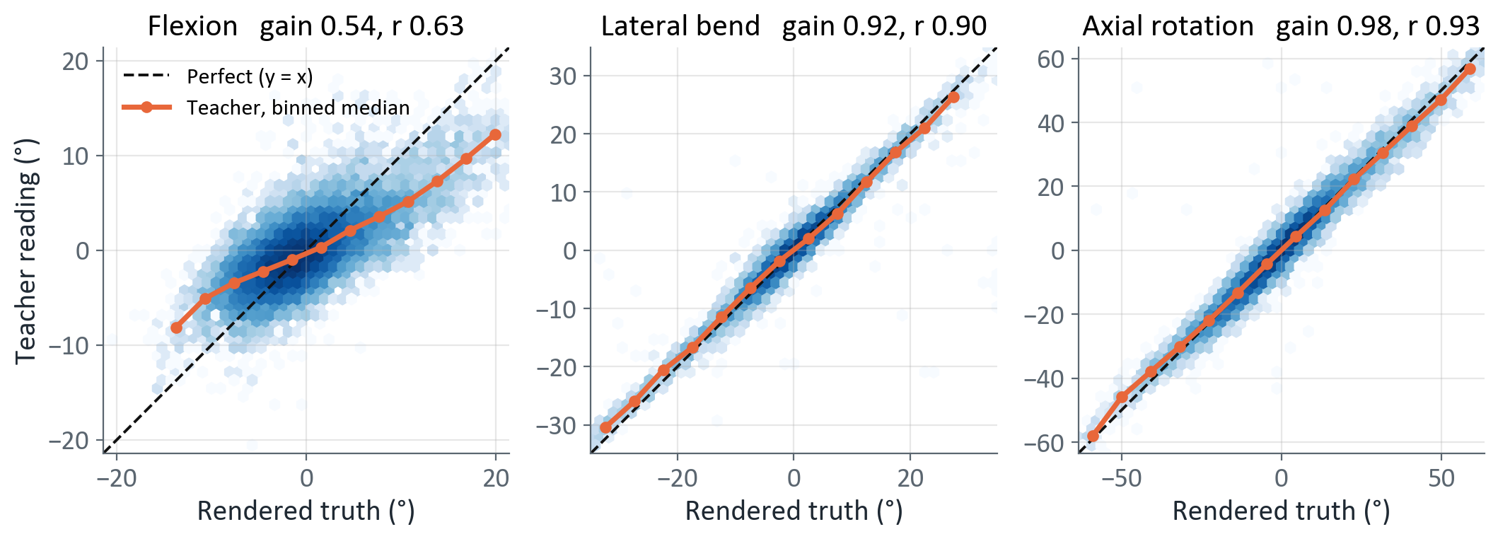
Teacher misreads synthetic flexion, so labels use rendered truth
Teacher on synthetic people: flexion gain 0.54 (r 0.63); lateral 0.92, axial 0.98
On real people the teacher reads flexion at gain ≈ 0.9 vs mocap, so this is a synthetic-domain gap; copying it would teach the student to under-read flexion
So: synthetic trunk label = rendered truth (offset to the teacher's mean per person); keypoints and arms stay teacher labels
Notes:
Each panel: rendered truth vs teacher reading, relative to each person's mean pose. Gain = least-squares slope through zero.

Slide 24
Synthetic people improve flexion on new people
Adding synthetic people: flexion 2.58 → 2.21°
Synthetic at 40 % of batches: flexion 2.21 → 1.94°, total 2.85 → 2.67°
Same recipe trained twice differs by up to 0.2°
v4 flexion-balanced synthetic poses: flexion 1.96°, no gain
Lateral: worse in v3 (2.75°), back to v2's level with 40 % synthetic (2.26°)
Teacher (dashed blue) is still the ceiling
Notes:
Mean over the 6 unseen protocol takes of each take's median error vs mocap, frames ICP solved. 'Rerun' is the same recipe trained again. wc takes split with each method's woc-take orientation.

Slide 25
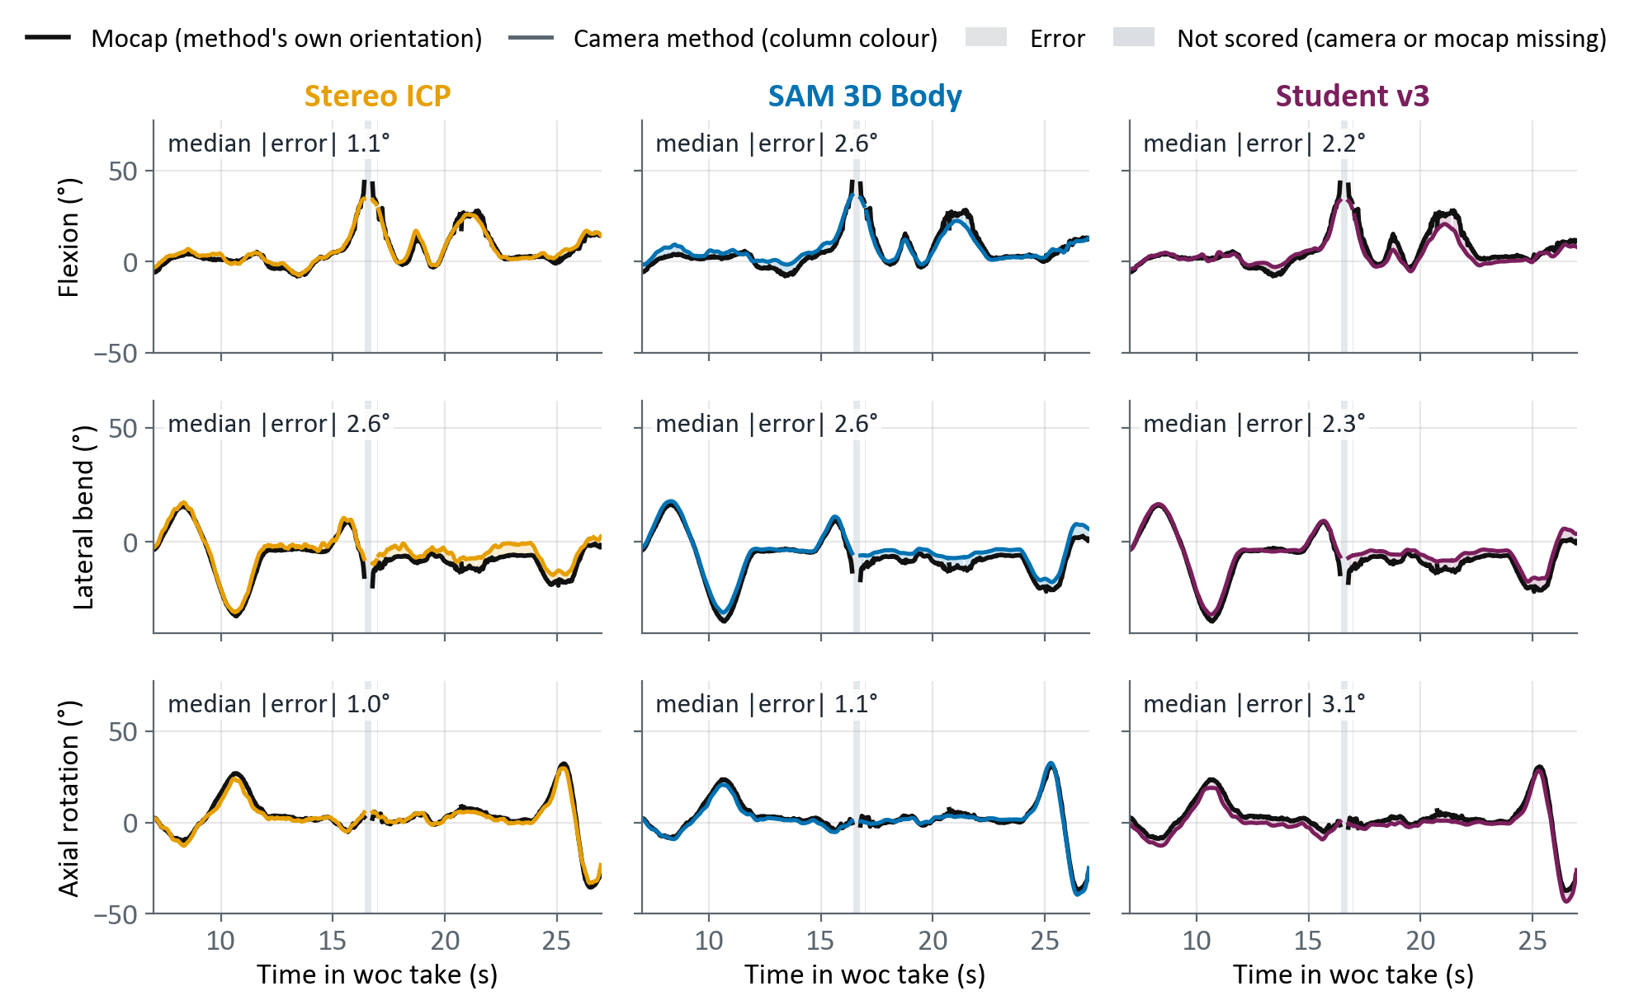
Protocol take close-up: Lee (new person)
20 s of the 56 s take (7–27 s)
Median |error| here, flexion / lateral / axial
  ICP 1.1 / 2.6 / 1.0°
  SAM 3D Body 2.6 / 2.6 / 1.1°
  Student v3 2.2 / 2.3 / 3.1°
ICP solves 98 % here and follows every peak
Forward lean at 21 s (mocap 28°): ICP 24°, SAM 3D Body 20°, student 18°
After a 0.3 s mocap dropout at 16.5 s, all three methods' lateral error grows by 2–3° at once: most likely the mocap re-locked, not the cameras
Each column: one method vs mocap in that method's own orientation · each angle from the start pose · student never saw this person
Notes:
Lee's woc take, 7–27 s of 56 s, picked as the 20 s where all three angles move most. Student v3 = r18_v3mix_all, which never saw Lee. Each method is compared with mocap in its own camera-to-mocap orientation, fitted on this take. Whole-take median |error| flexion / lateral / axial: ICP 1.0 / 2.9 / 0.9°, SAM 3D Body 1.8 / 2.0 / 1.1°, student 2.2 / 1.6 / 2.2°; ICP solves 99 % of the take.

Slide 26
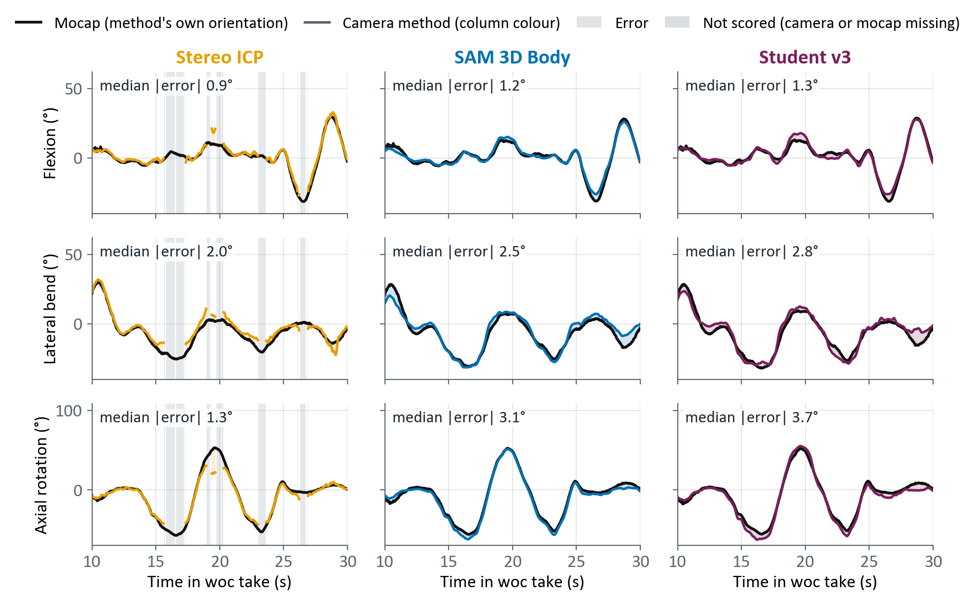
Protocol take close-up: Arjun (new person)
20 s of the 51 s take (10–30 s)
Median |error| here, flexion / lateral / axial
  ICP 0.9 / 2.0 / 1.3°
  SAM 3D Body 1.2 / 2.5 / 3.1°
  Student v3 1.3 / 2.8 / 3.7°
ICP solves 81 % here: it loses the ends of both left twists (−57°, −53°) and reads 22° at the +53° twist
Side bend at 10.5 s (mocap 28°): SAM 3D Body 20°, student 23°
SAM 3D Body and student over-read the left twists by 5⁠–⁠7°
Each column: one method vs mocap in that method's own orientation · each angle from the start pose · student never saw this person
Notes:
Arjun's woc take, 10–30 s of 51 s, picked as the 20 s where all three angles move most. Student v3 = r18_v3mix_all, which never saw Arjun. Each method is compared with mocap in its own camera-to-mocap orientation, fitted on this take. Whole-take median |error| flexion / lateral / axial: ICP 0.8 / 1.5 / 0.8°, SAM 3D Body 1.2 / 2.5 / 2.5°, student 1.1 / 2.5 / 2.4°; ICP solves 88 % of the take.

Slide 27
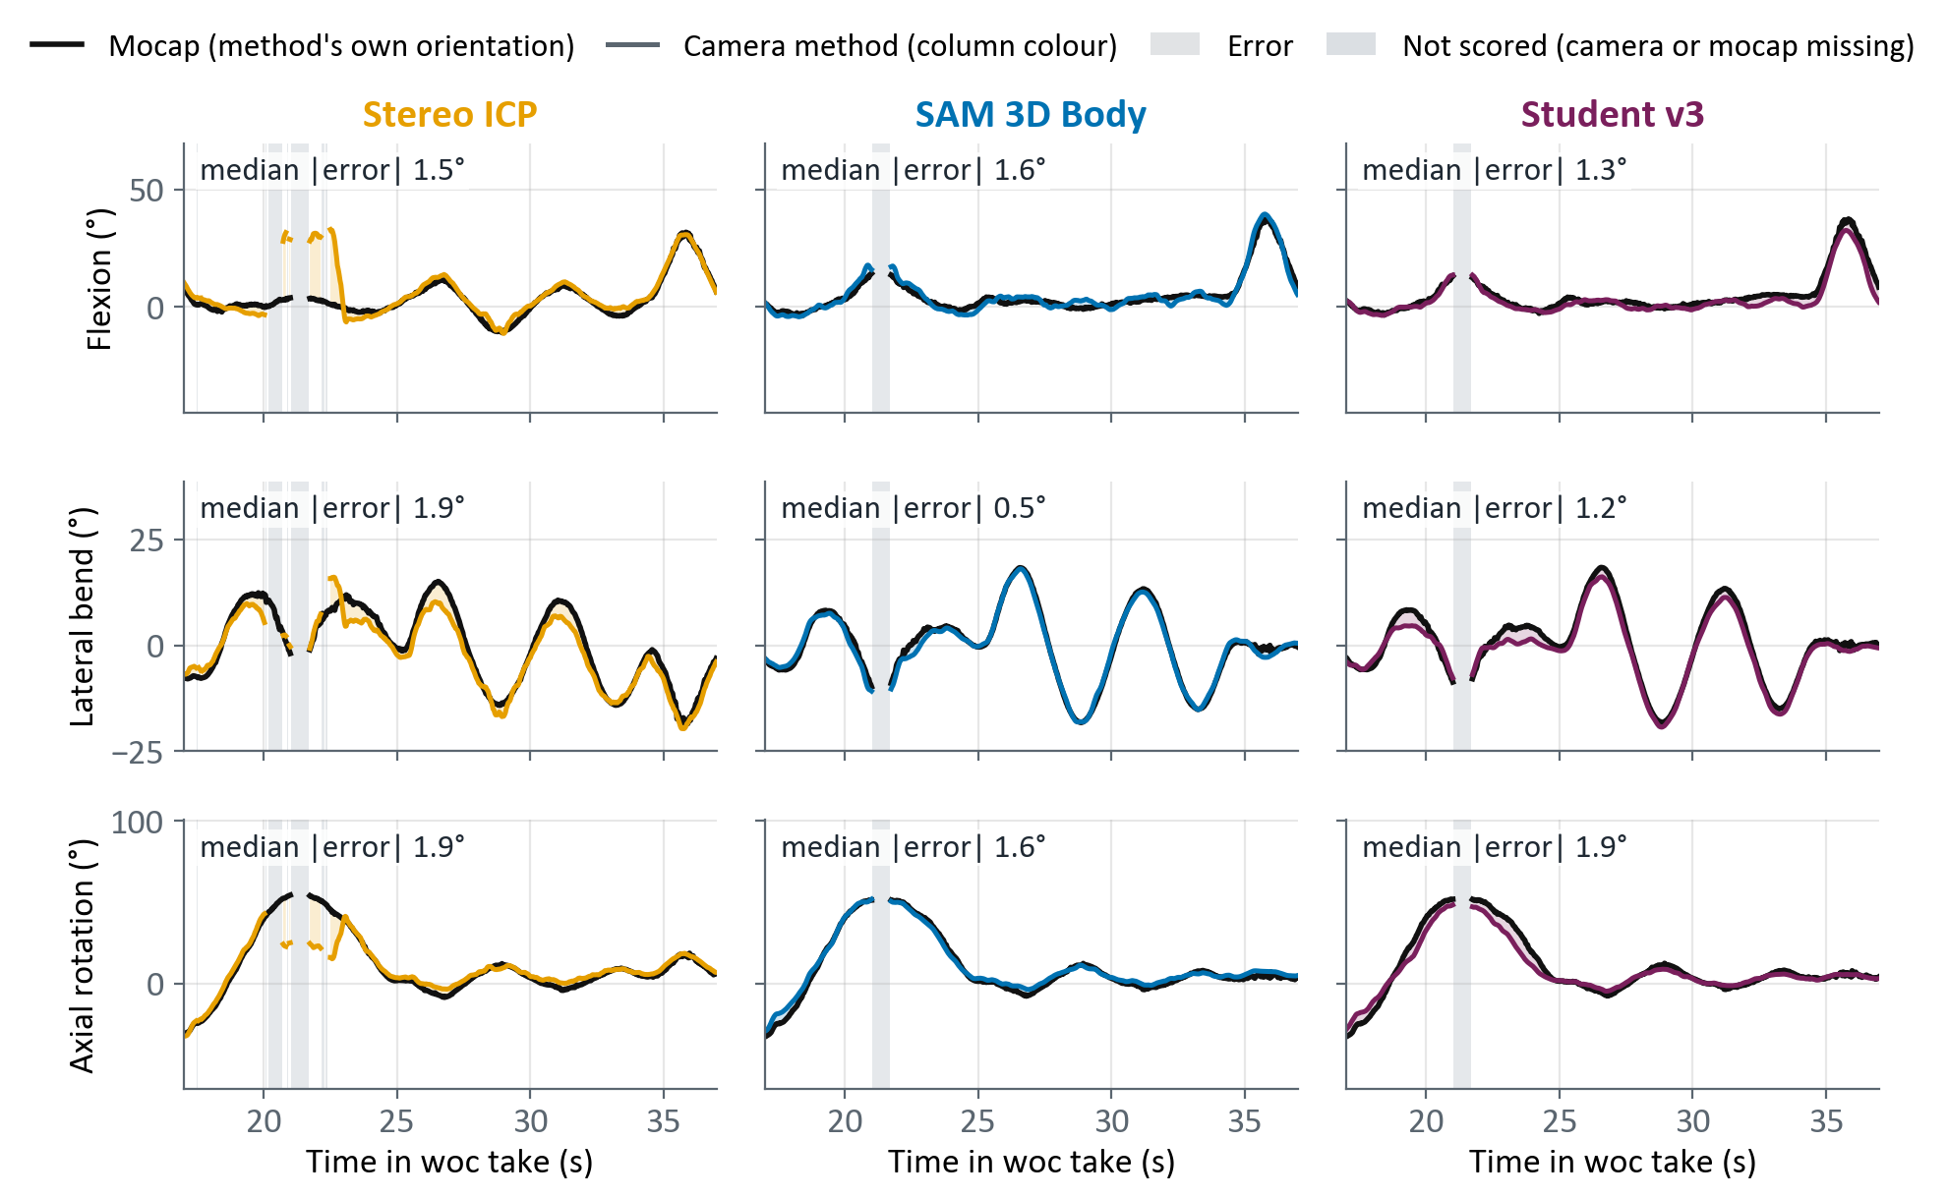
Protocol take close-up: Jerome (new person)
20 s of the 54 s take (17–37 s)
Median |error| here, flexion / lateral / axial
  ICP 1.5 / 1.9 / 1.9°
  SAM 3D Body 1.6 / 0.5 / 1.6°
  Student v3 1.3 / 1.2 / 1.9°
At full twist (54°, 21 s) ICP reads 25° and jumps to about 30° flexion for 2 s while mocap reads 4°: a wrong registration
SAM 3D Body follows lateral bend within 0.6°
Student under-reads the 38° lean at 36 s (32°) and the 41° twist at 23 s (31°)
Each column: one method vs mocap in that method's own orientation · each angle from the start pose · student never saw this person
Notes:
Jerome's woc take, 17–37 s of 54 s, picked as the 20 s where all three angles move most. Student v3 = r18_v3mix_all, which never saw Jerome. Each method is compared with mocap in its own camera-to-mocap orientation, fitted on this take. Whole-take median |error| flexion / lateral / axial: ICP 1.2 / 1.4 / 1.4°, SAM 3D Body 1.5 / 0.5 / 1.5°, student 1.7 / 1.1 / 1.2°; ICP solves 92 % of the take.

Slide 28
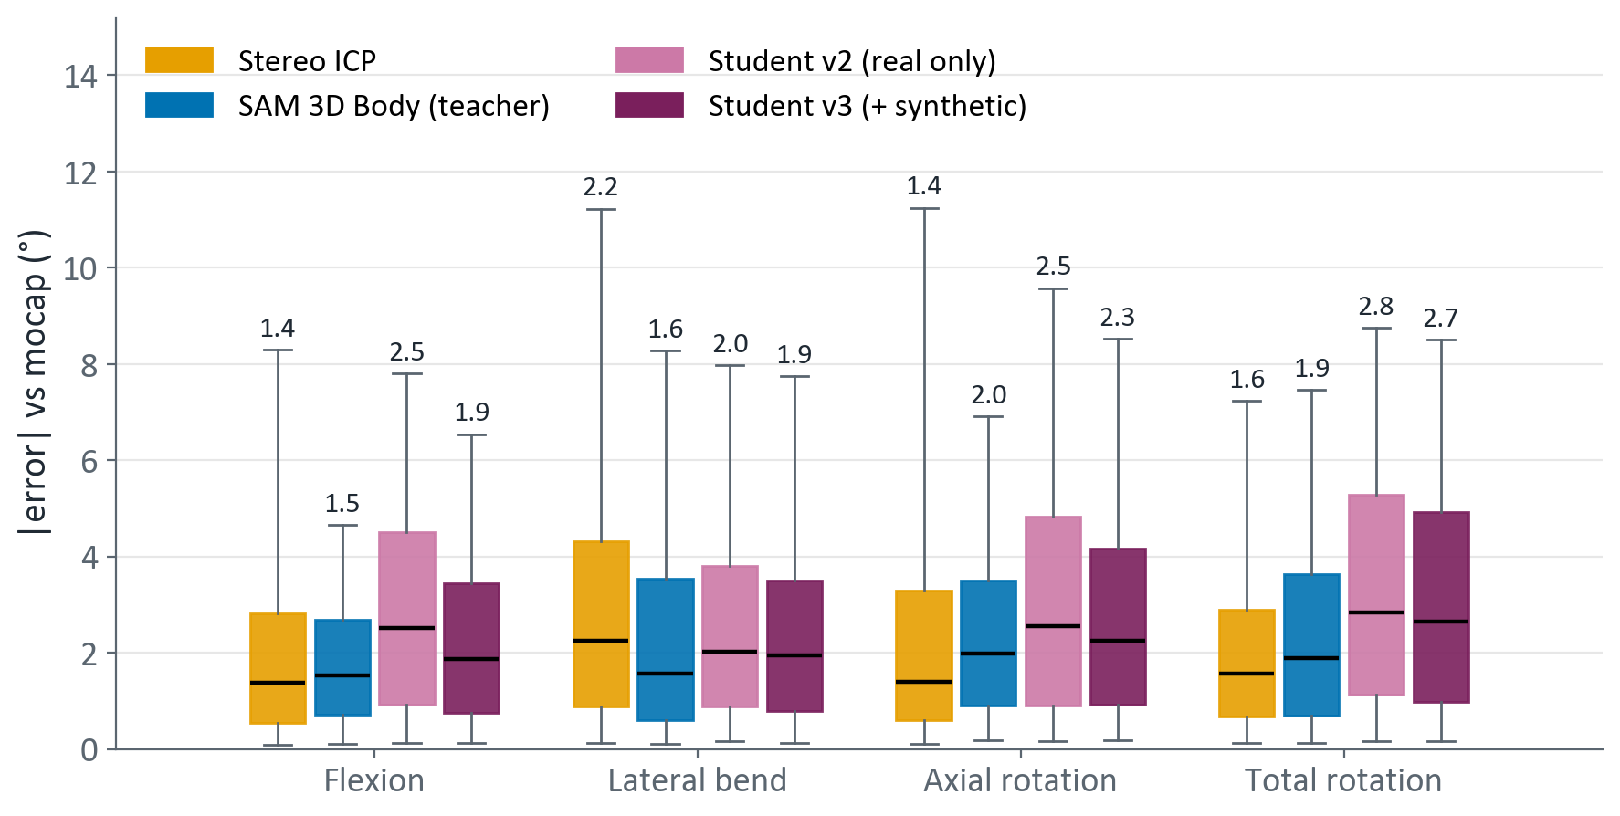
Where we are: new people, protocol takes
ICP is the most accurate where it sees the chest: 1.4–2.2°
Teacher 1.5–2.0°
Student v3 1.9–2.7°, student v2 2.0–2.8°
Student v3 vs teacher: +0.3° flexion, +0.3° axial, +0.8° total
Synthetic people closed most of the flexion gap (v2 → v3)
Box = middle 50 % of frames · line = median (printed) · whiskers = 5th–95th percentile
Flexion / lateral / axial: each method's camera-to-mocap orientation fitted on the person's woc take
Notes:
Never-seen people (Arjun, Jerome, Lee), woc + wc takes, frames ICP solved (about 90 % of frames).

Slide 29
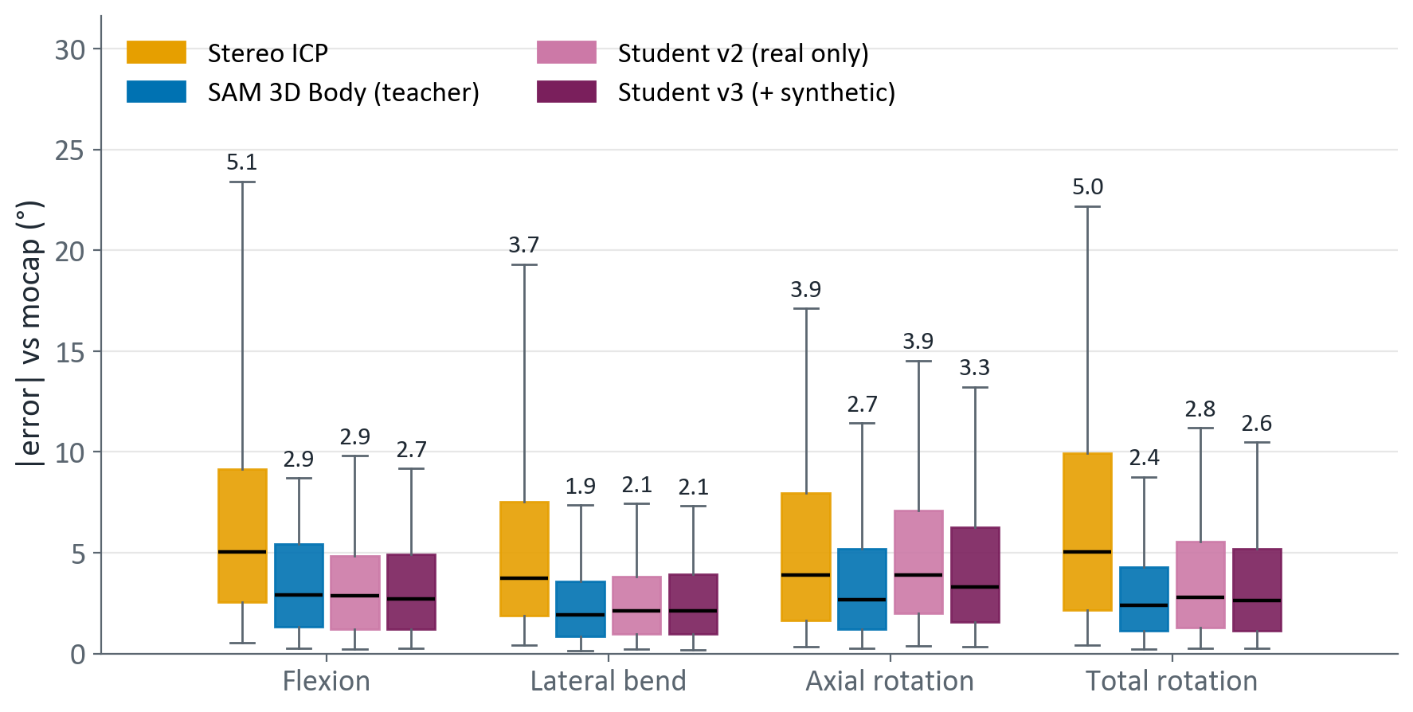
Where we are: new people, game takes
ICP solves only 48–73 % of frames; teacher and student 99–100 %
ICP: 3.7–5.1° median even on the frames it solved
Teacher 1.9–2.9° · student v3 2.1–3.3°
Synthetic people help axial most here: 3.9 → 3.3°
Student v3 minus teacher: flexion −0.2, lateral +0.2, axial +0.6, total +0.2°
Box = middle 50 % of frames · line = median (printed) · whiskers = 5th–95th percentile
Flexion / lateral / axial: each method's camera-to-mocap orientation fitted on the person's woc take
Notes:
Never-seen people, game take with trunk compensation, every frame each method solved. ICP boxes leave out the frames it lost.

Slide 30
Summary
Stereo ICP
Best accuracy when the chest is visible (1.4–2.2° on new people's protocol takes). In the game it loses up to half the frames, and small-shell frames are silently wrong.
Options from here
  Use ICP when the chest shell is large (≥ 800 points), the student otherwise
  More identity variety: outfits, body shapes
  Mocap as labels for the training people (beat the teacher)
  Per-axis gain correction for flexion
Compare recipes with ≥ 2 runs each: one run cannot resolve 0.2°
SAM 3D Body
Answers on every frame, 1.3–3.9° in the game. 631 M parameters, 200 ms on a laptop GPU: cannot run on the Q6A.
Student
4.1 ms on the Q6A NPU. v1 failed on unseen postures; real-only v2 overfit its 5 people and shrank large flexion.
Synthetic humans
1,500 new identities with exact trunk truth. New-people flexion 2.58 → 1.94°; still 0.3–0.8° behind the teacher.

