Slide 1


| Tech Management, SRI-B
CLAWS
CLASH OF THE
RVCE _Cognitive Ops
Multi-Agent Semantic Threat
Evaluation and Reconstruction
Siddharth R,Shrikrishna Shanbhag , Nithin Gowda R S , Sujith D K

Slide 2
Idea
Problem Statement
The Problem: Alert Fatigue. Enterprise SOCs process 10,000–100,000 alerts daily, but fewer than 50% are ever investigated.
Persona: SOC(Security Operations Center) Analysts and Incident Responders.
Why it Matters: Missed detections lead to a 197-day average attacker dwell time and 40%+ annual analyst burnout rates.
Theme Selection: Productivity Platforms. We are solving the "investigation bottleneck" by automating the manual, 2–8 hour process of timeline reconstruction.

Slide 3
Idea
Current Solution & Gaps
Existing Solutions: Cloud-native SIEMs (Microsoft Sentinel, Splunk, Elastic).
What’s Broken:
Cloud Dependency: High privacy risk and data egress costs.
Context Gap: They produce raw "alert clusters" instead of human-readable stories.
Inaccessible: Too expensive and complex for SMEs or air-gapped environments.
Opportunity: A local-first, agentic system that thinks like an analyst without sending a single byte to the cloud.

Slide 4
Idea
Your Solutions
Core Idea: A 4-plane autonomous pipeline that converts machine noise into human intelligence.
Key Features:
Synthetic Intent Translation: Converts raw JSON logs into natural language sentences to improve AI embedding quality.
Semantic Correlation: Uses BGE-m3 vector search to find behaviorally linked events (e.g., linking a web shell to lateral movement).
Multi-Agent Orchestration: Three specialized OpenClaw agents (Triage, Correlation, Timeline) manage the end-to-end investigation.
Intelligent Behavioral Enrichment: Templates automatically identify suspicious parent-child relationships (e.g., web server spawning shells) and use Shannon entropy formulas to detect stealthy DNS tunneling activity

Slide 5
Key features continued
Deep Semantic Correlation: Leverages BGE-m3 vectors and temporally bounded ($\pm$2 hours) HNSW queries to link behaviorally related events across disparate log sources.
Automated Narrative Synthesis: Qwen 2.5 (JSON-mode) generates deterministic forensic reports, providing autonomous MITRE ATT&CK mapping and root-cause analysis.
Real-Time Visualization: A dynamic Cytoscape.js knowledge graph uses the CoSE-Bilkent layout to cluster related attack entities (IPs, processes, users) visually for the analyst.
Production-Grade Hardening: Features kernel-level Seccomp sandboxing for agents, pybreaker-based circuit breakers for failure recovery, and a dedicated dead-letter queue for reliable alert delivery.
Local Autonomous Defense: A 4-plane, fully offline SOC platform designed to reduce manual timeline reconstruction from hours to sub-60-second forensic narratives

Slide 6
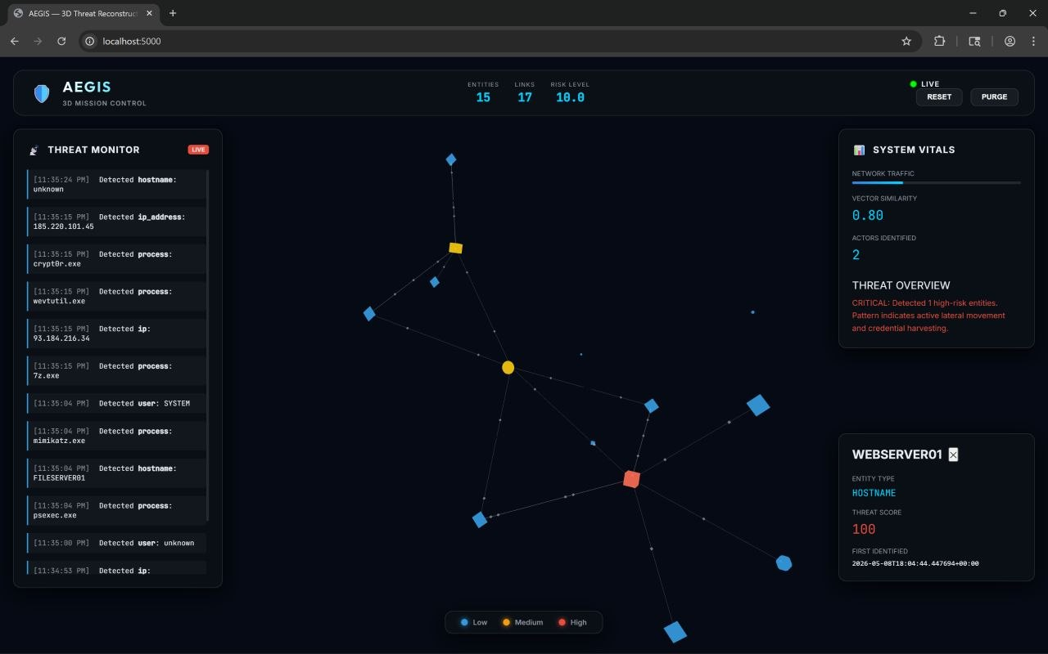
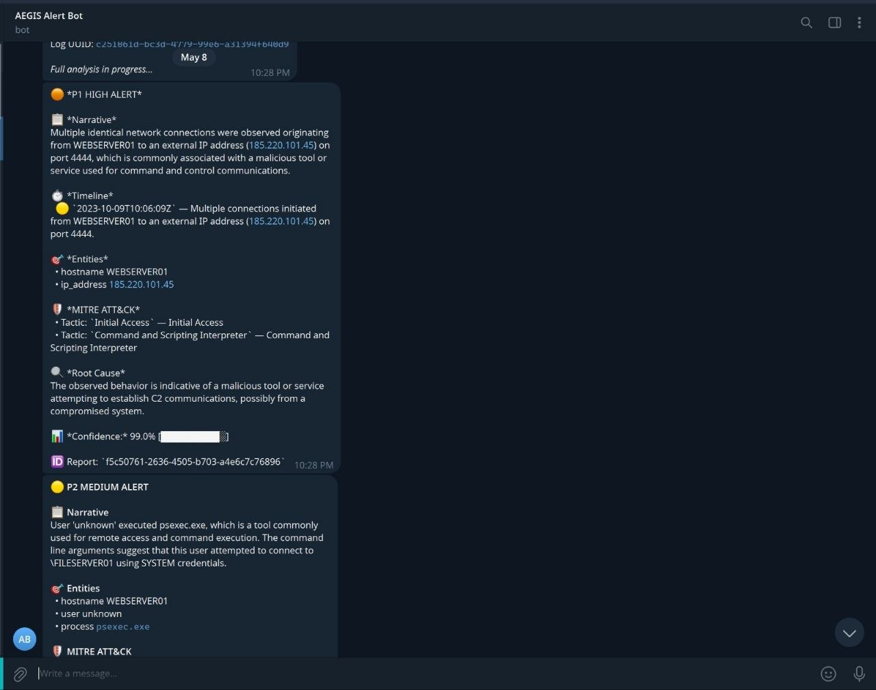
Idea
Demo/Product Walkthrough
Fig: Knowledge Graph Visualisation
Fig: Telegram Bot

Slide 7
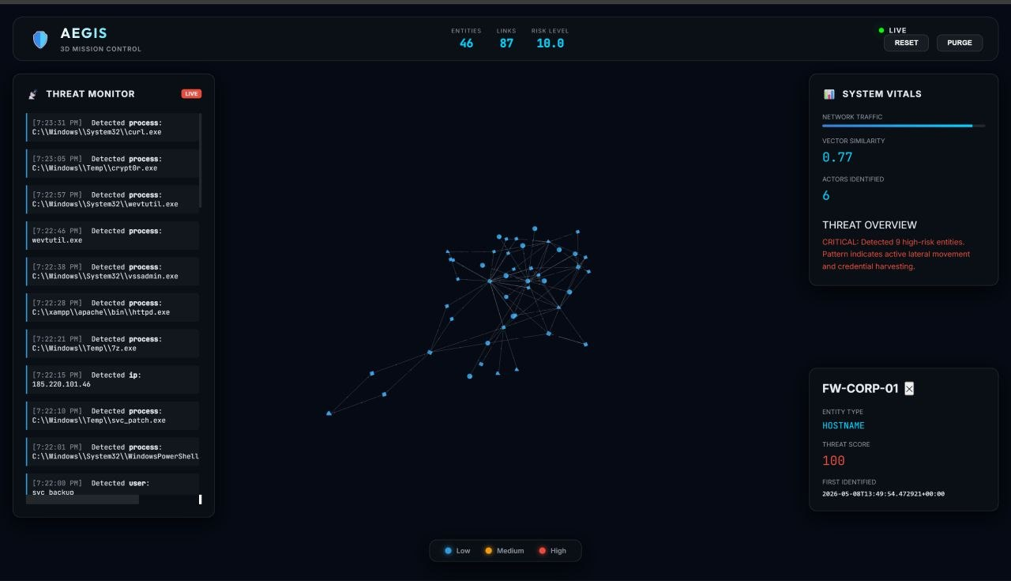
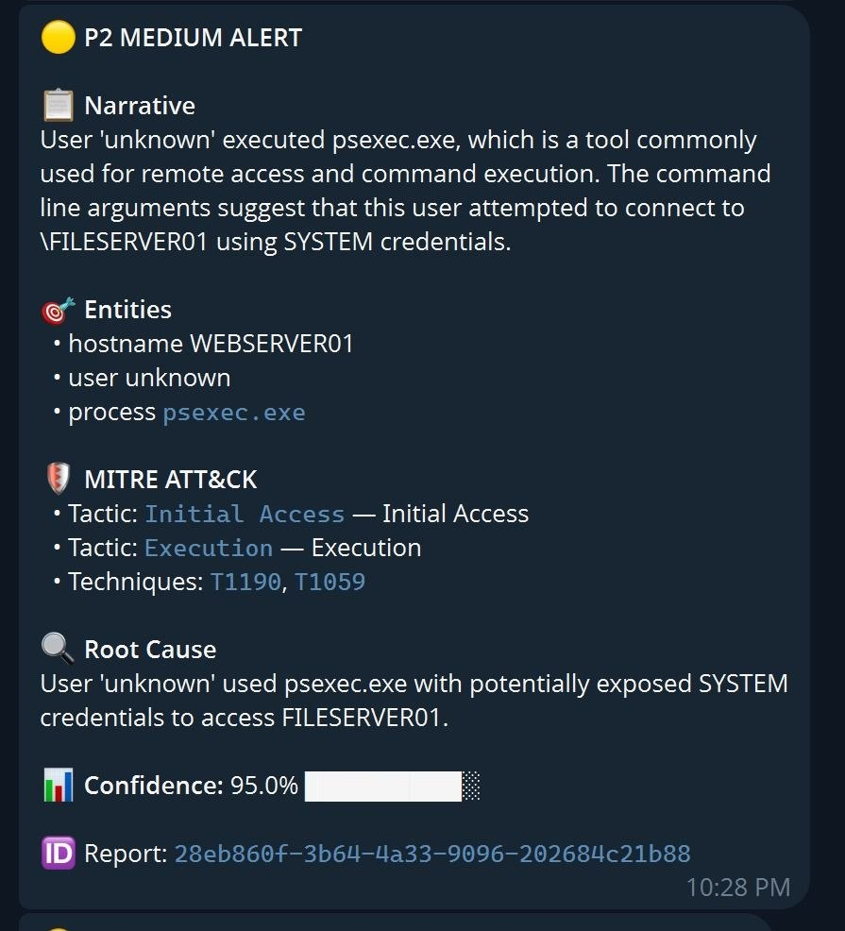
Fig: Knowledge Graph Visualisation
Fig: Telegram Bot

Slide 8
Idea
Tech & Architecture
Agent Orchestration: OpenClaw (Node.js) using HEARTBEAT.md for the event loop and Cognitive RAM for context.
AI Models:
BAAI/BGE-m3: For high-precision semantic embeddings.
Qwen 2.5 (via Ollama): For deterministic, JSON-mode forensic narrative synthesis.
System Flow: Plane 1 (Ingestion) → Plane 2 (OpenClaw Triage) → Plane 3 (Vector Correlation) → Plane 4 (Messaging/Graph Output).

Slide 9
Idea
Impact & Use cases
Impact: 80% reduction in timeline reconstruction time (from hours to <60 seconds).
Use Case 1: Air-Gapped Defense: Securing critical infrastructure where cloud access is forbidden.
Use Case 2: SME Security: Providing "Enterprise-grade" threat hunting at the cost of a single consumer GPU.
Scale Potential: Horizontally scalable via Redis Streams; supports 500+ events per second.

Slide 10
Idea
Differentiation
Moat 1: Synthetic Intent Translation: We don't embed raw logs (which confuses AI). We translate machine behavior into human intent before embedding, making our "search" 10x more accurate for obfuscated attacks.
Moat 2: Total Data Sovereignty: Zero-cloud dependency. The forensic brain stays entirely within the user's hardware, satisfying the strictest regulatory requirements (GDPR/HIPAA).

Slide 11
Idea
Links
GitHub Repo : https://github.com/SujithDodmane/MultiAgent-Semantic-Cyber-Threat-Reconstruction
Demo/Walkthrough Video: https://drive.google.com/file/d/1eGgH9Qf1WejvmMY0vBLBosxPNV1fMPz3/view?usp=sharing
Document submitted :
Detailed Methodology :
Abstract Report , Detailed Methodology
https://drive.google.com/drive/folders/1oKSkRKaJxHX_tuUB89J8liEfdYQpWu1o?usp=sharing

Slide 12
Idea
<Brownie Slide>
Chain-of-Custody: Every raw log is SHA-256 hashed at the second of ingestion to prevent evidence tampering.
Safety First: Implements Seccomp profiles and Docker read-only mounts to sandbox the AI agents—preventing the "analyst" from being compromised by a malicious log.
Resilience: Uses a Circuit Breaker pattern and Dead-Letter Queues to ensure the system never crashes, even if the AI model is overloaded.

