Slide 1
Members @ WORK
Prajyot Suvarna
Sujith Umapathy

Slide 2
Are you new to e-reading?
Do you hate looking up on the meaning of that word every now and then?
Is it hindering your reading experience?
Would you dare to read a Shashi Tharoor’s book?

Slide 3
Proposed Solution
Phase 1 : Building an application that takes in the user’s vocabulary level and reduces the complexity for a better reading experience
Phase 2 : Application capable of increasing the complexity of the words to enhance user’s vocabulary
Phase 3 : Building an e-reader app that would suggest the user to increase the complexity as and when he progresses through the book

Slide 4



Intell- e -Reader
A simplified reader app that reduces the complexity of the words for an easy and enhanced reading experience
Team Members:
Prajyot Suvarna
Sujith Umapathy
Guided By:
Prof. Sreeganesh Thottempudi

Slide 5

He had embarked on a journey around the world to write what became the magnificent eleven-volume ‘The Story of Civilization’ .
But he was, in his own words, so ‘filled with astonishment and indignation’ at what he saw and read of Britain’s ‘conscious and deliberate bleeding of India’ that he set aside his research into the past to write a passionate denunciation of this ‘greatest crime in all history’.
His short book, The Case for India, remains a classic, a profoundly empathetic work of compassion and outrage that tore apart the self-serving justifications of the British for their long and shameless record of rapacity in India.
He had begun on a journey around the world to write what became the brilliant eleven-volume ‘The Story of Civilization’ .
But he was, in his own words, so ‘filled with wonder and rage’ at what he saw and read of Britain’s ‘conscious and deliberate bleeding of India’ that he set aside his research into the past to write a passionate accusation of this ‘greatest crime in all history’.
His short book, The Case for India, remains a classic, a very kind work of compassion and outrage that tore apart the self-serving justifications of the British for their long and shameless record of greed in India.
Which seems easier ??

Slide 6
Technical Workflow
Build A Data Bank
Formulate a data bank of words with their complexity level (based on CERF)
Identify complex words
We identify the complex words in a page using the data bank
Check sentence integrity
We use NLTK modals to verify the sentence integrity
Generate a new page
Generate a new page with simplified words
Find the synonyms
Find the synonym using web scraping

Slide 7
DESIGN REVIEW

Slide 8
Workflow 1 - BUILD A DATA BANK
Teachers Word Level Survey of Common Words
Web Scrapping ‘English Profile.com’ for Commonly used words
Combining the previous 2 databanks and removing of redundant data
Creating a .csv of the Word data bank
.csv -> .json

Slide 9
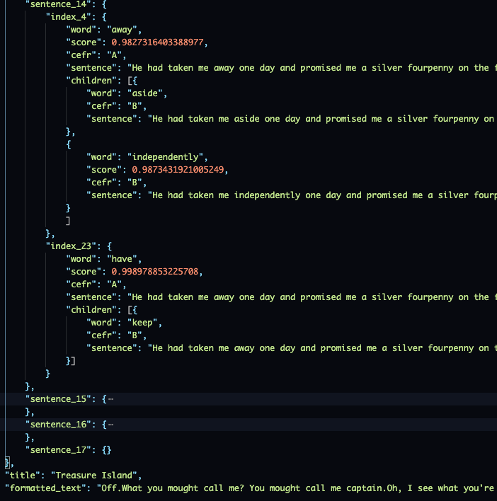
Workflow 2 - IDENTIFYING COMPLEX WORDS
Break the document into paragraph and then sentences
Cleaning the data for :
Stop Words
Conjunctions
Proper Nouns
Interjection
Determiner and many more.
Identify the words/ tokens with CEFR Level B or C
Formulate the appropriate JSON structure to highlight the word on the UI

Slide 10
Workflow 3 - SCRAPING THE WEB FOR SYNONYMS
Scraping ‘Thesaurus.com’
Scraping ‘Synonym.com’
Unifying the data
Cleaning for unwanted synonym phrases
Constructing a .csv file
.csv -> .json

Slide 11
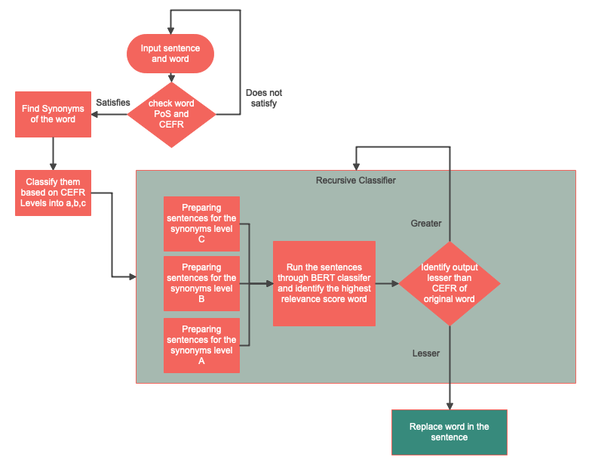
Workflow for a WORD

Slide 12
WORKFLOW
Sentence :
… British
people
community
in India
CEFR :
A
B
C
State,
Center
Neighborhood,
Company,
Public,
Union
Association,
Communal,
Environment,
Nation
People
Society
Score : .9932
Score : .9940
Score : .9930

Slide 13
Generate and display PDF
Stage1
Gather modified sentences
Stage 2
Forming Paragraphs out of the sentences
Write on to a new PDF
Stage 3
Prepare a JSON response
Display the changes on the UI
Verify the grammatic conformance

Slide 14





TOOLS & LIBRARIES

Slide 15

THANK YOU!

