Slide 1
Team BitExposers
Introduction:
The gap between academic education and industry requirements remains a major challenge for student employability. In line with the Make in India initiative, this project introduces an AI-driven web platform focused on improving student productivity and career readiness. The system combines intelligent assessments, AI-based interviews, resume analysis, and personalized learning paths to help students identify skill gaps and prepare effectively for job roles. By providing structured, industry-aligned guidance and adaptive learning, the platform serves as a scalable bridge between colleges and employers, supporting the development of a skilled and job-ready workforce.
Team Members:
Abdul Samad
Sujith Chandra Jarati
Sandeep Megharaj

Slide 2
1. Problem Statement
In today’s dynamic and competitive job market, individuals often face significant challenges in navigating their career paths effectively. These challenges include:
Resume Optimization - Crafting resumes that not only highlight skills and experience but also successfully pass through Applicant Tracking Systems (ATS) is a complex task. Many well-qualified candidates are overlooked due to unoptimized resumes.
Interview Preparation - Preparing for diverse interview formats (technical, behavioral, voice-based) requires targeted practice and constructive feedback, which is often difficult to obtain outside of formal coaching.
Skill Gap and Learning Paths - Identifying relevant skills for desired roles and finding structured, personalized learning roadmaps to acquire those skills can be overwhelming.
Career Guidance - Accessing personalized insights into industry trends, salary expectations, and career progression paths is crucial for informed decision-making but often requires expensive human consultation.
These hurdles often lead to prolonged job searches, missed opportunities, and a lack of confidence, preventing individuals from achieving their full career potential.

Slide 3
2. Our Approach
CareerGuideAI offers an innovative, AI-powered solution designed to democratize access to comprehensive career development tools. By leveraging advanced artificial intelligence, the application provides a personalized and interactive platform that addresses the aforementioned challenges head-on:
AI-Powered ATS Resume Checker - Users can upload their resumes and job descriptions to receive an instant analysis, including a match percentage, identified keywords, and actionable feedback to optimize their resumes for ATS compatibility.
Interactive Interview Preparation - The platform provides tools for practicing various interview scenarios, including AI voice interviews, technical quizzes, and behavioral assessments. Users receive immediate feedback and improvement tips to refine their interviewing skills.
Personalized Course Generation - Based on user goals and identified skill gaps, CareerGuideAI dynamically generates customized learning roadmaps and courses, complete with AI-generated ratings and progress tracking to foster continuous skill development.
Dynamic Resume Studio - A flexible studio allows users to create, edit, and manage multiple resumes using Markdown, with seamless PDF export capabilities, ensuring professional and tailored applications.

Slide 4
Certification Management - Upon successful completion of courses, users can receive and download certificates, validating their newly acquired skills.
Market Insights - The application provides valuable industry insights, including salary ranges, trending skills, and career progression advice, empowering users to make strategic career decisions.
Gamified Progress Tracking - Features like daily streaks and chapter progress tracking encourage consistent engagement and celebrate user achievements.

Slide 5
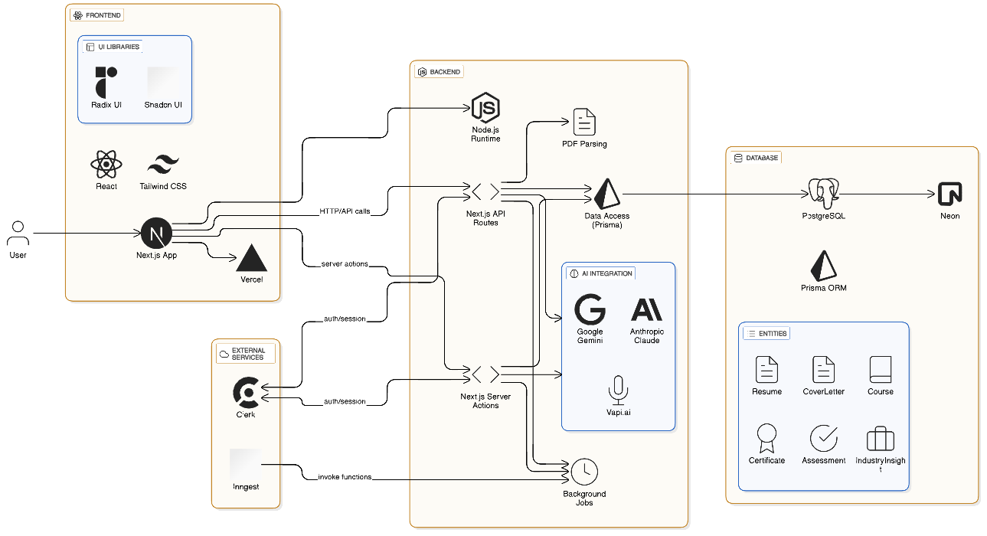
3. System Architecture

Slide 6
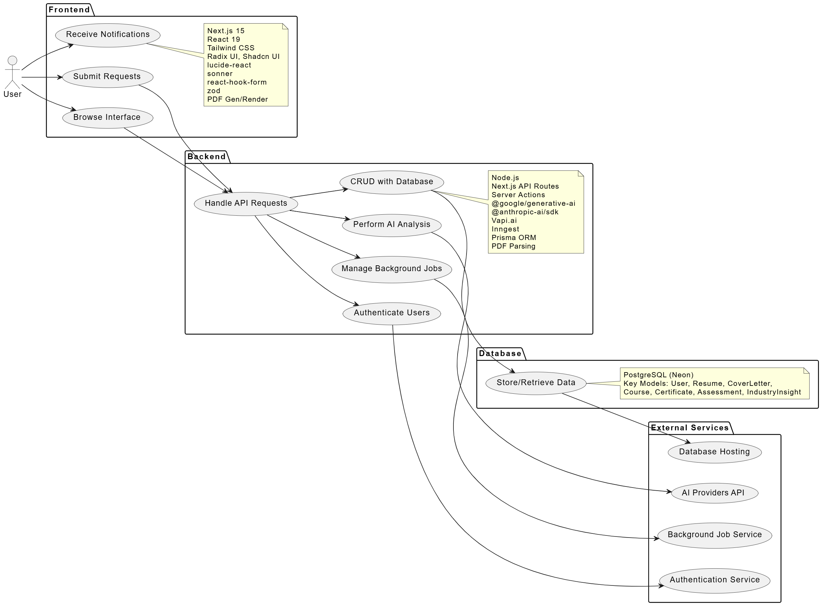
4. Use Case Diagram

Slide 7
5. Current Solutions & Proposed Solutions
Existing solutions such as HireVue and Pymetrics primarily focus on assessment and screening. They evaluate candidates’ skills, cognitive traits, or behavioral patterns and highlight gaps or errors, but their role largely ends at diagnosis.
These platforms do not provide actionable solutions, personalized improvement plans, or continuous guidance to help students bridge those gaps. In contrast, our project is designed as an all-rounder career enablement platform.
It not only identifies skill gaps but also explains the reasons behind them, offers AI-driven, personalized recommendations, and guides students with targeted learning paths, practice modules, and mock interviews.
By combining assessment, feedback, mentoring, and progress tracking in a single ecosystem, the platform actively supports students in improving employability, not just measuring it. This end-to-end approach makes our solution more holistic, impactful, and aligned with real student career growth needs.

Slide 8
Thank You

