Slide 1
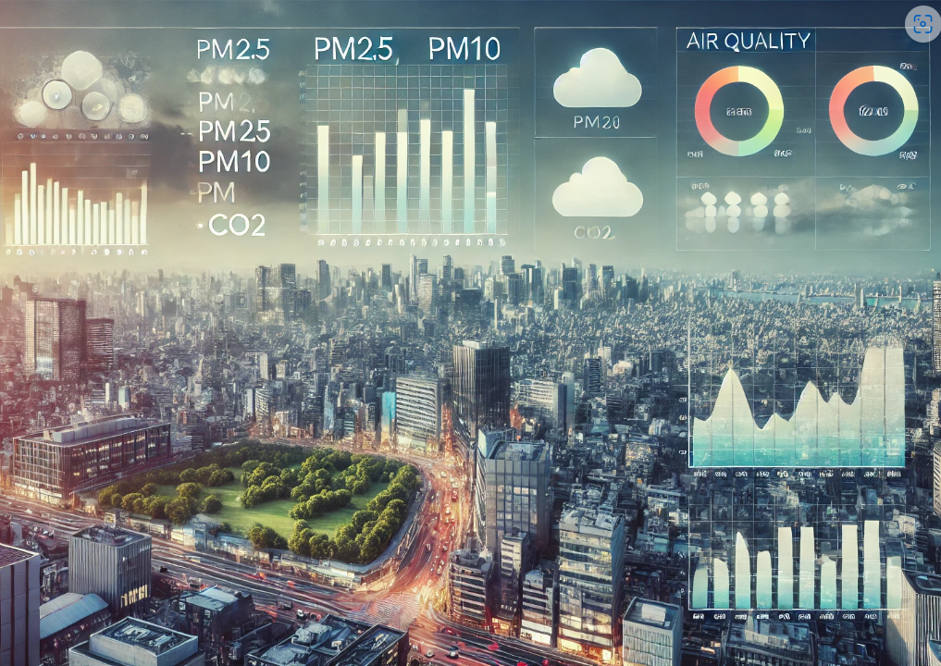
Exploratory Data Analysis Of Air Quality
By: Sai Sujith Reddy, Jupalli
Github: Github
Instructor: Dr. Christelle Scharff

Slide 2

Introduction
Indeed, studies have established that such air pollutants as O3, NO2, PM, and volatile organic compounds are associated with increased risks of respiratory illnesses, cardiovascular diseases, and even cancer. So says the WHO, adding that this was echoed in the works of Rinsky et al. and Kelly & Fussell as far back as 1987 and 2015, respectively. Monitoring these pollutants allows an understanding of the trends in exposure so that appropriate intervention may be done to reduce mortalities attributed to air pollution.
Temperature and humidity are among the most influential factors on pollutant behavior because of their implications for chemical reactions, the formation of particles, and atmospheric dispersion. The present work incorporates EDA, time series data analysis, and machine learning into air quality analysis to enable further advances in predictive modeling relevant to environmental management.

Slide 3
Research Question(s):​
1. How do pollutant levels like CO, NOx and Benzene vary in urban areas over time?​
2. What is the relationship between pollutants and environmental variables like temperature and humidity?​
3. Can historical data predict future air quality indices?​

Slide 4
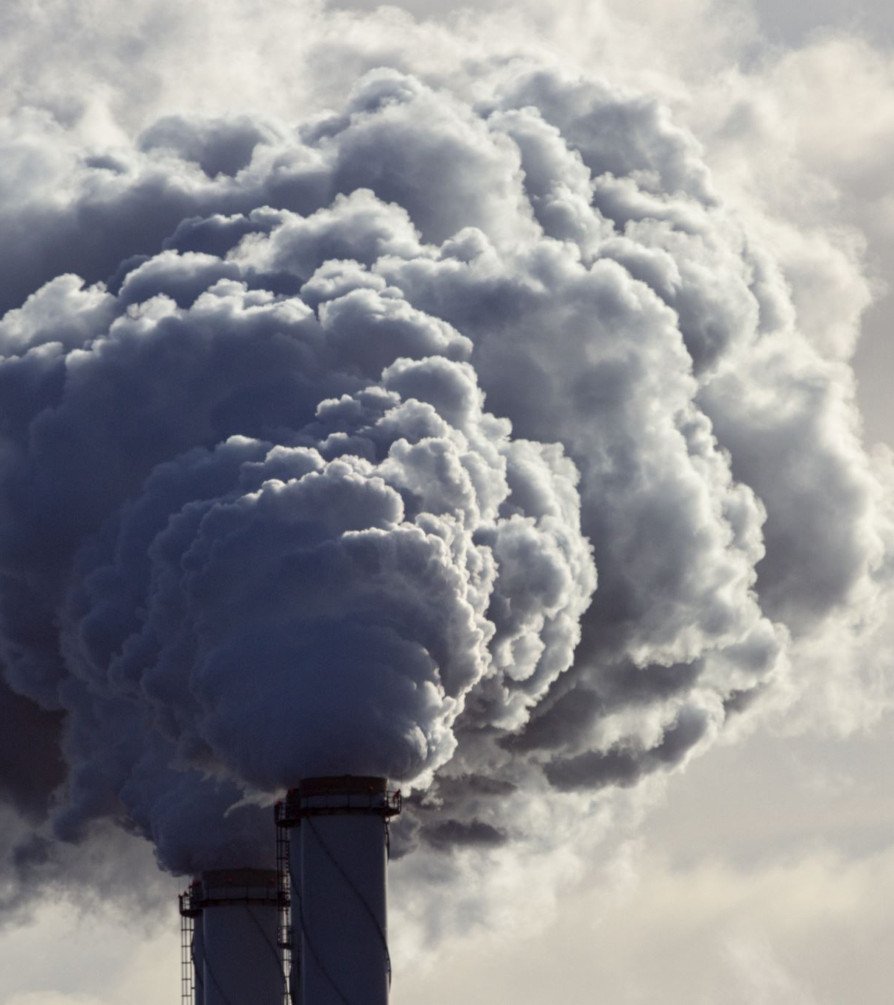
Literature review
The toxicity in air is one of the most serious global issues. 91 % of the population are dwelling in places where WHO limits concerning air quality are violated. Air pollution is responsible for around 4.2 million deaths annually due to diseases related to the heart and lungs. WHO, 2016, 2018.
Several identified advanced ways of analyzing pollution levels and health impacts, whereas trend analyses from recent studies, such as Vetter et al. (2020), showed the importance of such research on NOx and particulate matter across cities.
Machine learning, especially methods using neural networks, has lately been explored for forecasting air quality; there is still considerable deficiency regarding knowledge of spatiotemporal patterns and corresponding health linkages.
This project uses granular data and ML models to analyze urban air quality and help uncover insights to inform policies on the impact of pollution on public health.

Slide 5
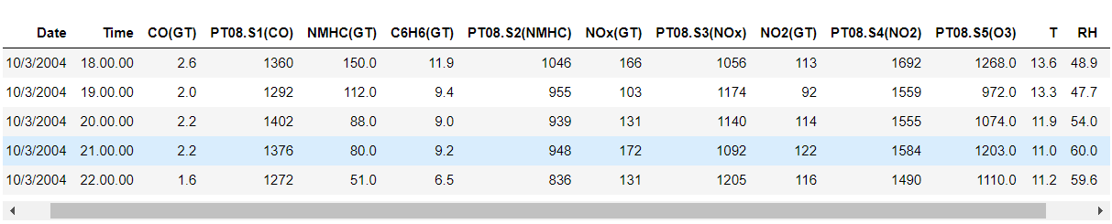
Dataset Overview
Link to the data :Air+QualityUCI
The AirQualityUCI dataset contains measurements of air pollutants and meteorological data.
The Key Pollutants include CO, NOx and NO2.
Meteorological data includes temperature (T), Relative humidity (RH), and Absolute humidity (AH).
Measurements were taken hourly over a period, capturing variations across different conditions from 10/03/2004 to 10/03/2005.
Before proceeding with a detailed EDA, I had to do some basic data cleaning steps, including checking for missing values and replacing the placeholder for missing values (-200) with pd.NA. Since we encountered an issue with replacing -200 directly with pd.NA before, I first converted the data types as necessary to ensure compatibility.

Slide 6
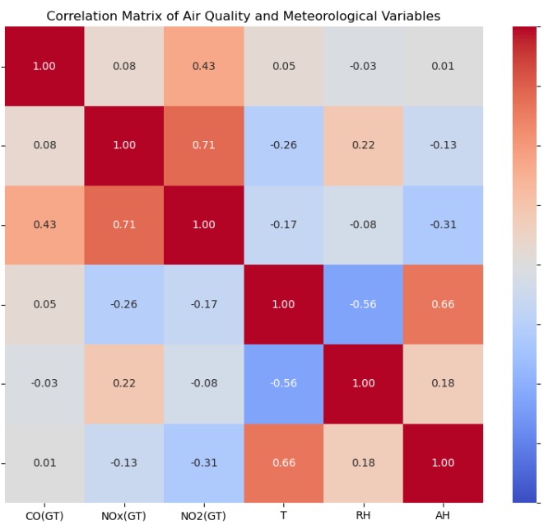
EDA & Methodology
EDA Results: Correlation among Pollutants: Exploratory data analysis showed that the pollutants tend to increase or decrease together, and in many cases, are correlated with other pollutants. Seasonal Trends: The data often follows seasonal trends. For instance, the values might be higher during colder months due to heating activities and the general atmospheric condition, which traps pollutants near the surface of the earth. Variance in the Concentration of Pollutants: The levels of pollutants vary so much throughout the year, with episodes where their concentration seems high and could be related to certain events or seasonal changes. Models: SARIMAX: Through this model, it is quite simple to model frequent oscillations which occur in pollutant levels caused by temperature and humidity changes. LSTM: is suitable in the modeling of temporal dependencies inside air quality data by learning complex patterns and time trends applied in forecasting future pollutant levels based on past data; it handles variable lengths of time and nonlinear relationships between data points, making it highly valuable for air quality forecasting.

Slide 7
Next Steps:
Forecasting & Analysis Fine-tuning the SARIMAX and LSTM Models: Although the first step in implementing the models through the application of the SARIMAX and LSTM techniques was enlightening, it is at this stage that further refinement should be done to realize accuracy and robustness. For instance, tuning hyperparameters, besides taking into consideration different seasonal and non-seasonal variations, may involve fusing extra data, like measures of traffic flow or industrial activities that could enrich predictive capabilities of the model. These models would then better capture dynamics that are particular to air pollutant levels with respect to time. Policy Recommendations: These predictive models and seasonal analyses are quite fundamental in formulating specific environmental policies. For example, based on the forecasted trends, consideration could be given to enforcement of stricter vehicular emission regulations during high-pollution seasons or offering incentives for using cleaner modes of transport.

Slide 8
References:
Measuring the Impact of Urban Street Trees on Air Quality and Respiratory Illness, Yuan Lai Constantine E. Kontokosta https://www.researchgate.net/publication/320727407_Measuring_the_Impact_of_Urban_Street_Trees_on_Air_Quality_and_Respiratory_Illness
AirSPEC: An IoT-empowered Air Quality Monitoring System integrated with a Machine Learning Framework to Detect and Predict defined Air Quality parameters. Nuwan Bandara, Sahan Hettiarachchi, Phabhani Athukorala https://arxiv.org/abs/2111.14125

