Slide 1
MOBILE APP FOR DIRECT ACCESS FOR FARMERS
CSE7101- Capstone Project
Review-5
Batch Number: CSE_76
Under the Supervision of,
Mr. Jerrin Joe Francis
Assistant Professor
School of Computer Science and Engineering
Presidency University
Roll Number | Student Name
20221CSE0735 20221CSE0738 20221CSE0747 | DARSHAN B SUJITH M MADDIN NAGASHREE M N
Name of the Program: B.Tech - CSE
Name of the HoD: Dr. Asif Mohamed H B
Name of the Program Project Coordinator: Dr. Jayavadivel Ravi
Name of the School Project Coordinators: Dr. Sampath A K , Dr. Geetha A

Slide 2
Problem Statement Number: PSCS_281
Organization: Presidency University
Category (Hardware / Software / Both) : Software
Problem Description: Farmers often face challenges in accessing markets, leading to lower income due to middlemen. This gap restricts their ability to sell produce at fair prices. Description: Create a mobile application that connects farmers directly with consumers and retailers. The app should include features for listing produce, negotiating prices, and managing transactions, thereby reducing dependence on intermediaries. Expected Solution: A user-friendly mobile platform that enables farmers to showcase their products and connect with buyers directly, enhancing their income potential..

Slide 3
Content
Abstract
Literature Survey
Objectives
Existing Methods & Drawbacks
Proposed Method & Feasibility Study
Architecture Diagram
Modules
Hardware and Software details
Timeline (Gantt chart)
References

Slide 4
Abstract
Farmers often lose income due to middlemen in the market chain.
A mobile app is developed to directly connect farmers with verified buyers.
The app provides multilingual support, voice assistance, and offline access.
Features include product listing, price negotiation, payments, logistics, and advisory.
This solution ensures fair pricing, transparency, and improved farmer income.

Slide 5
Literature Survey
Ref No. | Title | Author(s) | Methods/Algorithms | Merits | Demerits
1 | Mobile App for Direct Market Access for Farmers | Aniket Chauhan, Kalpana K Harish, Utkarsh Kumar, Raunak | AI (Linear Regression for price prediction), Blockchain, GPS logistics, real-time analytics | Accurate price forecasting, secure transactions, optimized delivery routes | Requires high-quality data, blockchain scalability issues, stable GPS connectivity needed
2 | Mobile Application to Direct Marketing Access for Farmers | Dr. Latha P H, Ms. Amulya R, Mr. Darshan GS, Ms. Aabha Pandey, Mr. Vinayaka C | AI for price prediction and crop recommendations, PayPal API for secure payments, Weather API | User-friendly interface, real-time synchronization, secure payment and escrow support | Relies on PayPal, limited blockchain use, connectivity and digital literacy challenges
3 | AI-Driven Platform for Direct Market Access for Farmers | Rupali Vyas, Vedita Kesharwani, Chirag Rohra, Rounak Sundrani | AI-driven pricing models (ML algorithms), chatbots, payment gateway integration | Real-time pricing optimization, personalized recommendations, multilingual and voice support | High development complexity, requires digital training and infrastructure support
4 | Blockchain Technology in Agriculture: Real-World Implementation | Various authors | Blockchain for transparent transactions, smart contracts, IoT for supply chain tracking | Enhanced transparency, trust-building, reduced fraud, improved supply chain monitoring | Blockchain adoption challenges, infrastructure and tech literacy constraints
5 | Blockchains for Sustainable and Inclusive Finance | Giuseppe Tripoli, Jürgen Schmidhuber | Blockchain technology, smart contracts, decentralized finance (DeFi) models | Highlights blockchain’s transformative role in inclusive finance, transparent records, secure transactions | Implementation complexity, scalability, regulatory/legal uncertainties

Slide 6
6 | Blockchain Technology in Agriculture: Case Study of Blockchain Start-up Companies | Chandra Sekhar Bhusal | Survey and case studies of blockchain tech in agriculture; blockchain, smart contracts, IoT | Highlights practical blockchain applications addressing transparency, fraud, price manipulation; supports small farmers | Early-stage tech, cost and scalability challenges; limited first-hand data; adoption barriers
7 | AI-Powered Mobile Applications for Smallholder Farmers: Transforming Agricultural Productivity, Market Integration, and Resource Optimization | Vivek Kumar Soni, Roshan Verma, Sakshi Verma, Vasu Dewangan | Mixed methods: literature review, stakeholder interviews, pilot testing; AI-based app integrating agri-data, market, finance, resource optimization | Real impact on farm productivity, market access, financial inclusion; comprehensive app features and proposed solutions | Barriers: internet access, digital literacy, smartphone cost; scalability and security concerns
8 | Artificial Intelligence in Agricultural Extension for Sustainable Livelihoods Among Rural Farmers in Abuja, Nigeria | Ayodele Olajide Olawumi, Beatrice Itoya Oyediji, Joseph Bamidele, Ugochinyere Princess Eleke, Mudashir Adeola Olaitan, Samson Olayemi Sennuga | Machine learning models for weather and market prediction, predictive analytics for yield/pest/crop price, mobile app with voice and sensor integration, AI-enabled advisory platforms | Enhanced farming decisions; location-based, scalable, multilingual support | Connectivity gaps, digital literacy issues, high device cost, lack of training, trust and language barriers

Slide 7
9 | Emerging Opportunities for Blockchain in the Agri-food Industry | Mischa Tripoli, Josef Schmidhuber | Blockchain/distributed ledger tech (DLT), smart contracts, consensus algorithms (PoW, PoS), IoT-based supply chain integration, cryptographic product provenance (RFID, QR, crypto-anchors) | Supply chain transparency, tamper-proof transactions, financial inclusion, digital identity management | Technical complexity, scalability and regulatory challenges, interoperability, high energy usage, resource barriers
10 | Design and Implementation of Smart Hydroponics Farming Using IoT-Based AI Controller with Mobile Application System | S. V. S. Ramakrishnam Raju, Bhasker Dappuri, P. Ravi Kiran Varma, Murali Yachamaneni, D. Marlene Grace Verghese, Manoj Kumar Mishra | IoT sensors (NPK, sunlight, pH, water temp, turbidity, image), Raspberry Pi control, mobile app interface; Deep Learning Convolutional Neural Network (DLCNN) for nutrient prediction and plant disease classification, cloud-based AI processing, RSA/SHA security | Real-time farm monitoring/automation; superior disease detection and nutrient estimation accuracy; user-friendly secure app for both manual and auto modes | System costs, sensor calibration/maintainability, require reliable connectivity; complex hardware and AI model setup; generalizability to traditional farming may be limited

Slide 8
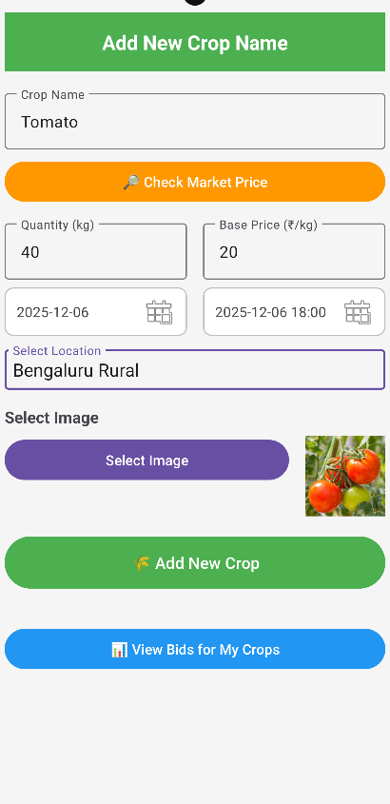
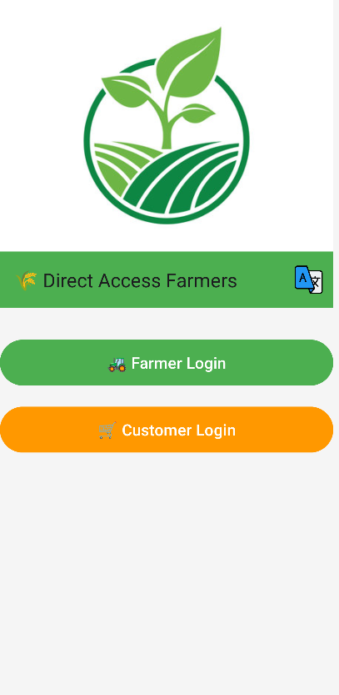
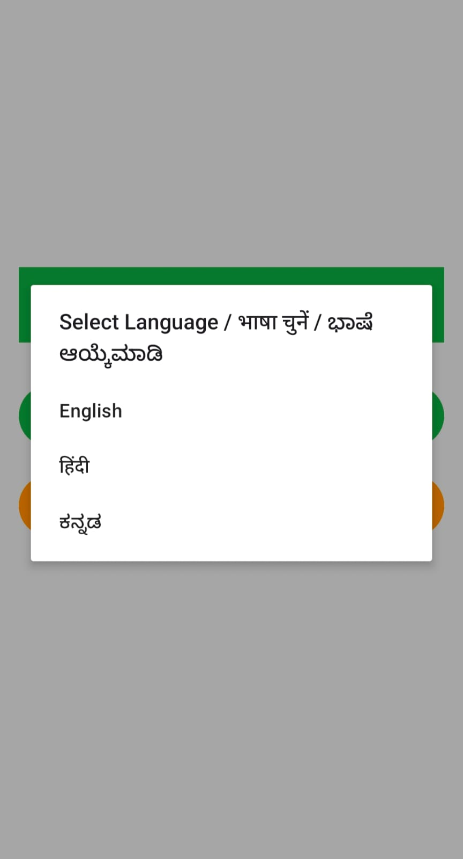
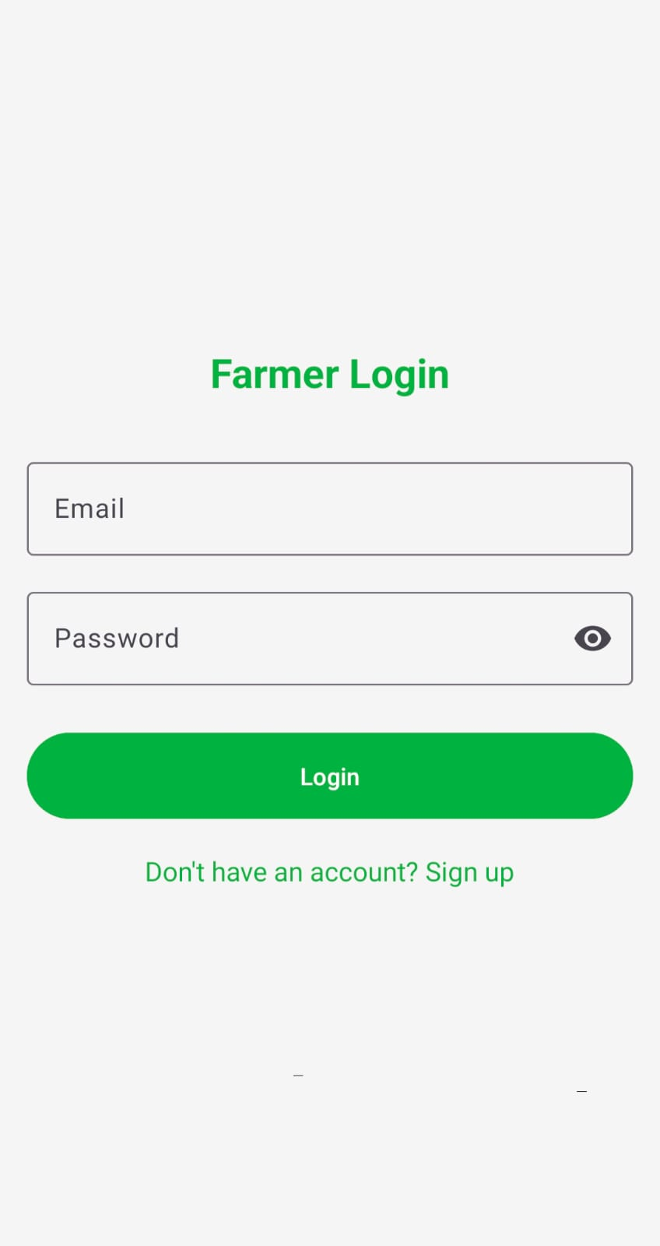
Project Output [snapshots]

Slide 9
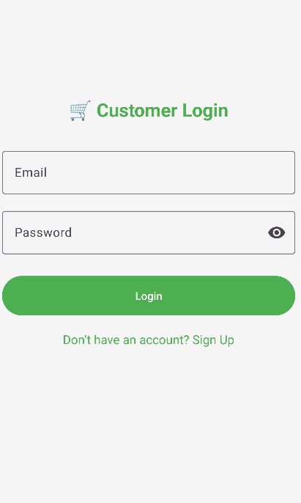
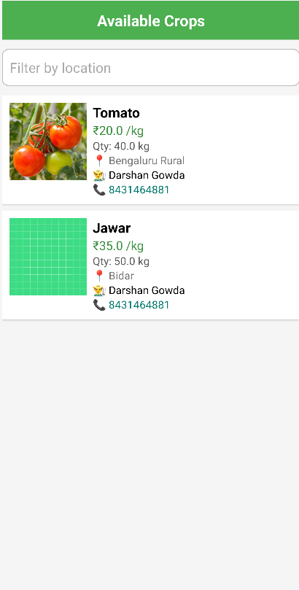
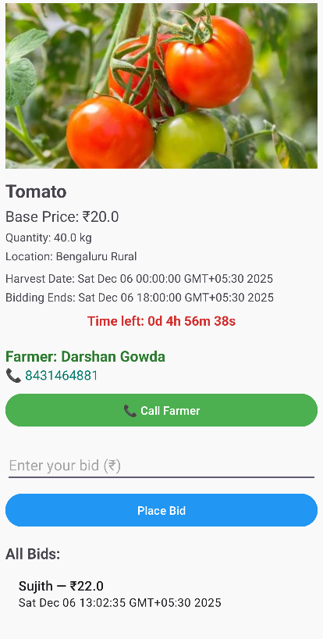




Slide 10
Objectives
Facilitate Direct Market Access – connect farmers directly with verified buyers, removing intermediaries and ensuring fair prices.
Promote Inclusive & Accessible Usage – provide multilingual and voice-assisted support for farmers with low digital literacy.
Enable Reliable Access in Rural Areas – implement offline-first features so farmers can use the app even with poor connectivity.
Integrate Essential Services – unify market price tracking, crop advisory, logistics, and secure digital payments in one platform.

Slide 11
Existing Methods & Drawbacks
Existing Methods
Digital marketplaces – secure payments, and scalable cloud systems.
Farmer mobile apps – provide market prices, weather/pest alerts, extension advice, and finance/insurance linkages.
Survey-based studies – structured questionnaires and regression/statistical models to assess adoption and willingness.
Prototype/system designs – platforms like Agriconnect with geolocation, inventory tracking, multi-payment, and scalable software stacks.
Reviews & qualitative analysis – literature reviews, case studies, interviews, and thematic studies on benefits, challenges, and perceptions.
Drawbacks
Low digital literacy & usability issues – farmers need training; apps often not user-friendly.
Weak infrastructure – poor rural connectivity, electricity gaps, and limited offline functionality.
Poor localization & relevance – generic content not tailored to crops, languages, or micro-climates.
Fragmented ecosystem & weak evidence – too many unintegrated apps; few long-term evaluations of impact.
Equity & sustainability gaps – affordability, gender, and smallholder inclusion overlooked; heavy reliance on donor projects without strong business models.

Slide 12
Proposed Method
Direct Farmer–Buyer Platform – connects farmers with verified buyers, reducing middlemen.
Bidding & Negotiation – buyers place bids; highest bidder wins, ensuring fair pricing.
Offline-First & Accessible – supports use without internet; multilingual and voice-based UI.
Integrated Services – combines market prices, weather forecasts, crop advisory, payments, and logistics.
Secure Transactions – UPI/payment gateway, offer history, and fraud prevention.
Admin Module – verifies users, resolves disputes, and monitors activities.

Slide 13
Feasibility Study
Technical Feasibility – Built using Android Studio and Firebase (Firestore, Auth, Cloud Functions, FCM, Storage) with external APIs for payments, weather, and logistics. Firebase supports offline sync and scalability.
Economic Feasibility – Low-cost development using Firebase’s free tier and open-source tools; scalable to paid plans when needed.
Operational Feasibility Farmer-friendly design with simple UI, multilingual support, offline capability, and transparent bidding system.
Social Feasibility Empowers smallholder farmers, supports women’s participation, eliminates exploitation by middlemen, and builds trust through direct access.
Scalability Feasibility – Firebase’s cloud-based deployment ensures large-scale adoption, real-time updates, and easy future expansion.

Slide 14
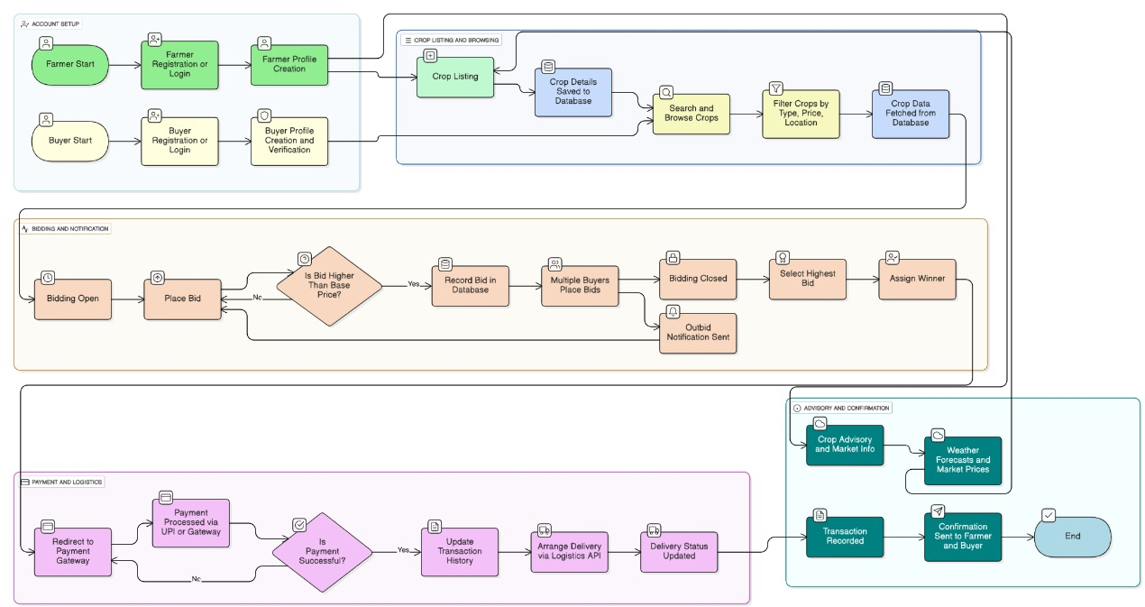
Architecture Diagram

Slide 15
Modules
Authentication & User Management – Provides OTP/email login with role-based access for farmers, buyers, and admins.
Farmer Module – Lets farmers create profiles, list crops, and negotiate orders via multilingual/voice-friendly interfaces.
Buyer Module – Enables buyers to search crops, make offers, negotiate, and pay securely.
Market Advisory & Analytics – Offers real-time prices, weather forecasts, and crop/disease recommendations.
Payment & Transaction – Handles UPI/payment gateway integration, records history, and confirms transactions.
Admin Module – Verifies users, resolves disputes, and monitors platform activity.

Slide 16
Hardware and Software details
Software Requirements:
Android Studio (Java/Kotlin) – Mobile app development
Firebase Authentication – OTP/Email login
Firebase Firestore – Real-time database with offline sync
Firebase Cloud Functions – Backend logic (bidding, notifications)
Firebase Cloud Storage – Crop images and files
Firebase Cloud Messaging (FCM) – Push notifications
Git + GitHub – Version control
Frontend (Mobile App):
Android Studio (Java/Kotlin) for UI + app logic
Firebase local cache for offline storage
Backend:
Firebase Cloud Functions for business logic
Firestore Database for main storage

Slide 17
Github Link
Github Link : https://github.com/SujithMMaddin/mobile-app-direct-access-farmers

Slide 18
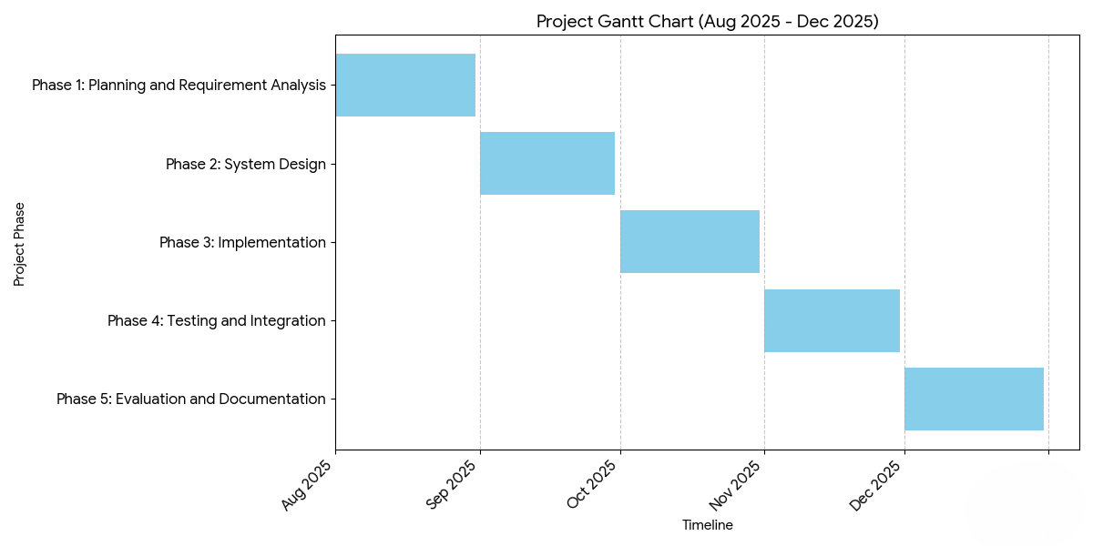
Timeline of the Project (Gantt Chart)

Slide 19
References :
[1] A. N. Akshaya, M. Subash, S. S. M. Sai, R. B. Sakthivel, and A. Praveena, “Mobile Application for Direct Market Access for Farmers,” Int. J. Res. Appl. Sci. Eng. Technol. (IJRASET), vol. 13, no. 1, Jan. 2025. [Online]. Available:Link
[2] A. Tati, P. Landage, S. Auti, and N. Naikwadi, “Mobile Application for Farmer to Get Direct Access to Market, Transport, and Fertilizer Shops,” Int. J. Res. Appl. Sci. Eng. Technol. (IJRASET), vol. 13, no. 1, Jan. 2025. [Online]. Available:Link
[3] C. Hinojosa, M. A. Rodríguez, and S. A. Morales, “AgroTIC: Bridging Farmers, Agronomists & Merchants,” arXiv preprint, arXiv:2305.12418, May 2023. [Online]. Available:Link
[4] F. Ayim, J. Armah, and K. Agyekum, “Adoption of ICT Innovations in the Agriculture Sector in Africa: A Systematic Literature Review,” arXiv preprint, arXiv:2006.13831, Jun. 2020. [Online]. Available:Link

Slide 20
[5] D. Saria, E. Mnyanyi, and A. Sife, “A Farmers’ Digital Information System (FDIS) for Sustainable Agriculture in Tanzania,” Information, vol. 15, no. 12, pp. 1–20, Dec. 2023. [Online]. Available:Link
[6] R. Gaviglio, A. Bertoni, and D. Demartini, “Adoption of Digital Technologies in Small-scale European Farming,” Precision Agriculture, vol. 23, pp. 1578–1599, Aug. 2022. [Online]. Available:Link
[7] R. Fountas, A. Sorensen, and J. Tsiropoulos, “Smartphone Applications Targeting Precision Agriculture Practices—A Systematic Review,” Agronomy, vol. 10, no. 6, p. 855, Jun. 2020. [Online]. Available:Link
[8] P. Marak and M. Sarma, “Toward Sustainable Digital Agriculture for Smallholder Farmers: A Systematic Literature Review,” Sustainability, vol. 15, no. 16, p. 12530, Aug. 2023. [Online]. Available:Link
[9] J. Kabubo-Mariara, “MFarm: Market Access via Mobile/SMS in Kenya,” Wired Magazine, 2013. [Online]. Available:Link
[10] ITC Ltd., “E-Choupal: An Initiative of ITC Limited,” Wikipedia, 2023. [Online]. Available:Link

Slide 21


