Slide 1
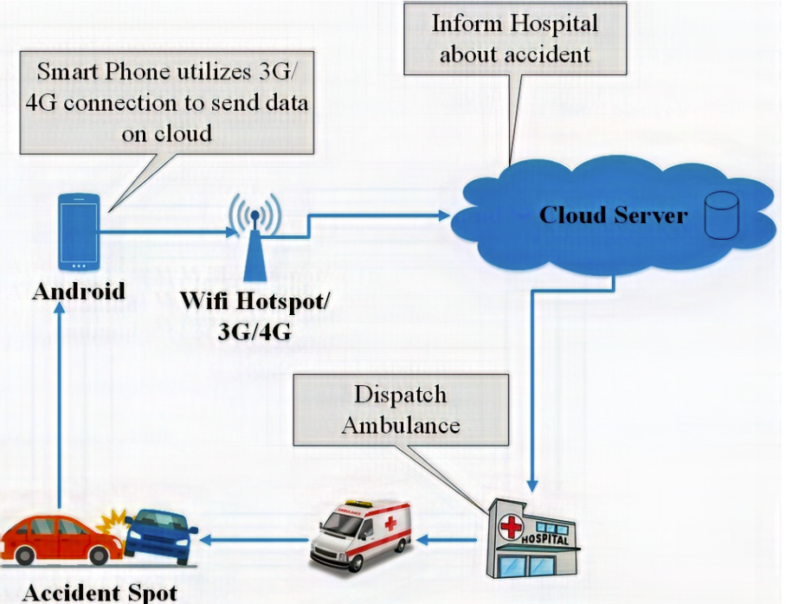
Collision Risk Prediction
Autonomous Ambulance System — Data Analytics & ML
S.V. Ganesh (23STUCHH010460)
Nadimpalli Raja Sujith Varma (23STUCHH010477)
Supervisor: Dr. Chandrashekhar A
Dept. of CSE (AI & ML) • IcfaiTech IFHE, Hyderabad • April 2026

Slide 2
Introduction
Autonomous Vehicles (AVs)
The Core Challenge
Use AI and sensor data to navigate without human intervention. Represent the future of transportation with applications from personal mobility to emergency services.
AVs must navigate complex urban traffic safely at speed. Collision Risk Prediction is essential to identify hazardous situations before they occur.
Autonomous Ambulance System (AAS)
Our Approach
Mission-critical application where minimizing response time and maximizing safety are vital. Operates at SAE Level 4 — highly automated in defined conditions.
Data-driven ML model using KITTI dataset features (object density, distance) to classify scenarios as High Risk or Low Risk in real time.

Slide 3
Problem Definition
Objective
Develop a data-driven model to predict collision risk in autonomous ambulance systems using features derived from real-world driving datasets — enhancing safety and improving decision-making.
Key Research Questions
Q1
Q2
Can collision risk be predicted using object density and distance information?
Does a decrease in distance to nearby objects increase likelihood of collision?
Q3
Q4
Does higher traffic density (more surrounding objects) lead to higher risk?
Can machine learning models effectively classify safe vs. high-risk driving scenarios?

Slide 4
Dataset Selection — KITTI
KITTI Vision Benchmark Suite
Data Processing Pipeline
Object Detection Dataset
1
Data Wrangling
✔ Widely used for autonomous driving research
Raw label files → structured DataFrame
✔ Contains labelled driving scene data
Cleaning
2
✔ LiDAR + stereo camera data
Remove "DontCare" entries, handle missing values
✔ Urban traffic environments
3
Feature Engineering
✔ 500 samples used for efficient processing
num_objects, min_distance, avg_distance
4
Labelling
High Risk (1): dense traffic or very low distance; Low Risk (0): otherwise
5
Normalization
Distance-based features implicitly normalized

Slide 5
Data Preprocessing & Feature Engineering
num_objects
min_distance
avg_distance
Feature Variable
Feature Variable
Feature Variable
Number of detected objects in the scene — represents traffic density
Minimum distance to the closest surrounding object — critical safety indicator
Average distance to all detected objects — overall traffic proximity
Target Variable: collision_risk
HIGH RISK (1) — Object density is high OR distance to nearby object is very low
LOW RISK (0) — Normal traffic conditions, safe distance maintained

Slide 6
Exploratory Data Analysis (EDA)
Techniques Used
Feature Correlation Insights
📊 Histogram
num_objects ↔ collision_risk
+0.65
Distribution of object counts across scenes
Strong positive
📦 Boxplot
min_distance ↔ collision_risk
−0.45
min_distance compared across risk categories
Moderate negative
🔥 Heatmap
avg_distance ↔ collision_risk
−0.22
Feature correlation matrix (num_objects, distances, risk)
Weak negative
🧩 Confusion Matrix
min_distance ↔ avg_distance
+0.79
Actual vs predicted classification evaluation
Strong positive
⚠️ Outlier Detection
num_objects ↔ min_distance
−0.47
Identifies extreme density / very low distance cases
Moderate negative
Key Insight: Object density & min_distance are primary collision risk predictors

Slide 7
Methodology & System Pipeline
1
2
3
4
5
6
7
8
9
Data Collection
Preprocessing
Feature Eng.
Data Split
Model
Training
Evaluation
Prediction
Risk Output
KITTI Dataset
Cleaning & Wrangling
num_objects, distances
Train 80% / Test 20%
Random Forest
Fit on training data
Acc, Prec, Recall, F1
New scenario input
High Risk / Low Risk
Input Features
Algorithm
Output Classes
num_objects
min_distance
avg_distance
Random Forest
(100 estimators)
Handles non-linearity
0 → Low Risk
1 → High Risk
Binary classification

Slide 8
Model Development — Random Forest Classifier
Why Random Forest?
Classification Approach
✔ Handles non-linear relationships in traffic data
Class 0 — LOW RISK
Safe driving scenario. Adequate distance to surroundings, normal traffic density.
✔ Ensemble of decision trees → robust predictions
✔ Resistant to overfitting with proper tuning
Class 1 — HIGH RISK
✔ Provides feature importance scores
Hazardous scenario. High object count and/or very low minimum distance detected.
✔ Interpretable and computationally efficient
Sample Output
✔ No need for feature scaling
Sample 1: 0 → Low Risk
Sample 2: 1 → High Risk
Sample 7: 1 → High Risk

Slide 9
Model Evaluation
100%
1.00
1.00
1.00
Accuracy
Precision
Recall
F1-Score
Classification Report
Evaluation Setup
Class | Precision | Recall | F1 | Support
0 (Low Risk) | 1.00 | 1.00 | 1.00 | 73
1 (High Risk) | 1.00 | 1.00 | 1.00 | 27
Train / Test Split
Train: 80%
Test: 20%
Cross-Validation
Cross-validation Scores
5-fold CV validates model on different data subsets to confirm generalization.
[1.0 1.0 1.0 1.0 1.0] → Average: 1.0
Hyperparameter Tuning
Optimizes number of trees, depth, and split criteria for best performance.

Slide 10
Results & Insights
Confusion Matrix
Feature Importance & Key Insights
Predicted 0
Predicted 1
min_distance
52%
73
True Negative
0
False Positive
Actual 0
num_objects
36%
avg_distance
12%
0
False Negative
27
True Positive
Actual 1
→ Lower min_distance = highest collision risk signal
→ ML outperforms simple rule-based threshold methods
AUC-ROC = 1.00
Perfect separation achieved
→ Perfect AUC = 1.0 (complete class separation achieved)
→ Model is efficient and deployable in real-time systems

Slide 11
Future Work
⚠ Simplified Risk Labelling
⚠ Lack of Temporal Analysis
⚠ Absence of Sensor Fusion
Future Work
✦ Real-time sensor & V2X data integration
✦ LSTM / temporal modeling
✦ Multi-sensor fusion (LiDAR + camera)
✦ Deep learning for higher accuracy

Slide 12
Conclusion
✔
Successfully built a data-driven collision risk prediction model using the KITTI dataset.
✔
Random Forest achieved 100% accuracy — perfect precision, recall, and F1-score.
✔
Minimum distance and object density are the most critical collision risk predictors.
✔
Results validated using confusion matrix, ROC (AUC = 1.0), and cross-validation.
✔
Demonstrates the power of data analytics in enhancing AV decision-layer safety.
This work lays the foundation for real-time, sensor-fused AV safety systems.
Thank You

