Slide 1
Stock market Prediction

Slide 2
Abstract
The stock market is highly volatile and unpredictable by nature. The use of statistical analysis has played a major role in assisting stock market prediction. This research paper aims at using various statistical methods to analyse historical data of the Nifty 50(NSE) as well as forecast its direction for the next twelve months. This study aims to tell the market scenario of the future by supporting it with statistical answers. Specifically, Auto Regressive Integrated Moving Average (ARIMA) Modelling, Exponential Smoothing, and Mean Squared Error analysis are the foci of interest. Nifty 50 dataset is publicly available on Yahoo Finance. It consists of historical daily opening and closing stock prices along with a few other additional market parameters.
KEYWORDS­--- Nifty50, ARIMA, Exponential Smoothing, Stock Price Forecasting

Slide 3
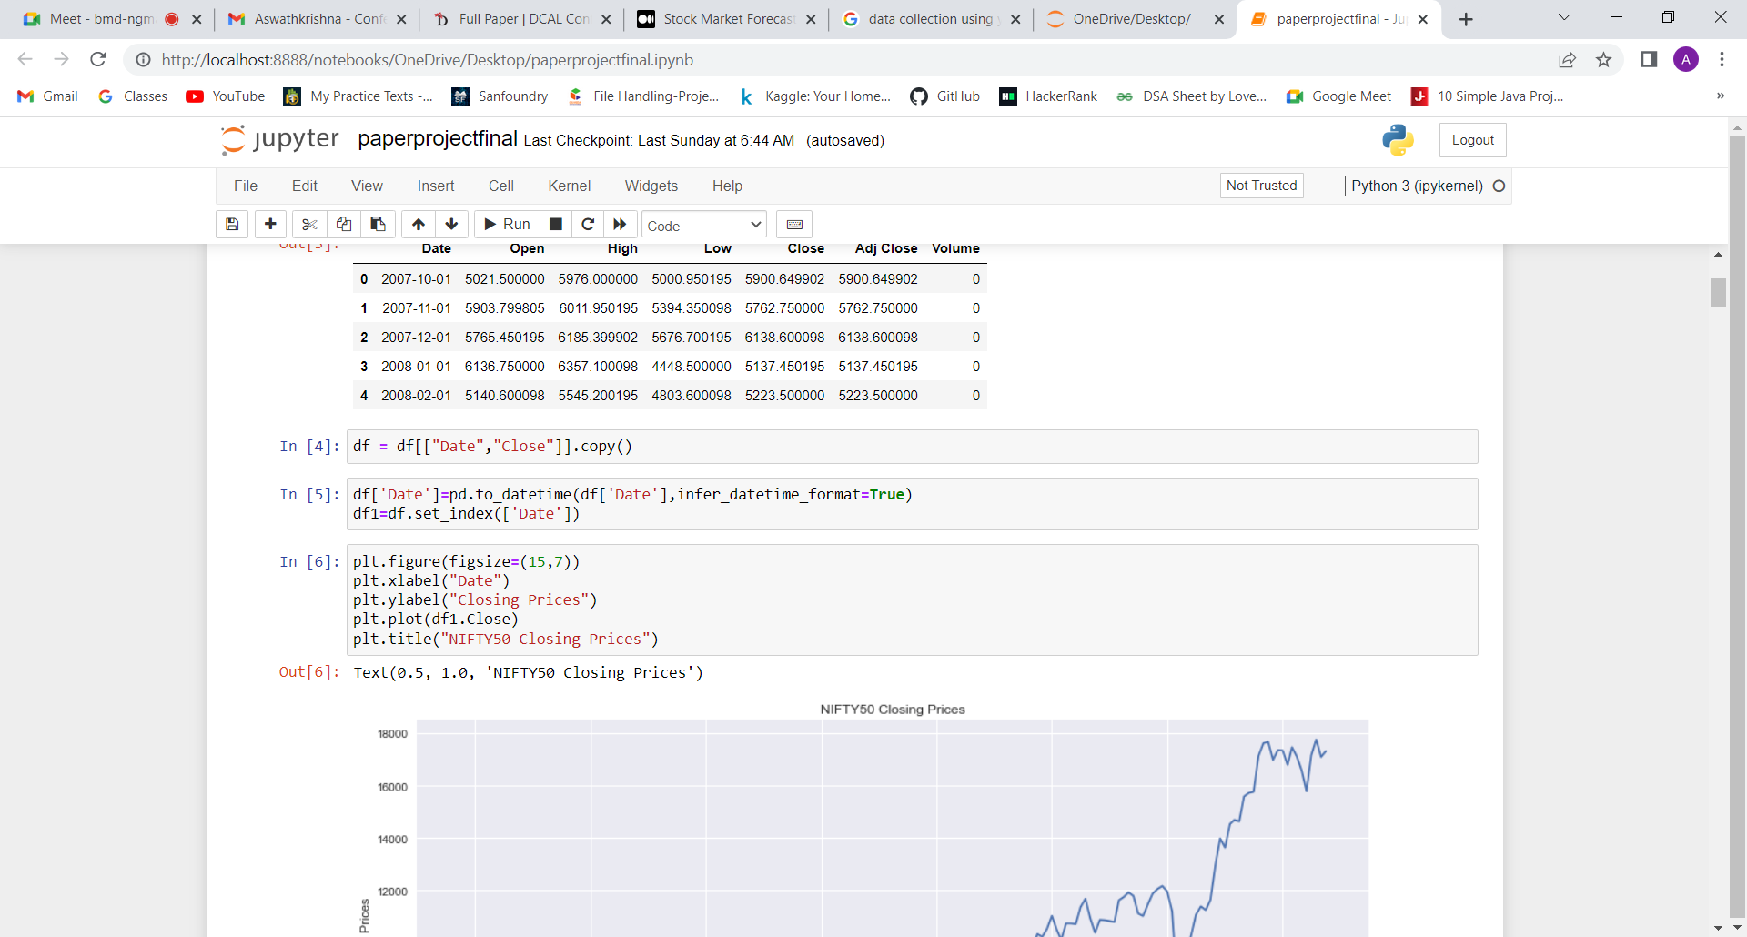
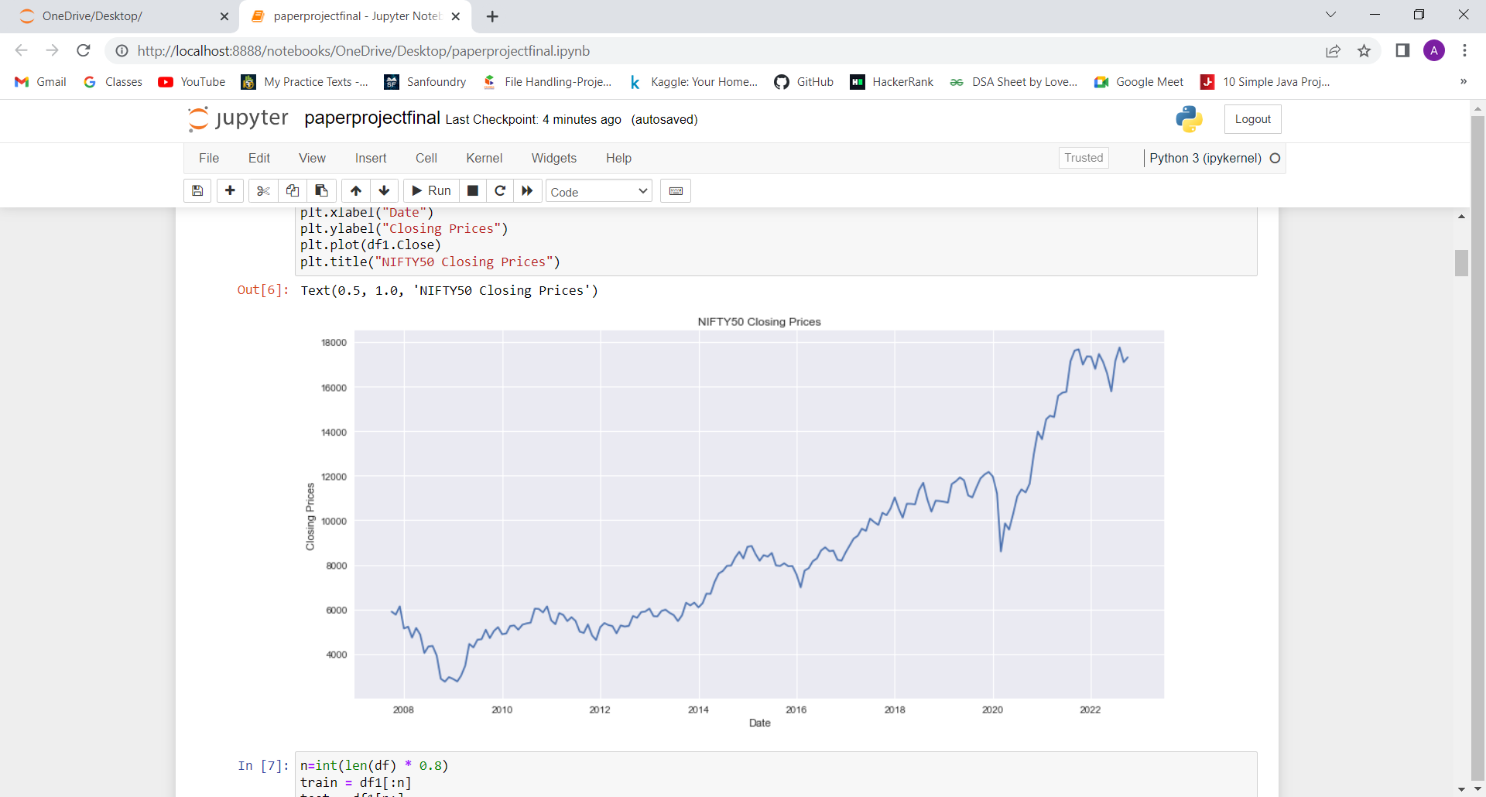
Data Collection
For this research, we have collected data on the monthly closing stock indices of NIFTY50 for fourteen years(2007-2022). The dataset is composed of 7 attributes and 180 records. It consists of historical daily opening and closing stock prices along with a few other additional market parameters. Fig.1 shows the monthly closing price of Nifty50 from October 1, 2007 to October 1, 2022

Slide 4
Why ARIMA and Exponential Smoothing
A popular and widely used statistical method for time series forecasting is the ARIMA model. It is one of the most popular models to predict linear time series data. This model has been used extensively in the field of finance and economics as it is known to be robust, efficient, and has a strong potential for short-term share market prediction. Exponential smoothing and ARIMA models are the two most widely used approaches to time series forecasting and provide complementary approaches to the problem. While exponential smoothing models are based on a description of the trend and seasonality in the data, ARIMA models aim to describe the auto-correlation(Autocorrelation is the degree of similarity between a given time series and lagged version of itself over successive time intervals) in the data.

Slide 5
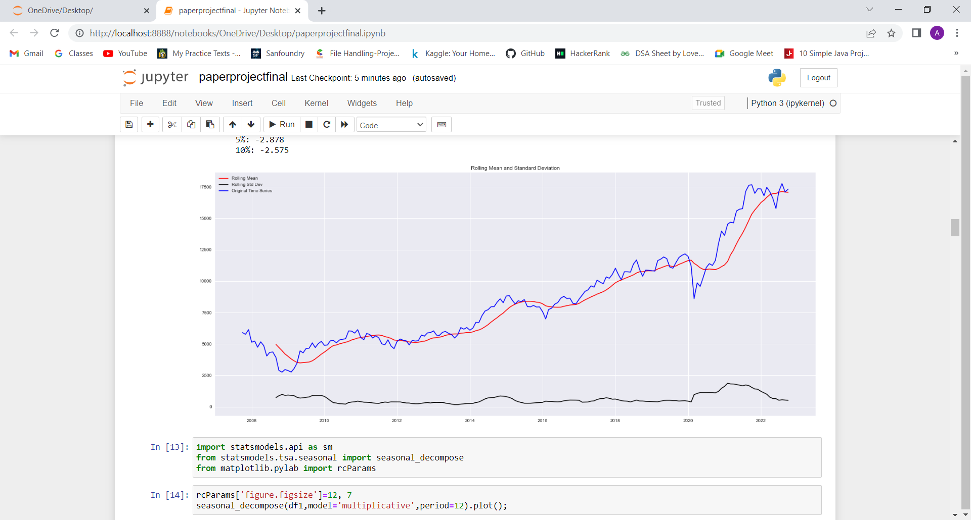
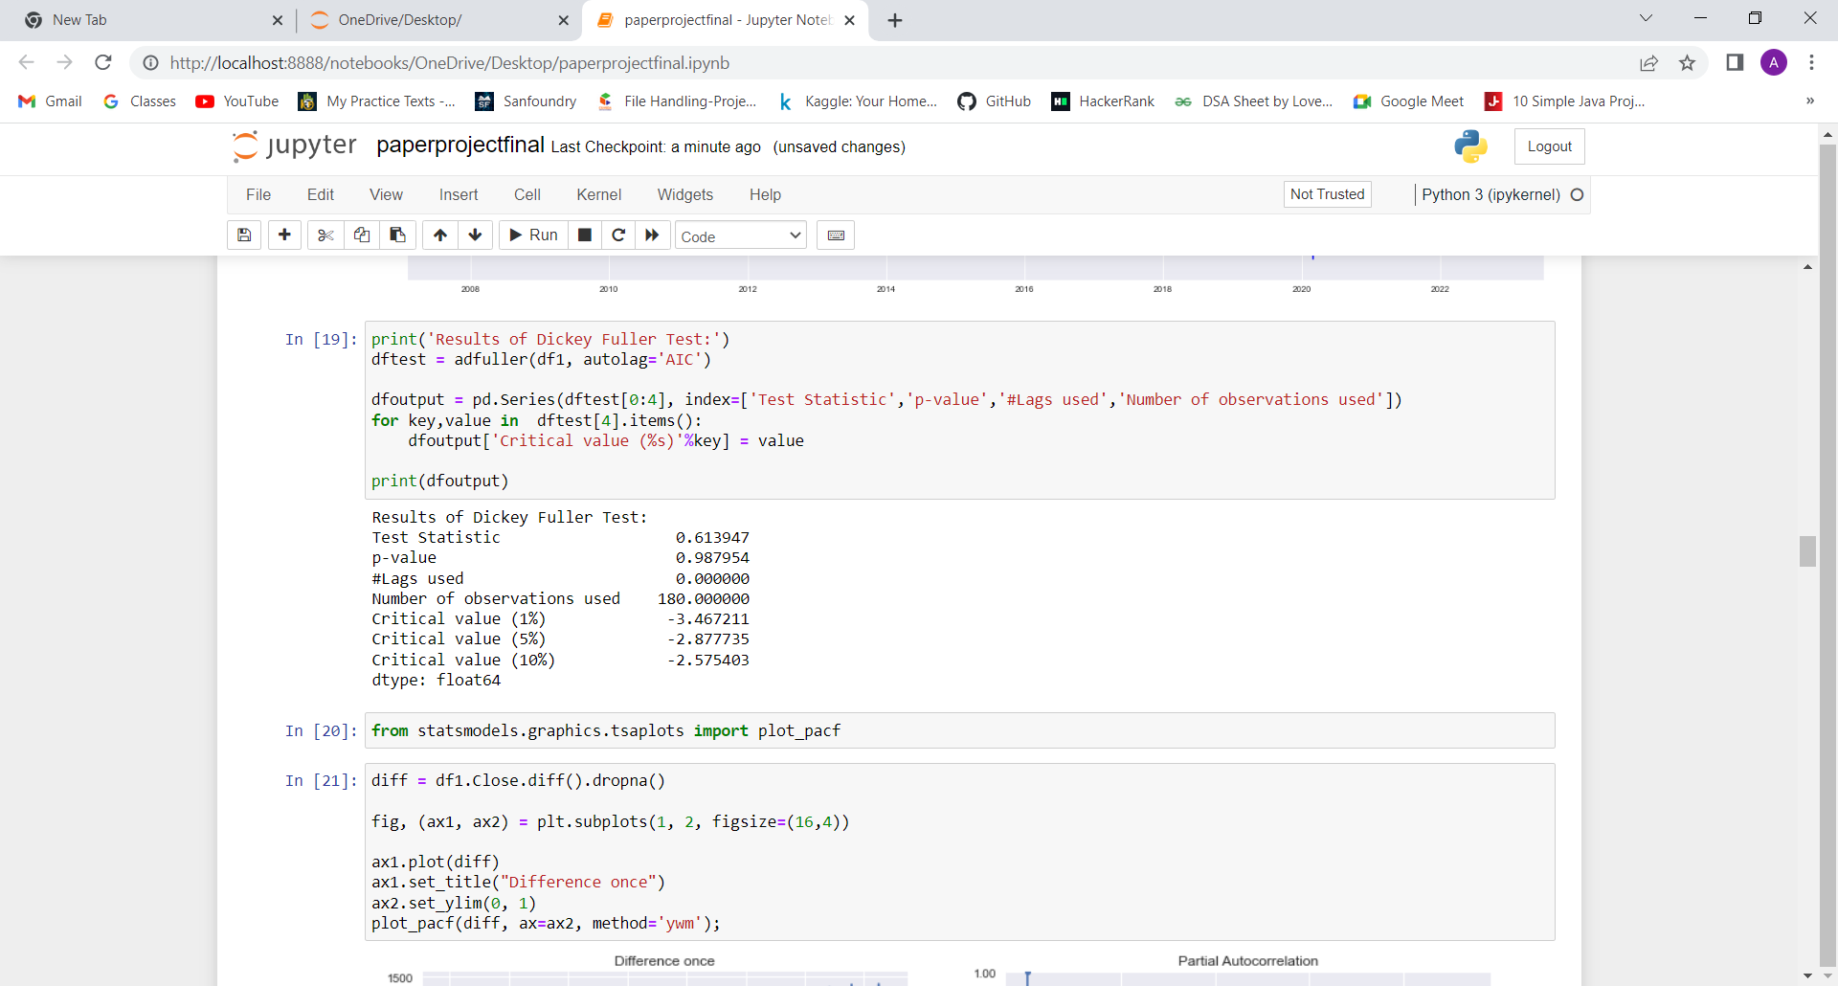
ARIMA
Finding Stationarity
For ARIMA, time series has to be made stationary for further analysis.A time series data is considered to be stationary when the mean and standard deviation remain constant over time. Methods used to check stationarity of a time series data are as follows.
Rolling Statistics
We can plot the rolling mean and standard deviation to check if the statistics show an upward or downward trend. If these statistics vary over time, then the time series is highly likely to be non-stationary.
ADF Test
The null hypothesis of the ADF test is that the time series is not stationary. Null hypothesis of the ADF test is rejected only when the p-value turns to be less than the significance value (0.05).

Slide 6
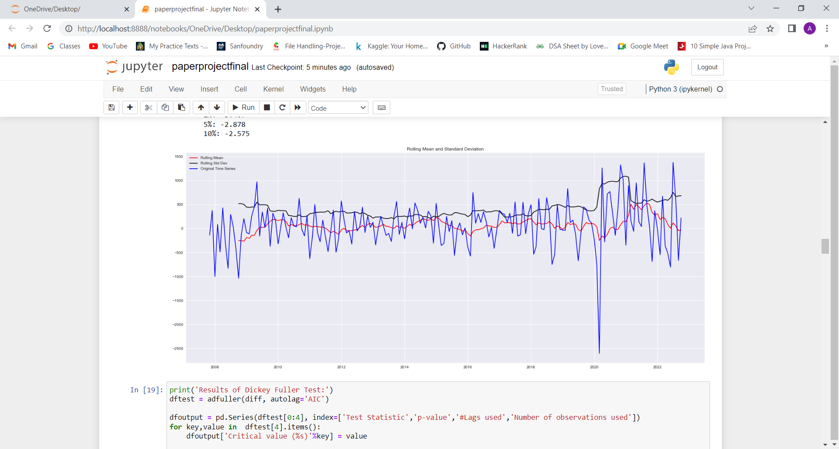
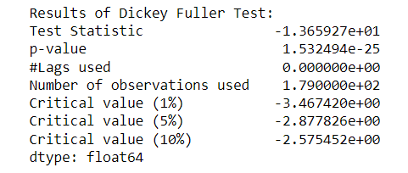
To Make Time Series Stationary
Use NumPy’s square root function to transform the required column
Then shift the transformation by one using the “shift’ function.
Take the difference between both the original transformation and shift.
Steps 2 and 3 can be done by just using the pandas “diff” function.
Code to obtain the above-mentioned steps
diff = df1.Close.diff().dropna()
After Differencing

Slide 7
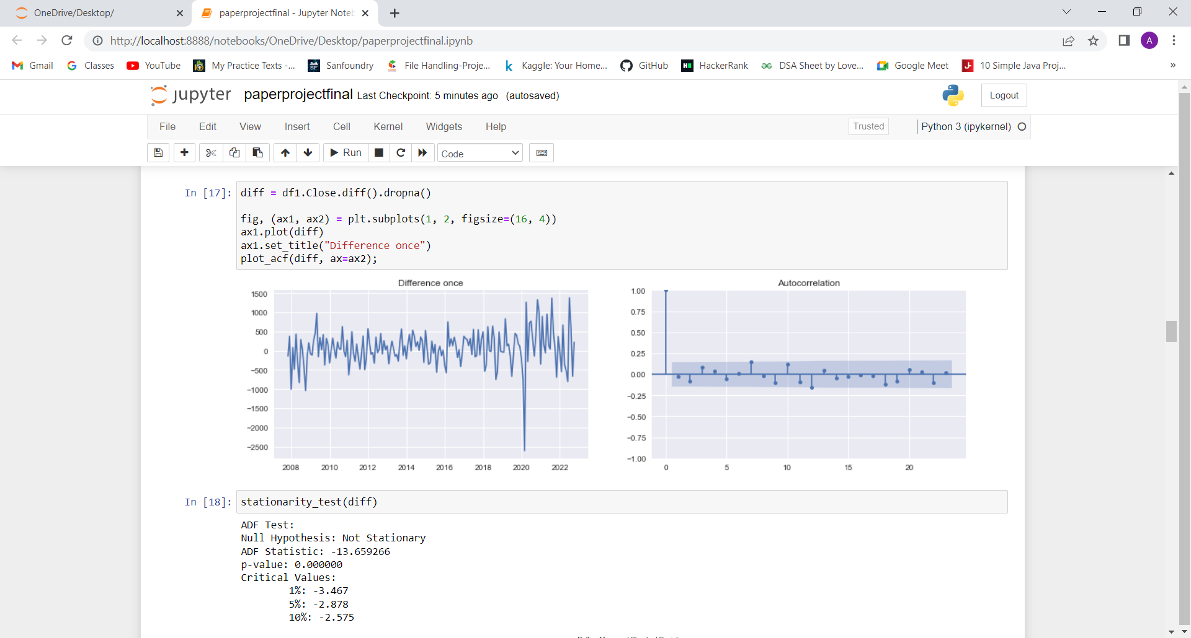
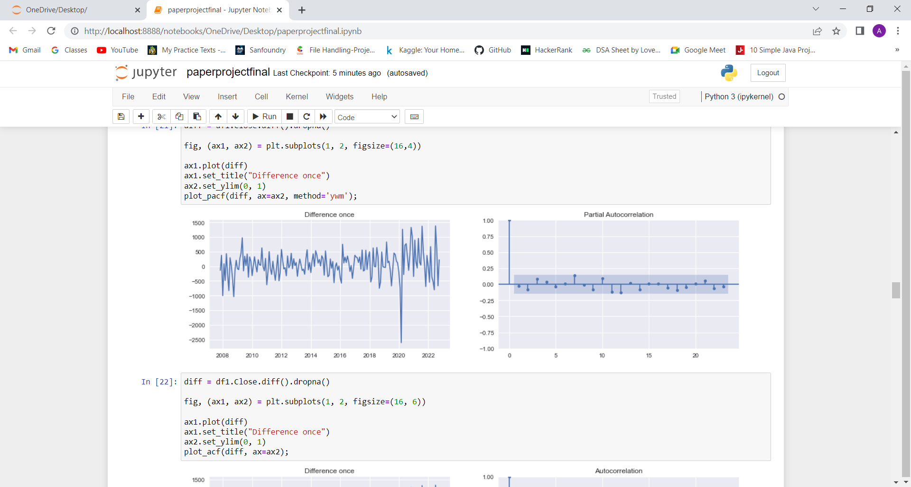
P and Q for ARIMA
Autocorrelation function (ACF) and Partial Autocorrelation Function (PACF, also called Partial ACF) are important functions in analysing a time series. They generally produce plots that are very important in finding the values p and q for Autoregressive (AR) and Moving Average (MA) models.

Slide 8
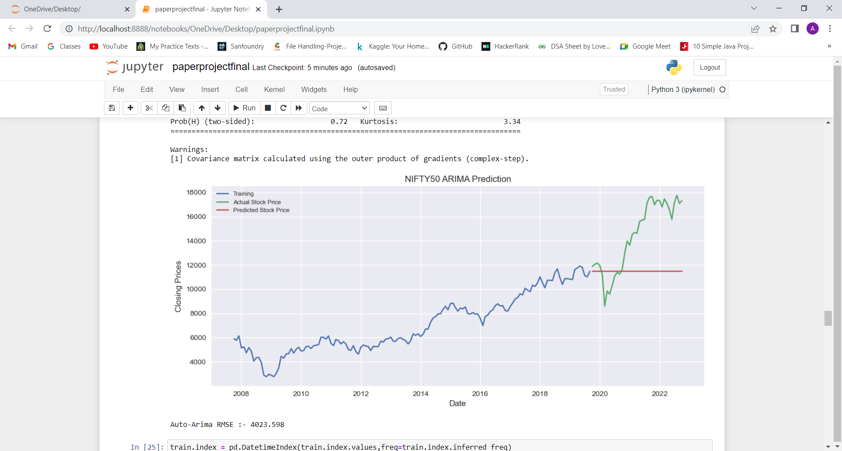
Performance of ARIMA
For ARIMA (p,d,q) model, the values obtained are p = 0, d = 1 and q = 0. So the model is fitted for ARIMA (0,1,0). The ARIMA() function was imported from the arima_model sub-package of statsmodel.tsa package.
Code to implement ARIMA model in python
train.index = pd.DatetimeIndex(train.index.values,freq=train.index.inferred_freq)
model = ARIMA(train, order=(0,1,0))
result = model.fit()

Slide 9
Exponential smoothing Model
Exponential smoothing is a time series forecasting method for univariate data that can be extended to support data with a systematic trend or seasonal component. It is a powerful forecasting method that may be used as an alternative to the popular Box-Jenkins ARIMA family of methods.
Parameters of Exponential Smoothing
Trend
Seasonal
Seasonal period
The seasonal parameter was set as ‘multiplicative’ as seasonality was not constant in the dataset. The seasonal periods were chosen as 12, which means the data will exhibit seasonality after every twelve months.

Slide 10
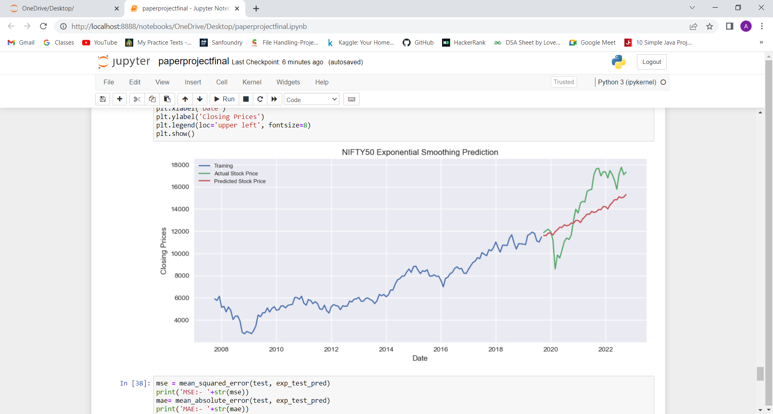
Performance of Exponential Smoothing
The exponential smoothing() function was imported from the holtwinters sub-package of statsmodel.tsa package
Code to implement Exponential Smoothing model in python
from statsmodels.tsa.holtwinters import ExponentialSmoothing
hwmodel=ExponentialSmoothing(train,trend='mul', seasonal='mul', seasonal_periods=12).fit()

Slide 11
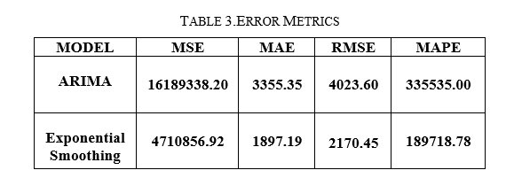
Conclusion
The accuracy of the forecasting models ARIMA and Exponential Smoothing was measured by error metrics such as Mean Absolute Deviation(MAD), Mean Absolute Percentage Error(MAPE), Mean Squared Error(MSE), Root Mean Squared Error(RMSE).The lesser the value of these metrics higher the accuracy of model.

