Slide 1













This certificate is proudly presented to
TEAM
SOLOVISION
For participating in the 7th Annual Charleston Sports
Fest Given this day 13th of June in the year 2020
nnovix
B U I L D I N G A F U T U R E F U E L E D B Y
I N N O V A T I O N
Bridging skills with opportunities
Sujitha Nagasuri
22A95A0512
CSE
INSTITUTION’S INNOVATION COUNCIL
(Ministry of HRD Initiative)
MoE’S INNOVATION CELL
(GOVERNMENT OF INDIA)

Slide 2
nnovix
B U I L D I N G A F U T U R E F U E L E D B Y I N N O V A T I O N
PROBLEM STATEMENT
companies often invest significant time and resources in recruiting top talent exclusively from well known reputed colleges, inadvertently missing out on the potential of talented students from smaller institutions and spending days of time for recruitment. This limits the opportunities available to these students. additionally, colleges with limited resources, struggle to connect their students with job opportunities from leading companies and Small and medium-sized enterprises (SMEs) often struggle to recruit talent from top-tier colleges due to limited resources and lack of access to campus placement opportunities.

Slide 3
nnovix
B U I L D I N G A F U T U R E F U E L E D B Y I N N O V A T I O N
IDEA APPROACH
Vision: Empowering an inclusive future of talent acquisition by bridging companies with bright minds from all colleges through our innovative online platform.
We propose to develop an online web platform that serves as a mediator between companies and colleges, streamlining the recruitment process and bridging the gap between students from various colleges and reputed companies. This platform aims to provide equal opportunities for students from both reputed and smaller colleges, simplify the recruitment process for companies By saving their time , and enhance the overall efficiency campus recruitment.

Slide 4
nnovix
B U I L D I N G A F U T U R E F U E L E D B Y I N N O V A T I O N
OVERVIEW OF SOLUTION OR STATISTICS
The Society for Human Resource Management (SHRM) found that companies spend an average of $4,129 and 42 days to fill a vacant position. This platform will have two types of users: colleges and students.
For Companies:
Companies can register on the platform and post job vacancies, specifying their requirements and desired skill sets. They can browse through the profiles of students from various colleges, view their academic achievements, skills, and portfolios, and directly contact us to recruit students from the colleges listed on our website.
For Colleges:
Colleges can register on the platform and showcase their students' profiles, academic achievements, and skills to companies. They can create a detailed profile for their institution, upload student profiles, and provide information about their courses, faculty. This will enable colleges to promote their students and increase their visibility among potential employers.

Slide 5
nnovix
B U I L D I N G A F U T U R E F U E L E D B Y I N N O V A T I O N
BUDGET ESTIMATION& REVENUE MODEL
Business Model: B2B (Business-to-Business)
Revenue Models:
Subscription Model: Companies and colleges pay a monthly or annual subscription fee to access the platform and its features.
Pay-Per-Recruitment: Companies pay a fee for each successful recruitment made through the platform.
Freemium Model: Basic access to the platform is free for companies and colleges, with the option to upgrade to a premium subscription for access to advanced features and services.
Training and Development Programs: Provide training and development programs, workshops, and courses for students for a fee.
Budget Estimation: To develop a website with the mentioned features it costs between INR 37,000 to INR 2,50,000

Slide 6
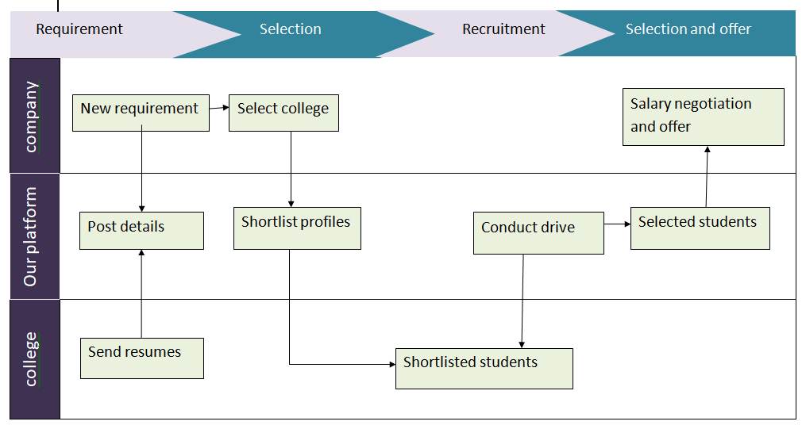
nnovix
B U I L D I N G A F U T U R E F U E L E D B Y I N N O V A T I O N
TECHNOLOGY STACK
FLOW CHART
MERN stack
HTML CSS
Bootstrap
AWS
MS Azure
Mysql

Slide 7
nnovix
B U I L D I N G A F U T U R E F U E L E D B Y I N N O V A T I O N
THANK YOU

