Slide 1
STUDENT NAME:U.SUJITHA REGISTER NO AND NMID:24131241802522032 & 79D3980786871448BE442752058E42FD DEPARTMENT:B.SC COMPUTER SCIENCE COLLEGE:GOVERNMENT ARTS AND SCIENCE COLLEGE VADALUR \ ANNAMALAI UNIVERSITY
Digital portfolio

Slide 2
PROJECT TITLE
INTERACTIVE DIGITAL PORTFOLIO OF STUDENT PROFILE USING FRONT END WEB DEVELOPMENT FOR COLORING AND BOX METHOD OF CSS

Slide 3
AGENDA
1.Problem statement
2.Project overview
3.End users
4.Tools and technologies
5.Portfolio design and layout
6.Features and functionality
7.Results and screenshots
8.Conclusions
9.Github link

Slide 4
PROBLEM STATEMENT
“Create a digital portfolio that effectively showcase an individuals skill experience, and Projects to potential employers, clients, or collaborators, while overcoming the challenges of designing and developing a visually appealing and user-friendly website using HTML and CSS.”
Key problems:
1.Maintaining consistency
2.Optimizing for search engines
3.Balancing content and design

Slide 5
PROJECT OVERVIEW
Project type : Student digital portfolio
Owner : Sujitha uthandi
Purpose : showcase skills, education, and achievements to potential employers, clients, or collaborators
Target Audience : potential employers, clients, collaborators, industry peers.
PORTFOLIO CONTENT:
1.Introduction : My introduction
2. Call-to-Action : To view my work
3.About Me Section : My information of my skills and qualities
PROJECT GOALS:
1.Effectively communicate
Sujitha Uthandi’s skills and experience to potential employers, clients, or collaborators
2.Showcase projects and achievements in a clear and concise manner(though”view My Work” section details are not visible in the image)

Slide 6
WHO ARE THE END USERS
To Potential employers : looking to assses Sujitha Uthandi’s skills and experience for potential job opportunities
Clients : interested in collaborating or hiring Sujitha Uthandi for projects or services
Collaborators : Looking to work with Sujitha Uthandi on projects or initiatives
Industry peers : Interested in Sujitha Uthandi’s work,skills,and achievements in the field of software development

Slide 7
NEXT PROFESSIONALS
ARE SEEING PROFILE AND RESULT

Slide 8
TOOLS AND TECHIQUES
HTML→structure(pages,sections)
CSS→styling (colors, layouts, responsiveness)
Java script→Interactivity(navigation menu,animations,form,validation)
Code Editor→visual studio code and hosting platforms Github pages

Slide 9
PORTFOLIO DESIGN AND LAYOUT
Sections Included :
1.Home/About Me
2.Projects
3.Skills
4.Contact
5.Responsive layout (mobile + desktop view)

Slide 10
FEATURES & FUNCTIONALITY
FEATURES:
1.Introduction Section-A brief introduction of me being a student and to become a software developer
2.About Me Section:A section showcasing my educational qualification, age, college,achievements completed courses, and certificates.
3.call-to-Action(CTA)Button:A”View My Work”button that encourages visitors to explore my projects and achievements.
4.Project Showcase:A section(potentially in the “View My Work”section)that showcases my projects,including descriptions,images,and links to live demos or GitHub repositories.
Functionality:
1.Responsive Design:The portfolio is designed to be responsive, ensuring that it looks great and functions well on different devices and screen sizes.
2.Easy Navigation:The portfolio has a clear and concise navigation menu that allows visitors to easily find and acces different sections.
3.User Engagement:The portfolio is designed to engage visitors, with features such as the CTA button and project showcase.
4.Future Development:The portfolio is designed to be easily updated and expanded,allowing my to add more projects and details in the future.

Slide 11
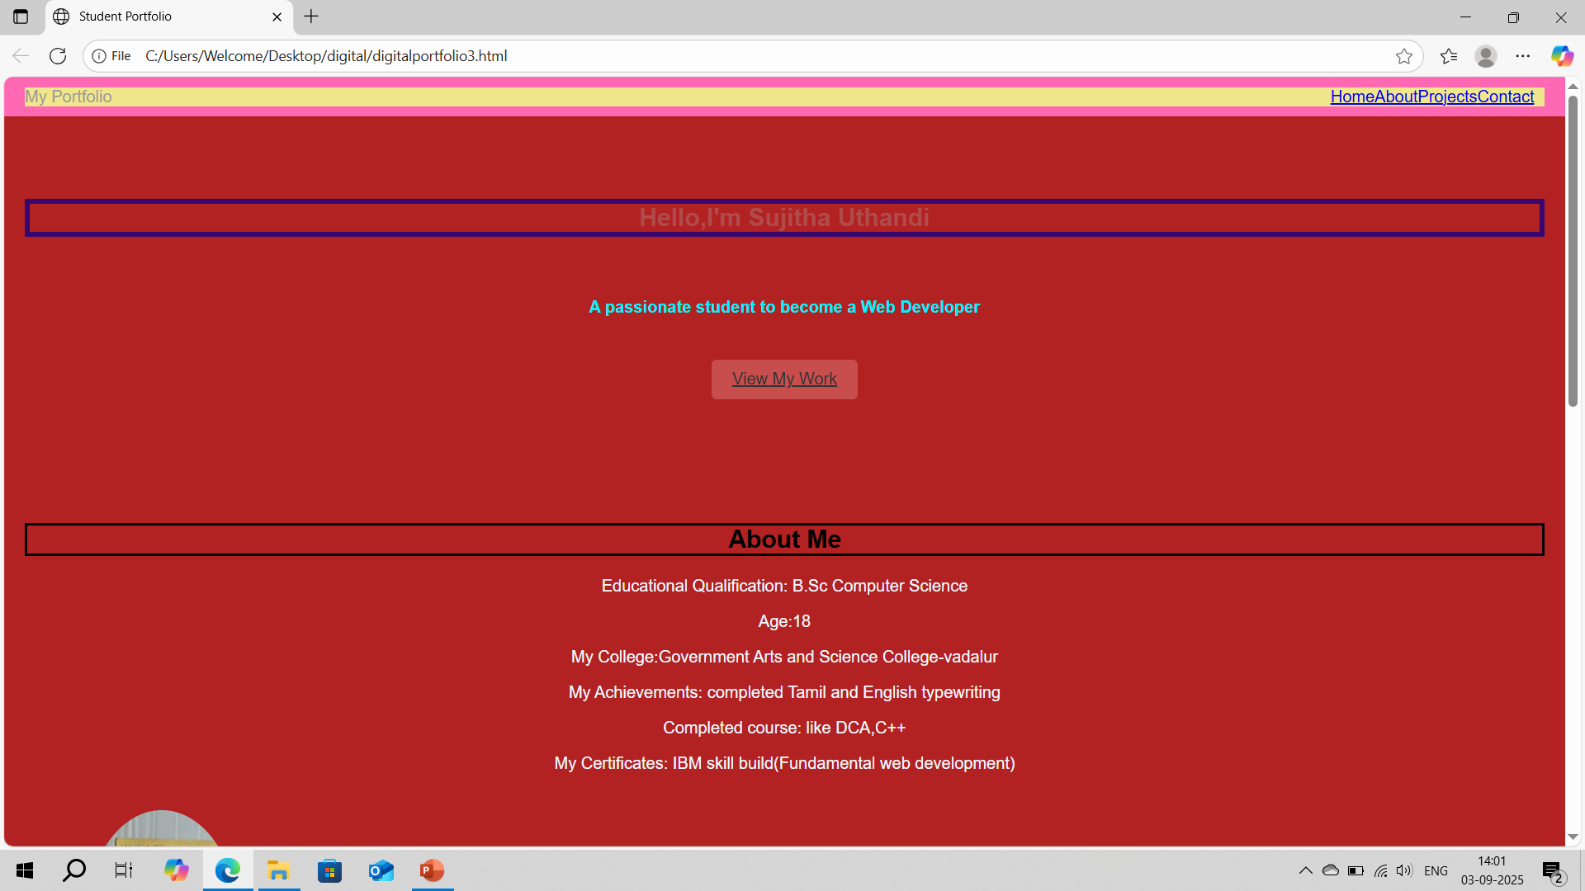
Screenshot-1

Slide 12
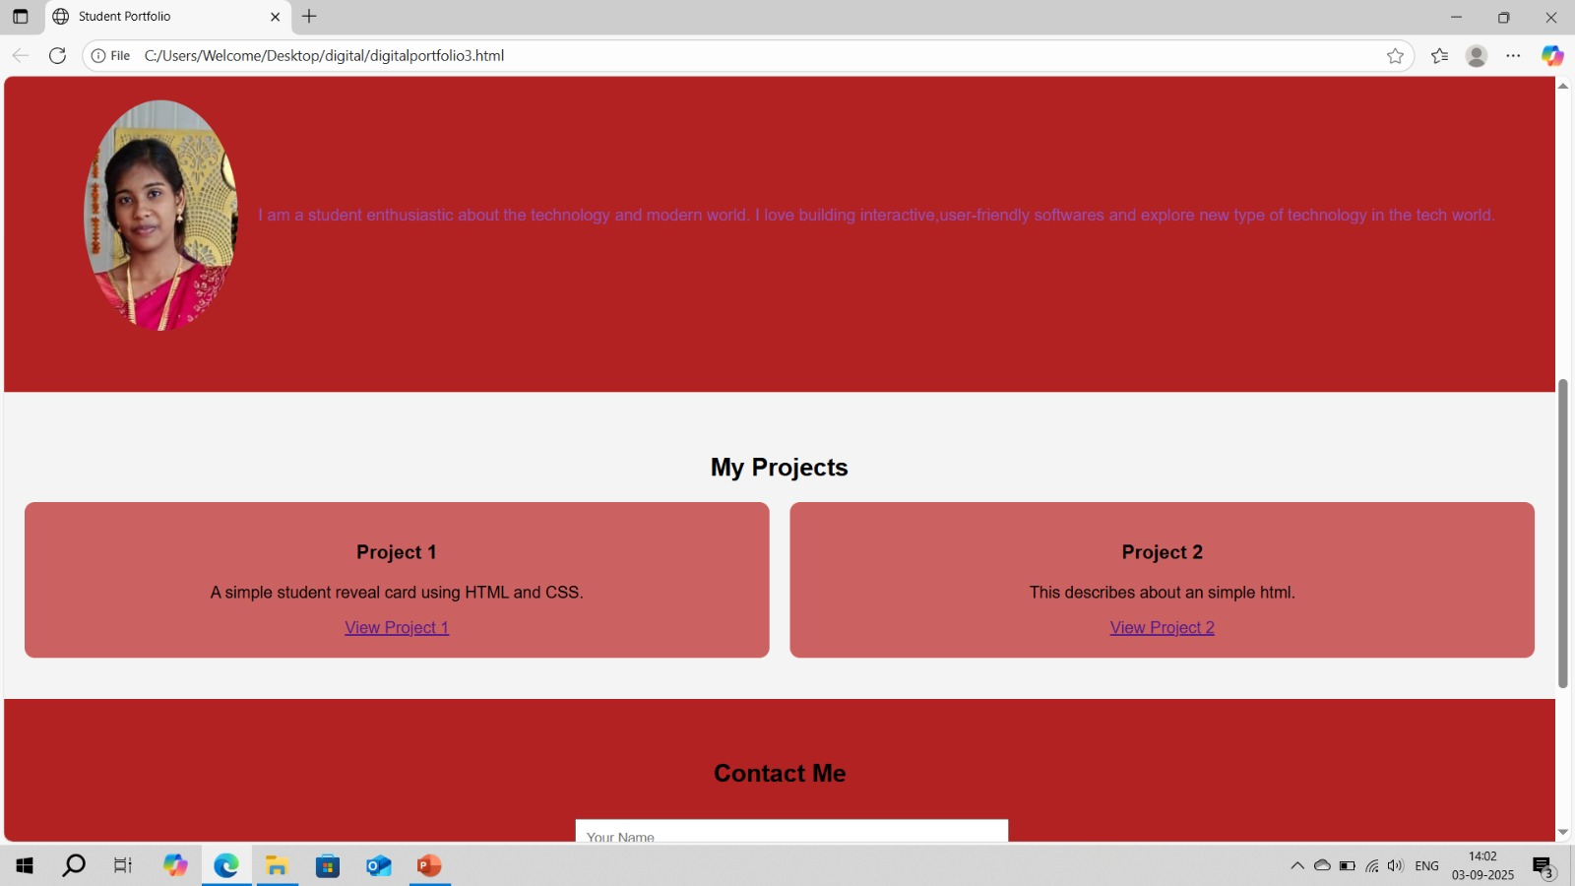
Screenshot-2

Slide 13
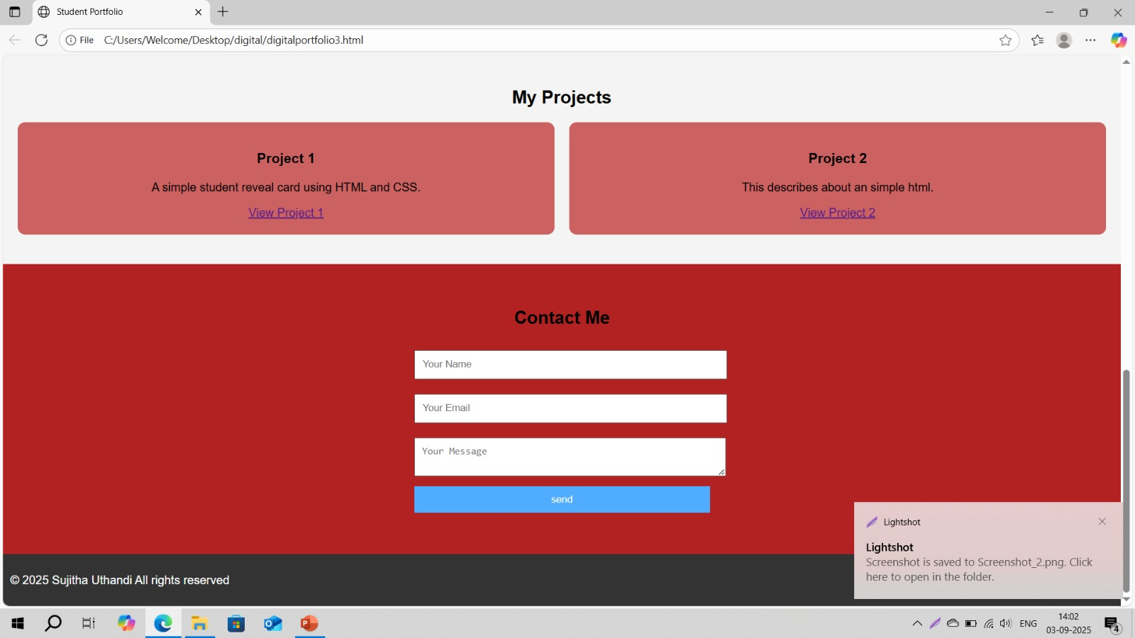
Screenshot-3

Slide 14
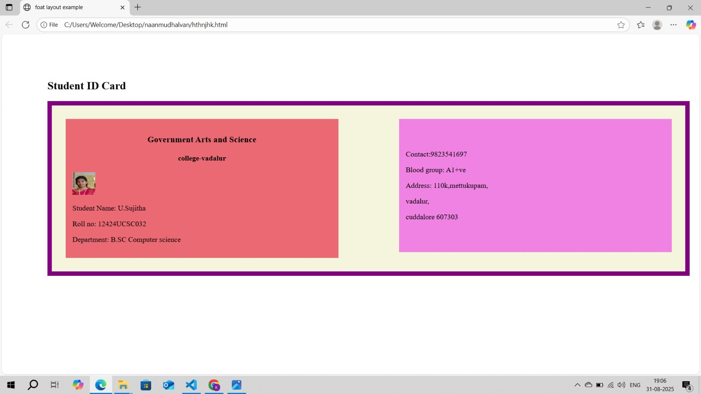
Screenshot-4

Slide 15
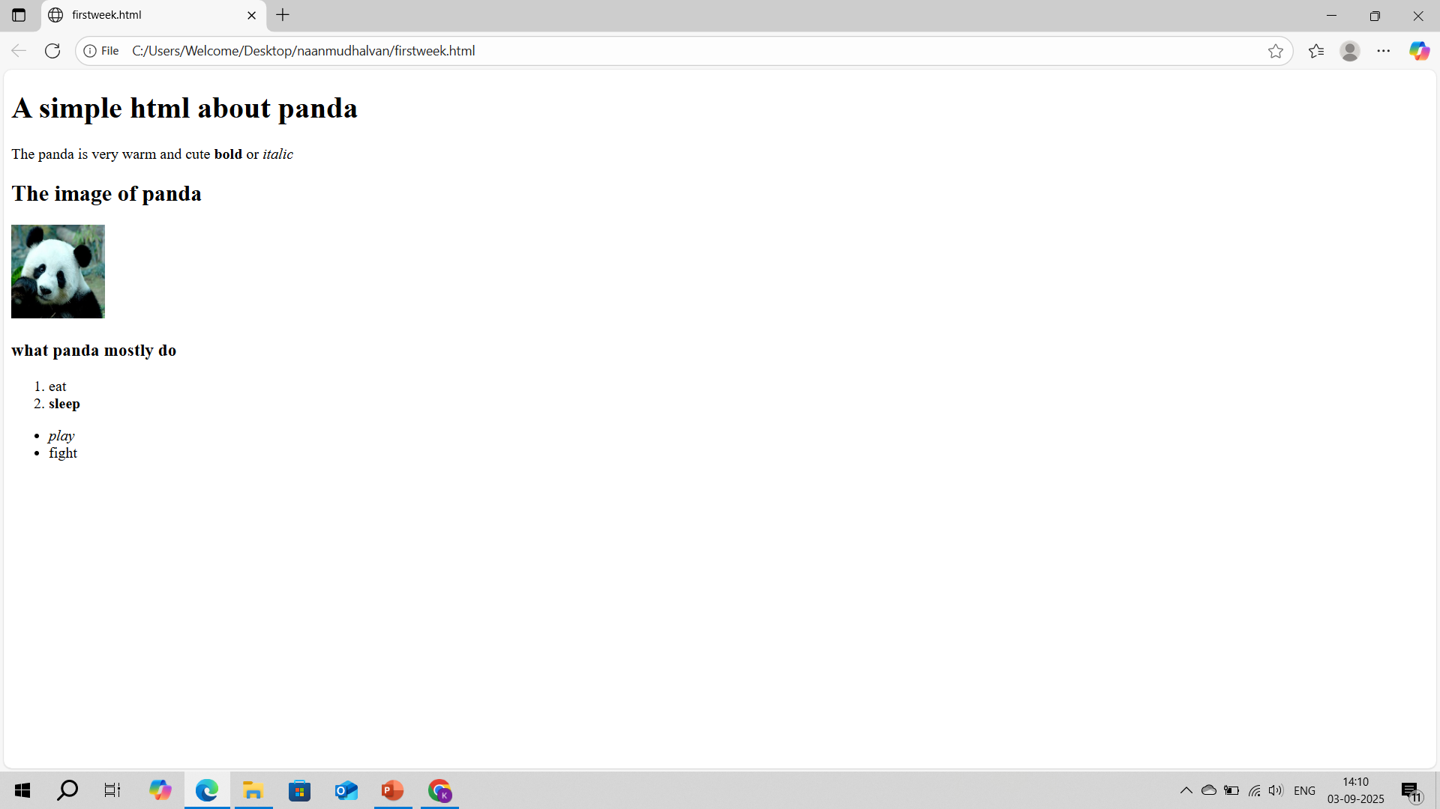
Screenshot-5

Slide 16
CONCLUSION
Highlight of this Project:
Showcasing skills and experience
Clear and concise presentation
User-friendly design
Final Summary
Sujitha Uthandi student digital portfolio is a valuable tool for anyone looking to showcase their skills and experience in software development.The portfolio is well-designed,easy to navigate, and effectively communicates sujitha uthandi passion for software development.
Benefits of Society
Promoting digital literacy
Encouraging innovation
Enhancing employability

Slide 17
THANK YOU
SUBMITTED BY:
Sujitha Uthandi
sujitha352007@gmail.com

