Slide 1

TypeScript
By: Sujith .K
(GIT-APGK)

Slide 2
What is TypeScript?
The word TypeScript means, Specifying and providing more focus on types.
TypeScript lets you write JavaScript the way you really want to.
TypeScript is a typed superset of JavaScript that compiles to plain JavaScript.
Any browser. Any host. Any OS. Open Source.

Slide 3
Why use TypeScript?
TypeScript provides more flexibility and helps to write more error free code.
The main reason is the difference between JavaScript and TypeScript, that is JavaScript is Function oriented programming language where, TypeScript is more like Object Oriented Programming language which supports classes, interfaces, generics, annotations, public/private/protected access and more.
This help to make the code modular and reduces the code repetition.

Slide 4
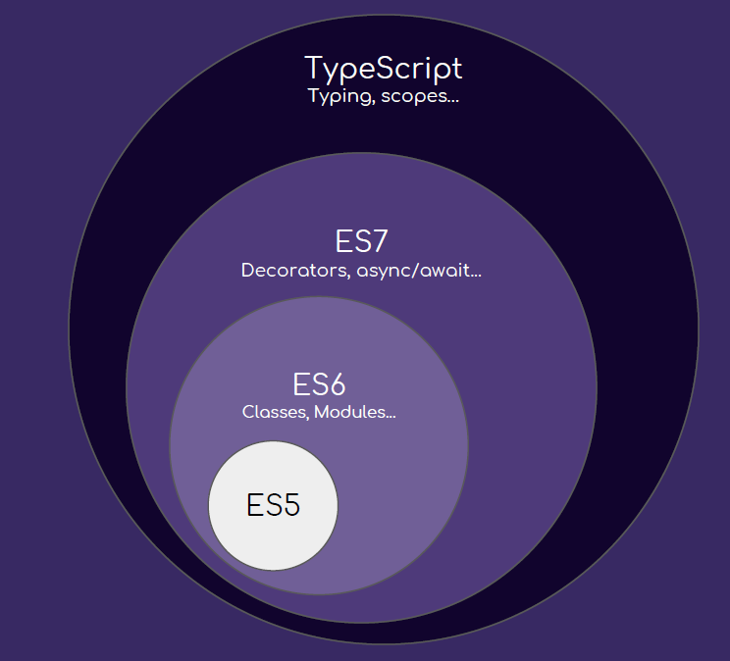
How TypeScript work?
Hello.ts
Compiled
Hello.js
Executed
Executed in browser.

Slide 5
How to install TypeScript ?
Download and install NodeJS: https://nodejs.org/en/download/
Open terminal and type the command has follows:
>> node --version
>> tsc --version
>> npm install typescript -g

Slide 6
Setup environment for TypeScript?
Open VS Code editor → Go to Extensions → Search for “JavaScript and TypeScript Nightly”
→ install that package in the Editor.
Now to Compile and Run your file:
To reduce the compilation for each change we can type:
>> tsc [filename].ts
>> node [filename].js
>> tsc --init
>> tsc --watch
>> node [filename].js

Slide 7
Data Types
Any
Primitive:
Number
Boolean
String
Void
Null
Undefined - Same as JS
Array
Enum

Slide 8
Hello Word Program
Hello.ts
Hello.js
var message:string = "Hello World"
console.log(message)
//Generated by typescript 1.8.10
var message = "Hello World";
console.log(message);

Slide 9
Declaring variables in TypeScript.
var name:string = "John";
var score1:number;
score1 = 50;
var score2 = 42.50;
var sum;
sum = score1 + score2;
console.log("name"+name);
console.log("first score: "+score1);
console.log("second score: "+score2);
console.log("sum of the scores: "+sum);
var name = "John";
var score1;
score1 = 50;
var score2 = 42.50;
var sum;
sum = score1 + score2;
console.log("name" + name);
console.log("first score: " + score1);
console.log("second score: " + score2);
console.log("sum of the scores: " + sum);

Slide 10
What is Interface?
Interfaces define properties, methods, and events, which are the members of the interface.
Interfaces contain only the declaration of the members.
It is the responsibility of the deriving class to define the members.
Syntax:
interface interface_name { }

Slide 11
Example:
interface IPerson {
firstName:string,
lastName:string,
sayHi: ()=>string
}
var customer:IPerson = {
firstName:"Tom",
lastName:"Hanks",
sayHi: ():string =>{return "Hi there"}
}
console.log("Customer Object ")
console.log(customer.firstName)
console.log(customer.lastName)
console.log(customer.sayHi())
var employee:IPerson = {
firstName:"Jim",
lastName:"Blakes",
sayHi: ():string =>{return "Hello!!!"}
}
console.log("Employee Object ")
console.log(employee.firstName);
console.log(employee.lastName);
OUTPUT:
Customer object
Tom
Hanks
Hi there
Employee object
Jim
Blakes
Hello!!!

Slide 12
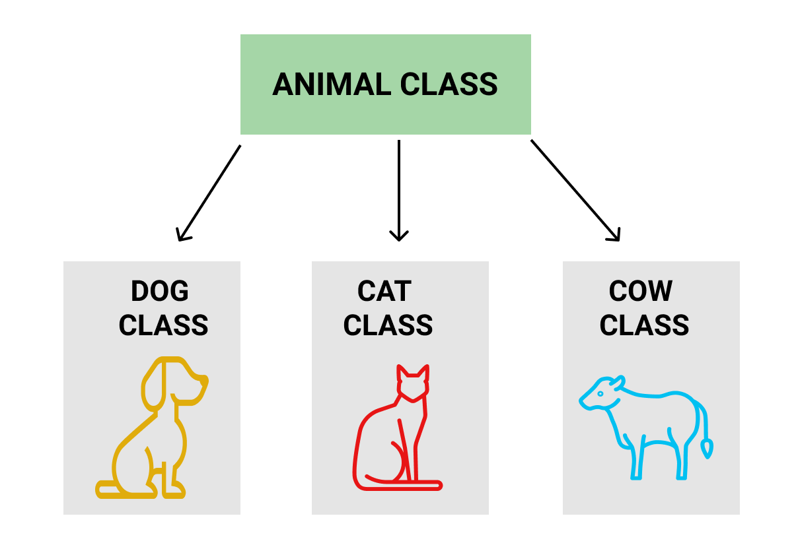
What is Class?
A class in terms of OOP is a blueprint for creating objects.
A class encapsulates data for the object.
Typescript gives built in support for this concept called class.
JavaScript ES5 or earlier didn’t support classes.
Typescript gets this feature from ES6.

Slide 13
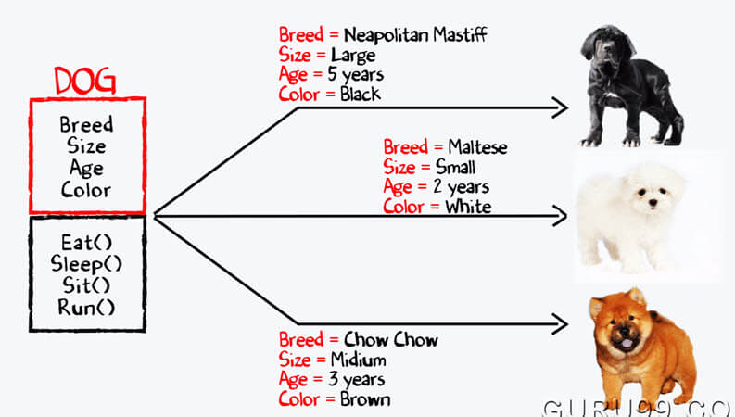
What is Object?
An object is an instance which contains set of key value pairs.
The values can be scalar values or functions

Slide 14
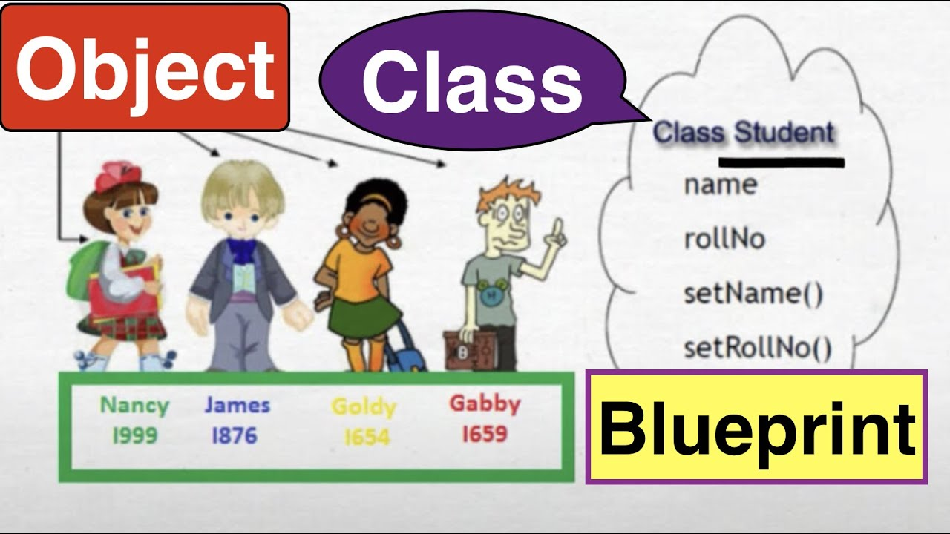
Example:

Slide 15
Checking the code……
class Car {
//field
Name:string;
Engine:string;
Color:string;
Seats:number;
//constructor
constructor(Name:string, Engine:string, Seats?:number, Color:string = "White",) {
this.Name = Name;
this.Engine = Engine ;
this.Color = Color;
this.Seats = Seats;
}
//function
disp():void {
console.log("Function displays Name is : "+this.Name)
console.log("Function displays Engine is : "+this.Engine)
console.log("Function displays Color is : "+this.Color)
}
}
//Create an object
let Car1 = new Car("BMW","XX213", 4, "Blue");
let Car2 = new Car("Ferrari","RX2Z7",2);
//Access the field
console.log("Reading attribute value Engine as : "+Car1.Engine)
//Access the function
Car1.disp();
// Car2.disp();
console.log("Ferrari Color : "+Car2.Color);

Slide 16
OUTPUT:
Reading attribute value Engine as : XX213
Function displays Name is : BMW
Function displays Engine is : XX213
Function displays Color is : Blue
Ferrari Color : White

Slide 17
Class with Interface…………..

Slide 18
What is inheritance?
When a class derives from another class.
The child class will inherit all the public and protected properties and methods from the parent class.
In addition, it can have its own properties and methods.
An inherited class is defined by using the extends keyword.

Slide 19

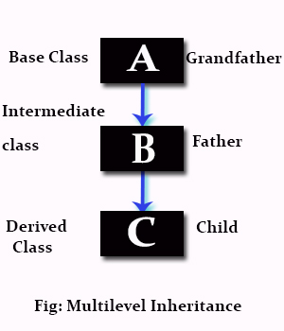

Slide 20
Let’s see a demo for this >>>>>>>

Slide 21
Exporting and Importing a Class.
To make the code for readable format we should always create different modules of the project.
To do so, we have to remember the keyword like: import, from, export.
For example:
Import {class_name} from ‘[relative_path]’;
Example: import {Shape} from './Shape';
export class {class_name}{//the code};
Example: export class Shape {}

Slide 22
Let’s see a demo for this >>>>>>>

Slide 23
What are access specifiers?
Class can control the visibility of its data members. This is done using access modifiers.
There are three types of access modifiers in TypeScript: public, private and protected.
Public
By default, all members of a class in TypeScript are public. All the public members can be accessed anywhere without any restrictions.
Private
The private access modifier ensures that class members are visible only to that class and are not accessible outside the containing class.
Protected
The protected access modifier is similar to the private access modifier, except that protected members can be accessed using their deriving classes.

Slide 24
Let’s see a demo for this >>>>>>>

Slide 25
How to work with packages?
To install Node packages we have Node Package Manager (NPM) which gets pre-installed with NodeJS.
To install the dependencies we can use the command:
This will create a “package.json” file which we can modify.
npm install [package name] –save
Example: npm install lite-server --save

Slide 26
Thank you
Source code: https://github.com/Sujithk007/TypeScript-Workshop

