Slide 1
Walmart Sales & Profit Dashboard
Internship Task 4 — Dashboard Design
Interactive business dashboard developed using Microsoft Power BI.
Tool: Microsoft Power BI
Data Analyst Internship • Task 4: Dashboard Design 1

Slide 2
Task Objective
Task 4: Dashboard Design
Design an interactive dashboard for business stakeholders.
Choose appropriate KPIs such as Sales, Profit and Growth.
Use slicers/filters to make the dashboard interactive.
Include time-series analysis to understand trends over time.
Use cards for totals and summary information.
Apply a consistent visual theme and add navigation if possible.
Data Analyst Internship • Task 4: Dashboard Design 2

Slide 3
Dataset & Tool
Implementation used for the internship task
Dataset: Sales/Financial data used for Walmart sales and profit analysis.
Visualization tool: Microsoft Power BI.
The dashboard was designed for business stakeholders to monitor performance.
Interactive filters allow users to explore the dashboard by Year, Geography and Category.
The design combines KPI cards, trend charts and category comparisons.
Data Analyst Internship • Task 4: Dashboard Design 3

Slide 4
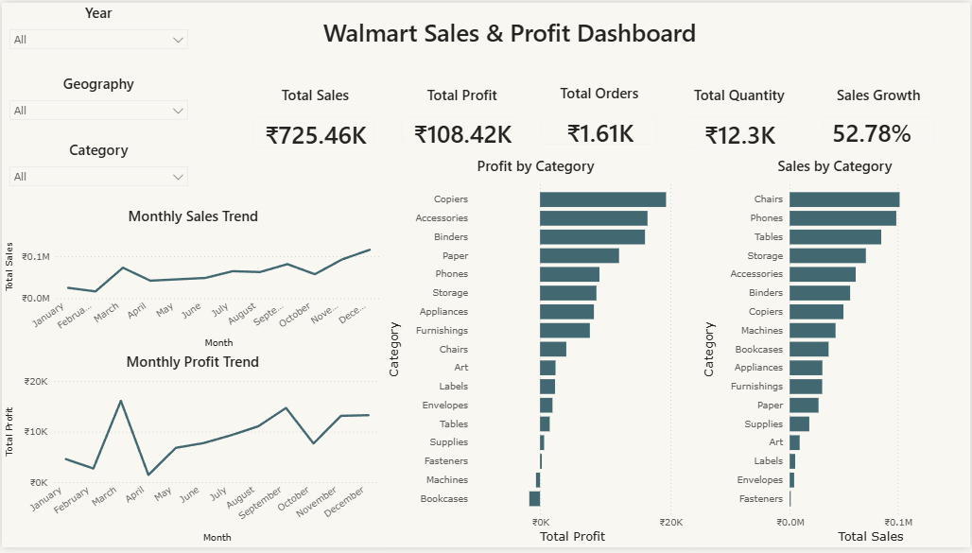
Interactive Dashboard
Walmart Sales & Profit Dashboard created in Power BI
Data Analyst Internship • Task 4: Dashboard Design 4

Slide 5
Key Performance Indicators
Summary cards used to communicate business performance
Total Sales
₹725.46K
Total Profit
₹108.42K
Total Orders
₹1.61K
Total Quantity
₹12.3K
Sales Growth
52.78%
KPI cards provide a quick summary for stakeholders.
Sales, Profit and Growth directly address the task's suggested KPIs.
Orders and Quantity provide additional operational context.
Data Analyst Internship • Task 4: Dashboard Design 5

Slide 6
Dashboard Interactivity
Filters/slicers implemented in the Power BI dashboard
Year filter — allows users to focus on a selected year.
Geography filter — supports analysis across geographic selections.
Category filter — allows users to investigate individual product categories.
Interactive filtering helps stakeholders move from an overall view to a focused analysis.
These filters satisfy the task requirement to use slicers/filters for interactivity.
Data Analyst Internship • Task 4: Dashboard Design 6

Slide 7
Time-Series & Category Analysis
Monthly Sales Trend — visualizes sales movement across the months.
Monthly Profit Trend — shows changes in monthly profitability.
Profit by Category — compares category-level contribution to profit.
Sales by Category — ranks categories according to sales performance.
The combination supports both trend analysis and category comparison.
Data Analyst Internship • Task 4: Dashboard Design 7

Slide 8
Key Business Insights
Based on the values and visual patterns shown in the dashboard
Total Sales: approximately ₹725.46K.
Total Profit: approximately ₹108.42K.
Sales Growth: 52.78% in the displayed dashboard view.
Copiers are the highest-profit category in the displayed analysis.
Chairs and Phones are among the leading categories by sales.
Monthly sales and profit fluctuate, making trend monitoring useful for business decisions.
Data Analyst Internship • Task 4: Dashboard Design 8

Slide 9
Business Value & Conclusion
The dashboard converts sales data into a clear business performance view.
Stakeholders can quickly monitor sales, profit, orders, quantity and growth.
Filters make it possible to explore performance from different perspectives.
Trend charts help identify changes over time, while category charts support comparison.
The dashboard meets the core Task 4 objective of creating an interactive stakeholder dashboard.
Data Analyst Internship • Task 4: Dashboard Design 9

Slide 10
Task 4 Interview Questions — Quick Answers
Key elements of a dashboard → KPIs, filters/slicers, charts, summaries and a clear layout.
KPI → A measurable value used to track business performance.
Slicer in Power BI → An interactive visual filter used to filter dashboard data.
Power BI vs Tableau → Both are business-intelligence and visualization tools; this task was completed using Power BI.
How to make a dashboard interactive → Use slicers/filters and interactive visuals.
Large datasets → Optimize the data model, reduce unnecessary data/columns and use efficient calculations.
Trend analysis charts → Line charts are suitable for showing changes over time.
Data Analyst Internship • Task 4: Dashboard Design 10

