Slide 1
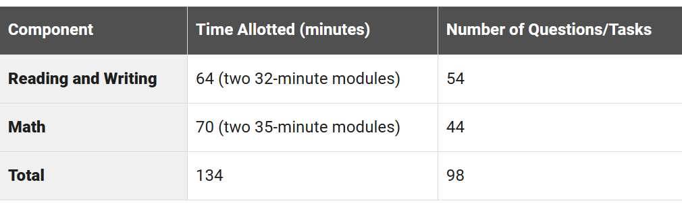
STRUCTURE - SAT

Slide 2
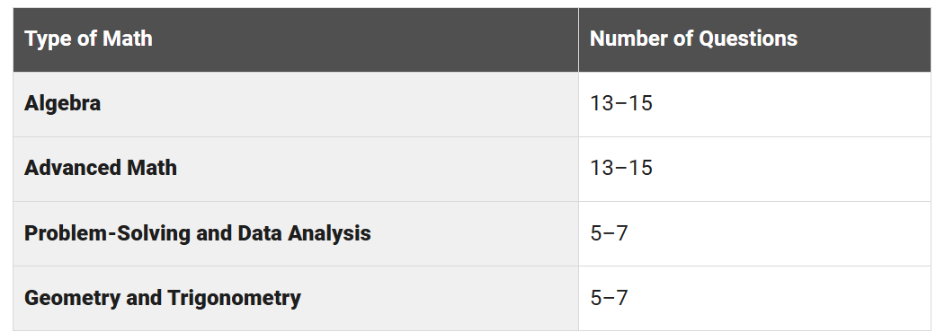
MATHS STRUCTURE -SAT

Slide 3
SAT STRUCTURE (MATHS)
Domain | Description | Specific Skills Tested
Algebra | Measures the ability to analyze, fluently solve, and create linear equations and inequalities as well as analyze and fluently solve equations and systems of equations using multiple techniques. | Linear equations in one variable Linear functions Linear equations in two variables Systems of two linear equations in two variables Linear inequalities in one or two variables
Advanced Math | Measures skills and knowledge central for progression to more advanced math courses, including demonstrating an understanding of absolute value, quadratic, exponential, polynomial, rational, radical, and other nonlinear equations. | Nonlinear functions Nonlinear equations in one variable Systems of equations in two variables Equivalent expressions
Problem-Solving and Data Analysis | Measures the ability to apply quantitative reasoning about ratios, rates, and proportional relationships; understand and apply unit rate; and analyze and interpret one- and two-variable data. | Ratios, rates, proportional relationships, and units Percentages One-variable data: Distributions and measures of center and spread Two-variable data: Models and scatterplots Probability and conditional probability Inference from sample statistics and margin of error Evaluating statistical claims: Observational studies and experiments
Geometry and Trigonometry | Measures the ability to solve problems that focus on area and volume formulas; lines, angles, and triangles; right triangles and trigonometry; and circles. | Area and volume Lines, angles, and triangles Right triangles and trigonometry Circles

Slide 4
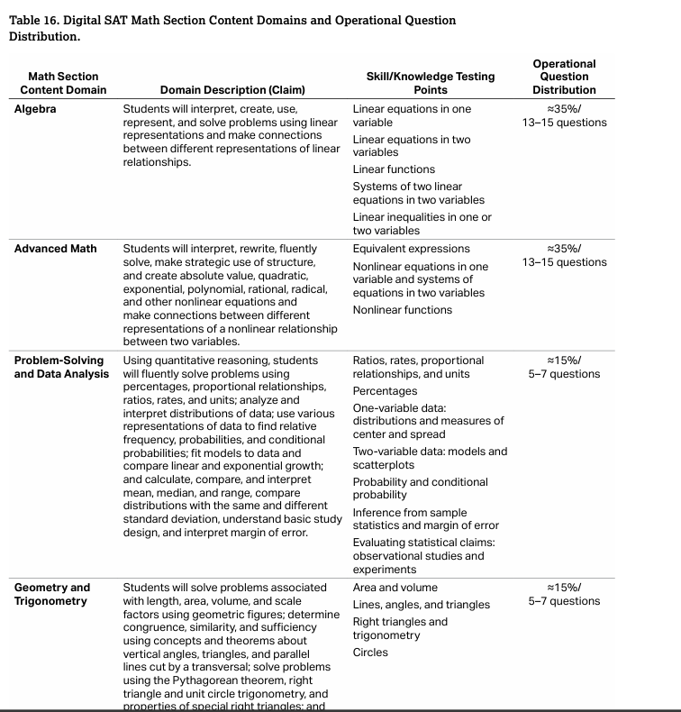

Slide 5
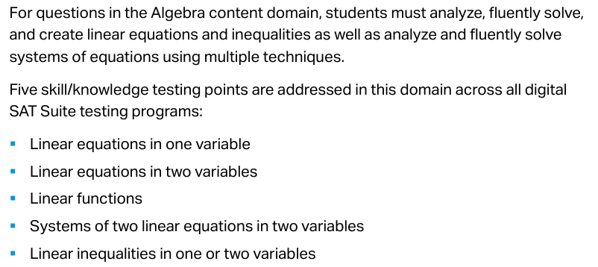
ALGEBRA

Slide 6
ALGEBRA
y < −4x + 4
Which point (x, y) is a solution to the given inequality in the xy-plane?
A) (2, −1) B) (2, 1) C) (0, 5) D) (−4, 0)

Slide 7
ALGEBRA
Figure A and figure B are both regular polygons. The sum of the perimeter of figure A and the perimeter of figure B is 69 inches. The equation 3x + 6y = 69 represents this situation, where x is the number of sides of figure A and y is the number of sides of figure B.
Which statement is the best interpretation of 6 in this context?
Each side of figure B has a length of 6 inches.
The number of sides of figure B is 6.
Each side of figure A has a length of 6 inches.
The number of sides of figure A is 6

Slide 8
ALGEBRA
Store A sells raspberries for $7.50 per pint and blackberries for $13.00 per pint. Store B sells raspberries for $8.50 per pint and blackberries for $12.00 per pint.
A certain purchase of raspberries and blackberries would cost $325.00 at store B or $335.00 at store A.
A total of how many pints of blackberries and raspberries are in this purchase?

Slide 9
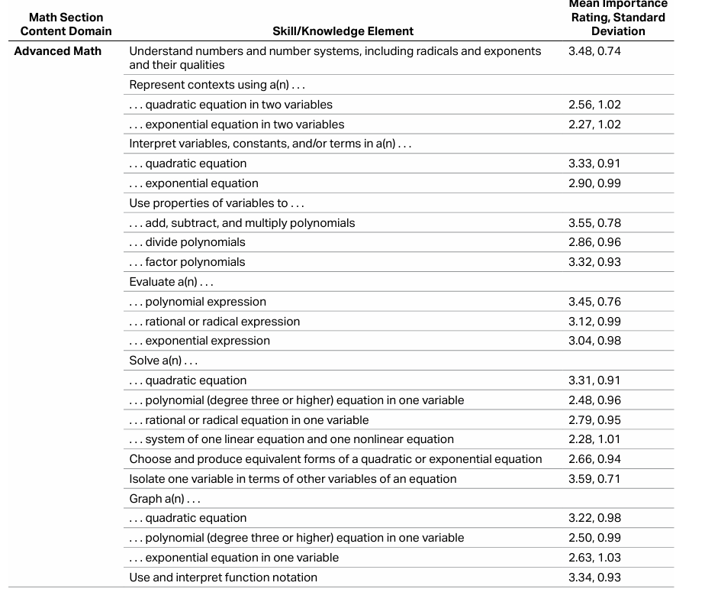

Slide 10
ADVANCED MATHS
g (x) = - x ² + 50, where both x and g(x) are natural numbers.
How many values of x exist ?

Slide 11
ADVANCED MATHS
The function g(x) is defined by g(x) = a^{x} + b, where a and b are positive constants. The graph of y = g(x) in the xy-plane passes through the points (0, 11) and (-1, 61/6). Find the value of ab.

Slide 12
ADVANCED MATHS
x² − 34x + c= 0
In the given equation, c is a constant. The equation has no real solutions if c>n. What is the least possible value of n?

Slide 13
ADVANCED MATHS
(x − 1)⁶ = -123456789
How many distinct real solutions does the given equation have?

Slide 14
ADVANCED MATHS
For the function f, f (0) = 960, and for each increase in x by 1.5, the value of f (x) decreases by 37.5%. What is the value of f (3)?

Slide 15
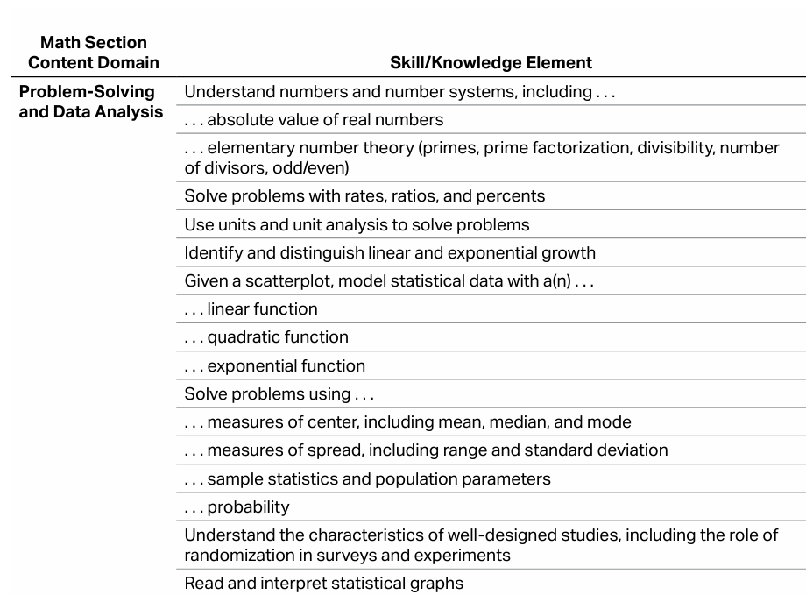

Slide 16
PROBLEM SOLVING AND DATA ANALYSIS
In a group, 40% of the items are red, while the remaining are blue in color. Of all the blue items in the group, only 30% have stripes. What percentage of the items in the group are blue but do not have stripes?

Slide 17
PROBLEM SOLVING AND DATA ANALYSIS
The population of a town increased by 10% from 2022 to 2023. However, it decreased by 10% from 2023 to 2024. If the 2024 population is k times the 2022 population, what is the value of k ?

Slide 18
SAT –GEOMETRY & TRIGONOMETRY
Domain | Description | Specific Skills Tested

Slide 19
GEOMETRY & TRIGONOMETRY
A certain town has an area of 4.36 square miles. What is the area, in square yards, of this town? (1 mile = 1,760 yards)
A) 13,505,34 B) 7,674 C) 710,459 D) 13,505,536

Slide 20
GEOMETRY & TRIGONOMETRY
A cube has an edge length of 68 inches. A solid sphere with a radius of 34 inches is inside the cube, such that the sphere touches the center of each face of the cube.
To the nearest cubic inch, what is the volume of the space in the cube not taken up by the sphere?
A) 149,796 B) 264,500 C) 290,955 D) 310,800

Slide 21
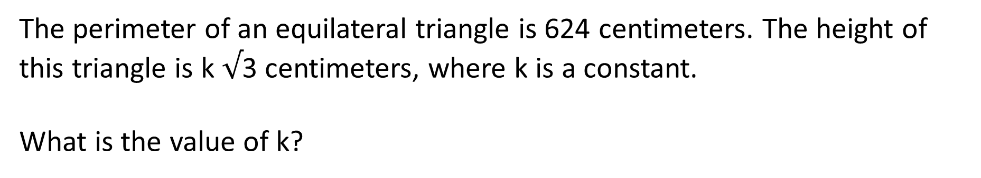
GEOMETRY & TRIGONOMETRY
The perimeter of an equilateral triangle is 624 centimeters. The height of this triangle is k $√$3 centimeters, where k is a constant.
What is the value of k?

Slide 22
GEOMETRY & TRIGONOMETRY
Two right-angled triangles ABC and PQR are similar, right-angled at B and Q, angle A and angle C of triangle ABC correspond to angle R and angle P of triangle PQR respectively. If angle P measures 27°, then what is the measure of angle C?

Slide 23
GEOMETRY & TRIGONOMETRY
A circle in the xy-plane has a diameter with endpoints (2,4) and (2,14) . An equation of this circle is (x -2)² + (y-2)² = r², where r is a positive constant. What is the value of r ?

