Slide 1
BrandPulseAI
AI-Powered Marketing Strategy & Creative Automation Platform
Team :
Arnav Das - 2303041
Rahul Gavhar – 2303051
Suraj Das – 2303043
Saish Dhuri - 2303046
Mentor:
Dr. Anil Chhangani

Slide 2
The Problem
01
02
03
Fragmented Tools
Repeated Inputs
No Unified Workflow
Strategy, content, influencer discovery, and design each require separate tools — causing context loss and inconsistency.
Users re-enter campaign details across every platform, wasting time and creating drift between brand voice and objectives.
No single platform guides a founder from raw idea → strategy → creative assets → influencer outreach in one place.

Slide 3
Our Solution: BrandPulse AI
Single-Source Campaign Intelligence
Define your campaign idea once — CampaignAI drives every downstream module from that single source of truth.
Idea Storage
Strategy Gen
Influencer Discovery
Cloud-backed via Firestore
AI-driven campaign plans
YouTube API + outreach
Creative Assets
Audio Ads
User Auth
Text + image generation
Gemini + ElevenLabs pipeline
Google OAuth via Firebase

Slide 4
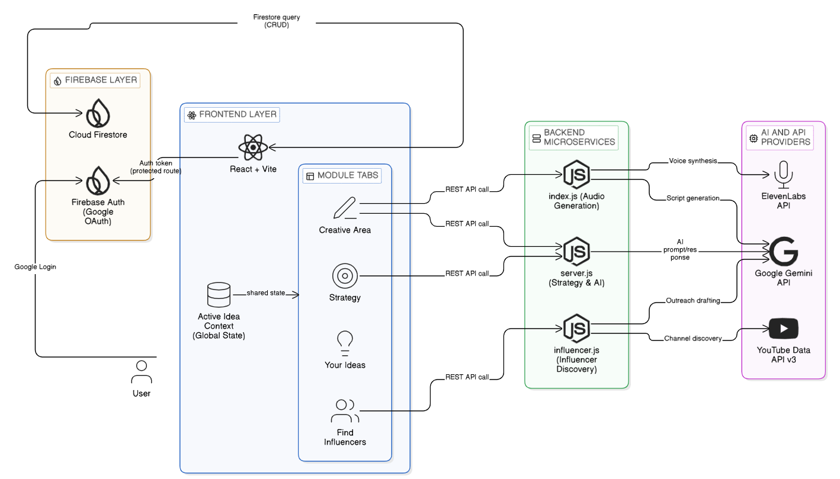
System Architecture

Slide 5
Key Modules
01
Your Ideas
Create, edit, and delete campaign ideas. Firestore-persisted with real-time sync. One idea becomes the global active context.
02
Strategy Generator
AI builds a full campaign strategy from your active idea: goals, messaging, platform selection, and execution roadmap.
03
Creative Area
Generate marketing copy, ad captions, and visual assets powered by Gemini — all aligned to the active campaign idea.
04
Influencer Finder
YouTube Data API discovers relevant creators. Auto-drafts personalized outreach messages based on your campaign tone.

Slide 6
Technology Stack
Frontend
Backend
Cloud & Auth
AI & APIs
React + Vite
React Router
Tailwind CSS
Firebase SDK
Node.js + Express
dotenv/node-fetch
3 microservices
REST APIs
Firebase Auth (Google)
Cloud Firestore
User-scoped queries
Route protection
Google Gemini
ElevenLabs TTS
YouTube Data API v3
Structured JSON schemas

Slide 7
How It Works
1
2
3
4
5
6
Google Login
Create Idea
Set Active
Pick Module
Generate
Review Output
Firebase Auth
Stored in Firestore
Global context
Strategy / Creative / Influencer
AI backend call
Error-aware UI
All modules share the same active idea → coherent outputs, no re-entry of campaign details

Slide 8
Limitations & Future Work
Current Limitations
Future Roadmap
Third-party API quota & billing dependencies
Multiple backend services need coordinated startup
No role-based access beyond per-user isolation
Team workspaces with role-based access
KPI analytics dashboard & generation history
API gateway + health checks + CI/CD
Multi-platform influencer discovery (Instagram, Pinterest)
Containerized production deployment

Slide 9
Conclusion
BrandPulse AI demonstrates that even at project scale, a cloud-backed, authentication-enabled platform with single-source campaign intelligence can dramatically improve workflow continuity and practical usability for early-stage founders and small teams.
Thank You
Questions & Feedback Welcome

