Slide 1
Blind’s Eye : IoT based real-time surrounding identification and object detection eHIMANSHU SHEKHAR ENROLLMENT NO. : 12017002002067 SUJOY SEAL ENROLLMENT NO. : 12017002002010 Under the supervision of PROF. TUFAN SAHA Department of Computer Science and Engineering Institute of Engineering and Management

Slide 2
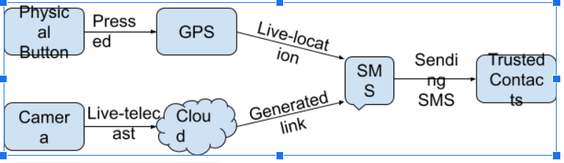
Process :

Slide 3
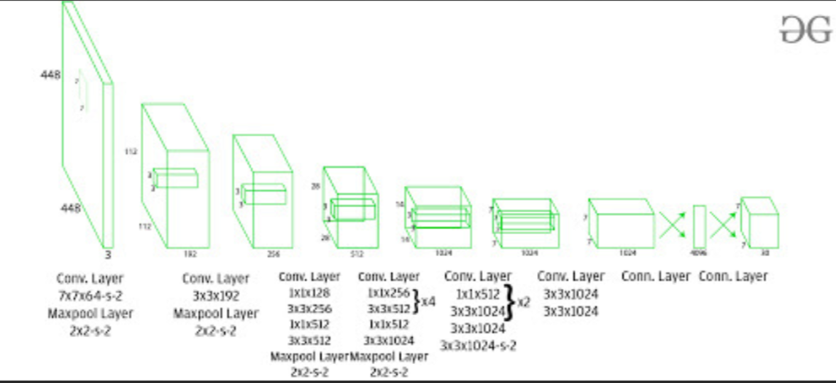
ARCHITECTURE

Slide 4
CODE :
#Extracting features to detect objects
blob=cv2.dnn.blobFromImage(img,0.00392,(416,416),(0,0,0),True,crop=False)
#Inverting blue with red
#bgr->rgb
#We need to pass the img_blob to the algorithm
net.setInput(blob)
outs=net.forward(output_layers)
#print(outs)

Slide 5
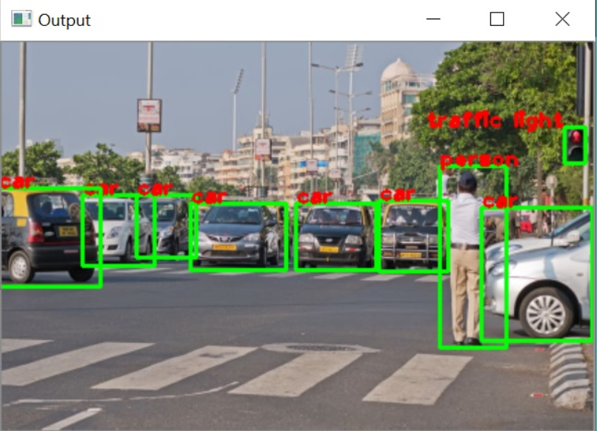
OUTPUT

Slide 6
Status :
Need to implement hardware for making system portable .
Plan of Action : Raspberry Pi 3 with Raspbian or Noobs .
Need to implement for a varied dataset
Plan of Action : Gather More dataset.
Use of CNN with more neurons instead of Open CV
Plan of Action : Modify existing Algorithm

Slide 7
THANK YOU !

