Slide 1





Unnati
PS-17 Business Contract Validation
To classify content within the Contract Clauses & to determine deviations from Template & highlight them
Brainware University
Mentor: Dr. Shivnath Ghosh
Team Lead : Sukanta Oraw
Members : Subhayan Mukhopadhyay, Arnab Bhattacharya, Shahid Aktar Mandal, Joy Biswas

Slide 2
Problem Statement
Objective: To classify content within contract clauses and identify deviations from templates.
Content Classification:
Categorize the information within each contract clause into predefined groups (e.g., parties, obligations, terms, conditions, termination).
2. Template Identification:
Analyze the contract structure and clause order to match it with existing templates.
3. Deviation Detection:
Compare the contract content with the identified template.
Highlight any modifications, or additional clauses that deviate from the standard template.
4. Deviation Analysis:
Evaluate the significance of identified deviations.
Determine if deviations impact contract terms, obligations, or legal implications.

Slide 3

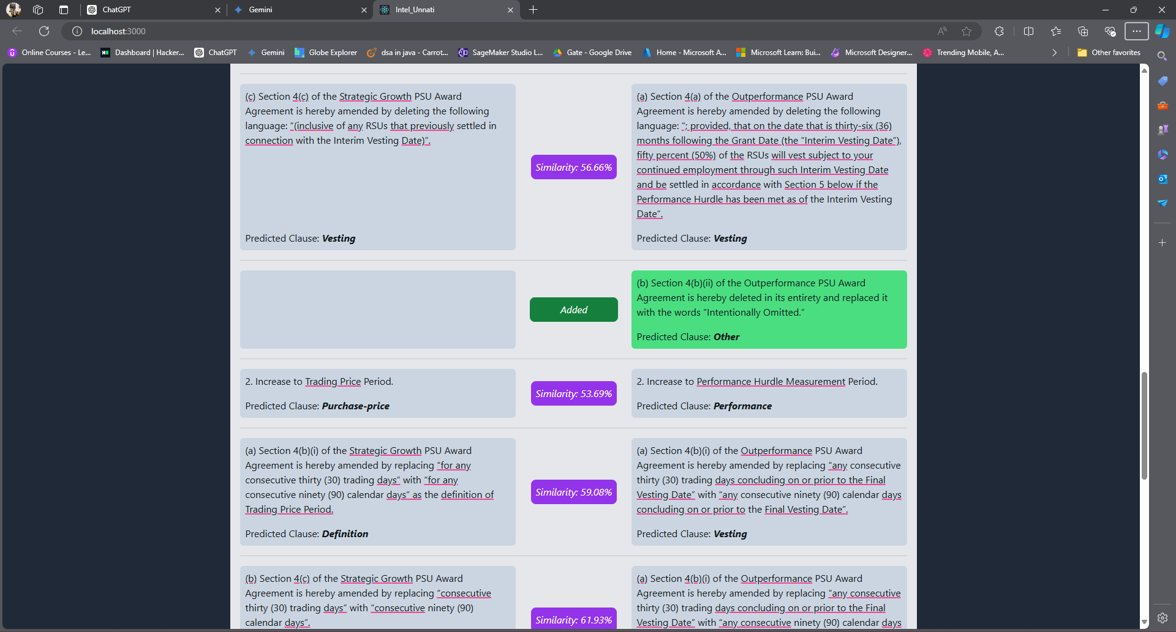
Unique Idea Brief (solution)
Utilize machine learning techniques to automate the classification and comparison of contract clauses.
Train model to classify clause types (e.g., Termination, Liability, etc.) using ensemble machine learning with 380+ clause types and 150,000+ clauses.
With an accuracy of approximate 80%, using the bahushruth/legalclausedataset from kaggle
Used cosine similarity to compare clauses between different contracts to identify similarities and deviations and python libraries to highlight the changes.

Slide 4
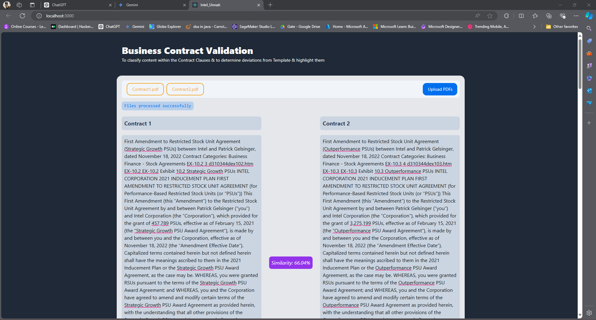
Features Offered
Clause Classification: Classification of contract clauses based on content analysis using trained model.
Clause Comparison: Comparison of clauses to highlight similarities and differences.
PDF Integration: Integration with PDF extraction for seamless document handling.
Results Visualization: Visualization of results with detailed annotations and similarity scores.
Summarize the Deviations: Summarize the deviations in the contract clauses using APIs of any LLM.

Slide 5
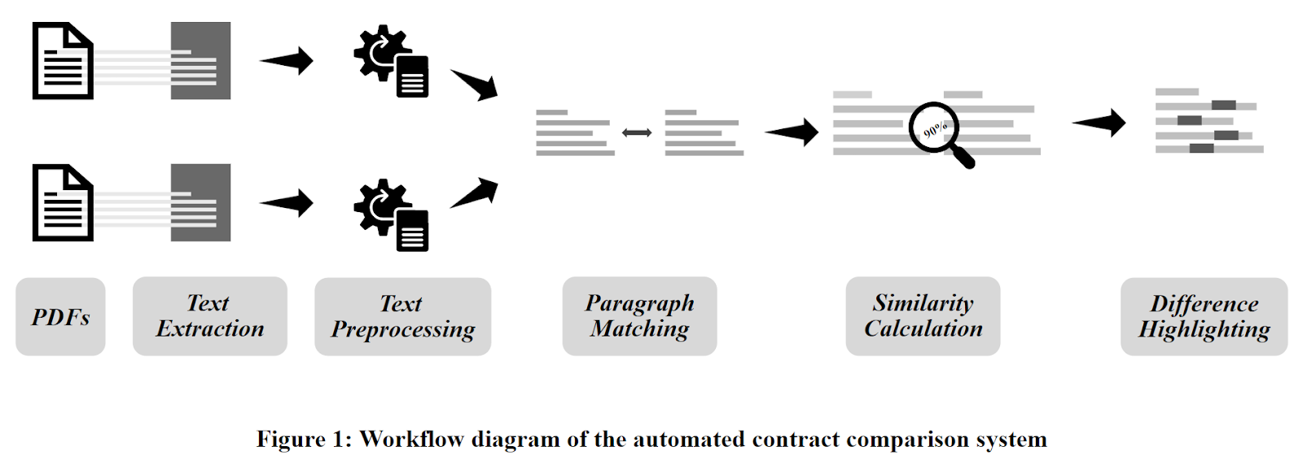
Process flow
Step 1: PDF Upload: Users upload two PDF contracts for comparison.
Step 2: Text Extraction: Extract text content from uploaded PDFs.
Step 3: Classification: Classify clauses using a trained ensemble model.
Step 4: Comparison: Calculate cosine similarity between corresponding clauses.
Step 5: Visualization: Display results with annotated paragraphs and similarity scores.

Slide 6
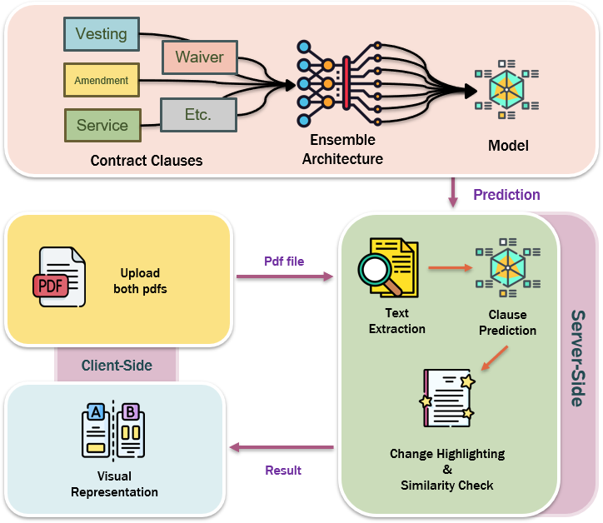
Architecture Diagram
Tech Stack
Python Libraries:
Flask
PyMuPDF
scikit-learn
spaCy
difflib
Front-End:
React(javascript)
NextUI
Tailwind(css)
ML:
MLPClassifier
Logistic Regression
SVC
Spacy
TfidfVectorizer
Daniel Gallego

Slide 7
Technologies Used
Front-End: React, Tailwind, NextUi
Backend-End: Flask, PyMuPDF, joblib, spacy, sklearn, difflib
Machine Learning: Pandas, Matplotlib, Sklearn, re, joblib
Algorithms : MPL Classifier, Logistic Regression, SVC

Slide 8
Team Members and Contribution
Sukanta Oraw : Machine Learning Model building and overall project monitoring and supervision.
Subhayan Mukhopadhyay : Machine Learning Model building and research for the project.
Arnab Bhattacharya : Front-End UI development for visual representation of the contract comparison.
Shahid Aktar Mandal : Front-End UI development and backend integration.
Joy Biswas : Finding the similarity between contracts and highlighting mismatched words.

Slide 9
Conclusion
The “Business Contract Validation” project is quite efficient in addressing the issues related to contract clause classification and comparison. Applying the machine learning and NLP methodologies, the system generates the clause list and tags clauses automatically implying significant time-saving when the contract is reviewed. This is very important since Cosine similarity ensures that results obtained when comparing the clauses are very accurate this will make analysis of the contracts more accurate. The frontend developed makes the system friendly to the users, thus enabling the easy usage of the system. The use of enhanced models, multilingualism, better data sets and text extraction more than put the system in a better position in the future enhancements. As for the supporting project, it optimizes contract handling and establishes the structure for further developments in the sphere of document automation.

Slide 10
THANK YOU

