Slide 1

FINAL PROJECT
BAN200ZAA
SENTIMENT ANALYSIS
AND TEXT MINING
Group 3
Sukanya | James | Chin | Matt

Slide 2
ABOUT THE DATASET
Amazon Product Review
Sourced from kaggle
Amazon customer product reviews
File Type: Text in CSV format
File Size: 286 MB
Size of the data:
568,454 rows
10 columns
Our primary focus variables
Text and Score (star rating of product)
Notes:
Matt:
Columns available:
ID
ProductID
UserID
ProfileName
HelpfulnessNumerator
HelpfulnessDenominator
Score (star rating)
Time
Summary (title)
Text (free format)

Slide 3


BUSINESS PROBLEM (Matt)
Amazon is customer centric. If the product ratings from customers are inaccurate, customers do not receive accurate pre-purchase information.
Notes:
Matt:
We want to see if there was inconsistency between the customer scoring of the product and the actual textual sentiment scoring
While most of us may assume that 5 stars is best 1 star is the worst, this may not be clear to all.
The misunderstanding can happen in couple of ways.
Cultural Context. In the Philippines for instance, 1 is always the best. Anyone with similar background may also make the same natural mistake
Default value of 1 star: User simply didn’t update it. It happened to myself once when I was so engrossed in writing the review that I forgot to change the star rating of the product
If there was a problem, we wondered what we could do to resolve it but we had to see if there was a problem first

Slide 4
DATA CLEANING AND PREPARATION (Chin)

Slide 5
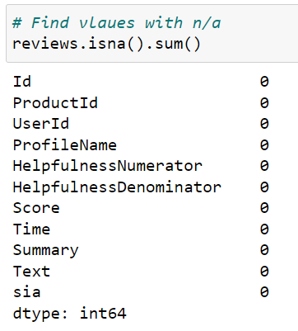
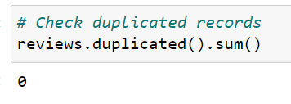
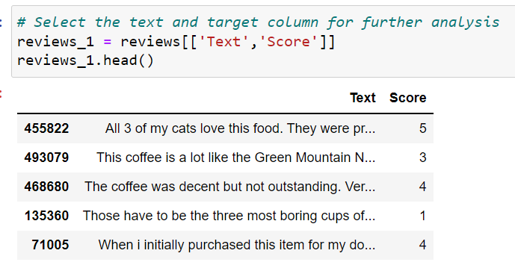
Data Exploration
No missing values
No duplicated records
Checking on the main columns (Text, Score)

Slide 6
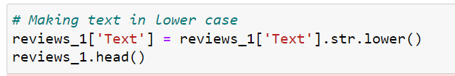
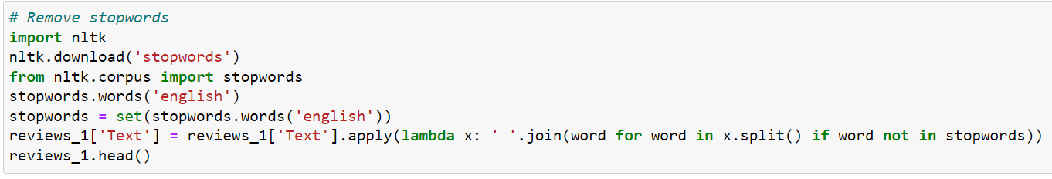
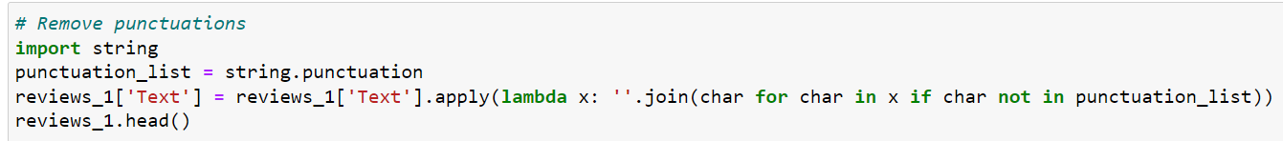
Data Cleaning
Lower case
Remove stopwords
Remove punctuations

Slide 7
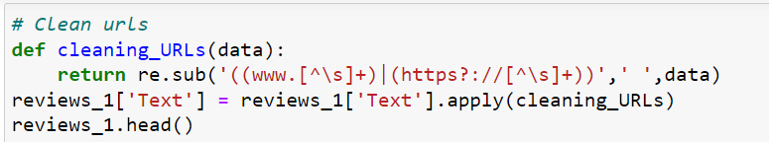
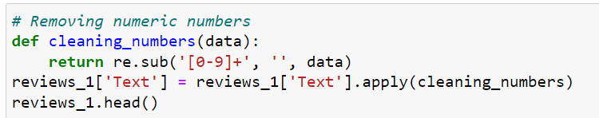
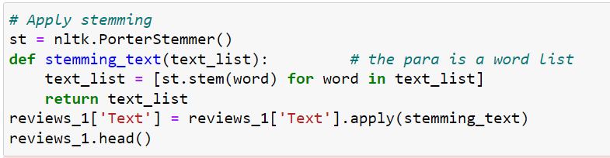
Data Cleaning
Remove URL
Remove numeric numbers
Apply stemming

Slide 8
DATA EXPLORATION & FEATURE VECTORIZING (James)

Slide 9
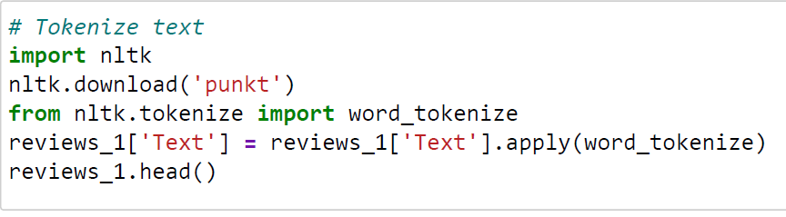
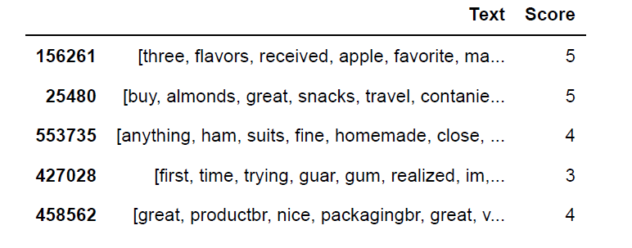
Tokenizing

Slide 10
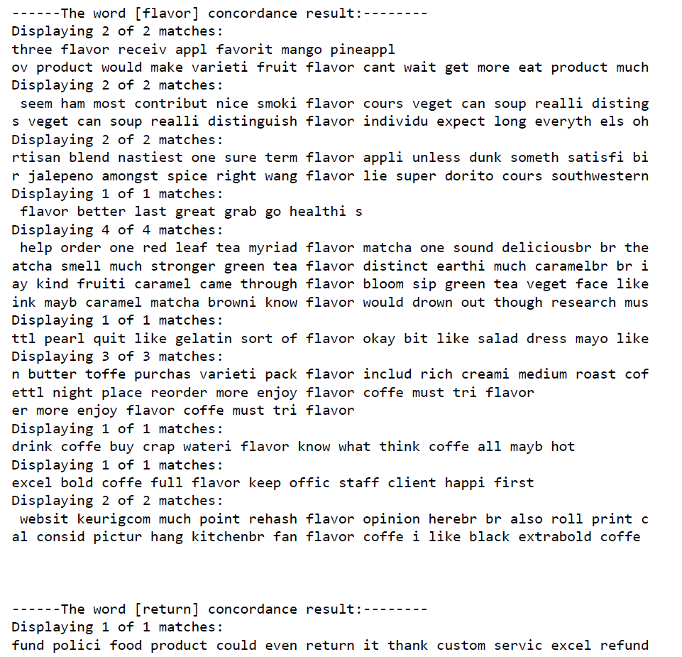
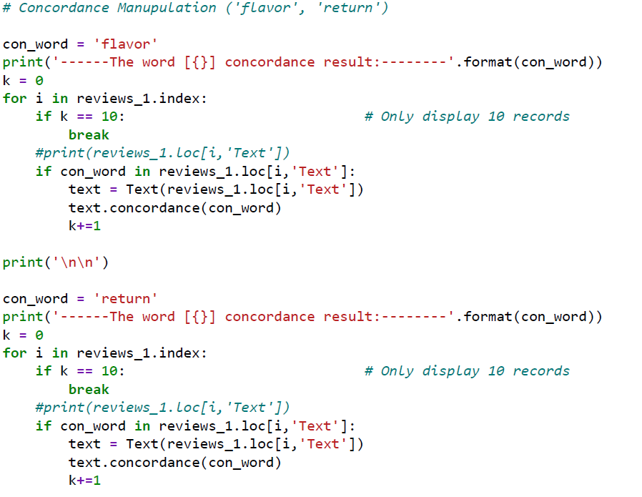
Data Exploration - Concordance

Slide 11
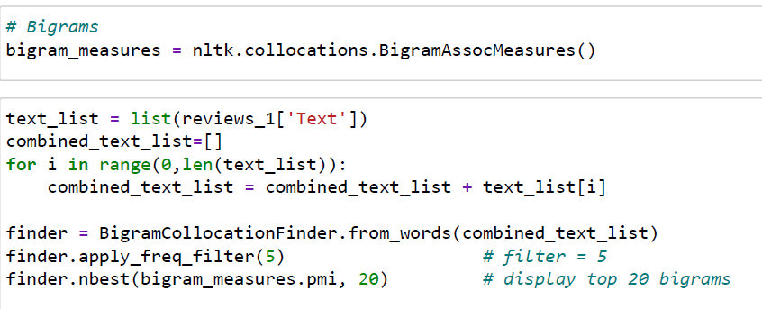
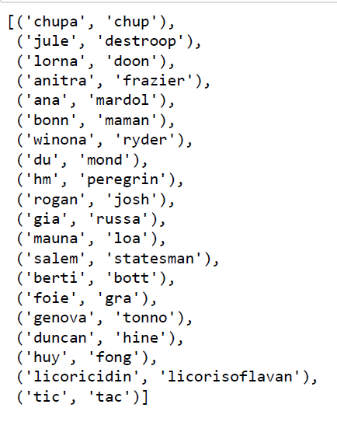
Data Exploration - Bigrams

Slide 12
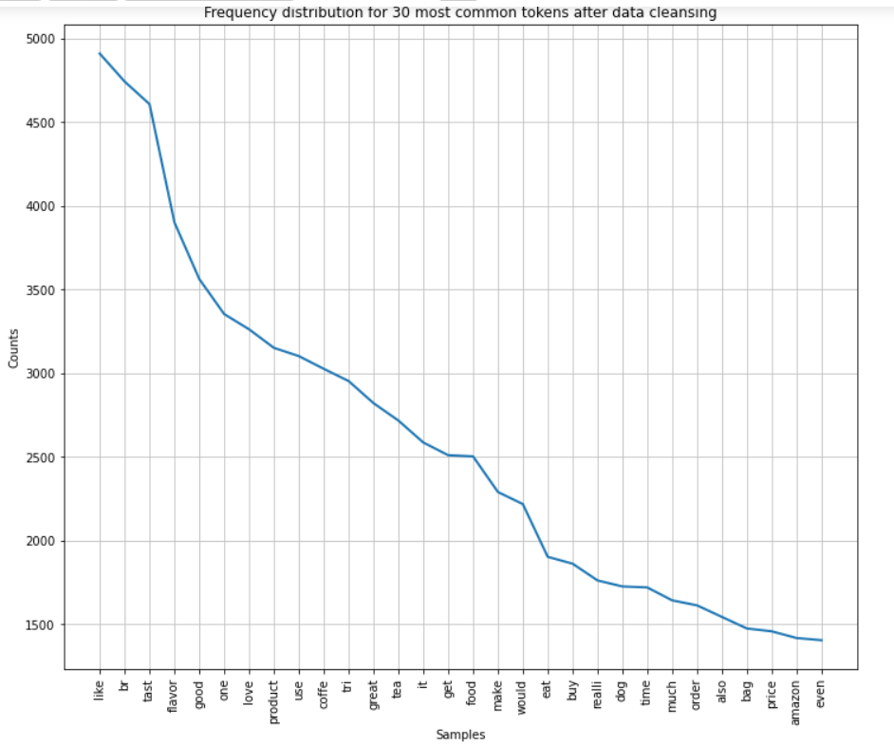
Data Exploration - Word Frequencies

Slide 13
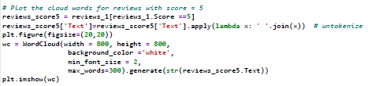
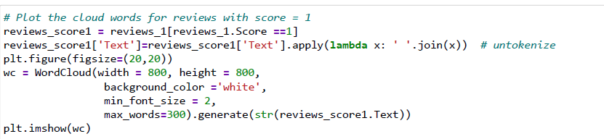
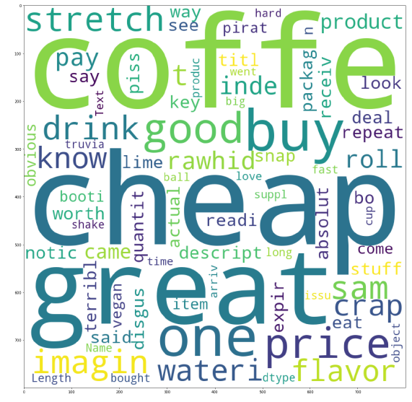
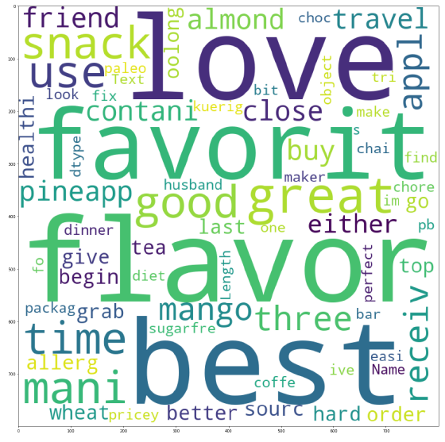
Data Exploration - WordClouds

Slide 14
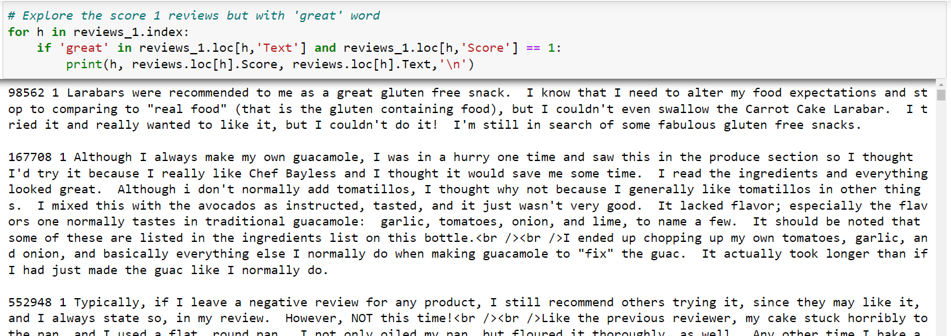
Backup Slide - Why ‘great’ shows in the first WC

Slide 15
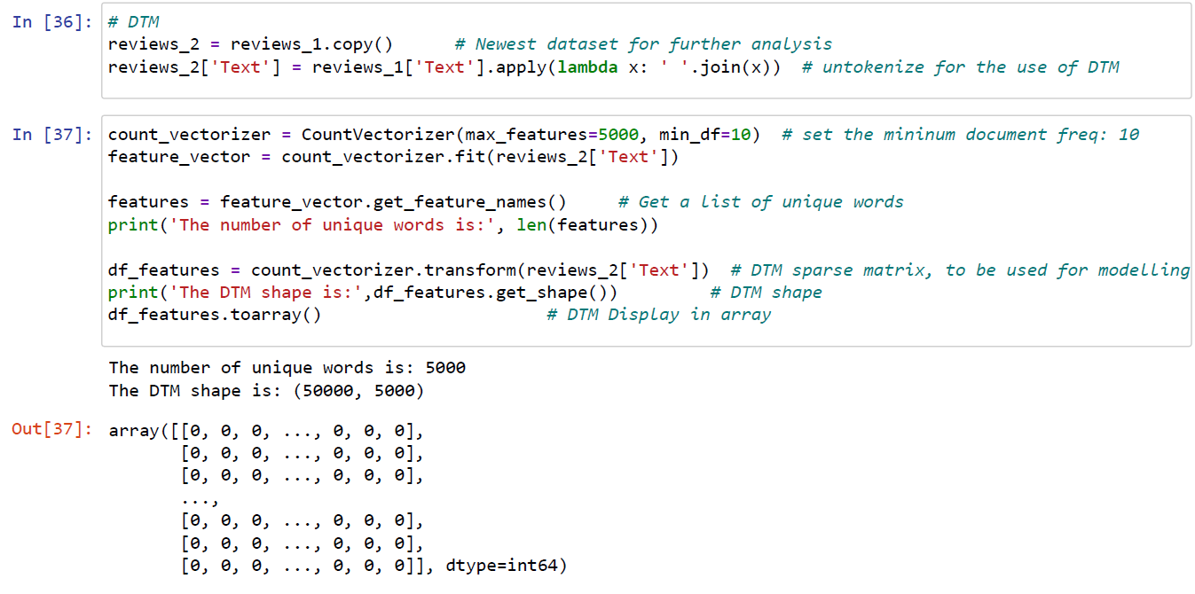
Features Vectorizing and DTM

Slide 16
SENTIMENT ANALYSIS
(Sukanya)

Slide 17
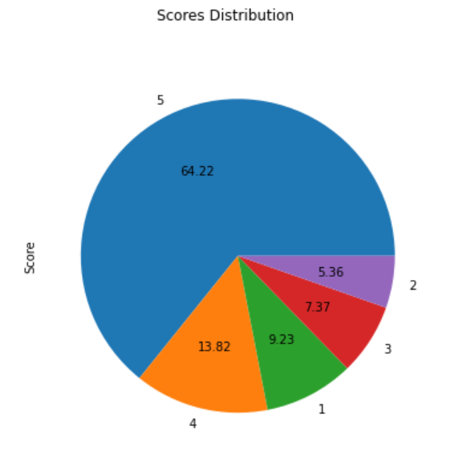
‘Score’ distribution
Initially, we can see the percentage of distribution of the star rating at Amazon by users, this indicates how much each score was given to products.
But this can be seen in the other way, due to cultural differences/misunderstanding or lack of information on what rating indicates what, user may give rating the opposite way.
For example: in races/competitions, Number 1 has the highest significance while Number 5 has the least significance, based on this thought process, users may rate 1 star on a good product which we want to compare with the “Textual” review, to equalize/standardize and provide with the accurate Scoring accordingly.

Slide 18
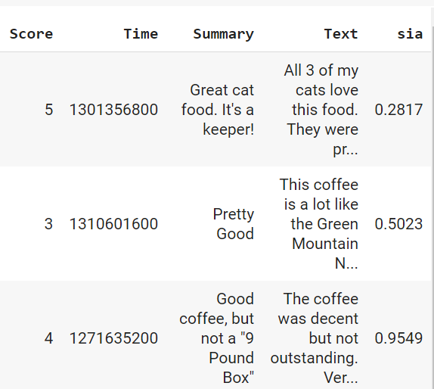
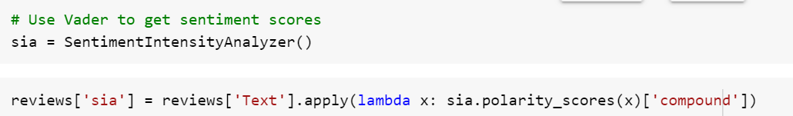
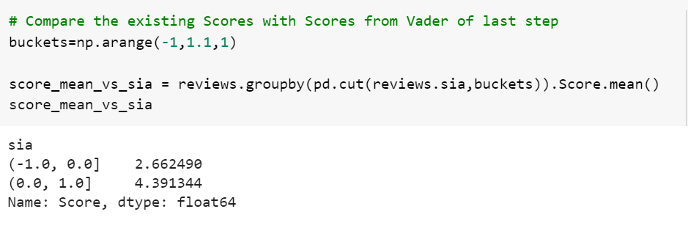
Using Vader
We use Vader to extract Scores (sia column) from “Text” field and divide it to extremes where positive is (0 to 1) and negative is (0 to -1) and 0 is excluded as it is neutral.

Slide 19
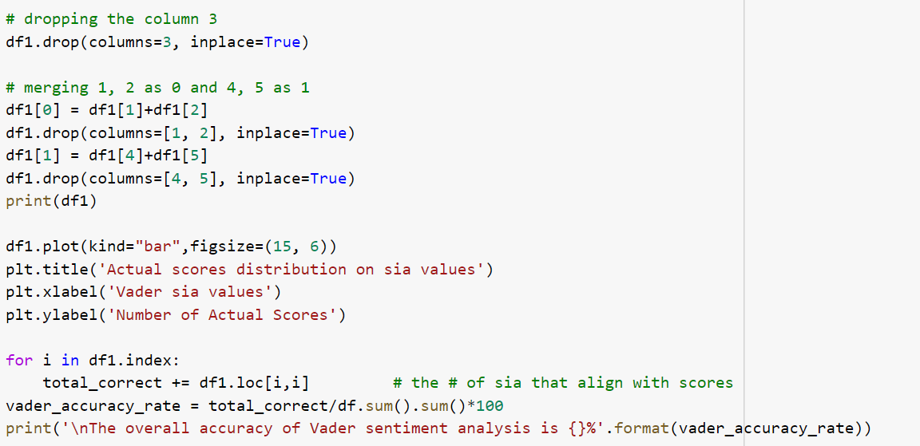
Using Vader
we merge the “Score” column in two sections - positives (4,5) and negatives (1,2) and exclude 3 to be neutral and plot graph against Actual Scores v/s Predicted Scores (more accurate taken from the “Text”)

Slide 20
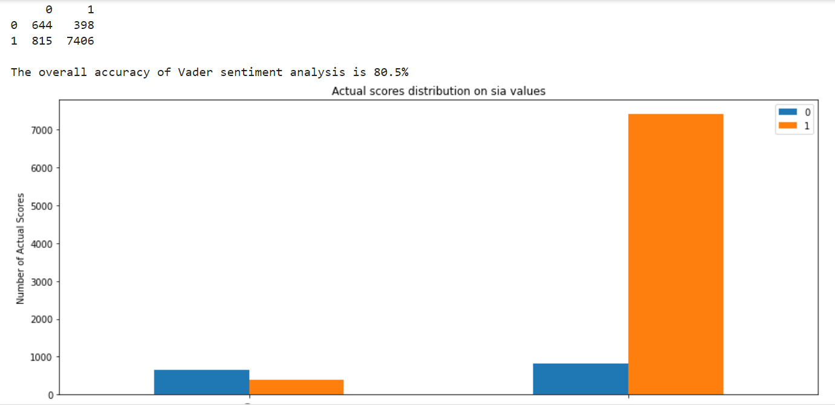
Using Vader
The Blue indicates “Scores” from the dataset and the Orange indicates “Text(sia)” from the dataset. Left hand side indicates 0 (Negatives) and Right hand side indicates 1 (Positives).
We can infer that if we compare “Scores” to “Text” (Actual v/s Predicted), we can see that there are a lot lesser negative reviews than indicated by Scores and there are a lot more positive reviews than indicated by Scores, which means this algorithm can help benefit Amazon in better product ratings and enhance customer’s trust on products.
The accuracy rate is 80.5%

Slide 21
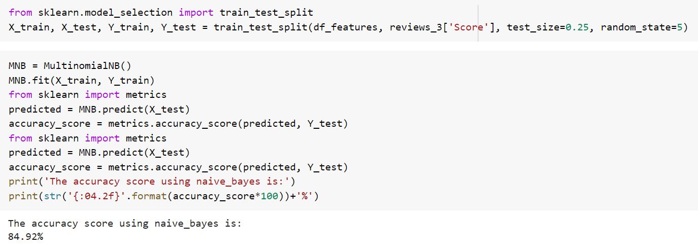
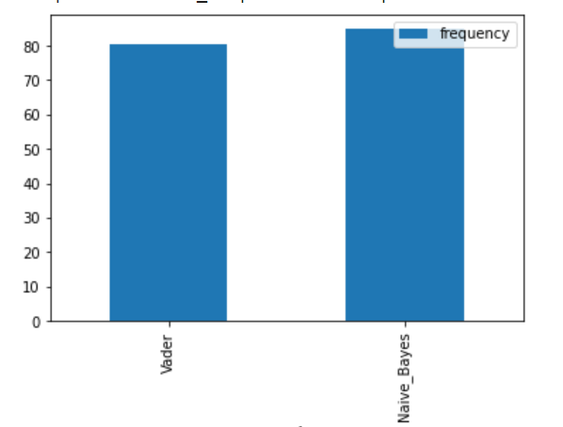
Using Naive Bayes (additionally)
Naive Bayes classifier gives an accuracy rate of 84.92% which is 4.42% higher than Vader.
Choosing the correct algorithm for the model is very important to the company.

Slide 22
FINDING AND CONCLUSIONS
(Matt)
Notes:
Matt

Slide 23
Findings and Conclusions
1 in 5 product scoring could be better scored (Using Vader)
Recommendations:
Use of Legend
Do a real-time scoring of the product review text being submitted
Compare with customer star scoring
Flag inconsistency to the customer
Result:
Cleaner, more accurate data
Better product review scoring = Better Trust = Happier Customer
Notes:
Matt (Findings and Conclusions)
19.5% Mismatch : Product Score vs Text review sentiment
Roughly 1 in 5 reviews were inconsistent in this respect
Recommendations to minimize this problem:
Legend might be used to clearly label 5 star as highest positive, 1 as lowest
During product review submission, text sentiment could be scored immediately and compared with the customer rated scoring
If discrepancy between the customer star score and sentiment, prompt the customer that 5 star rating is the highest and 1 star being low and give opportunity to correct
Predicted Results:
Cleaner, consistent data coming in
Better product review scoring = Better Trust = Happier Customer

Slide 24
Thank You

