Slide 1

Loan Default Prediction Using Machine Learning and Apache Spark for Enhanced Risk Management.
Predicting loan defaults is critical for financial institutions. Machine learning offers powerful tools. This presentation outlines a comprehensive approach. We will leverage Spark for data processing. Tableau will be used for insightful visualizations.
Sukanya Nimbalkar (240843025042)
Ishika Sutane (240843025016)
Prachi Moje (240843025026)
Shreyas Kore (240843025037)

Slide 2
Understanding Loan Default
Loan default occurs when borrowers fail to repay their loans. This leads to financial losses for lenders. Accurate prediction minimizes these risks. It also helps lenders make informed decisions.
Problem Definition
We aim to predict loan defaults. We will use machine learning techniques. The goal is to improve prediction accuracy.
Business Impact
Reduced financial risk is a key outcome. Improved
decision-making is also important. Resource optimization is a major benefit.

Slide 3

Data Acquisition & Preparation with Spark
Large datasets require efficient handling. Apache Spark is a powerful tool for this. Spark enables fast data processing and transformation.
1
Data Acquisition
Gather loan application data. Include credit history and demographics.
2
Data Cleaning
Handle missing values and outliers. Ensure data consistency and accuracy.
3
Data Transformation
Convert categorical variables. Scale numerical features for modeling.

Slide 4

Feature Engineering
Raw data needs transformation for better prediction. Feature engineering creates meaningful predictors. This improves model performance significantly.
Income Ratio
Calculate income to debt ratio. This indicates repayment capacity.
Credit Score
Use credit scores as a key indicator. Higher scores mean lower default risk.
Loan Amount
Consider the size of the loan. Larger loans may have higher risks.

Slide 5

Machine Learning Model Selection & Training
Several algorithms are suitable for default prediction. Logistic Regression and Random Forests are popular. Select the best model based on performance.
1
Logistic Regression
Simple and interpretable model.
Random Forests
Handles non-linear relationships.
2
Gradient Boosting
Often provides high accuracy.
3

Slide 6
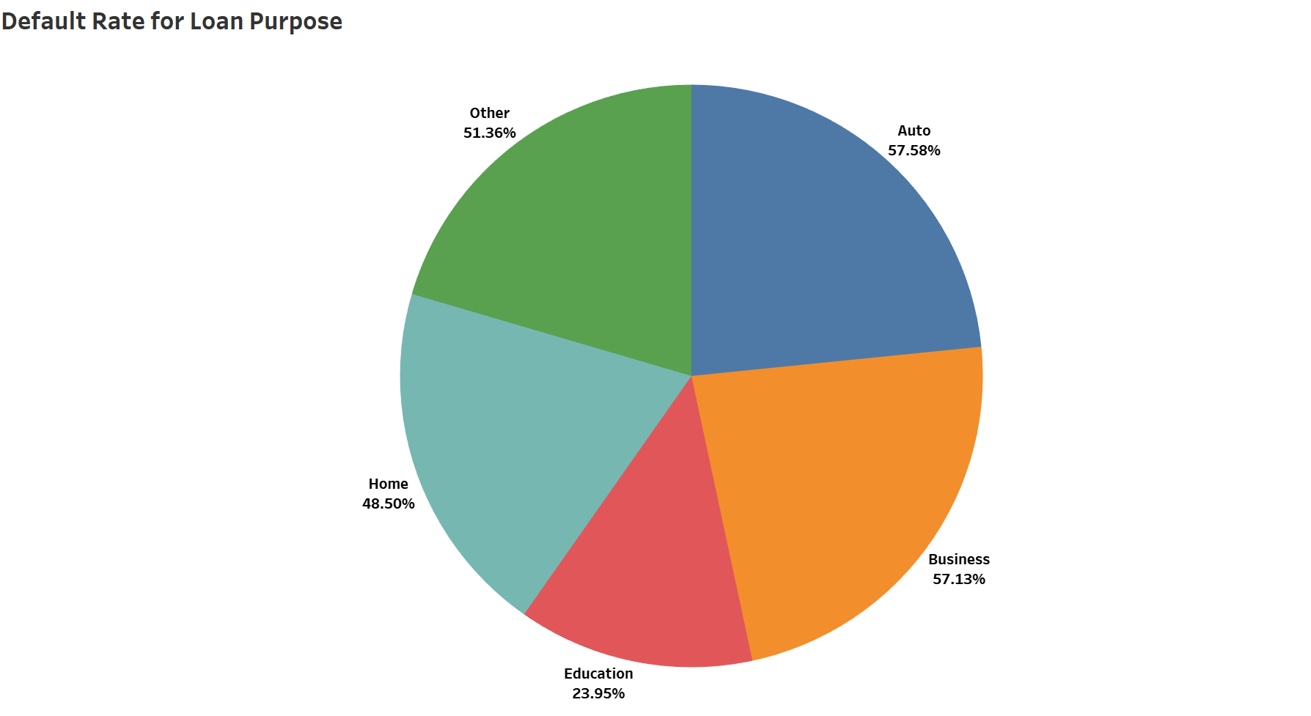
Visualization with Tableau
Tableau provides powerful visualization capabilities. Communicate insights through interactive dashboards. Visualize trends and patterns in the data.
.
.

Slide 7
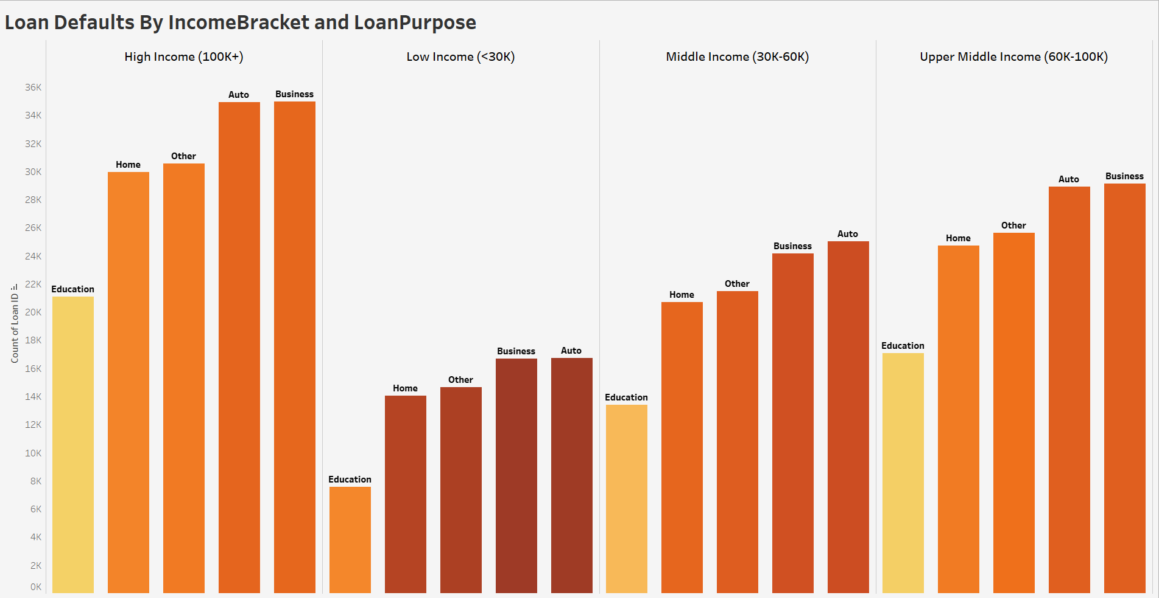

Slide 8
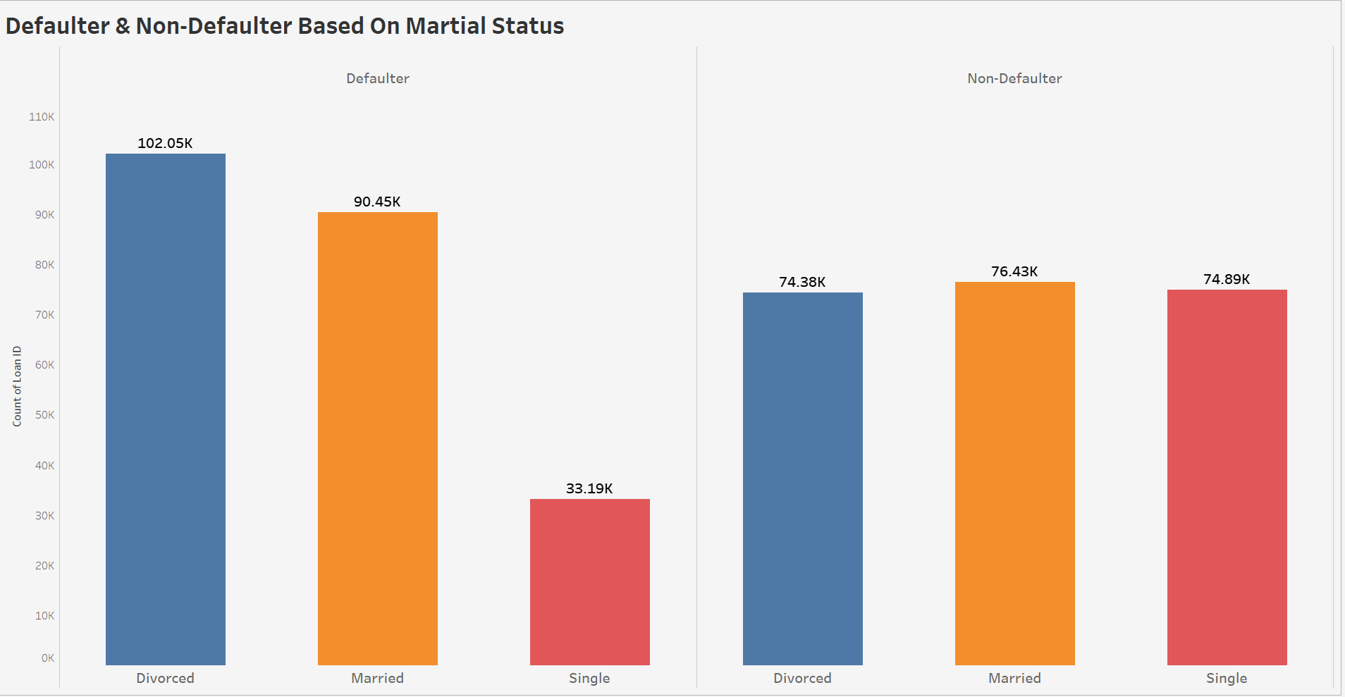

Slide 9
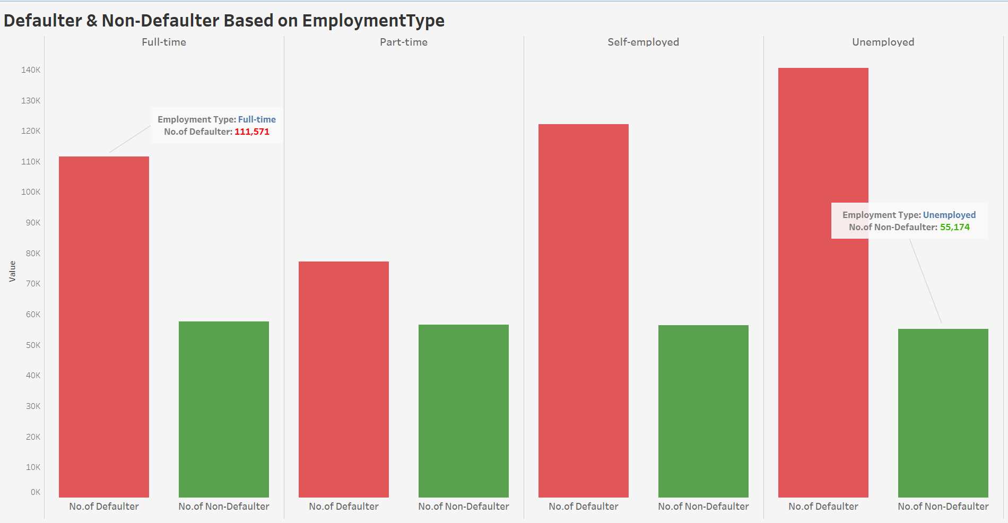

Slide 10

Conclusion
Machine learning offers valuable insights. Accurate default prediction is achievable. Business recommendations drive informed decisions.
1
Key Findings
Identified key risk factors.
2
Recommendations
Adjust loan approval criteria.
3
Future Work
Explore advanced algorithms.

