Slide 1
Indian Institute of Technology Gandhinagar
EE-652 Project Presentation
Universal Verification Method
Prepared By:-
Sukanya More - 20110205
Daniel Giftson - 20110051
Guided By:- Prof. Joycee Mekie

Slide 2
OUTLINE
Introduction to AXI
Key Features of AXI protocol
AXI signals and Working
Introduction To UVM
UVM Testbench
Result

Slide 3
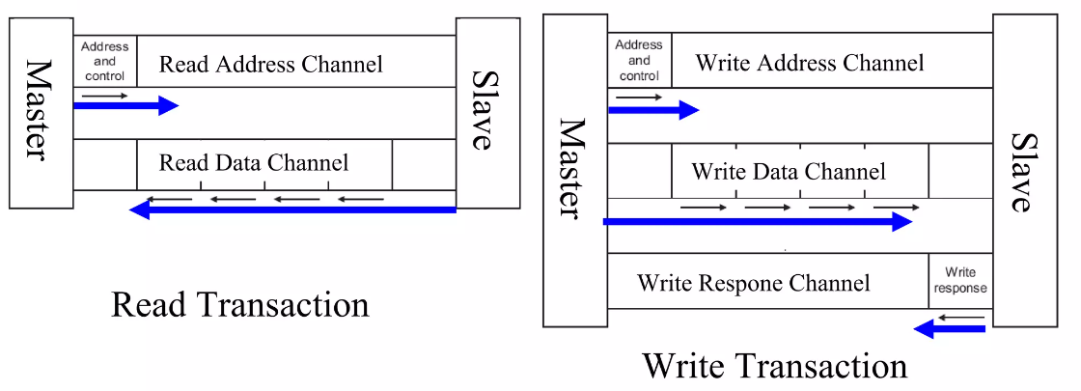
Introduction to AXI
AXI (Advanced eXtensible Interface) protocol is a synchronous burst-based transactions with only start address issued.
Has 5 channels - 2 for read and 3 for write.
Address/Control is issued ahead of actual data transfer.

Slide 4
Key Features of AXI Protocol
Separate Address/Control and Data channels.
Separate Read and Write data channels.
Multiple data transfers in a single transaction by issuing only the start address and the burst type.
Handles unaligned data transfers using byte strobes.
Allows either master/slave interface to specify the valid bytes for a particular transfer.
Eg: If data = 32’h6789, strb = 4’b0011, then the data transfer is 16’h89.
Supports multiple outstanding transactions, which means that multiple transactions can be in progress simultaneously.
Supports burst splitting and merging, which enables a burst transfer to be split into multiple smaller transfers or merged into a single larger transfer.
Provides support for different protection levels, including non-secure, secure, and privileged access.

Slide 5
AXI Write Signals
Write Address Channel
AWID
AWADDR
AWLEN
AWSIZE
AWBURST
AWLOCK
AWCACHE
AWPROT
AWQOS
AWREGION
AWUSER
AWVALID
AWREADY
Write Data Channel
WID
WDATA
WSTRB
WLAST
WUSER
WVALID
WREADY
Write Data Channel
BID
BRESP
BUSER
BVALID
BREADY

Slide 6
AXI Read Signals
Read Address Channel
ARID
ARADDR
ARLEN
ARSIZE
ARBURST
ARLOCK
ARCACHE
ARPROT
ARQOS
ARREGION
ARUSER
ARVALID
ARREADY
Read Data Channel
RID
RDATA
RRESP
RLAST
RUSER
ARVALID
ARREADY

Slide 7
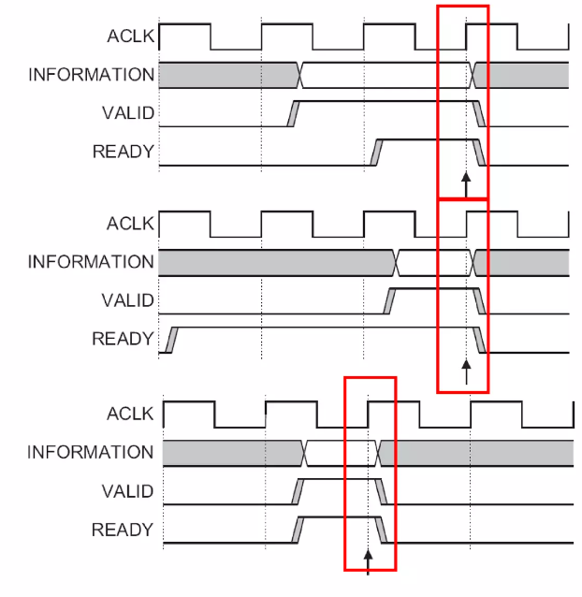
Handshake Process
All five transaction channels use the same VALID/READY handshake process to transfer address, data, and control information.
Helps in synchronizing the source/destination interfaces, prevents data loss, and corruption.
The source generates the VALID signal to indicate when the address, data or control information is available for transfer.
The information from the source remains stable until the destination drives the READY signal high, indicating successful transfer.

Slide 8
AXI FIFO Schematic
m_r_addr_ch
Master Interface
axi_fifo_rd_mem
m_r_data_ch
m_w_addr_ch
m_w_data_ch
s_r_addr_ch
m_w_resp_ch
s_r_data_ch
Slave Interface
axi_fifo_wr_mem
s_w_addr_ch
s_w_data_ch
s_w_resp_ch

Slide 9
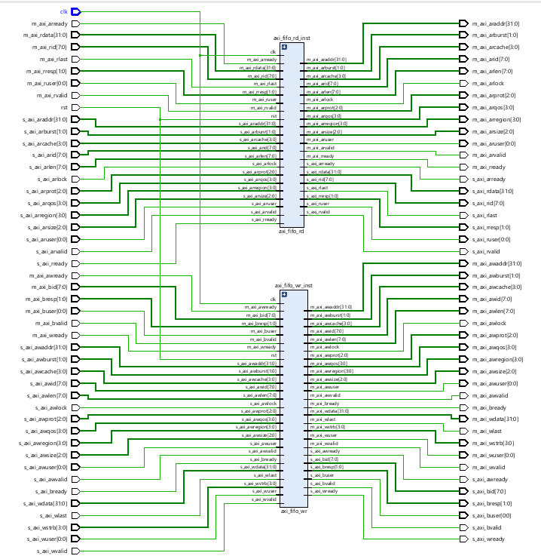
Schematic

Slide 10
What is UVM and Why UVM?
The Universal Verification Methodology (UVM) is a methodology standard built on top of the SystemVerilog language for the development of well constructed, reusable SystemVerilog-based Verification environment.
Basically consists of a set of base classes defined in it so that Verification environment can be developed by extending these base classes.
Provides with the advantage of reusability of the verification components from block level to Subsystem or SoC level.
Provides access to a centralized database (known as UVM Config db) for configuration data, such as parameters and settings, that can be accessed by any component within a UVM testbench.
Provides a structured and an organized way to perform the verification process using UVM Phases, which helps verification engineers to better organize their work and manage the complexity of the verification environment.

Slide 11
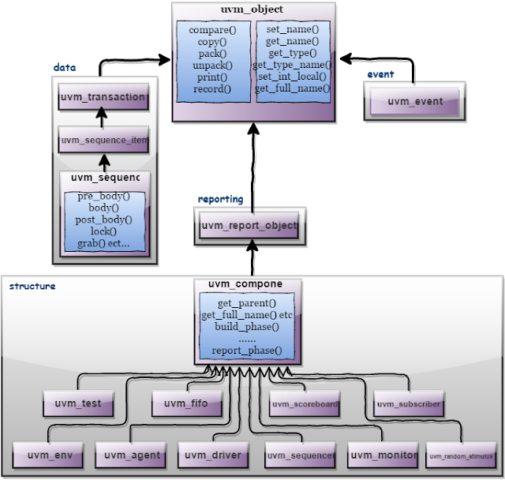
UVM Base Classes
UVM consists of three main types of classes:
uvm_object - Core class based operational methods, instance identification fields, and random seeding were defined in it.
uvm_transaction - Used in stimulus generation and analysis.
uvm_component - defines a phased test flow and also defines configuration, reporting, transaction recording, and factory interfaces.

Slide 12
UVM TESTBENCH
Testbench Architecture
UVM Sequence
UVM Sequence item
UVM Sequencer
UVM Driver
UVM Monitor
UVM Agent
UVM Scoreboard
UVM Environment
UVM Test
UVM Testbench Top

Slide 13
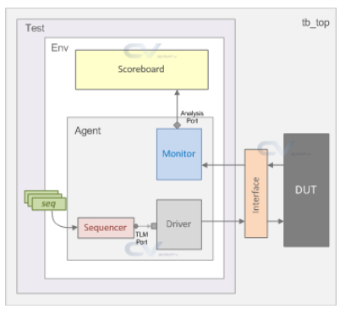
Testbench Architecture

Slide 14
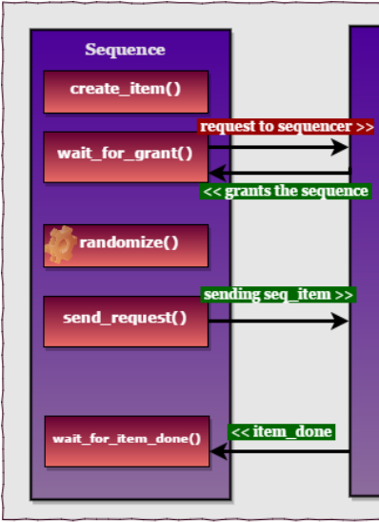
UVM Sequence
The Sequence class is a fundamental class in the UVM that is used to model stimulus generation in a verification environment. A sequence represents a sequence of operations or events that are generated by a testbench to drive inputs to a DUT (Device Under Test).
Uvm_squence_class contains UVM sequence macros these macros are used to start sequences and sequence items on default sequencer, m_sequencer.
Ex. `uvm_do(item/sequence): On calling `uvm_do() the above-defined 6 steps will be executed.

Slide 15
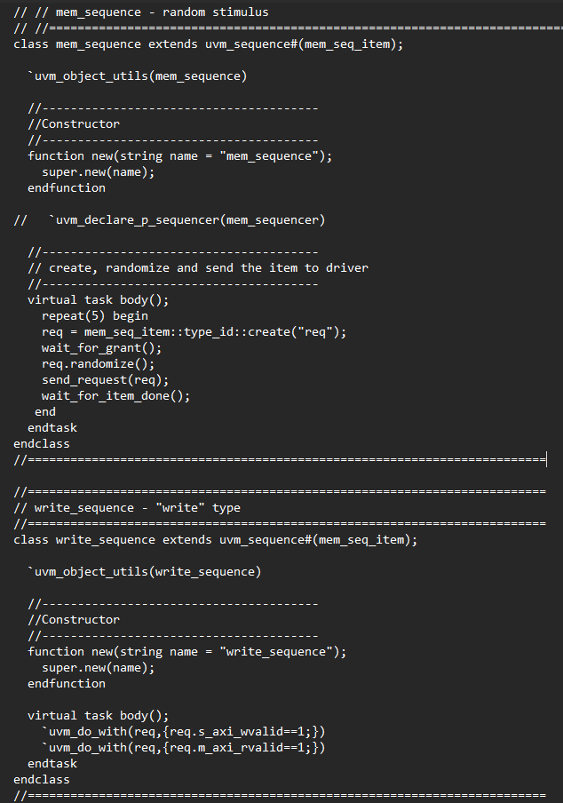
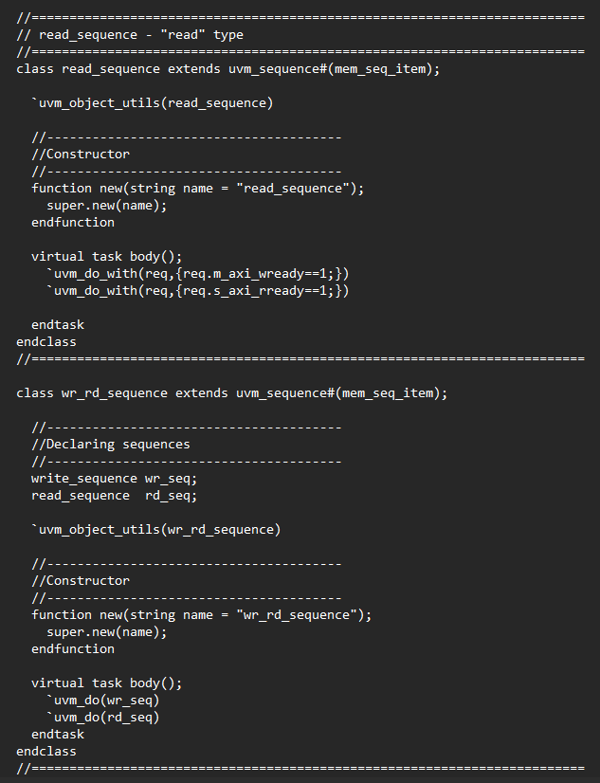
UVM Sequence
Methods to randomize the data after getting requenst
Calling sequence inside sequence
Performing other operations with constraints

Slide 16
UVM Sequence item
The uvm_sequence_item class defines fields that represent the data values of the transaction. Fields can be declared using the rand or randc keywords to enable randomization and constraint-based generation.
uvm_sequence_item uses macros, utility macros and field macros which help us to do define some methods in this class.
Utility macros in the UVM are a set of predefined macros that provide a convenient way to define methods with common functionality.
Field macros in the UVM proved us set of methods to operate on fields.

Slide 17
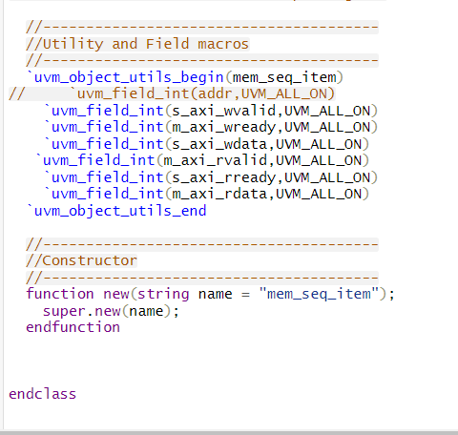
UVM Sequence item
Along with field declaration we used following method using macros.
UVM_ALLON -> Set all operations on (default)

Slide 18
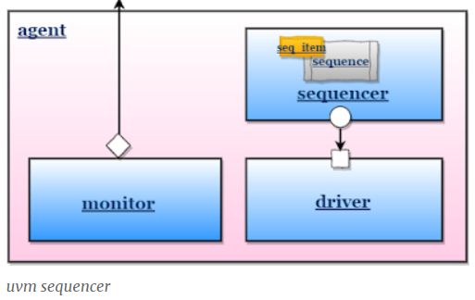
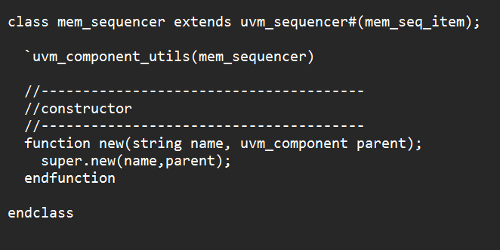
UVM Sequencer
Between sequences and the driver, the sequencer regulates the flow of request and response sequence items.
uvm_sequencer and uvm_driver base classes have seq_item_export and seq_item_port defined respectively. And they are connected in agent.

Slide 19
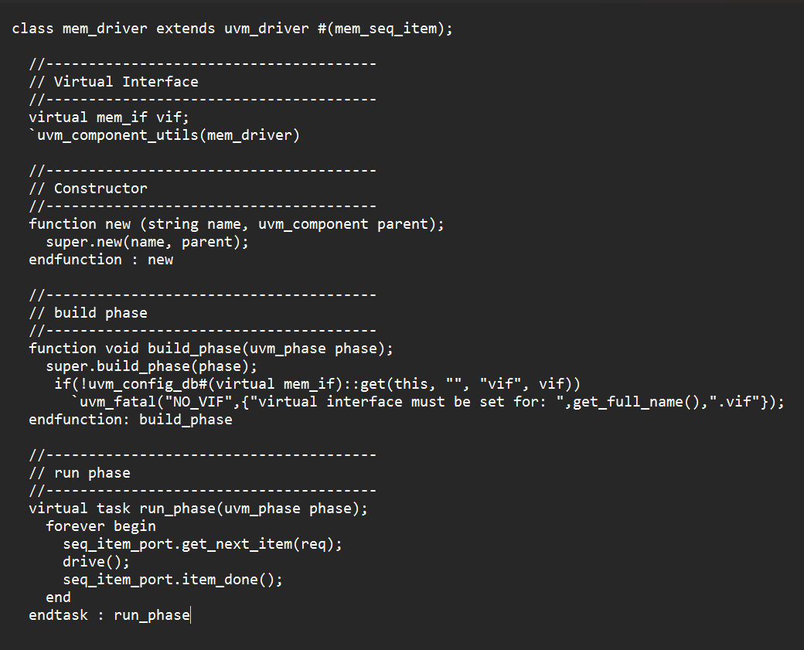
UVM Driver
The driver works in conjunction with the sequencer to ensure that the generated transactions are delivered to the DUT in the correct order and with the correct timing.
Drive task simply contains logic to drive the randomized sequence_item to the interface signal.
Getting the handle of the interface through config_db
get_next_item: This method blocks until a REQ sequence_item is available in the sequencer.
itm_done: The non-blocking item_done() method completes the driver-sequencer handshake

Slide 20
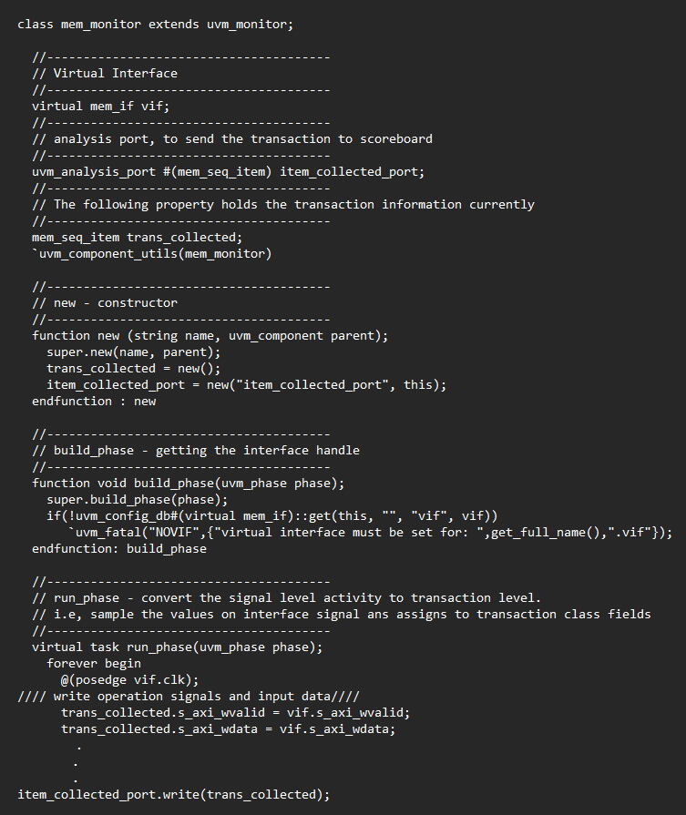
UVM Monitor
A monitor is a passive component that samples DUT signals over the virtual interface and transforms signal-level activity to transaction-level activity.
Monitor does not drive DUT signals, it only samples them therefore they are known as passive components.
Now trans collected port contains the data collected from interface
Run phase contains the logic to get data from interface
Items from trans_collected are written in item_collected_port

Slide 21
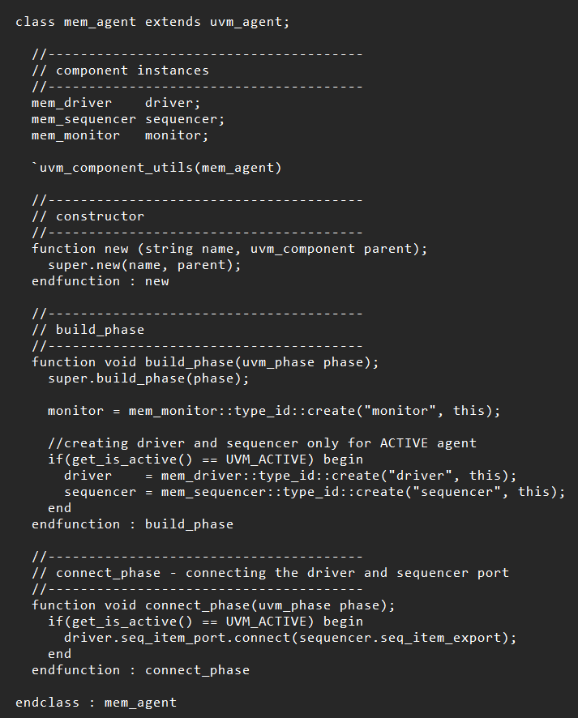
UVM Agent
Agent is container class, it typically contains a driver, a sequencer, and a monitor.
In build phase driver and sequencer are created for active agents and monitor for passive agent.
Connect phase is used to connect sequencer and driver port.

Slide 22
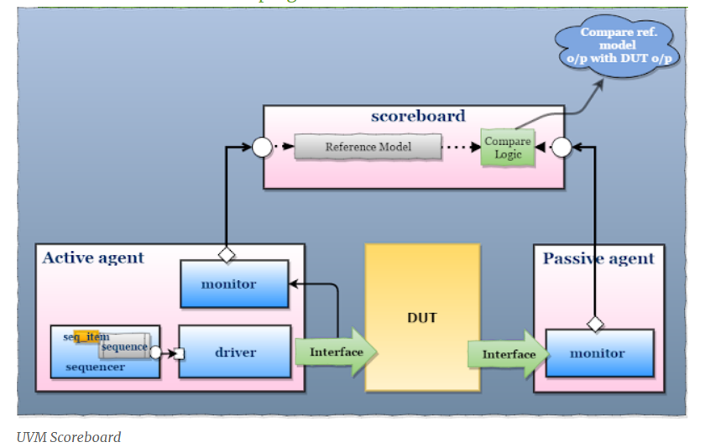
UVM Scoreboard
the scoreboard will check the correctness of the DUT by comparing the DUT output with the expected values

Slide 23
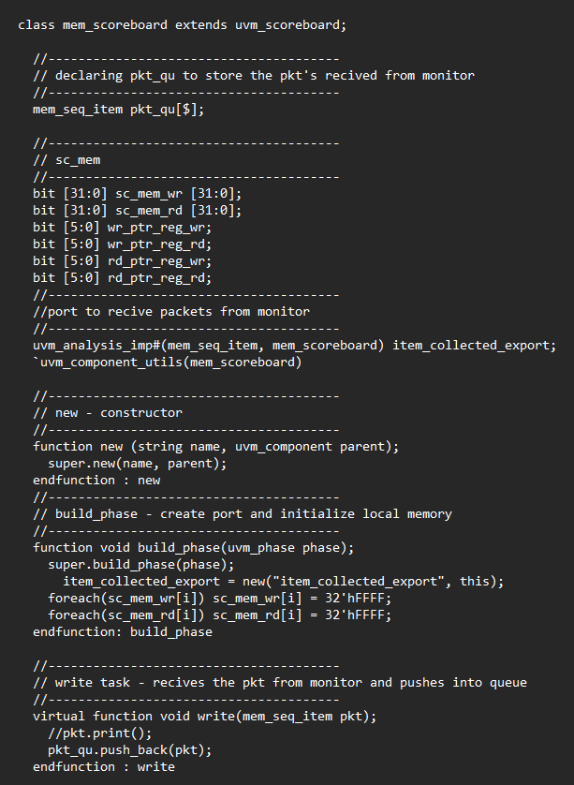
UVM Scoreboard
Created two dummy memories and write and read pointers for each memory for verification
Creating port to get data from monitor and instantiating the memories data
On calling write method from monitor scoreboard will receive transaction packet in queue.

Slide 24
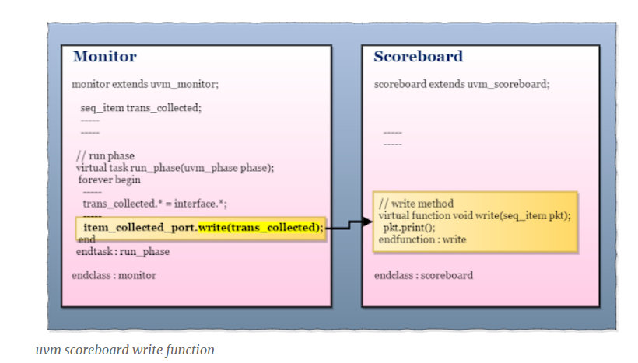
UVM Scoreboard

Slide 25
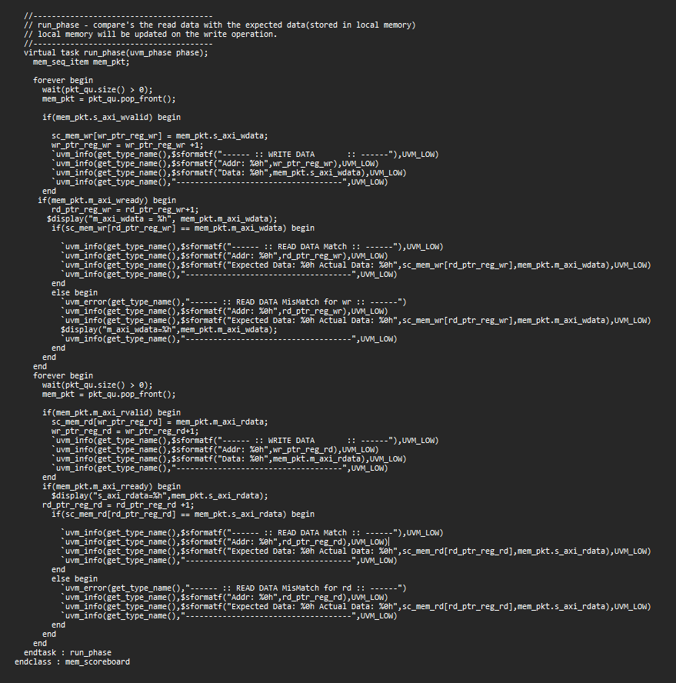
UVM Scoreboard
Logic used to check whether DUT is functioning correctly

Slide 26
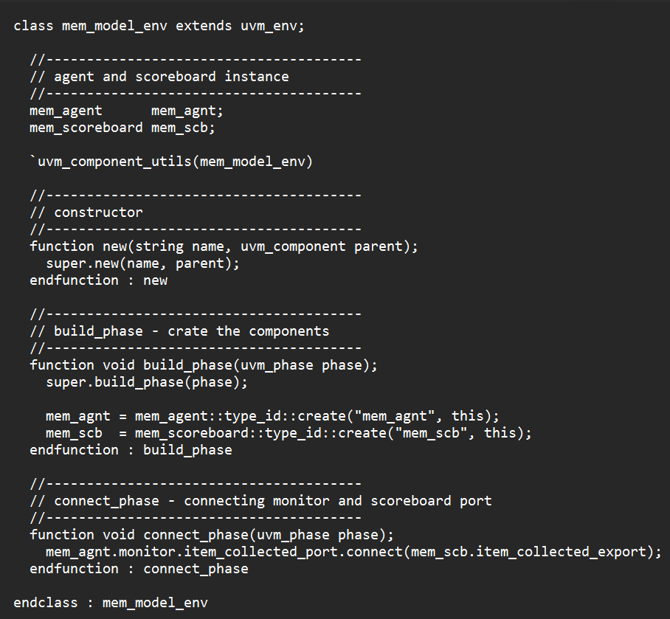
UVM Environment
The environment is the container class, It contains agent and scoreboard.
Connect phase is used to connect monitor and scoreboard port

Slide 27
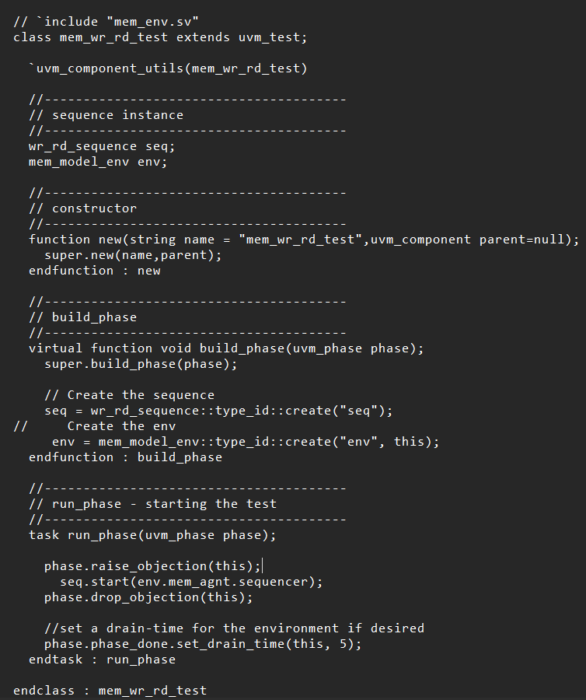
UVM Test
The test defines the test scenario for the testbench
test class contains the environment.
A sequence/sequences are created and started in the test
Creating environment and sequence in build phase
In run phase starting the sequence
phase.phase_done.set_drain_time method is used to set the amount of time that the phase should wait after it completes before transitioning to the next phase.

Slide 28
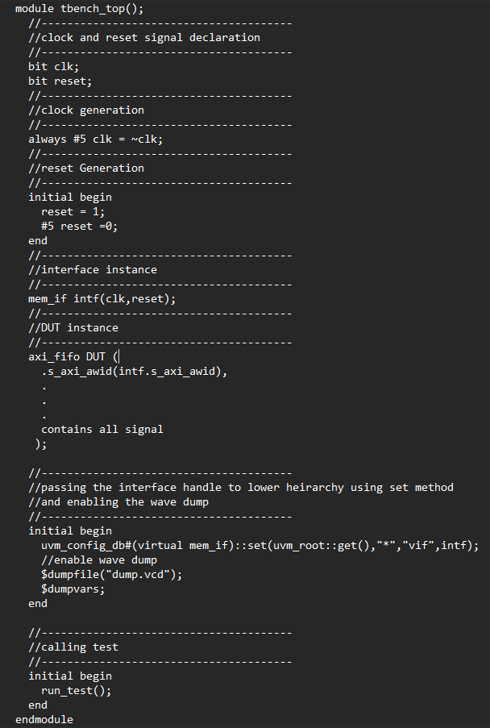
UVM Top Testbench
TestBench top is the module, it connects the DUT and Verification environment components.
Clock reset generation logic
Interface instance
DUT instance
virtual interface set configue_db and wave dump logic
run_test() method

Slide 29
Config_db
UVM Config DB is a mechanism for storing and retrieving configuration data in a testbench. It is typically used to set parameters, constraints, and other configuration data for UVM components, such as testcases, sequences, and other testbench entities.
The UVM Config DB provides a flexible and convenient way to modify the behavior of the testbench during runtime, without requiring changes to the design or testbench source code. This can be useful for debugging, optimization, and for running multiple testcases with different configurations.

Slide 30
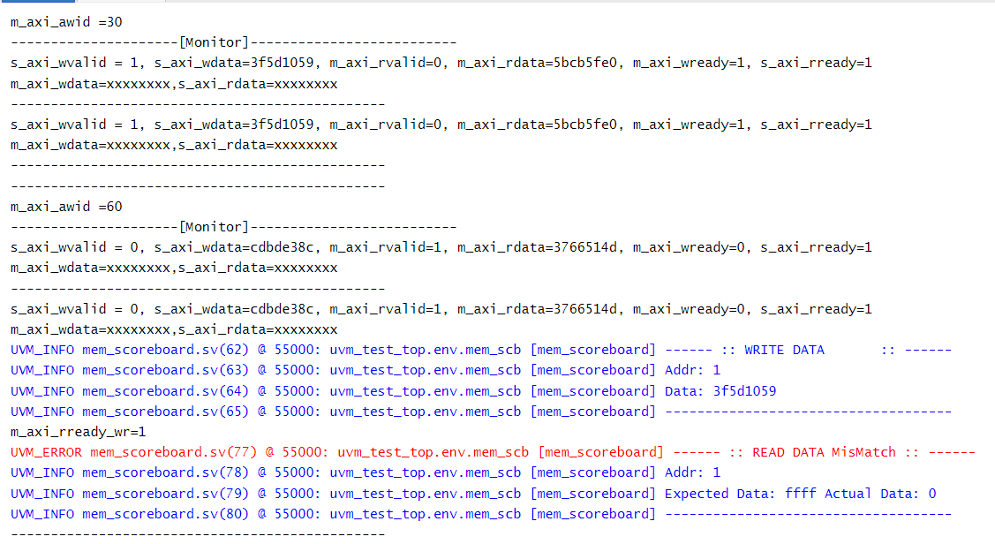
Verification Output

Slide 31
References
https://verificationguide.com/uvm/uvm-tutorial/
https://www.slideshare.net/AzadMishra1/axi-protocol-55779579
http://www.gstitt.ece.ufl.edu/courses/fall15/eel4720_5721/labs/refs/AXI4_specification.pdf
https://www.chipverify.com/uvm/uvm-sequence

Slide 32
THANK YOU!

